Slide 1
CSC365 Data structures and algorithms
Ioana Coman, PhD
Assistant Professor
Department of Computer Science

Slide 2
What is this course about?
We will study moderately complex data structures and algorithms that are essential in core areas of computer science
Compilers
Operating Systems
Database Systems
Search Engines
etc.
This is one of the most important (and fun) courses you will take
Prerequisite for almost all other upper level courses

Slide 3
What is it all about?
Solving problems
Get me from home to work
Balance my checkbook
Simulate a jet engine
Graduate from SUNY Oswego
Using a computer to help solve problems
Designing programs (architecture, algorithms)
Writing programs
Verifying programs
Documenting programs

Slide 4
Simple data structures you have seen
Set
Array
Tree
Data structure = representation and operations associated with a data type

Slide 5
Simple algorithms you have seen
Binary search
Bubble sort
Quick sort
…

Slide 6
Knowledge Assumed
We assume you know
Basic data structures
Arrays, sets, lists, stacks, queues, linked lists
Functions, logarithms, exponents, sets, series, derivatives, limits
Abstract Data types
Basic object oriented design concepts
abstraction, encapsulation, modularity

Slide 7
Skills Assumed
We assume you know how to program in Java
can design, implement, test, debug, read, understand and document relatively simple Java programs
including simple recursive code
This is not a course on Java. If you don’t know Java, start learning it now, before the programming assignments are due!
Books, tutorials on the web, etc.

Slide 8
What will you learn?
Analysis of moderately complex algorithms
How to predict algorithm’s performance
time and space complexity
Algorithm correctness
Moderately complex data structures that let us efficiently store, access, manage data
How to solve practical problems efficiently by choosing the appropriate data structures and algorithms

Slide 9
Topics Covered
Analysis of algorithms
Time and space complexity
Correctness
Data Structures
Dictionaries, hash tables
Priority queues and heaps
Trees, binary search trees, multi-way search trees
Graphs
Algorithms
Binary Search, sorting, algorithms on trees and graphs

Slide 10
Syllabus
Introduction (1)
Bitsets: relation to discrete math structures, big-O analysis, correctness (2,3,4, 31)
Hashing: probabilistic analysis, chained tables; hash functions, non-chained tables (5,11)
Sorting (1,6,7)
Elementary data structures, ADTs (10)
Searching, advanced data structures: Balanced trees: average vs worst case analysis; 2-3-4 trees; Red-black trees; as 2-3-4 emulation; graphical and code views; Traversal, range queries, and deletion for (balanced) trees (12,13,18)
Dynamic programming (15)
Graph algorithms (22,23,24)
Computational Geometry (33)
NP-Completeness (34)

Slide 11
Contact Info
Instructor Information
Ioana Coman, PhD
Lectures: MWF 1:50-2:45
Office hours: MWF 10-11 /Shineman 435
Lecture Notes
Available on Blackboard

Slide 12
Class Attendance
Lecture notes are only a summary of things happening in class, will not contain many examples
Students who attend lectures tend to do better
Attending lecture is most efficient way to learn the required material

Slide 13
Data Structures and Algorithms
Algorithm
Outline, the essence of a computational procedure, step-by-step instructions
Program – an implementation of an algorithm in some programming language
Data structure
Organization of data needed to solve the problem

Slide 14
Overall Picture
Data Structure and Algorithm Design Goals
Implementation Goals
Correctness
Robustness
Adaptability
Efficiency
Reusability

Slide 15
Overall Picture (2)
This course is not about:
Programming languages
Computer architecture
Software architecture
Software design and implementation principles
Issues concerning small and large scale programming
We will only touch upon the theory of complexity and computability

Slide 16
Algorithmic problem
Specification of output as a function of input
Specification of input
?
Infinite number of input instances satisfying the specification. For example:
A sorted, non-decreasing sequence of natural numbers. The sequence is of non-zero, finite length:
1, 20, 908, 909, 100000, 1000000000.
3.

Slide 17
Algorithmic Solution
Input instance, adhering to the specification
Algorithm
Output related to the input as required
Algorithm describes actions on the input instance
Infinitely many correct algorithms for the same algorithmic problem

Slide 18
Example: Sorting
OUTPUT
a permutation of the sequence of numbers
INPUT
sequence of numbers
Sort
a₁, a₂, a₃,….,a_{n}
b₁,b₂,b₃,….,b_{n}
2 5 4 10 7
2 4 5 7 10
Correctness
For any given input the algorithm halts with the output:
b₁ < b₂ < b₃ < …. < b_{n}
b₁, b₂, b₃, …., b_{n} is a permutation of a₁, a₂, a₃,….,a_{n}
Running time
Depends on
number of elements (n)
how (partially) sorted they are
algorithm

Slide 19
Insertion Sort
A
3
4
6
8
9
7
2
5
1
1
j
n
i
Strategy
Start “empty handed”
Insert a card in the right position of the already sorted hand
Continue until all cards are inserted/sorted
for j=2 to length(A)
do key=A[j]
“insert A[j] into the sorted sequence A[1..j-1]”
i=j-1
while i>0 and A[i]>key
do A[i+1]=A[i]
i--
A[i+1]:=key

Slide 20
Analysis of Algorithms
Efficiency:
Running time
Space used
Efficiency as a function of input size:
Number of data elements (numbers, points)
A number of bits in an input number

Slide 21
The RAM model
Very important to choose the level of detail.
The RAM model of computation: instructions are executed one after another, with no concurrent operations.
Instructions (each taking constant time):
Arithmetic (add, subtract, multiply, etc.)
Data movement (assign)
Control (branch, subroutine call, return)
Data types – integers and floats

Slide 22
Analysis of Insertion Sort
Time to compute the running time as a function of the input size
for j=2 to length(A)
do key=A[j]
“insert A[j] into the sorted sequence A[1..j-1]”
i=j-1
while i>0 and A[i]>key
do A[i+1]=A[i]
i--
A[i+1]:=key
cost c₁
c₂
0
c₃
c₄
c₅
c₆
c₇
times n n-1 n-1 n-1 n-1

Slide 23
Best/Worst/Average Case
Best case: elements already sorted → t_{j}=1, running time = f(n), i.e., linear time.
Worst case: elements are sorted in inverse order → t_{j}=j, running time = f(n²), i.e., quadratic time
Average case: t_{j}=j/2, running time = f(n²), i.e., quadratic time

Slide 24
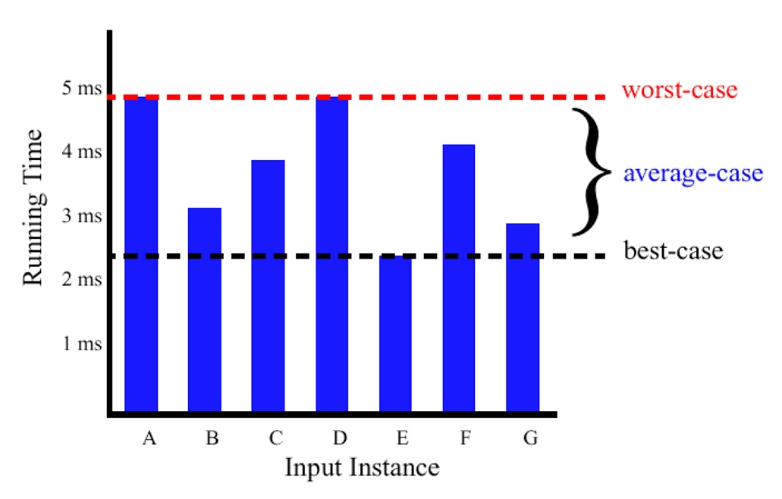
Best/Worst/Average Case (2)
For a specific size of input n, investigate running times for different input instances:

Slide 25
Best/Worst/Average Case (3)
For inputs of all sizes:
worst-case
6n
average-case
5n
best-case
Running time
4n
3n
2n
1n
1 2 3 4 5 6 7 8 9 10 11 12 …..
Input instance size

Slide 26
Best/Worst/Average Case (4)
Worst case is usually used:
It is an upper-bound and in certain application domains (e.g., air traffic control, surgery) knowing the worst-case time complexity is of crucial importance
For some algorithms worst case occurs fairly often
The average case is often as bad as the worst case
Finding the average case can be very difficult

Slide 27
Growth Functions

Slide 28
Growth Functions (2)

Slide 29
That’s it?
Is insertion sort the best approach to sorting?
Alternative strategy based on divide and conquer
MergeSort
sorting the numbers <4, 1, 3, 9> is split into
sorting <4, 1> and <3, 9> and
merging the results
Running time f(n log n)

