Slide 1

AutomateX
CAPABILITY BROCHURE · 2026
AI for UK rail
engineering
teams.
Where rail domain expertise meets AI.
Independent · Rail-domain native · Built by a chartered rail engineer
1 / 8

Slide 2
AutomateX
THE SHIFT
AI is reshaping rail engineering. The firms that act now will compound.
01
02
03
Tenders are asking.
Engineers are buried.
Quality is the lever.
AI questions in client briefs are now standard. Bluffing the answer loses the work. Evidence wins it.
Most of senior week absorbed by admin and template-driven work. Hours that should compound the firm.
Rework cycles bleed margin every project. Most firms track the rate. Few track the root cause.
automatex.uk
2 / 8

Slide 3
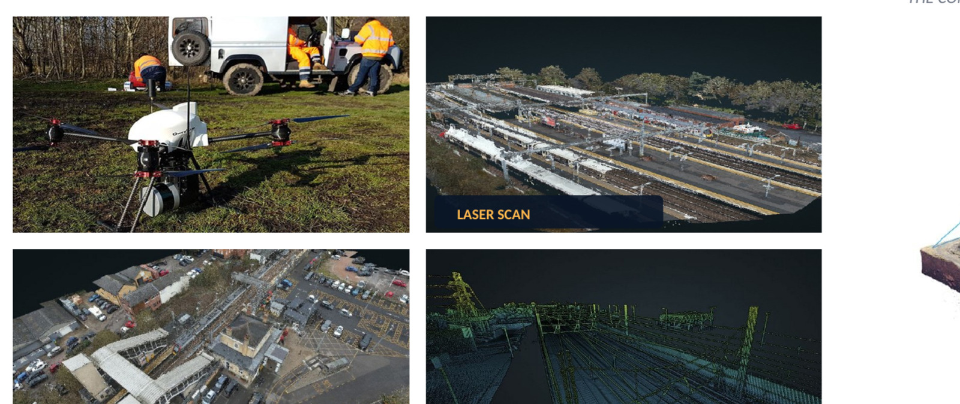
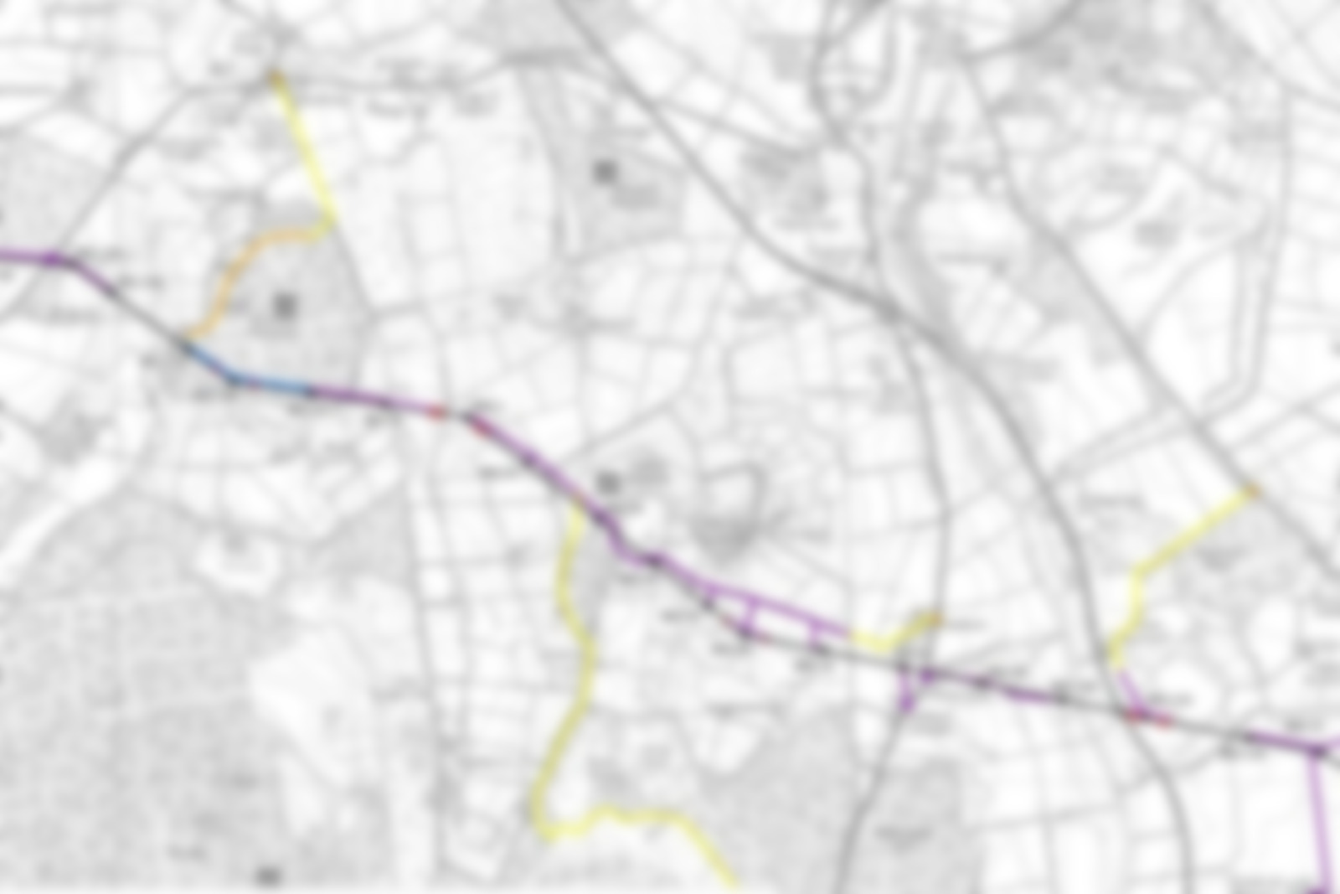
AutomateX
AI IN ACTION
Built. Deployed. In live use.
Five rail AI capabilities deployed across surveying, drawing take-off, assurance, tender response, and form drafting. The same architecture and rail-domain rigour applied to your X.
01 · AI-empowered survey processing
02 · AI-empowered drawing take-off
A national station network surveyed in weeks, with hidden defects surfaced by AI.
Automated linear take-off from rail drawings. Audited measurements, hours not days.
7,650
300+
0
99%
100%
80%
HD photos
Survey flights
Closures
Accuracy
Traceable
Time reduction
automatex.uk
3 / 8

Slide 4
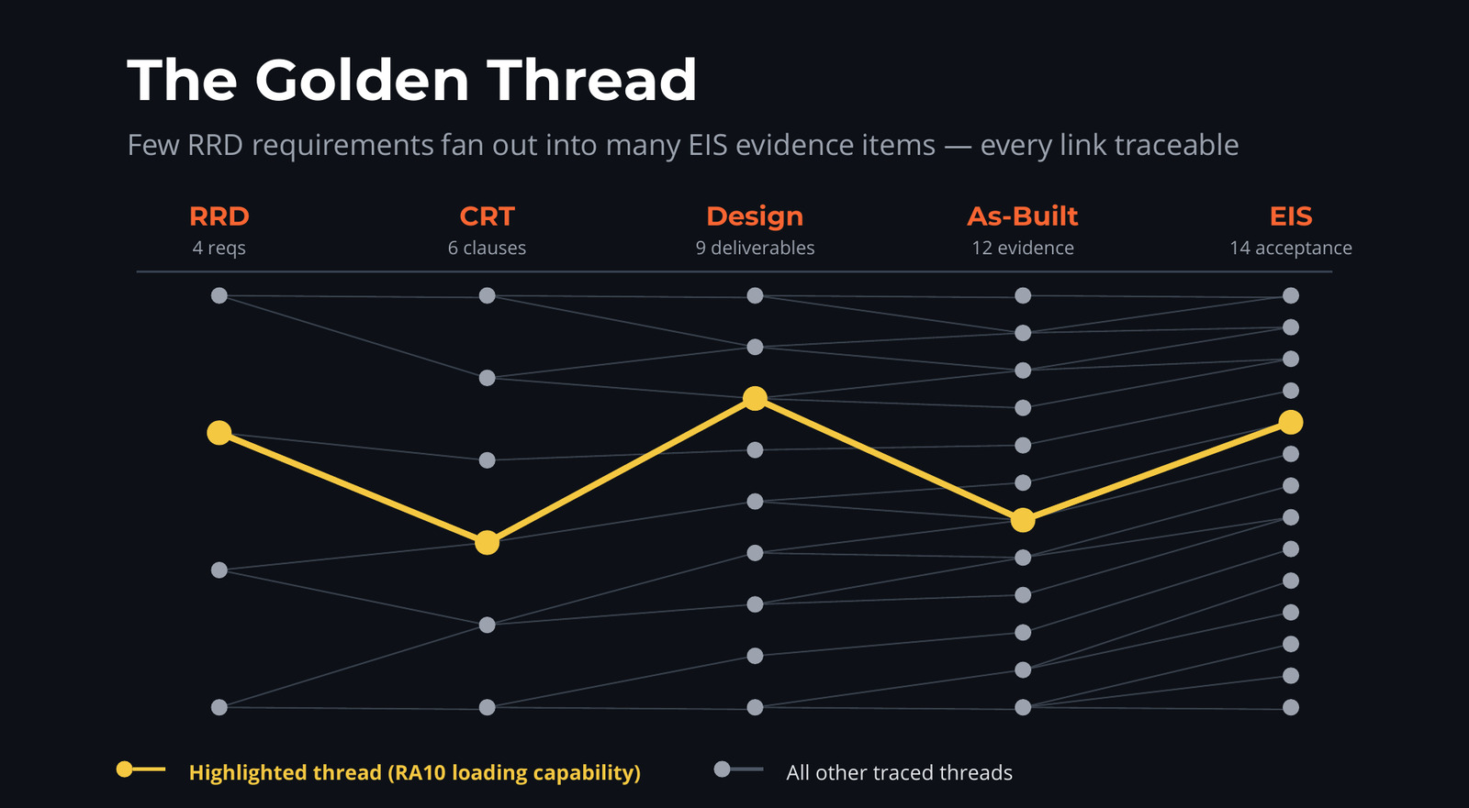
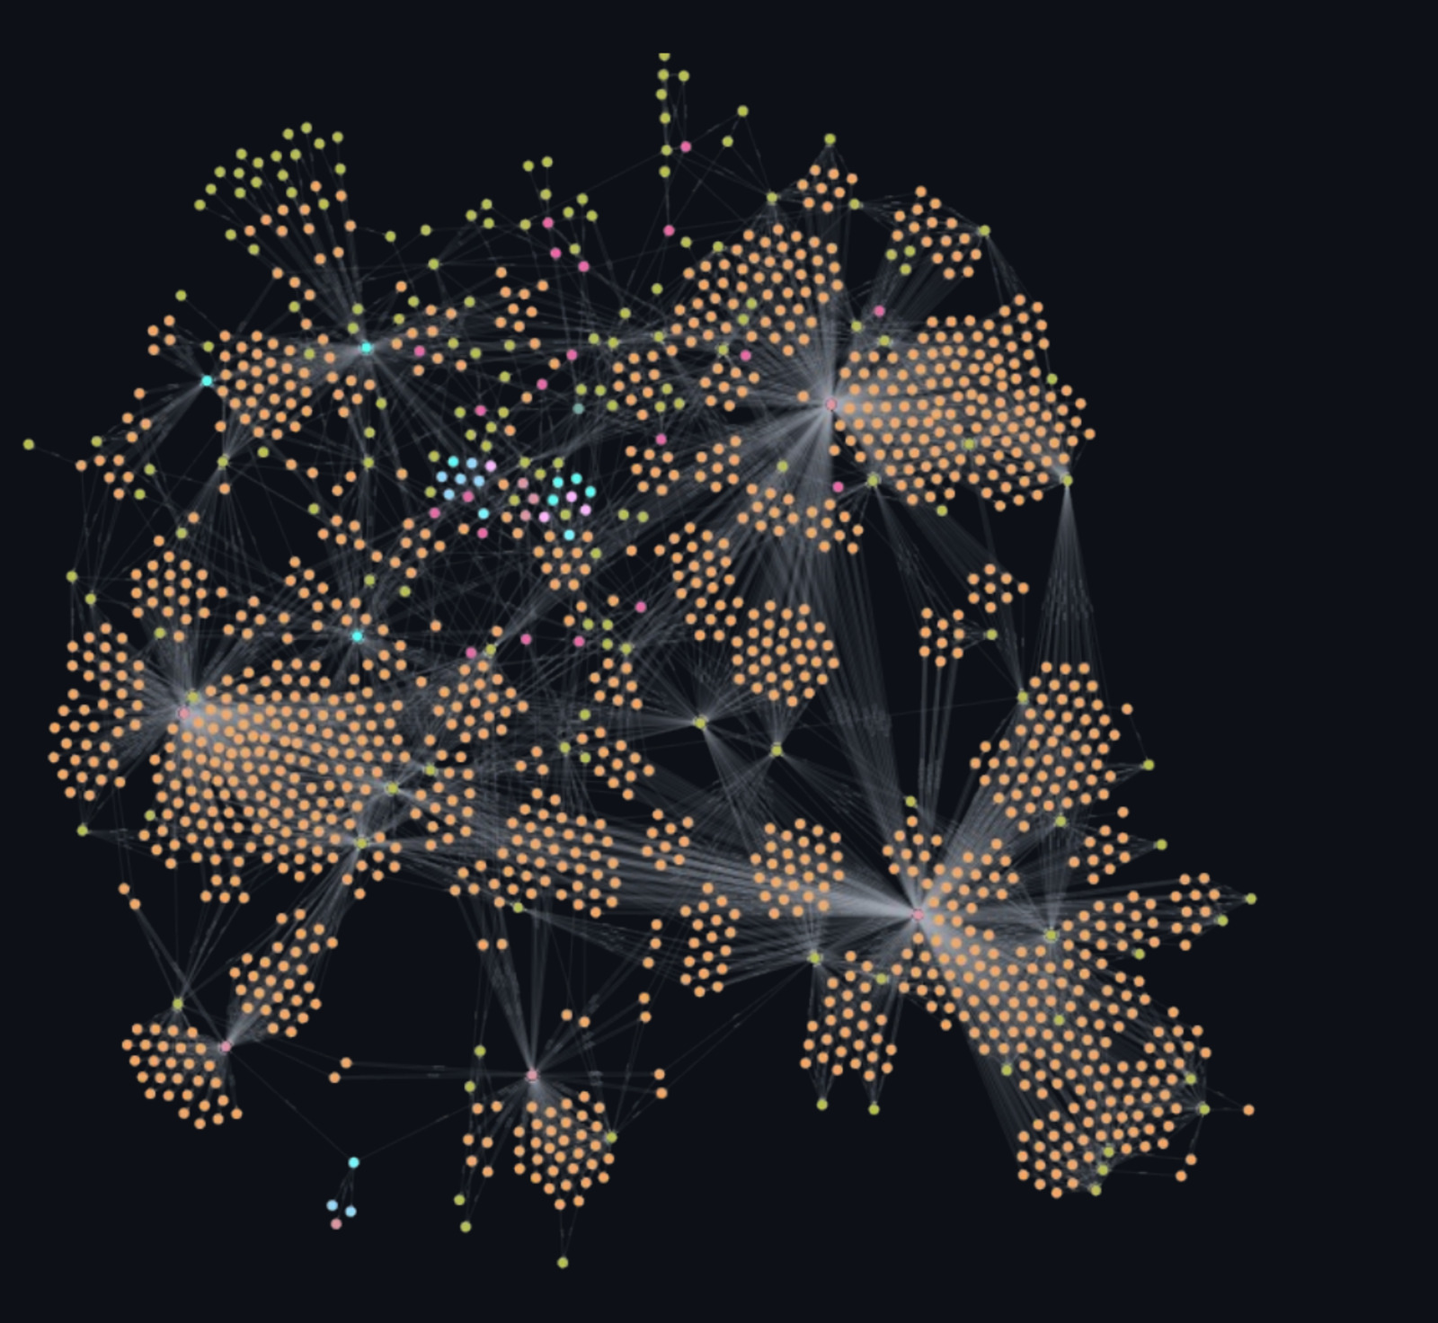
AutomateX
AI IN ACTION · CONTINUED
Two more capabilities. Same architecture. Different deployment.
03 · AI-empowered design review and verification
04 · Tender knowledge base
AI co-pilot for design reviews, requirements drafting, and verification traceability.
A rail-specific knowledge graph trained on standards, taxonomy, and project history.
The golden thread stays unbroken from design intent through to operational acceptance.
Drove tender response quality and efficiency. Every output cited, grounded in your domain.
£300k
5
0
80%
100%
100%
Potential annual saving
Stages traced
Broken links
Efficiency gain
Cited evidence
Grounded
automatex.uk
4 / 8

Slide 5
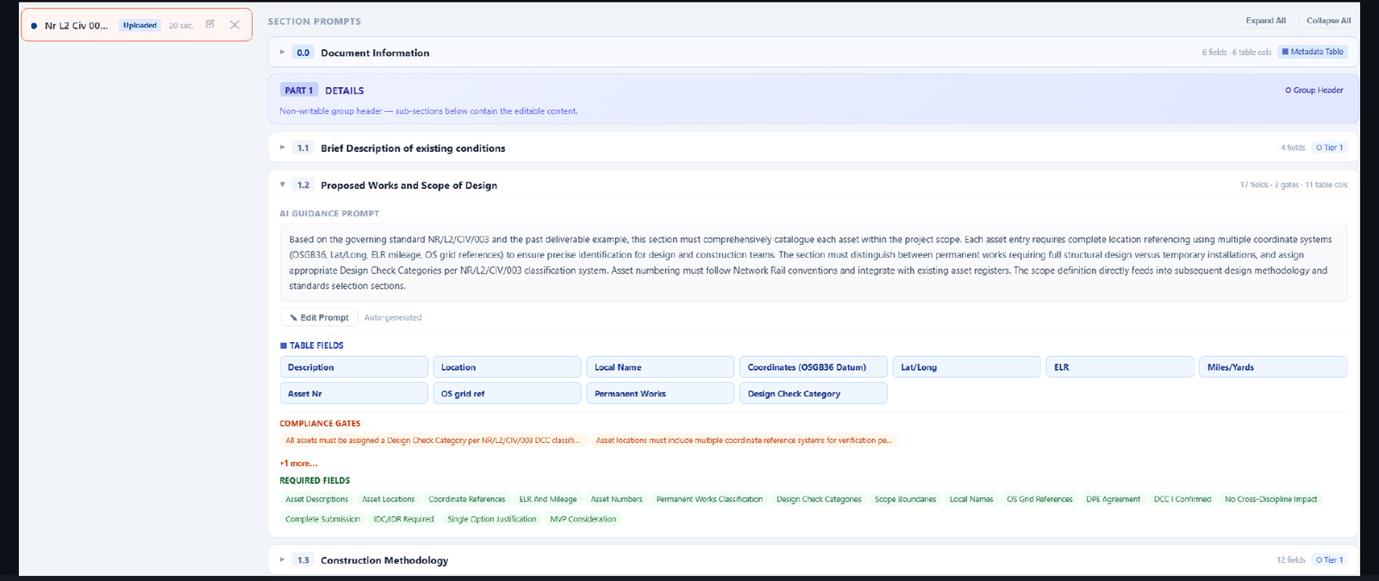
AutomateX
AI IN ACTION · AND IN PILOT
FIRST MOVE
Find your X. In five minutes.
AutomateX runs a free, rail-specific AI Readiness Assessment. Twenty questions across five operational pillars. You receive a personalised report that names your strongest pillar, your two weakest, and one quick win for this week. No generic advice. No AI snake oil.
05 · Scribtive (Pilot)
Doc assistance for PACE-compliant rail forms.
Section-by-section drafting with cited evidence and compliance gates. The product expression of everything else on these pages, in a tool engineers can use daily. Currently in pilot.
PACE
RAG
∞
automatex.uk / Take the Assessment
Aligned
Knowledge enabled
Audit trail
automatex.uk
5 / 8

Slide 6
AutomateX
THE FIVE PILLARS
How we measure AI readiness in rail.
Five operational pillars that, together, describe how a rail firm absorbs AI without breaking assurance.
01
02
03
04
05
RESILIENCE
THROUGHPUT
LEARNING
QUALITY
COMPETITIVENESS
Hero Dependency
Expertise Leverage
Continuous Improvement
First-Time Approval
AI Readiness
How resilient delivery is to senior absence and knowledge loss.
How much senior time becomes output, and how cleanly capability scales with the pipeline.
How much better each project makes the firm.
How often engineering deliverables pass first time. And whether you know why they do not.
Whether your tender response can evidence AI, not promise it.
Most teams score low on two. That is where the X is hiding, and where AutomateX goes to work.
automatex.uk
6 / 8

Slide 7
AutomateX
THREE WAYS FORWARD
Three ways to engage. You pick the one that fits.
Not a sequence. Options. Each step credits forward.
01
RECOMMENDED
03
CONVERSATION
02
IMPLEMENTATION
1-hour CPD
DIAGNOSIS
Build Engagement
Find Your X Workshop
£300
Outcome-priced
£250 with Assessment
£1,800
Custom-scoped
Group session covering the AI-in-rail landscape, real deployments, and a framework for spotting your X internally. CPD certificate included.
£1,500 with Assessment
The actual AI implementation. For teams who already know their X and want to move. Outcome-priced against a defined ROI hypothesis.
Hosted, structured workshop identifying top friction points across your team. Output: a tailored Find Your X Report with options costed. Workshop fee 100% credited toward Build within 60 days.
automatex.uk
7 / 8

Slide 8

AutomateX
THE FOUNDER
Bill Guo FICE CEng MEng
Founder and Engineering Director, AutomateX Ltd
ICE Asset Resilience Merit Award winner. Network Rail, TfL, HS2, and Tier 1 consulting and contractor background. Ten years on both sides of rail delivery, across more than 100 rail businesses.
In 2023 I started using AI to scale a rail consultancy from zero to about £1m ARR by 2025, and won one of 16 tactical design partner seats on Southern Renew Enterprise. The tools are not theory. They are how I got here.
We should learn to say no to the things AI can do better.
Find your X. Find your first move.
automatex.uk / Take the Assessment
Free 5-minute AI Readiness Assessment.
Book a discovery call with Bill.
calendly.com / bill-guo-automatex / discovery-chat
8 / 8

