Slide 1

Tutorial: Application of Clapeyron to polymeric and electrolyte systems
Pierre J. Walker

Slide 2
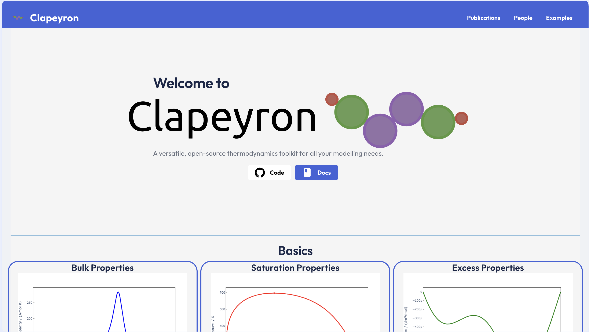
Overview
Basics
Building a model
Bulk properties
Equilibrium properties
Polymer Systems
Gas solubilities
Cloud points
Electrolytes
Building an electrolyte model
Bulk properties
Equilibrium properties
Polyelectrolytes
Poly acrylic acid
Reactive Equilibrium
Note: the first run of Julia code compiles it (slow). Should be fast after that.

Slide 3
Basics

Slide 4
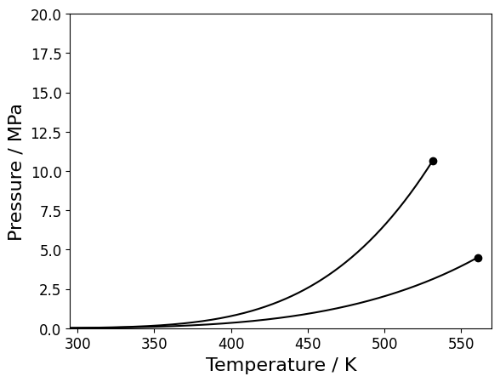

Binary Mixtures
For a binary mixture, there will be a region in $p,T$ space where two phases coexist.
We can only take slices
Isobaric
Isothermal
Constant composition

Slide 5
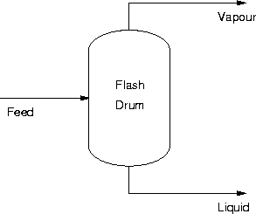

Flash Calculations
What is the state of the system at a given $z_{0}, p, T$?
Assuming we have a phase split: $μ_{i}\left(p,T,x_{α}\right)=μ_{i}\left(p,T,x_{β}\right)$

Slide 6

Flash Calculations
What is the state of the system at a given $z_{0}, p, T$?
Assuming we have a phase split: $x_{i,α}γ_{i,α}=x_{i,β}γ_{i,β}$

Slide 7
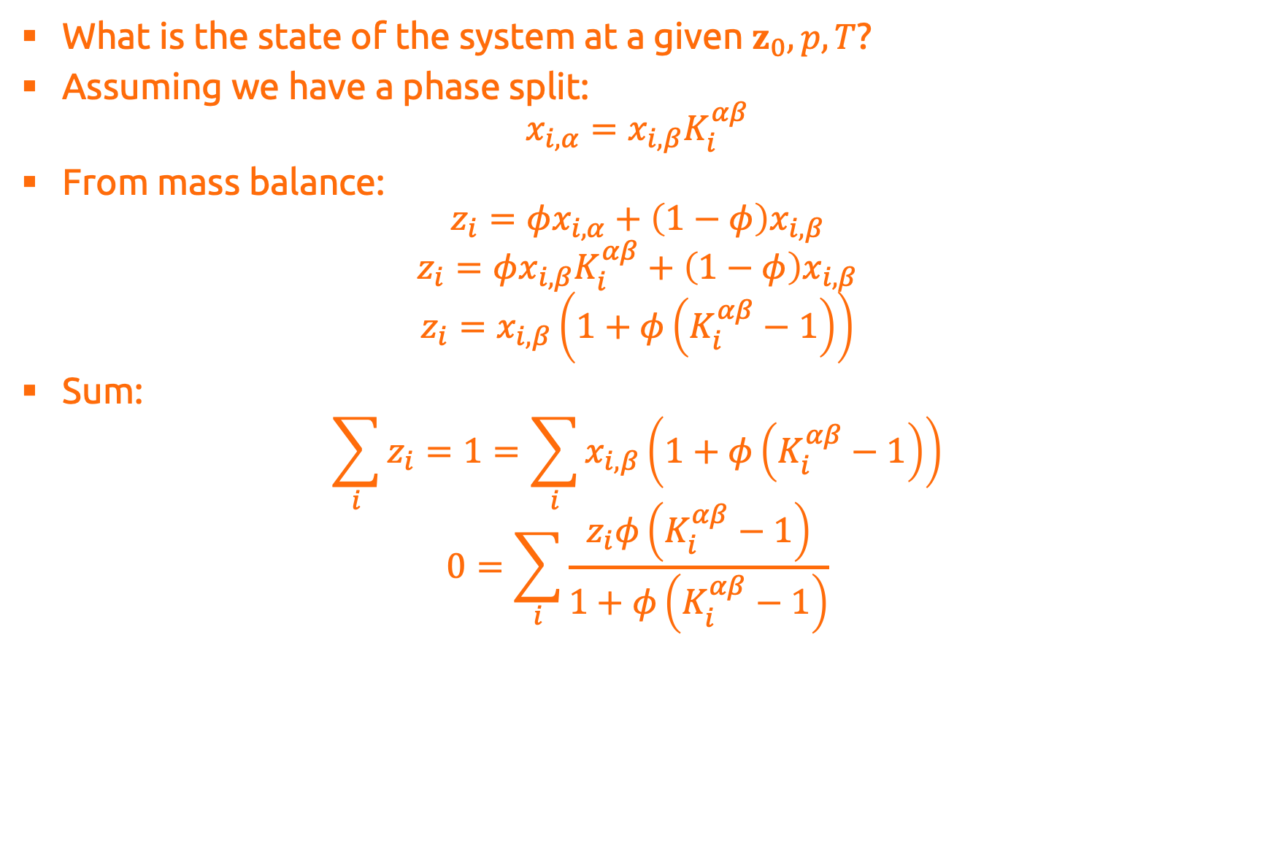
Flash Calculations
What is the state of the system at a given $z_{0}, p, T$?
Assuming we have a phase split: $x_{i,α}=x_{i,β}K_{i}^{αβ}$
From mass balance: $z_{i}=φx_{i,α}+\left(1−φ\right)x_{i,β}$
$$z_{i}=φx_{i,β}K_{i}^{αβ}+\left(1−φ\right)x_{i,β}$$
$$z_{i}=x_{i,β}\left(1+φ\left(K_{i}^{αβ}−1\right)\right)$$
Sum:
$$\sum_{i}{z_{i}}=1=\sum_{i}{x_{i,β}\left(1+φ\left(K_{i}^{αβ}−1\right)\right)}$$
$$0=\sum_{i}{\frac{z_{i}φ\left(K_{i}^{αβ}−1\right)}{1+φ\left(K_{i}^{αβ}−1\right)}}$$
Rachford–Rice equation:

Slide 8
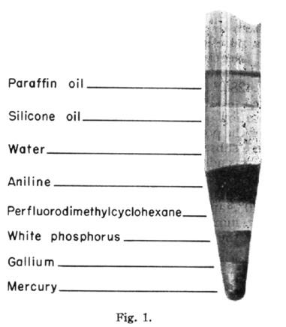

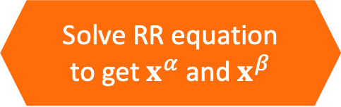



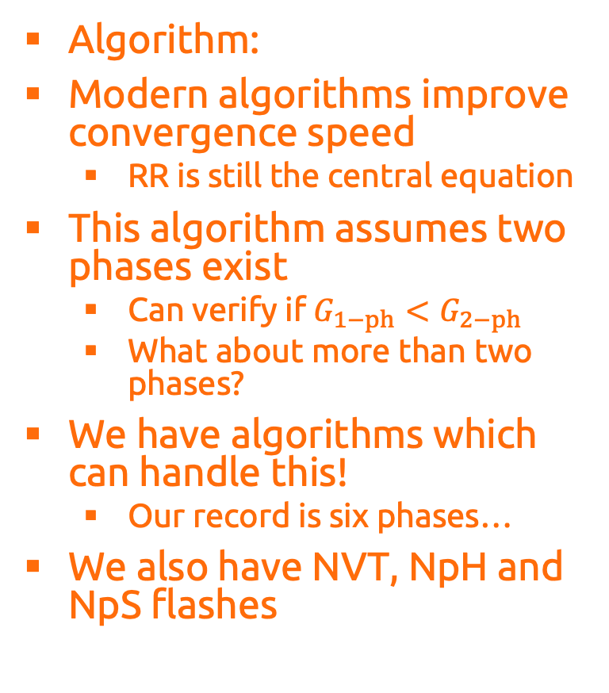

Flash Calculations
Algorithm:
Modern algorithms improve convergence speed
RR is still the central equation
This algorithm assumes two phases exist
Can verify if $G_{1−ph}<G_{2−ph}$
What about more than two phases?
We have algorithms which can handle this!
Our record is six phases…
We also have NVT, NpH and NpS flashes
Initial $z_{0}, p, T$
Guess for$K^{αβ}$
Solve RR equation to get $x^{α}$ and $x^{β}$
Update $K^{αβ}$
No
$\left|K_{new}^{αβ}−K_{old}^{αβ}\right|<ε$?
Yes
$x_{eq}^{α}$ and $x_{eq}^{β}$

Slide 9
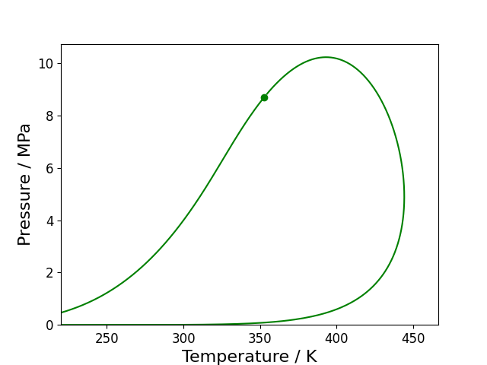
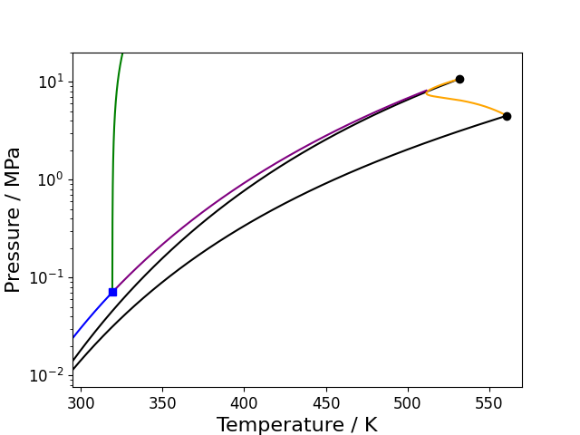
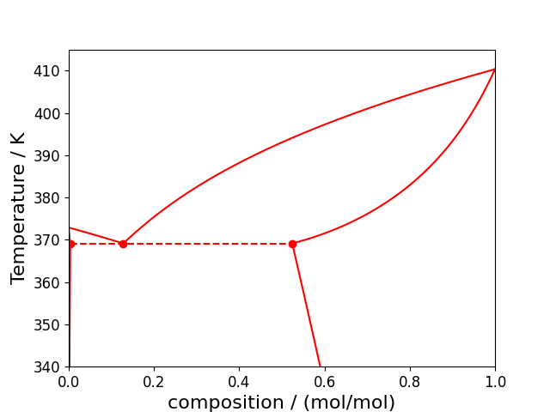
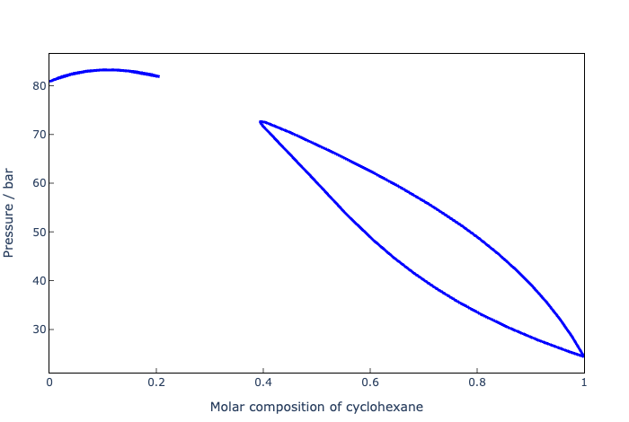
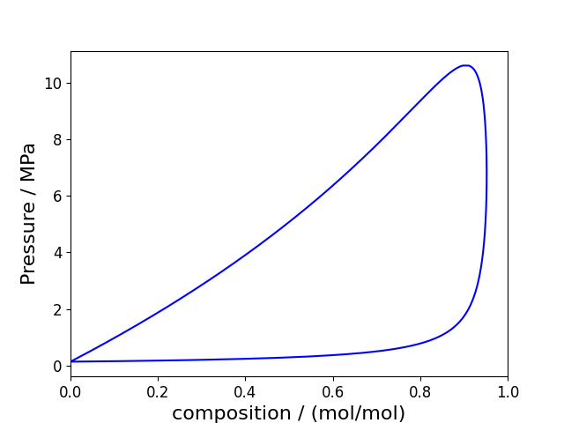
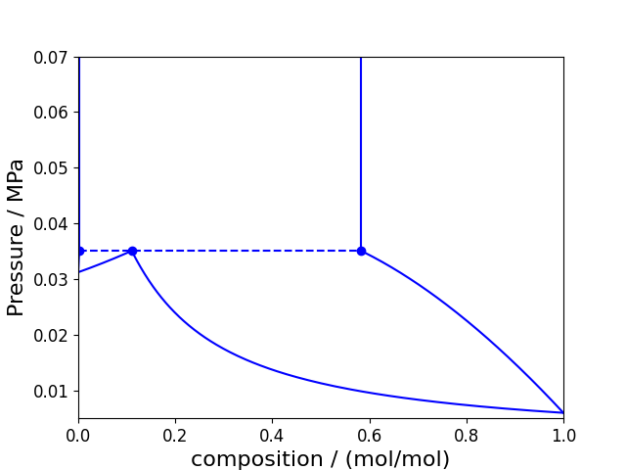
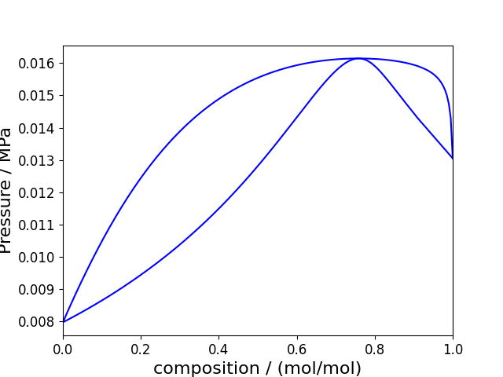
Binary Phase Diagrams
This was kind of a taster
Binary phase diagrams can become very complicated
LLE can merge with VLE (VLLE)
Can obtain equivalent isotherm phase diagrams
What if one component is supercritical?
Things then just get weird…
Different type of phase diagrams as well

Slide 10
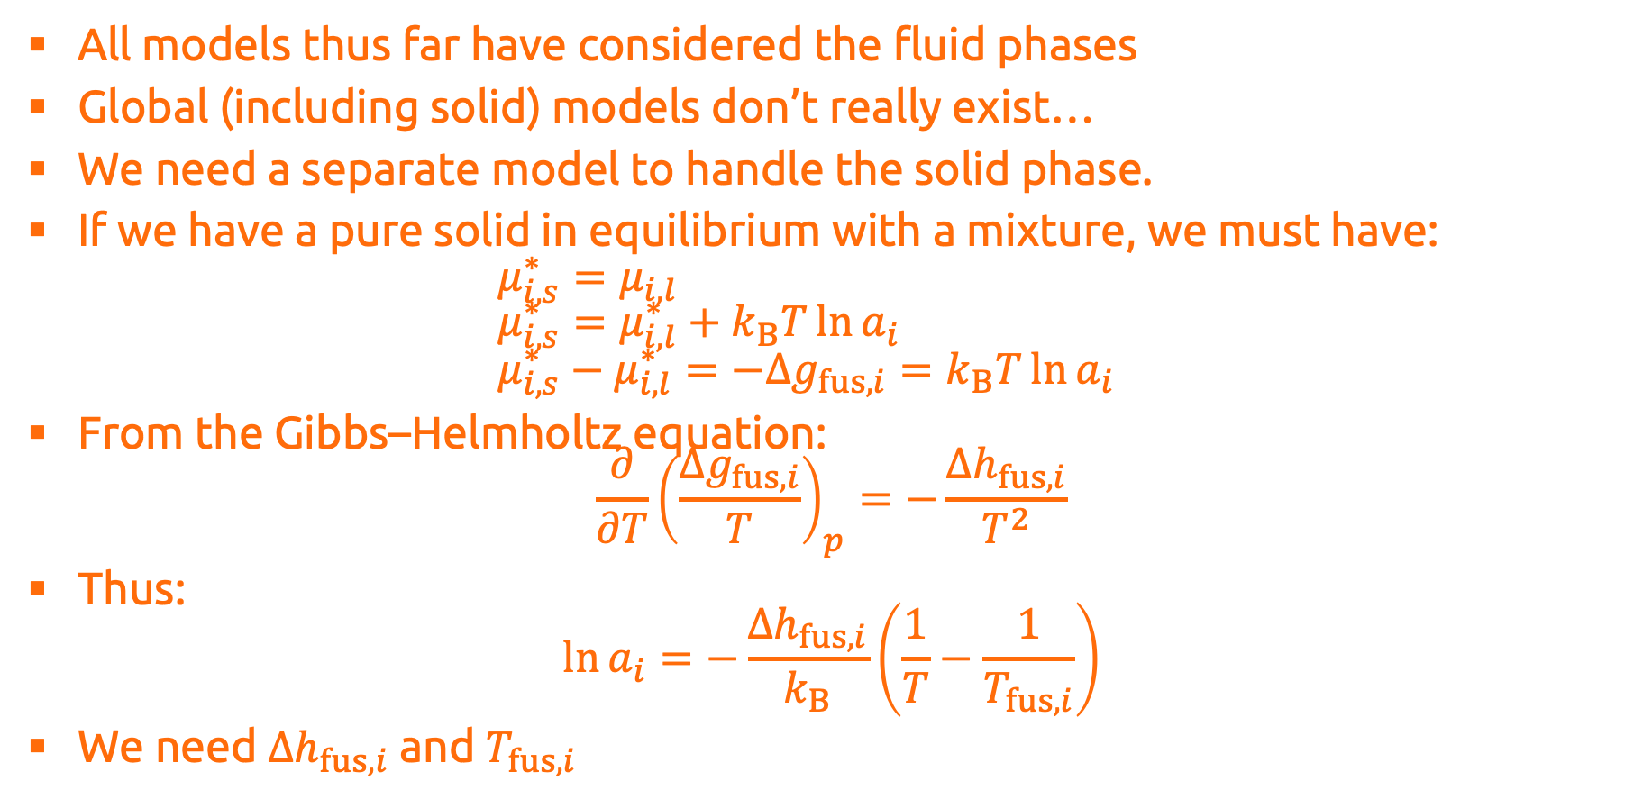
Solid–Liquid Equilibrium
All models thus far have considered the fluid phases
Global (including solid) models don’t really exist…
We need a separate model to handle the solid phase.
If we have a pure solid in equilibrium with a mixture, we must have: $μ_{i,s}^{∗}=μ_{i,l}$ $μ_{i,s}^{∗}=μ_{i,l}^{∗}+k_{B}T\ln{a_{i}}$ $μ_{i,s}^{∗}−μ_{i,l}^{∗}=−Δg_{fus,i}=k_{B}T\ln{a_{i}}$
From the Gibbs–Helmholtz equation: $\frac{∂}{∂T}{\left(\frac{Δg_{fus,i}}{T}\right)}_{p}=−\frac{Δh_{fus,i}}{T^{2}}$
Thus: $\ln{a_{i}}=−\frac{Δh_{fus,i}}{k_{B}}\left(\frac{1}{T}−\frac{1}{T_{fus,i}}\right)$
We need $Δh_{fus,i}$ and $T_{fus,i}$

Slide 11
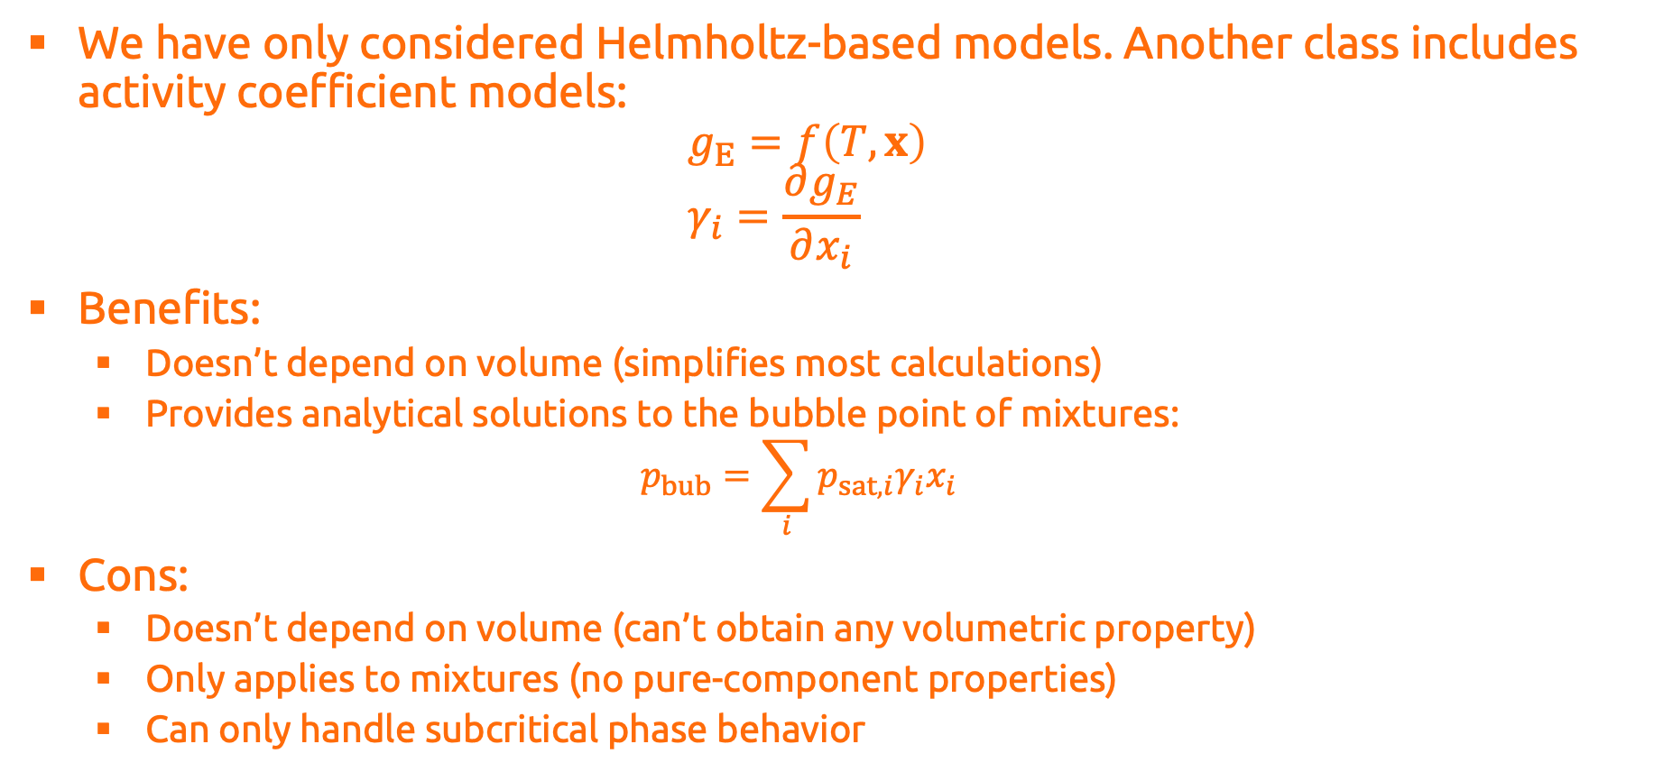
Aside – Activity Coefficient Models
We have only considered Helmholtz-based models. Another class includes activity coefficient models: $g_{E}=f\left(T,x\right)$ $γ_{i}=\frac{∂g_{E}}{∂x_{i}}$
Benefits:
Doesn’t depend on volume (simplifies most calculations)
Provides analytical solutions to the bubble point of mixtures: $p_{bub}=\sum_{i}{p_{sat,i}γ_{i}x_{i}}$
Cons:
Doesn’t depend on volume (can’t obtain any volumetric property)
Only applies to mixtures (no pure-component properties)
Can only handle subcritical phase behavior

Slide 12
Polymer Systems

Slide 13
Electrolyte Systems

Slide 14
Building a model
Electrolyte models are a little bit more challenging to use as there are usually two (or three) components:
Electrolyte
Model
Neutral
Model
Ion
Model
Dielectric
Model
PR
DH
Const
PCSAFT
MSA
Zhuang
SAFTVRMie
Born
MM1

Slide 15

Electrolyte Flash
We need to include the Donnan potential: $μ_{i}\left(p,T,x_{α}\right)=μ_{i}\left(p,T,x_{β}\right)+Z_{i}ψ$

Slide 16
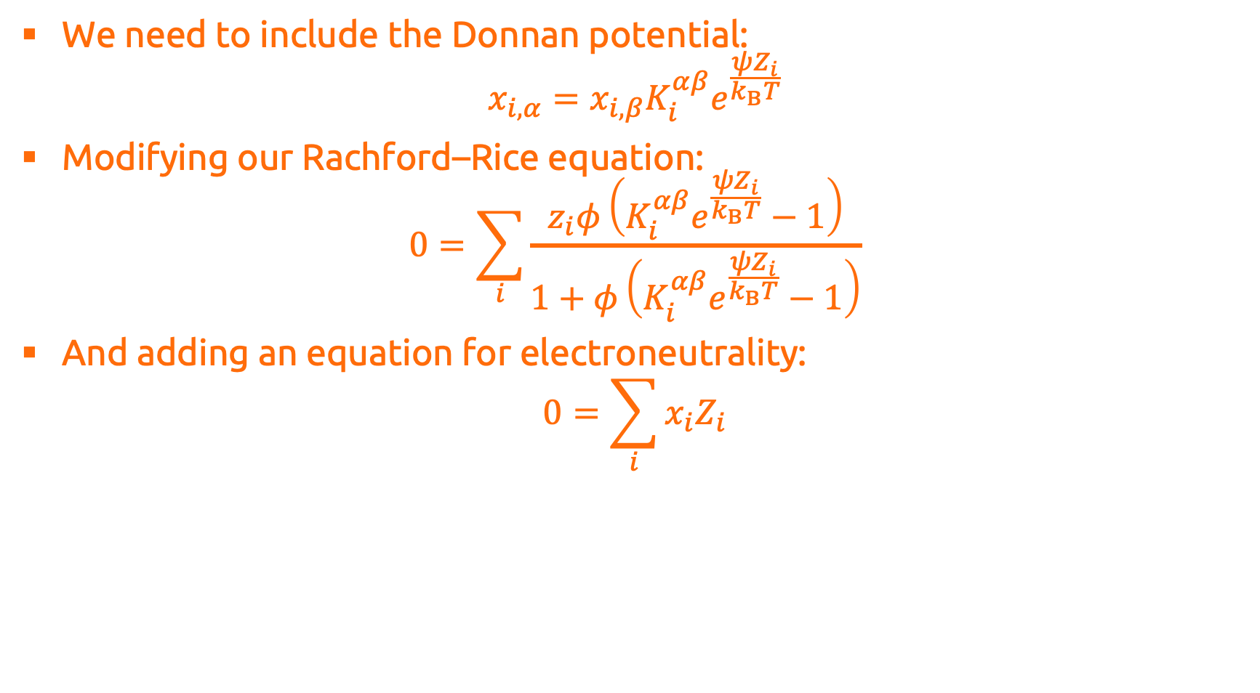
Electrolyte Flash
We need to include the Donnan potential: $x_{i,α}=x_{i,β}K_{i}^{αβ}e^{\frac{ψZ_{i}}{k_{B}T}}$
Modifying our Rachford–Rice equation: $0=\sum_{i}{\frac{z_{i}φ\left(K_{i}^{αβ}e^{\frac{ψZ_{i}}{k_{B}T}}−1\right)}{1+φ\left(K_{i}^{αβ}e^{\frac{ψZ_{i}}{k_{B}T}}−1\right)}}$
And adding an equation for electroneutrality: $0=\sum_{i}{x_{i}Z_{i}}$

Slide 17
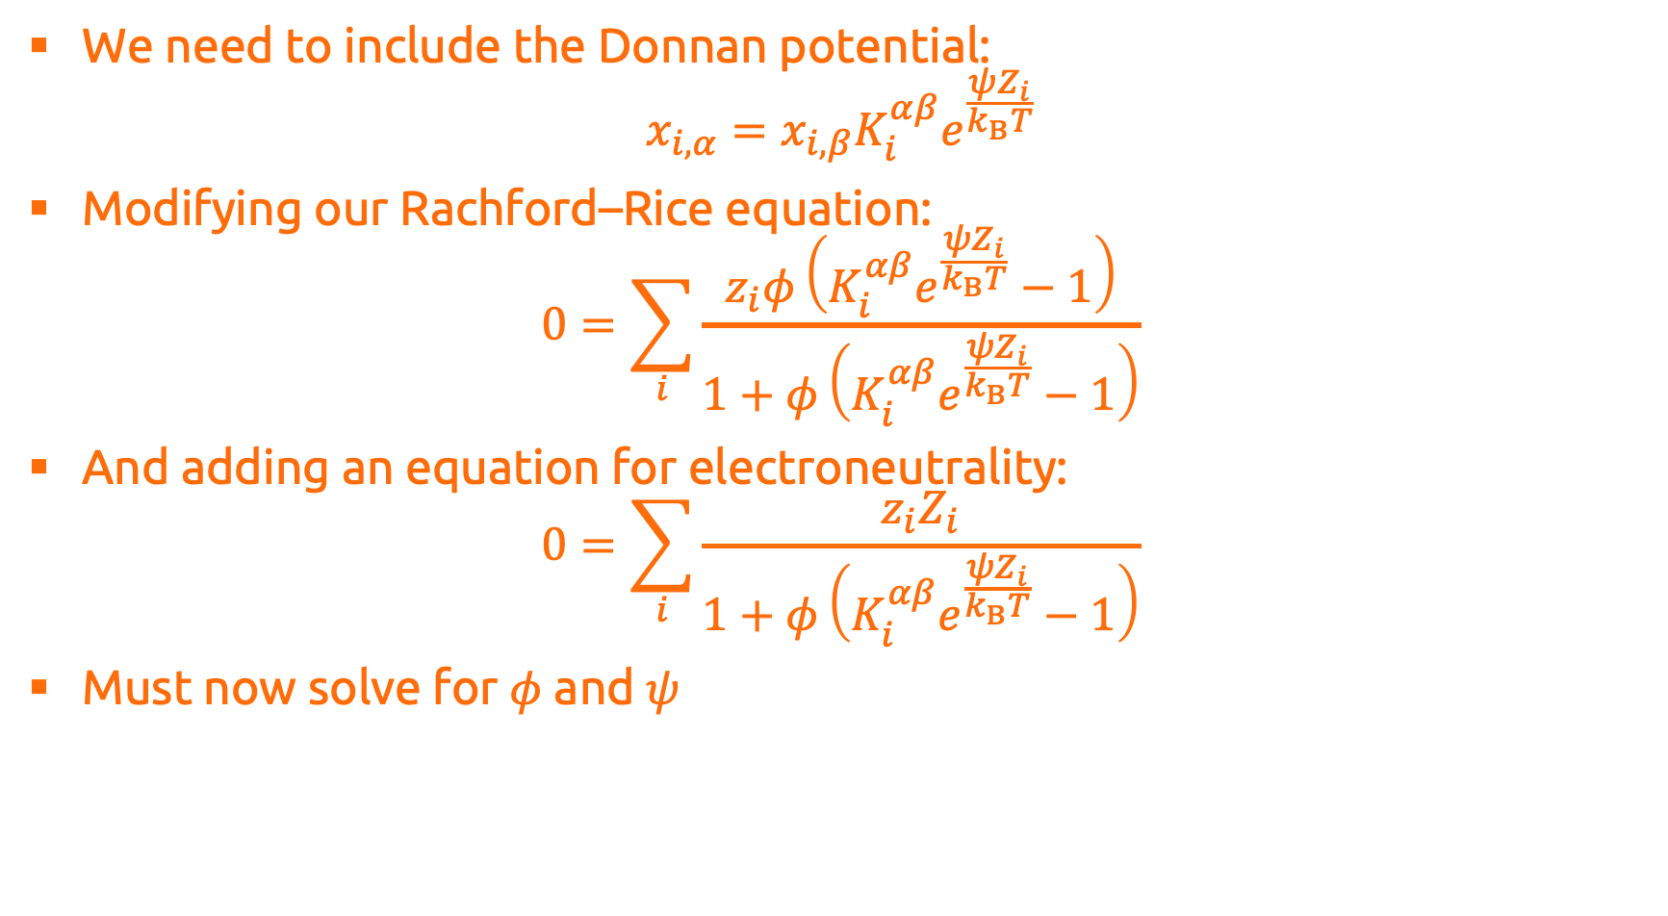
Electrolyte Flash
We need to include the Donnan potential: $x_{i,α}=x_{i,β}K_{i}^{αβ}e^{\frac{ψZ_{i}}{k_{B}T}}$
Modifying our Rachford–Rice equation: $0=\sum_{i}{\frac{z_{i}φ\left(K_{i}^{αβ}e^{\frac{ψZ_{i}}{k_{B}T}}−1\right)}{1+φ\left(K_{i}^{αβ}e^{\frac{ψZ_{i}}{k_{B}T}}−1\right)}}$
And adding an equation for electroneutrality: $0=\sum_{i}{\frac{z_{i}Z_{i}}{1+φ\left(K_{i}^{αβ}e^{\frac{ψZ_{i}}{k_{B}T}}−1\right)}}$
Must now solve for $φ$ and $ψ$

Slide 18
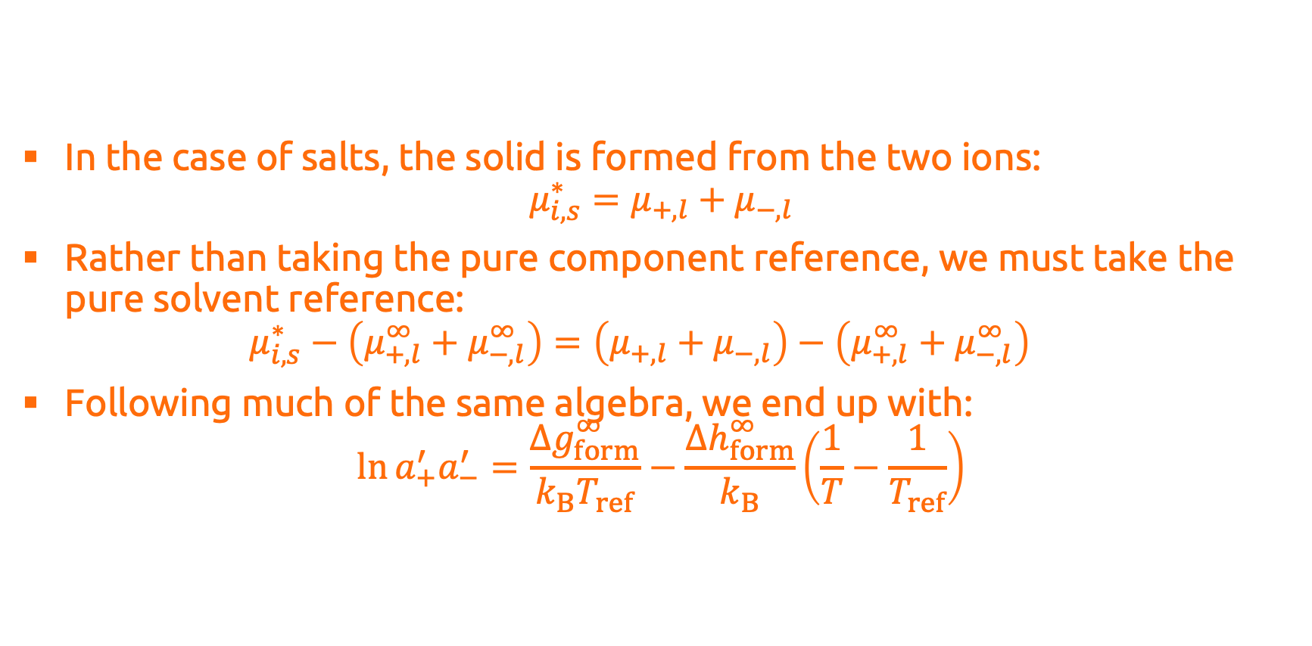
Solid–Liquid Equilibrium
In the case of salts, the solid is formed from the two ions: $μ_{i,s}^{∗}=μ_{+,l}+μ_{−,l}$
Rather than taking the pure component reference, we must take the pure solvent reference: $μ_{i,s}^{∗}−\left(μ_{+,l}^{∞}+μ_{−,l}^{∞}\right)=\left(μ_{+,l}+μ_{−,l}\right)−\left(μ_{+,l}^{∞}+μ_{−,l}^{∞}\right)$
Following much of the same algebra, we end up with: $\ln{a_{+}^{′}a_{−}^{′}}=\frac{Δg_{form}^{∞}}{k_{B}T_{ref}}−\frac{Δh_{form}^{∞}}{k_{B}}\left(\frac{1}{T}−\frac{1}{T_{ref}}\right)$

Slide 19
Polyelectrolyte Systems

Slide 20
Reactive Equilibrium

Slide 21
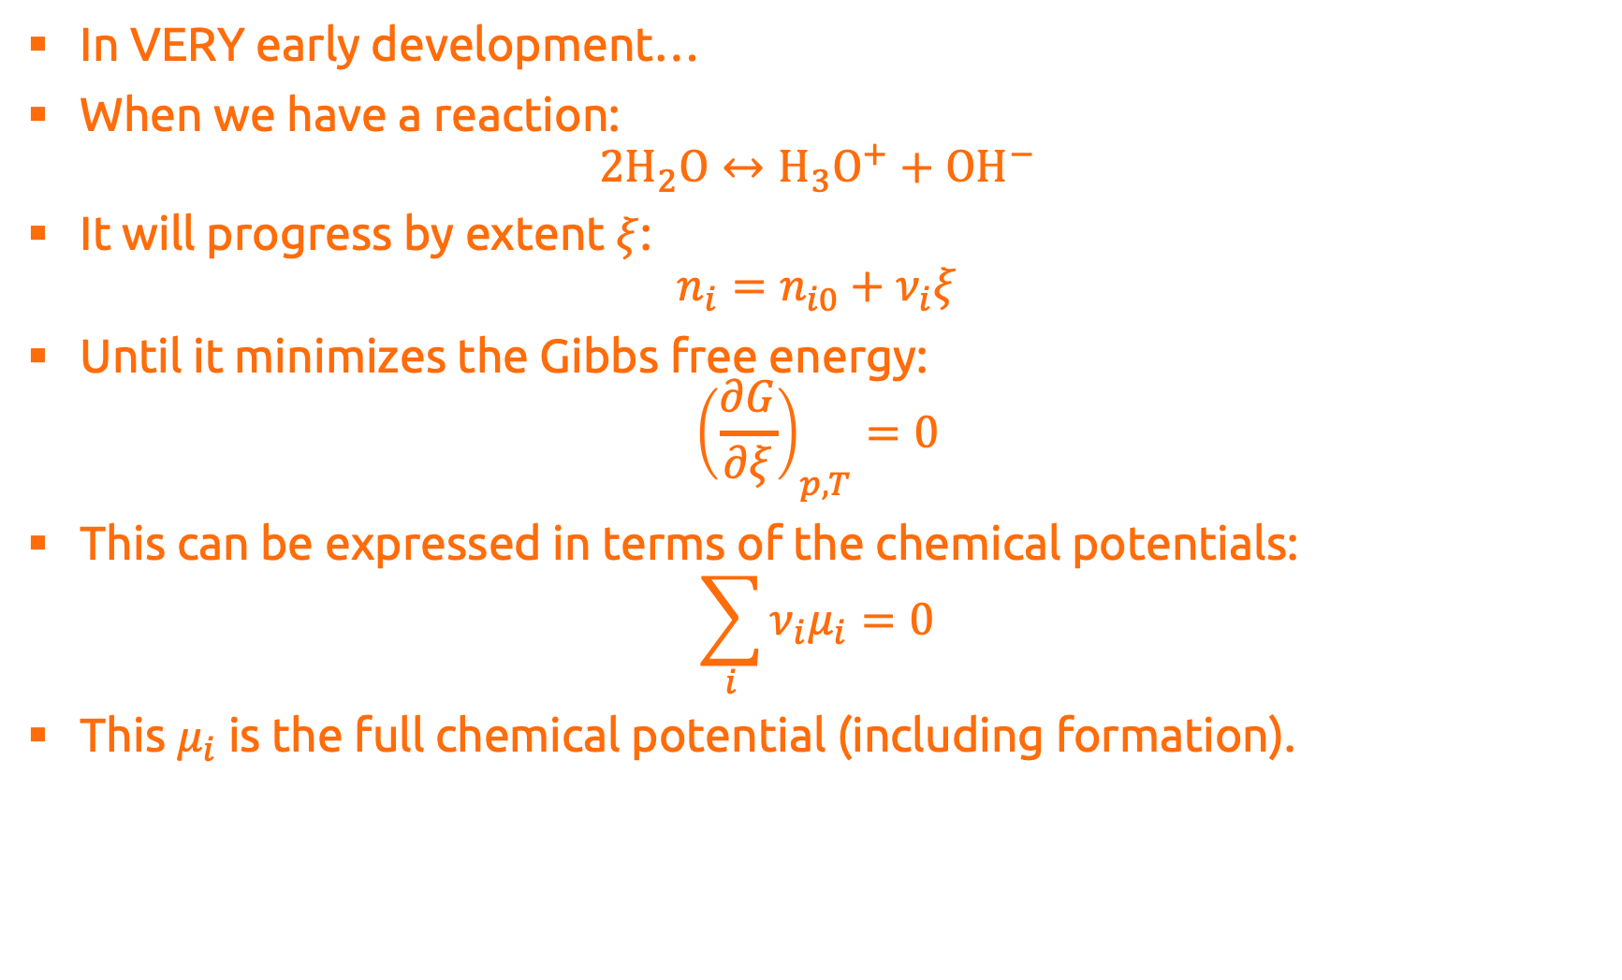
Reactive equilibrium
In VERY early development…
When we have a reaction: $2H_{2}O↔H_{3}O^{+}+{OH}^{−}$
It will progress by extent $ξ$: $n_{i}=n_{i0}+ν_{i}ξ$
Until it minimizes the Gibbs free energy: ${\left(\frac{∂G}{∂ξ}\right)}_{p,T}=0$
This can be expressed in terms of the chemical potentials: $\sum_{i}{ν_{i}μ_{i}}=0$
This $μ_{i}$ is the full chemical potential (including formation).

Slide 22
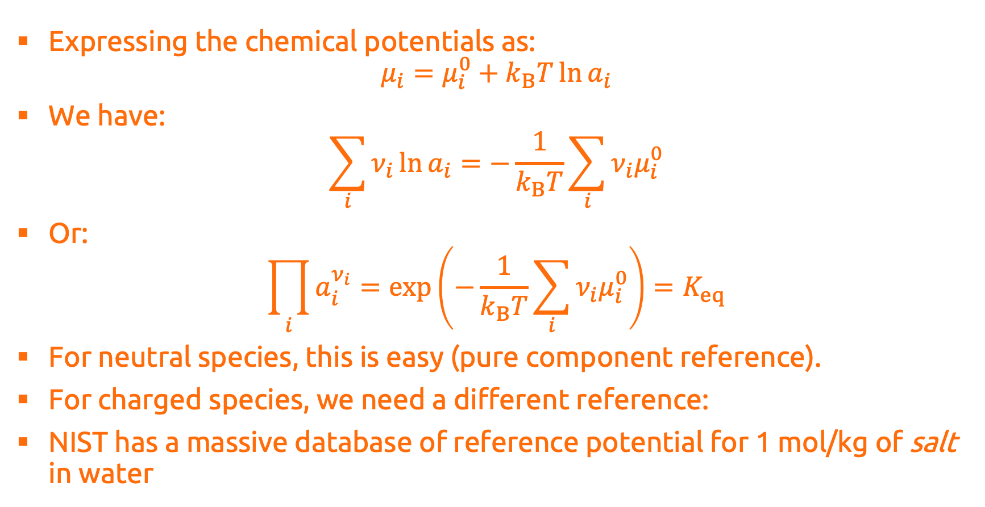
Reactive equilibrium
Expressing the chemical potentials as: $μ_{i}=μ_{i}^{0}+k_{B}T\ln{a_{i}}$
We have: $\sum_{i}{ν_{i}\ln{a_{i}}}=−\frac{1}{k_{B}T}\sum_{i}{ν_{i}μ_{i}^{0}}$
Or: $\prod_{i}{a_{i}^{ν_{i}}}=\exp\left(−\frac{1}{k_{B}T}\sum_{i}{ν_{i}μ_{i}^{0}}\right)=K_{eq}$
For neutral species, this is easy (pure component reference).
For charged species, we need a different reference:
NIST has a massive database of reference potential for 1 mol/kg of salt in water

Slide 23
Reactive equilibrium
I have compiled these in Clapeyron such that one can assemble a reactive model:
Define species: julia> species = ["water","hydronium","hydroxide"]
Define reactions: julia> reactions = [("water"=>-2,"hydronium"=>1,"hydroxide"=>1)]
Assemble: julia> eosmodel = SAFTgammaEMie(["water”],["hydronium","hydroxide"]) julia> model = ReactiveAqModel(species,reactions; model = eosmodel)
Use:
julia> n=equilibrate(model,p,T,n0) julia> pH(model,p,T,n0)

Slide 24
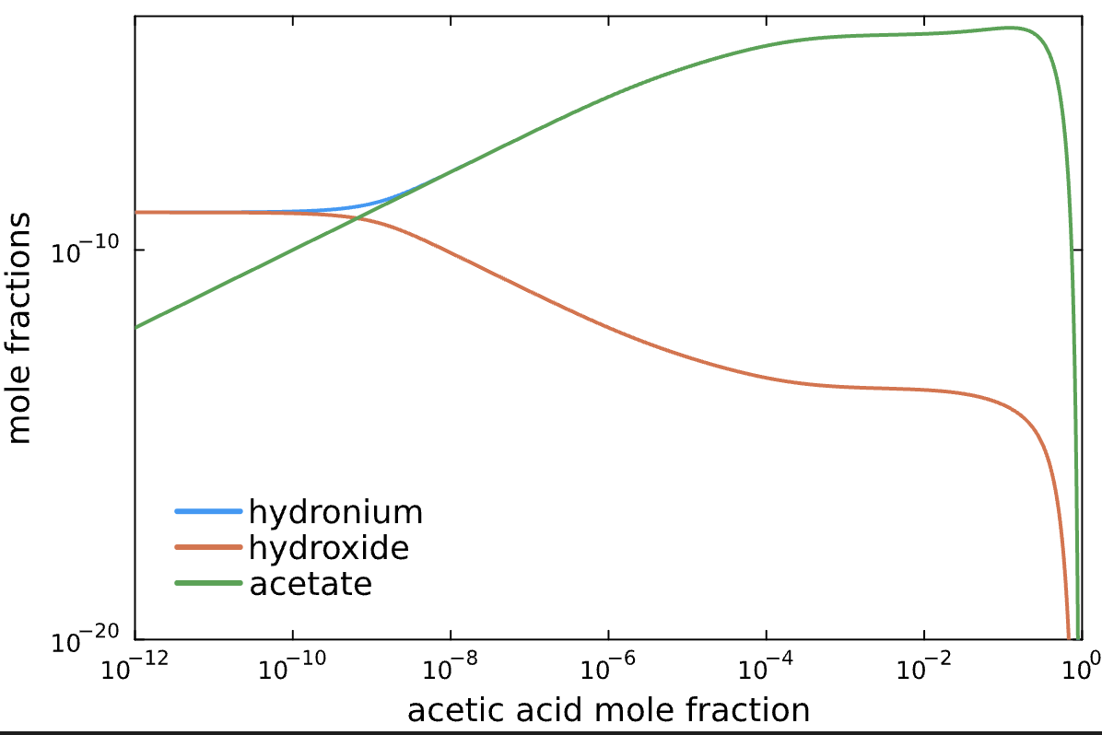
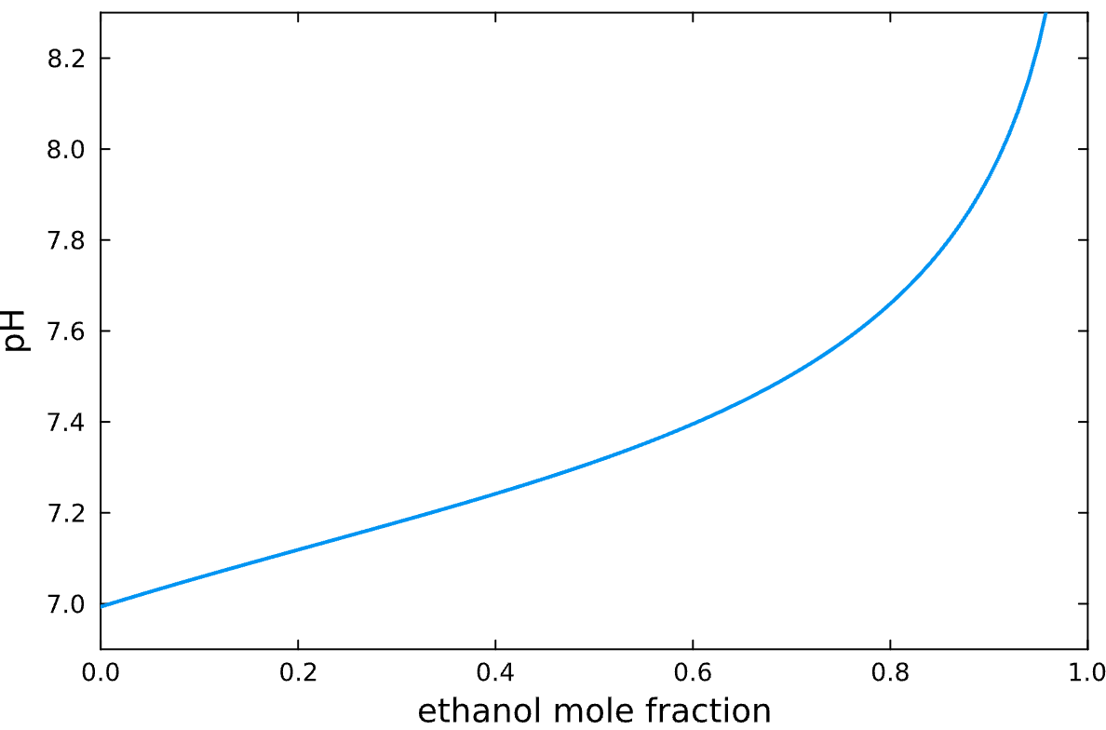
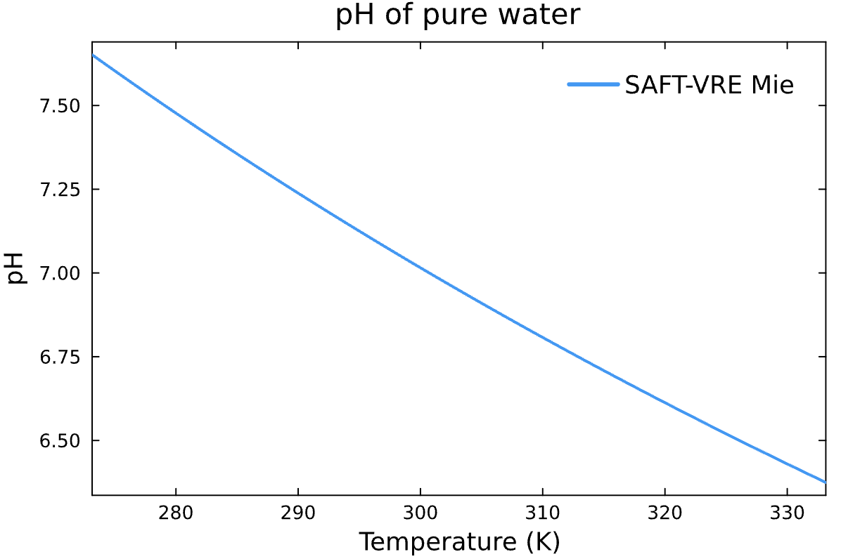
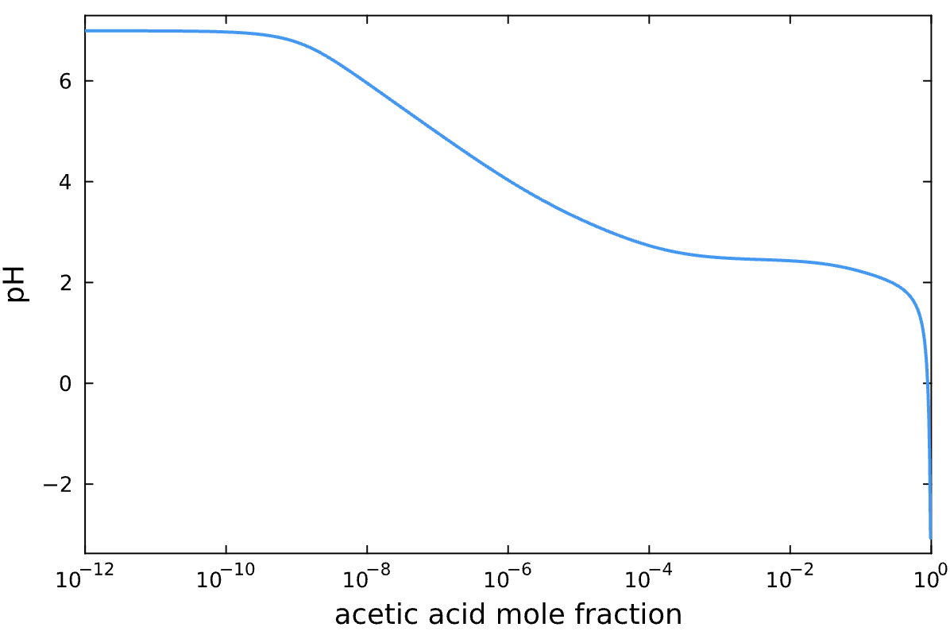
Reactive equilibrium
Obtained some interesting plots:

Slide 25
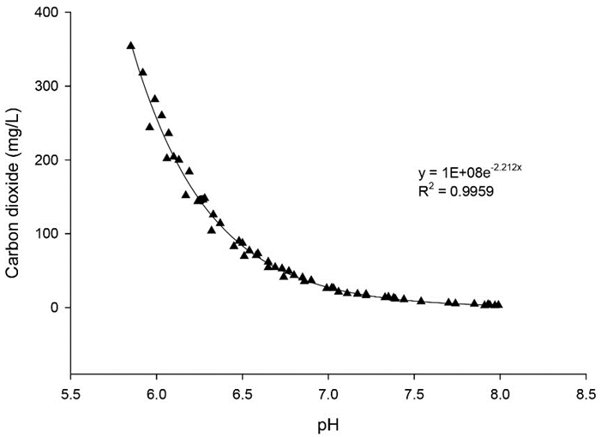
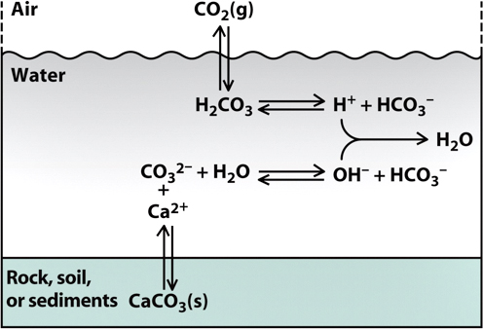
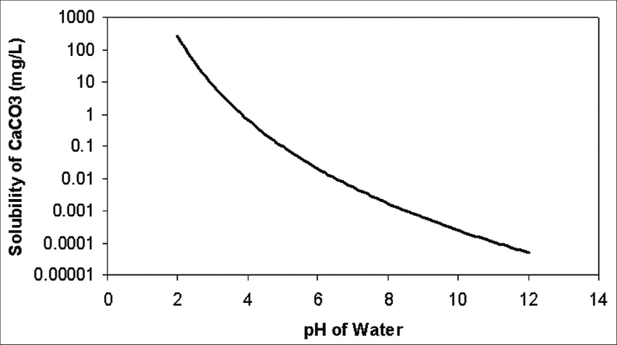
Next Steps
Integrate reactive equilibrium with all other solvers
Could then look at the effect of pH on:
Solubility of salts
Carbon dioxide solubility
SLVE?
Polyelectrolyte phase behavior

