Slide 1

Tutorial: Application of Clapeyron to polymeric and electrolyte systems
Pierre J. Walker

Slide 2
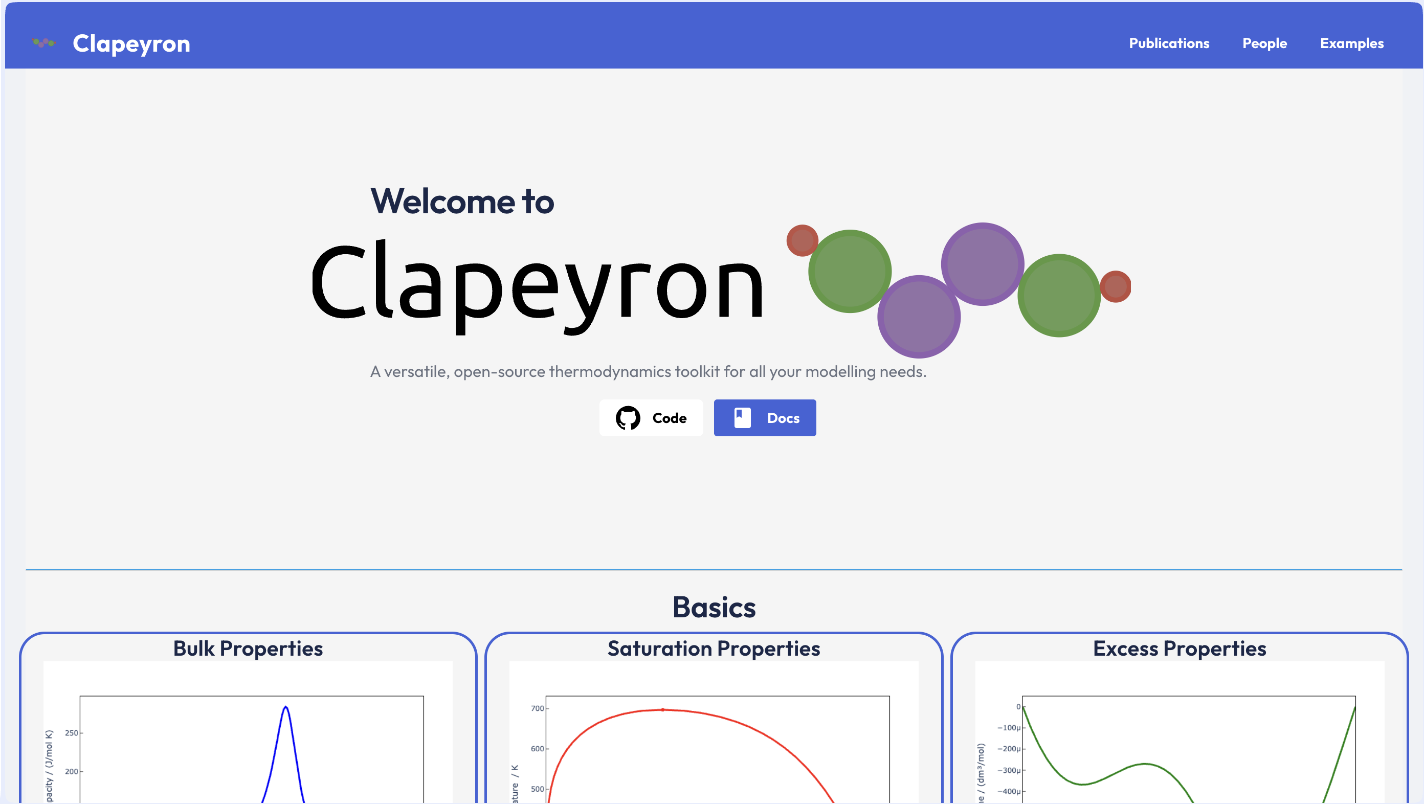
Overview
Basics
Building a model
Bulk properties
Equilibrium properties
Polymer Systems
Gas solubilities
Cloud points
Simple Electrolytes
Building an electrolyte model
Bulk properties
Equilibrium properties
Polyelectrolytes
Poly acrylic acid
Reactive Equilibrium

Slide 3
Basics

Slide 4
Building a model

Slide 5
Bulk Properties

Slide 6
Equilibrium Properties

Slide 7
Polymer Systems

Slide 8
Building a model

Slide 9
Electrolyte Systems

Slide 10
Building a model

Slide 11
Polyelectrolyte Systems

Slide 12
Reactive Equilibrium

