Slide 1


The First ChineseBabyLM Challenge
Training Data-efficient and Cognitively Plausible
Language Models for Chinese
Siyuan Song¹, Zhiheng Qian², Yunhao Zhang³, Linyang He⁴, Xiaozhe Ji⁵,
Yingxin Lin⁶, Hongao Zhu⁷, Chongtian Shao², Chuhan Lang⁸, Luan Li²,
Rui Wang², Renfen Hu⁵, Shaonan Wang⁸, Hai Hu⁸
Github
¹ Princeton University ² Shanghai Jiao Tong University
³ Chinese Academy of Sciences ⁴ Columbia University
⁵ Beijing Normal University ⁶ Tsinghua University
⁷ University of California San Diego ⁸ The Hong Kong Polytechnic University
NLPCC 2026 Shared Task
Homepage
Notes:
Good afternoon, I am Zhiheng Qian, from Shanghai Jiao Tong University. I am here to introduce the first ChineseBabyLM Challenge on behalf of the shared task organisers.

Slide 2
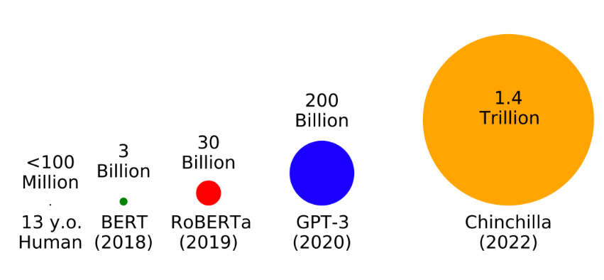
Motivation
Humans learn language from far less data
< 100M
Trillions
words heard by a child
by age 13
of words in modern LLM
pretraining corpora
Child: robust grammar from < 100M words
LLM: trillions of words
BabyLM: sample-efficient, developmentally plausible pretraining
English-first so far — no Chinese shared task
02
Notes:
Modern language models are trained on trillions of words. However, Children acquire language from far less input. By early adolescence, a child has been exposed to fewer than 100 million words.
BabyLM aims focus on data efficiency. However, it focus on English language, and there is no Chinese shared task so far.

Slide 3
Motivation
Why Chinese is a distinct test case
Logographic script — form carries meaning + sound
No word boundaries — segmentation must be learned
Rich compounding — lexical rules from little data
Flexible word order — grammar vs surface statistics
Phono-semantic compound characters
抱 (bào, hug) = 扌 (hand) + 包 (bāo)
radical 提手旁 → meaning · component → reading
妈 (mā, mom) = 女 (woman) + 马 (mǎ)
same recipe: semantic radical + phonetic component
Tokenization, character representation, and data needs all become research questions of their own.
03
Notes:
Chinese is a distinct case for data-efficient language modeling.
It uses a logographic writing system, where characters carry visual, semantic, and phonological information. It has no explicit word boundaries, so models must learn semantic segmentations. It makes extensive use of compounding, so models must learn how characters form words. It also allows relatively flexible word order, so models must capture grammatical relations rather than rely only on fixed surface patterns.
Therefore, we organized the first ChineseBabyLM challenge, a shared task with controlled training data and evaluation across multiple tracks.

Slide 4
Evaluation Tracks
14 TASKS IN THREE COMPLEMENTARY TRACKS
NLU
Cognitive Modeling Track
HANZI
Syntactic and semantic understanding
Alignment between human language representation and model representation
Chinese writing system knowledge
EXISTING BENCHMARKS
EXISTING BENCHMARKS
* NEW CHINESEBABYLM TASKS
OPEN TASKS
+
HIDDEN TASKS
ChineseBabyLM | NLPCC 2026
04
Notes:
Our challenge evaluates models along three complementary tracks.
The NLU track measures Chinese syntactic and semantic understanding.
The Cognitive Modeling track asks whether model representations resemble human language representations in the brain.
The Hanzi track focuses on knowledge specific to the Chinese writing system.
The challenge consists of open released during development, and hidden tasks released after the model submission deadline. The submitted models will be evaluated on both open and hidden tasks.

Slide 5
NLU Track
Zero-shot
Fine-tuning
OPEN TASKS
ZhoBLiMP (syntactic acceptability)
HIDDEN TASKS
XCOMPS-ZH (concept-property compatibility)
OPEN TASKS
AFQMC (semantic matching)
OCNLI (natural language inference)
TNEWS (news classification)
CLUEWSC2020 (coreference resolution)
HIDDEN TASKS
C3 (reading comprehension)
Diagnostic NLI (natural language inference)
Bolded tasks are selected from our works.
ZhoBLiMP (Liu et al., 2026), XCOMPS-ZH (He et al., 2025), CLUE (Xu et al., 2020), OCNLI (Hu et al., 2020), C3 (Sun et al., 2020), Diagnostic NLI (Hu et al., 2021)
ChineseBabyLM | NLPCC 2026
05
Notes:
The NLU track consists of zero-shot tasks and supervised fine-tuning tasks.
The open zero-shot tasks is ZhoBLiMP. and the hidden zero-shot task is XCOMPS-ZH
The open fine-tuning tasks are selected from CLUE; The hidden fine-tuning tasks are C3, a multiple-choice reading-comprehension benchmark, and Diagnostic NLI.
The Bolded tasks are selected from our works.

Slide 6
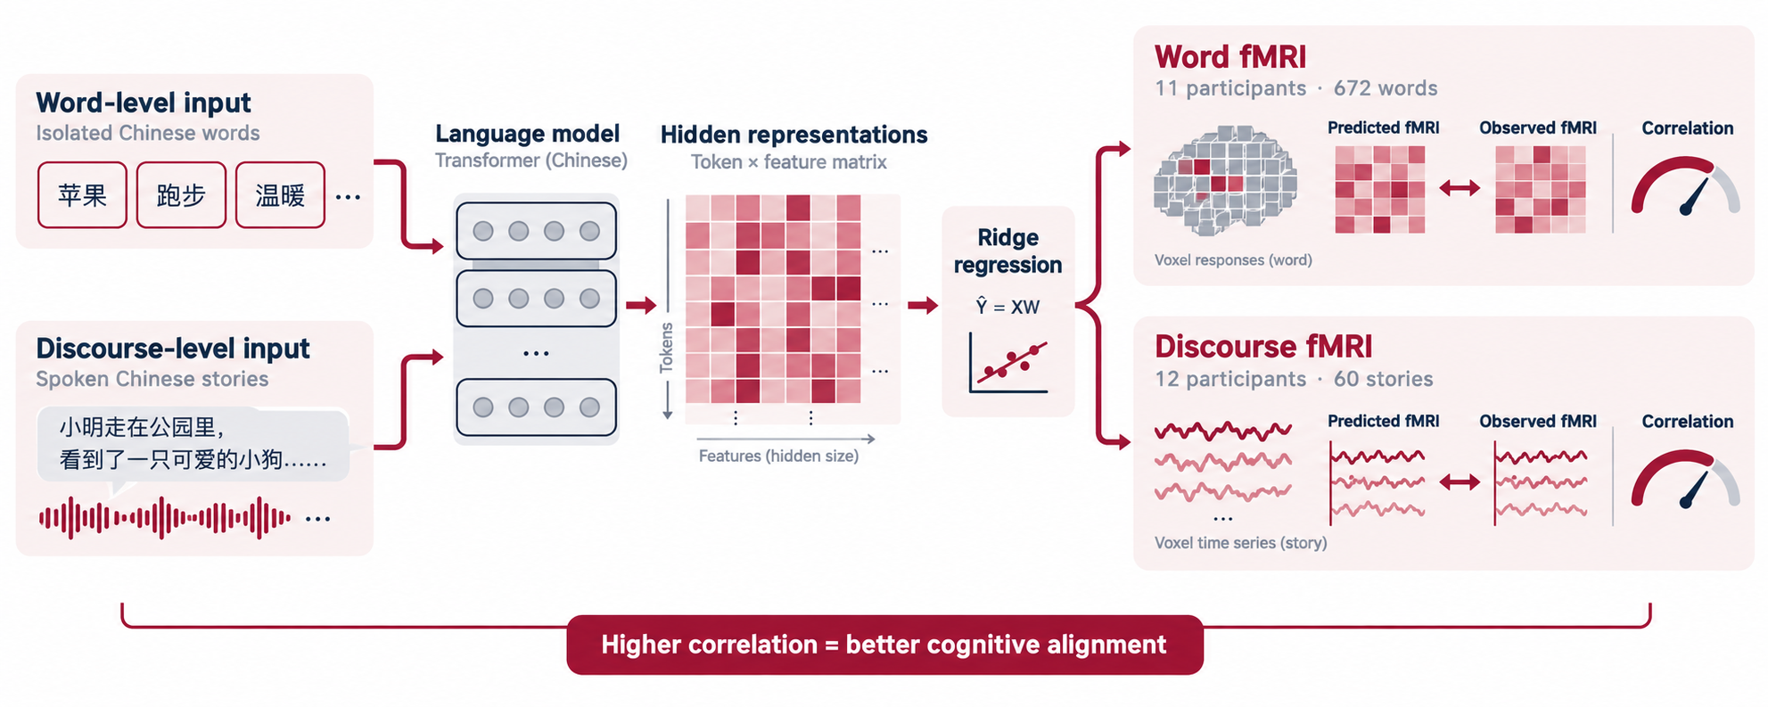
Cognitive Modeling Track
MulCogBench
Fit a ridge-regression from model representations to fMRI responses to evaluate the correlation between model representation and brain signal
Word fMRI (55% OPEN / 45 % HIDDEN)
11 participants reading 672 isolated words
Discourse fMRI (50% OPEN / 50 % HIDDEN)
12 participants listening to 60 stories
Chinese Stories
MulCogBench (Zhang et al., 2025)
ChineseBabyLM | NLPCC 2026
05
Notes:
The Cognitive Modeling track contains two human-model alignment tasks from MulCogBench.
For both tasks, we fit a ridge-regression from model representations to fMRI responses to evaluate the correlation between model representation and brain signal.
The word-level task uses brain responses from 11 participants reading 672 isolated words, while the discourse-level task uses data from 12 participants listening to 60 stories containing more than 52,000 words.

Slide 7
HANZI Track
* NEW BENCHMARKS
Structure
Pinyin
Character decomposition · 4,000 pairs · 50% open / 50% hidden
Homophone judgment · 4,000 pairs · 50% open / 50% hidden
GOOD
GOOD
阁字外围的部分是门。
“欲”和“芋”的声母、韵母和声调完全相同。
The outer component of 阁 is 门.
(yu4, yu4)
BAD
BAD
阁字外围的部分是包。
“欲”和“于”的声母、韵母和声调完全相同。
The outer component of 阁 is 包.
(yu4, yu2)
The model should assign a higher score to the true statement. An unknown token counts as an error.
ChineseBabyLM | NLPCC 2026
06
Notes:
Hanzi track composes of Chinese structure and pinyin knowledge tasks, which come from our unpublished work. Both are minimal pair tasks.
In the structure task, the model should understand the radical composition. For example, the outer component of 阁 is 门, not 包.
In the pinyin task, the model should understand the pronunciation of a Chinese character. For example, it should recognize that 欲 and 芋 have the same initial, final, and tone, while 欲 and 于 differ in tone.

Slide 8
Rules for Model Training
1. Pretrain from scratch
2. Data Constraints
Open Design Space
Tokenizer
Architecture
Model Scale
Training Strategy
…
Data Option 1
Data Option 2
Official 102M-word training corpus, sampled from the Chinese portion of BabyBabelLM
Self-compiled corpus. No more than 102M words calculated using Jieba 0.42.1 (default mode)
ChineseBabyLM | NLPCC 2026
07
Notes:
There are two key constraints for model training. first, the model should be trained from scratch. Second, there are two options for the training data. The option 1 is, the participant can use the official 102M word training corpus, which is sampled from BabyBabelLM. Or the participants could use a self-compiled corpus with not more than 102M words.

Slide 9
Rules for Model Training
* The pre-training corpus consists of child-oriented data.
Category | What it contains | Sources
Child-available speech | Speech children overhear daily | NaturalConv, ChildMandarin
Children's books | Storybooks + reading comprehension | Quangushi, GlotStoryBooks, CFT, CMRC-2019
Child-directed speech | Speech directed at children | CHILDES, ChildMandarin
Child wiki | Age-appropriate non-fiction | WikiJunior, Wikibooks
Educational | Exams · grammar · compositions | GAOKAO, CK-12, CSQ, FCGEC
Subtitles | Everyday spoken language | WenetSpeech
Total | Sampled from BabyBabelLM — naturalistic, developmentally relevant | 102M words
ChineseBabyLM | NLPCC 2026
07
Notes:
The table shows the composition of our official training corpus. It mainly consists of child-oriented data and other conversational or speech-like text.

Slide 10
Final Results
18
4
28
Overall leaderboard
TEAMS
Regions
SUBMISSIONS
Rank | Team | Institution | Overall
1 | BabyDragon | University of Chinese Academy of Sciences | 61.49
2 | OK的老大 | Fudan University | 57.79
3 | TUM Campus Heilbronn | Technical University of Munich | 54.90
4 | SMI | Jiangsu Normal University | 51.77
5 | lampa | University of Cambridge | 50.37
Track winners
NLU
60.99
YNU-HPCC
COGNITIVE MODELING
33.96
Deepscientist
HANZI
91.56
BabyDragon
ChineseBabyLM | NLPCC 2026
08
Notes:
We received 28 models subimissions from 18 teams.
Among teams, BabyDragon from University of Chinese Academy of Sciences ranked first overall with 61.49.
OK的老大 from Fudan University ranked second, while TUM Campus Heilbronn ranked third.
For track winners, YNU-HPCC is the winner of NLU track.
Deepscientist is the winner of cognitive modeling track
BabyDragon is the winner of HANZI track

Slide 11
Submitted Model Statistics
Architecture family
Reported parameter count
14 of 18 ranked systems reported parameter counts
Score variance by track
Valid submissions only
Hanzi strongly
separated the
final ranking
ChineseBabyLM | NLPCC 2026
09
Notes:
Finally, let me share a few statistics of the submitted models.
Encoder-only model accounted for 72% of the submissions, while the rest were decoder-only.
Among the teams that reported parameter counts, six fell between 100 and 150M, while the range extended from 12 million to 800 million.
In terms of the variance, Hanzi separated systems much more strongly, while Cognitive Modeling scores were tightly compressed

Slide 12
Thank You!
Github
NLPCC 2026 Shared Task
Homepage
Notes:
Thank you for listenining. You can scan the QR codes to reach the shared task homepage and github repository.

