Slide 1


Cobblestone Learning Centers

Slide 2
Company Profile
CLC offers tutoring services and test preparation courses to students in grades 7-12 across our metropolitan area.
We have multiple centers at which students can enroll in classes or receive one-on-one-tutoring. Some services are also offered on-line.
Current initiative to use data analytics to help us understand how to better serve our clients and how to steer our business strategy.

Slide 3
CLC Development Timeline
Investing in our future!
2012
2014
2015
2018
First two Cobblestone Learning centers opened in Beaverton and Camas.
CLC acquired our largest local competitor and added 12 new center locations.
Refresh program offered on-line for all locations, in addition to our in-person program.
Major overhaul of Tutoring program completed.
Focus on hiring more experienced tutors
Implementation of rigorous tutor training program
On-line tutoring services launched

Slide 4
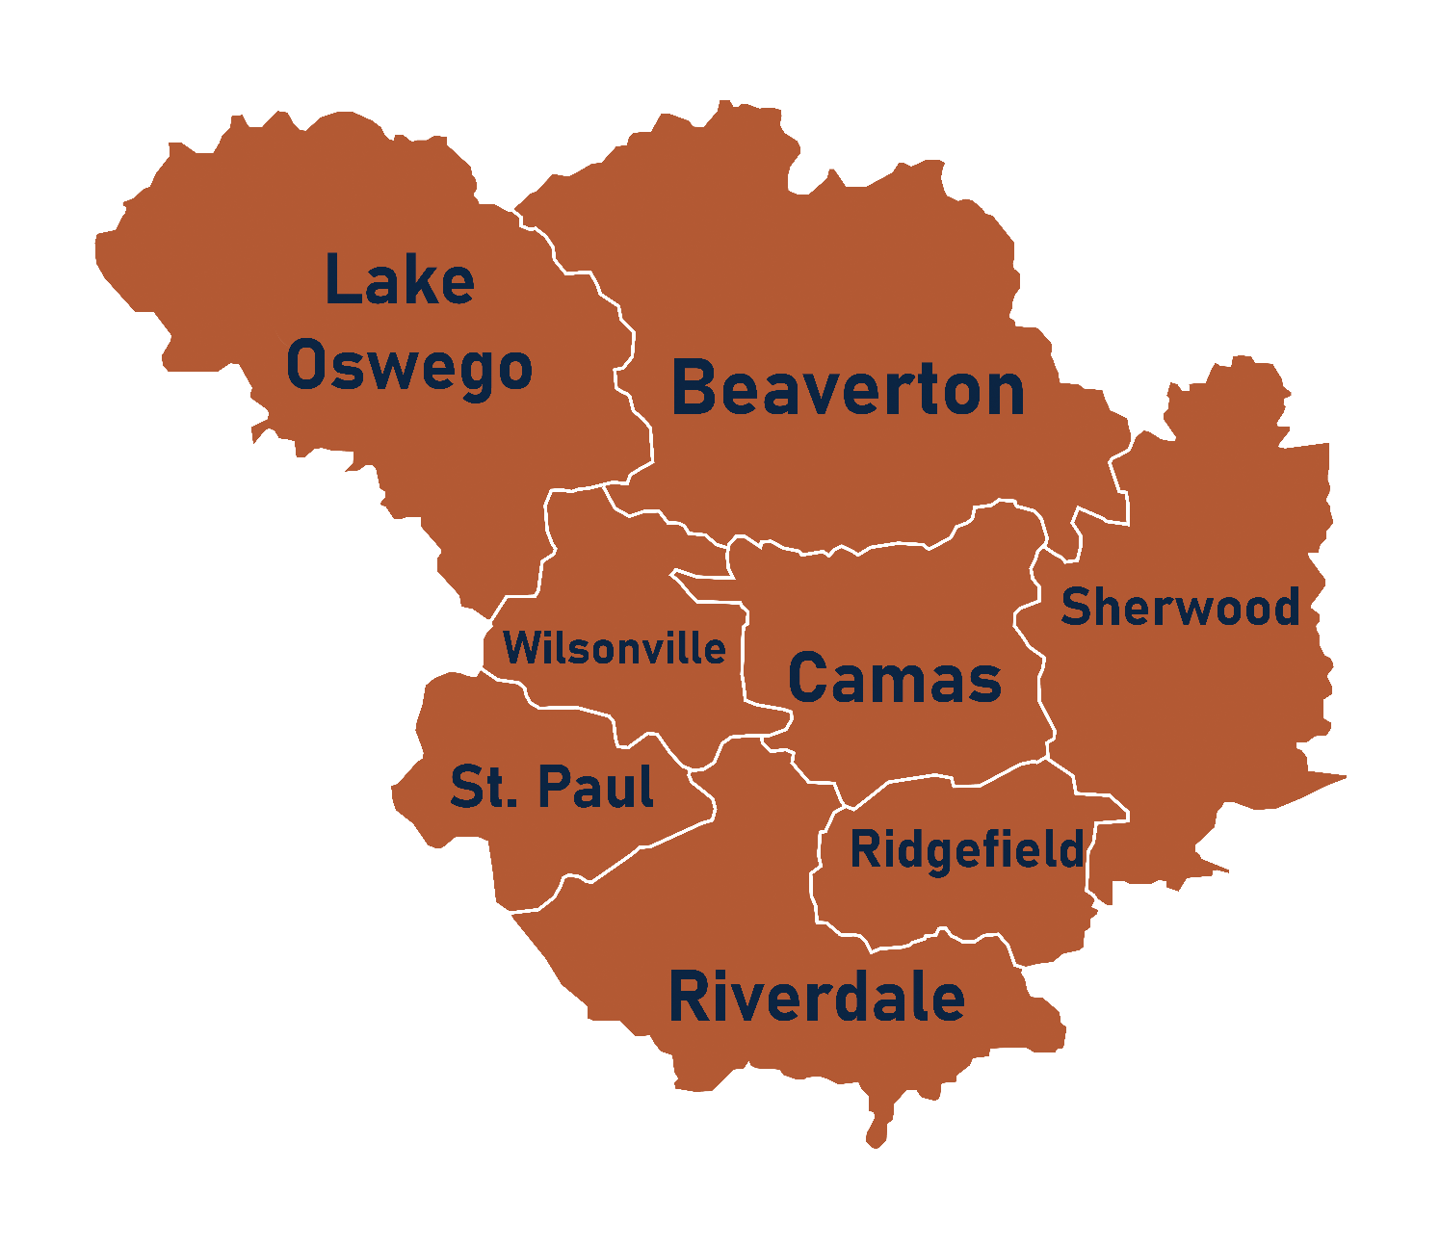
School Districts Served
District | 2018 Student Population
Beaverton | 21,870
Camas | 12,015
Lake Oswego | 19,170
Ridgefield | 17,820
Riverdale | 9,990
Sherwood | 20,925
St. Paul | 12,150
Wilsonville | 21,060

Slide 5
Programs Offered
SkillsAdvantage | Cobblestone Refresh | One-on-One Tutoring
2 hour sessions, once a week for 6 weeks | One 4 hour session | One hour sessions, booked once or twice/week in 1 – 4 week blocks
Offered: Mon, Wed and Fri evening, Sat morning | Offered: Sat and Sun afternoon, Wed evening | Offered: Scheduled individually with tutors
Location: centers | Location: centers & on-line | Location: centers, on-line starting in 2018

Slide 6
Student Assessments and Progress Tracking
CLC has a four-part general assessment for tracking student progress.
The general assessment includes a reading, writing, "calculator" math, and "no calculator" math component.
The writing score is on a scale of 100 points. The other three scores are each on a scale of 800 points.
When students first enroll at CLC, they take the general assessment and their scores are recorded as “intake”, or baseline, scores.
Every time a student completes one of CLC’s programs, they re-take the assessment and their scores are added to their student assessment record.

Slide 7
Analytics Objectives
Use the (anonymized) student assessments database to understand student achievement and student/program outcomes across the student population.
Generate high-level insight on program utilization and student trajectory, as well as understand effect of program participation on student outcomes.
Understand program effectiveness in center-based vs. on-line delivery modality.
CLC is considering adapting the SkillsAdvantage program to an on-line format. We would like to use insight from the transition to on-line tutoring to help decide whether we should pursue this initiative.

Slide 8
Thank You!
We look forward to meeting with you on Thursday, 11/10.
©2022 Elizabeth Mohr. This case was prepared for the MSBA and MSMA programs to facilitate classroom learning.

