Slide 1
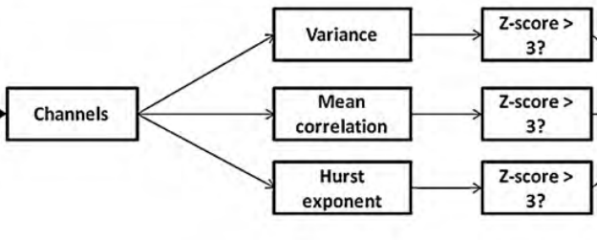
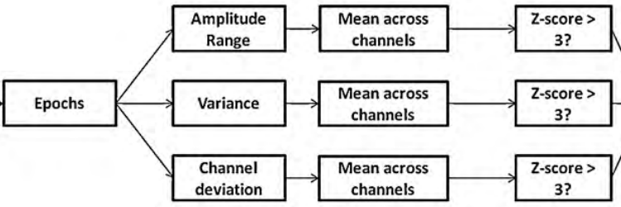
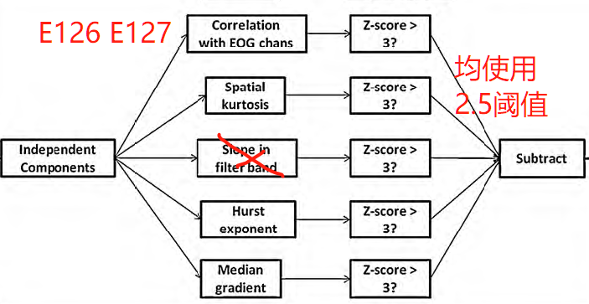
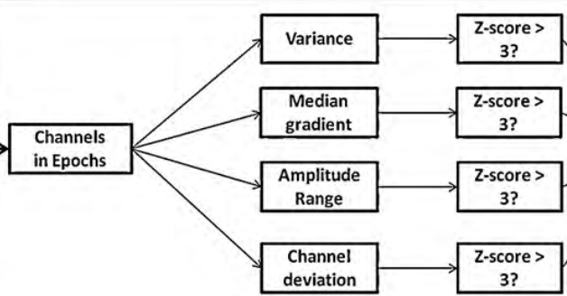
Import data
Down sampling (250Hz)
Remove data
Find begin event
Filter
Notch 48-52HZ
Low-Pass 40Hz
High-Pass 0.1Hz
FASTER
pop_rejchan
Find bad channel
Spectra: 3
Kurtosis: 3
Epoch
FASTER
Pop_autorej
% 'threshold':1000, 拒绝幅值波动大于1000 (uV)的epoch % 'startprob':5, 拒绝幅值波动大于均值5个标准差的epoch % 'maxrej’:2, 每次迭代删除epoch比例不大于2%，最多迭代8次
Find Bad Epoch
Interpolate
Re-reference (average)
FASTER
IClabel
ICA (N=129-badChan-1)
[NaN NaN; ... % Brain
0.7 1; ... % Muscel
0.7 1; ... % Eye
0.7 1; ... % Heart
0.7 1; ... % Line Noise
0.7 1; ... % Channel Noise
NaN NaN]); % Other
Remove ICs
Epoch Bad Channel
Visual Check
Post-processing (Baseline correction etc)

Slide 2
Visual Check
Really Bad
Bad Quality
Good Quality
Discard
Or
Redo Prep
Remove IC First
Reject Epochs
Find Bad Channel
Rate/Comment

