Slide 1
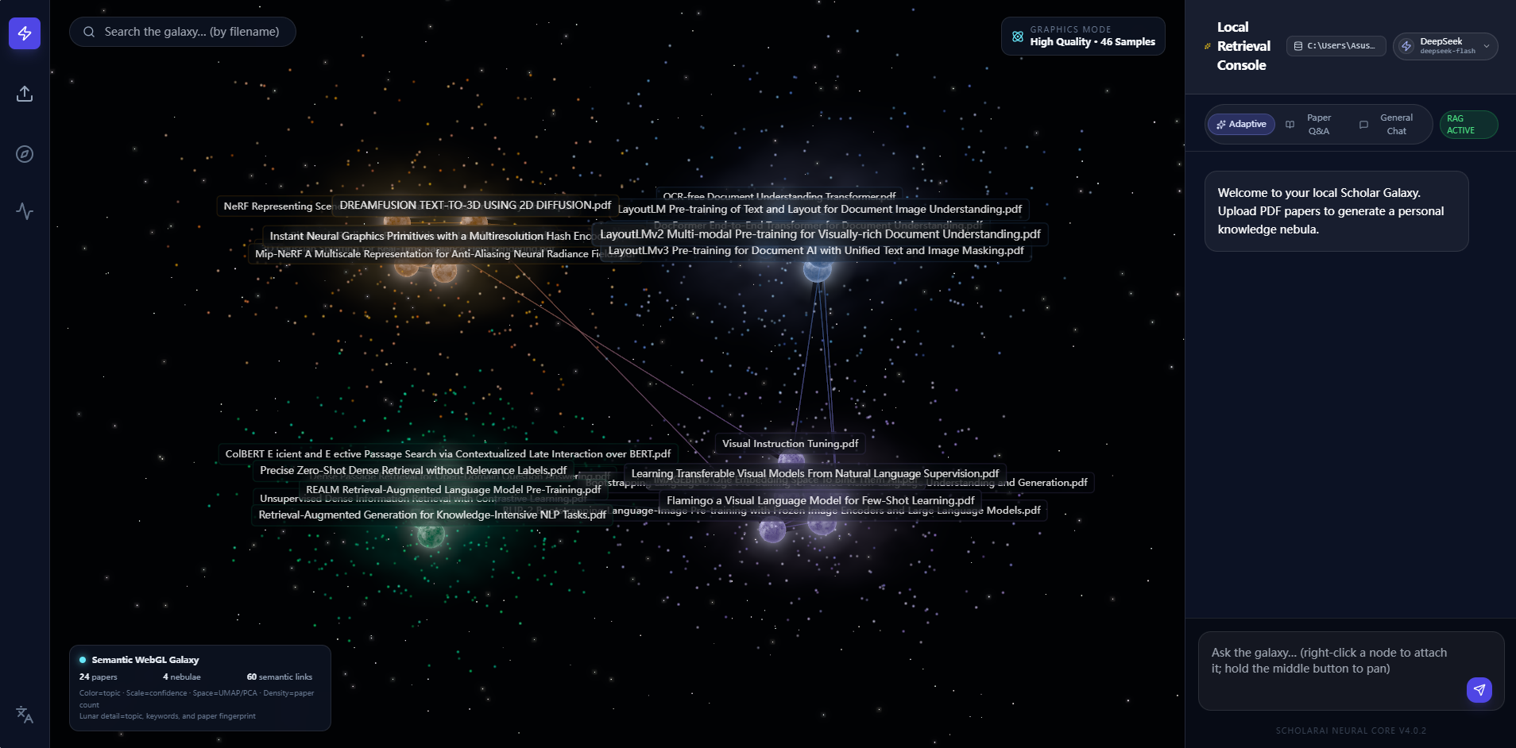
PDF
GALAXAI
VISION
DESIGN
SYSTEM
REVIEW
01
PDF-GalaxAI
An AI-Driven Interactive
Knowledge Exploration Platform
Independently Designed and Developed
[Li Shouchuan]
Application Portfolio
HKU MSc(Eng) Innovative Design and Technology
PDF-GalaxAI
01 / 10
Notes:
I independently designed and developed the application, integrating document processing, semantic retrieval, real-time 3D graphics and reading interactions. My application uses third-party frameworks and pretrained models. The independent ownership statement reflects the applicant’s explicit account of their development role.
Project sources:
C:/Users/Asus/Desktop/PDF_GalaxAI/README.md
C:/Users/Asus/Desktop/PDF_GalaxAI/package.json
C:/Users/Asus/Desktop/PDF_GalaxAI/backend/store.py
C:/Users/Asus/Desktop/PDF_GalaxAI/frontend/src/ui/App.tsx

Slide 2
PDF
GALAXAI
VISION
DESIGN
SYSTEM
REVIEW
02
Contents
The design rationale, interaction system and engineering behind PDF-GalaxAI.
01
User Problems & Product Workflow
03–04
Research needs and the connected reading experience
02
3D Semantic Knowledge Visualisation
05
Semantic relationships and interactive exploration
03
RAG, Evidence & System Architecture
06–08
Document processing, source verification and integration
04
Engineering Decisions & Reflection
09–10
Implementation trade-offs, evaluation and practical value
PDF-GalaxAI
02 / 10
Notes:
Portfolio structure: pages 3–4 explain research needs and the user workflow. Page 5 explains semantic exploration. Pages 6–8 connect retrieval, original-source reading and system integration. Pages 9–10 discuss engineering choices, evaluation and reflection.

Slide 3
PDF
GALAXAI
VISION
DESIGN
SYSTEM
REVIEW
03
User Problems & Design Objectives
Designed for researchers exploring relationships across a growing collection of papers.
RESEARCH TASK
PRODUCT RESPONSE
Fragmented knowledge
A semantic knowledge galaxy
Individual PDFs hide connections across a collection.
Organise papers by topic and expose related documents.
Slow changes of context
A connected reading workspace
Finding, reading and questioning require separate steps.
Carry the selected paper into AI dialogue and PDF reading.
Unclear AI provenance
Accessible source evidence
A fluent answer can be difficult to verify.
Return retrieved passages and links to original PDF pages.
Different privacy needs
A visible model choice
Cloud capability and local processing involve trade-offs.
Let users choose local or cloud inference in the same interface.
PDF-GalaxAI
03 / 10
Notes:
These objectives express the product’s design rationale for research workflows. They are design hypotheses, not findings from a completed user interview study. The project materials do not document a formal user research sample.
Project sources:
C:/Users/Asus/Desktop/PDF_GalaxAI/README.md
C:/Users/Asus/Desktop/PDF_GalaxAI/frontend/src/ui/App.tsx
C:/Users/Asus/Desktop/PDF_GalaxAI/frontend/src/ui/ReaderModal.tsx

Slide 4
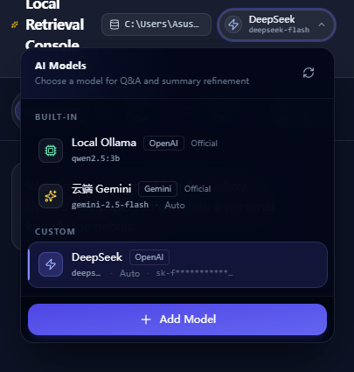
PDF
GALAXAI
VISION
DESIGN
SYSTEM
REVIEW
04
Product Concept & Workflow
A selected paper links galaxy exploration, contextual questions and original-source reading.
01
Import
02
Explore
03
Question
04
Verify
Upload and index papers
Select a paper in the galaxy
Add a reference and choose a model
Open the cited page in the reader
Data and interaction flow
Model panel crop
Upload PDF
Parse & index
Knowledge galaxy
Save the original
document
Text extraction
and embeddings
Topic groups
and paper nodes
【此处放本地与云端模型切换截图】
PDF reader
Source references
RAG question
Locate the source
and highlight terms
Paper, page and
passage context
Retrieve passages
and answer
PDF-GalaxAI
04 / 10
Notes:
The main App component owns selectedPaper, readerPaper, attachedPapers and activeHighlights. Search performs case-insensitive substring matching on titles, display titles, filenames and keywords. Node selection and right-click add-to-chat connect the galaxy to reading and questioning. The UI search is not a vector search.
Project sources:
C:/Users/Asus/Desktop/PDF_GalaxAI/frontend/src/ui/App.tsx
C:/Users/Asus/Desktop/PDF_GalaxAI/frontend/src/ui/GalaxyArea.tsx
C:/Users/Asus/Desktop/PDF_GalaxAI/frontend/src/rendering/GalaxyRenderer.tsx
C:/Users/Asus/Desktop/PDF_GalaxAI/frontend/src/ui/PaperDetail.tsx
A normal workflow is upload, graph exploration, paper context attachment, model/mode selection, question, citation and PDF reading. ModelPicker exposes built-in local/cloud and custom configurations. ModelManager offers protocol, endpoint, credentials, proxy selection and test connection. An index status warning indicates an embedding-model mismatch and offers a rebuild. Provider switching changes generation, not the local embedding representation. Vision questions require a compatible model and can use an uploaded or pasted screenshot in ReaderChat.
Project sources:
C:/Users/Asus/Desktop/PDF_GalaxAI/frontend/src/ui/ModelPicker.tsx
C:/Users/Asus/Desktop/PDF_GalaxAI/frontend/src/ui/ModelManager.tsx
C:/Users/Asus/Desktop/PDF_GalaxAI/frontend/src/ui/IndexAdmin.tsx
C:/Users/Asus/Desktop/PDF_GalaxAI/frontend/src/ui/ReaderChat.tsx
C:/Users/Asus/Desktop/PDF_GalaxAI/backend/models_registry.py
C:/Users/Asus/Desktop/PDF_GalaxAI/backend/llm_client.py

Slide 5
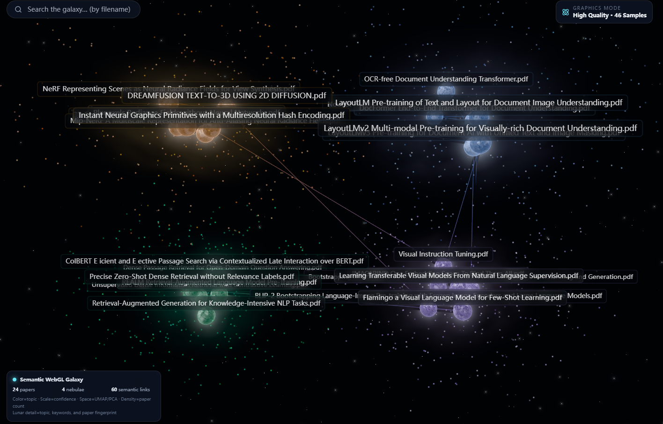
PDF
GALAXAI
VISION
DESIGN
SYSTEM
REVIEW
05
3D Semantic Knowledge Visualisation
3D topic groups provide a collection overview with direct access to individual papers.
16:9
Colour
KMeans topic cluster
Position
UMAP/PCA coordinates with additional cluster separation
Node size
【此处放三维语义知识星云截图】
Similarity to the assigned cluster centre
Nebula density
Number of papers in the cluster
Visual emphasis
Retrieved papers and selected search results
05 / 10
Notes:
Paper-level embeddings use the abstract and keywords. KMeans selects a cluster count using cosine silhouette scores where possible. UMAP/PCA produces three-dimensional coordinates, then store.py tightens and offsets clusters for separation. One to three papers use fixed positions. Position is an exploratory projection and not an exact semantic distance. Similarity edges use cosine top-4 neighbours and a 0.20 cutoff. The renderer currently draws edges with a common visual style, so it should not be described as encoding edge weight by line intensity. Nebula shading uses a sampled density field and a GPU particle system. 3D benefits remain a usability hypothesis pending comparison with list and 2D layouts.
Project sources:
C:/Users/Asus/Desktop/PDF_GalaxAI/backend/store.py
C:/Users/Asus/Desktop/PDF_GalaxAI/backend/clustering.py
C:/Users/Asus/Desktop/PDF_GalaxAI/backend/api.py
C:/Users/Asus/Desktop/PDF_GalaxAI/frontend/src/rendering/GalaxyRenderer.tsx
C:/Users/Asus/Desktop/PDF_GalaxAI/frontend/src/rendering/SemanticNebula.tsx

Slide 6
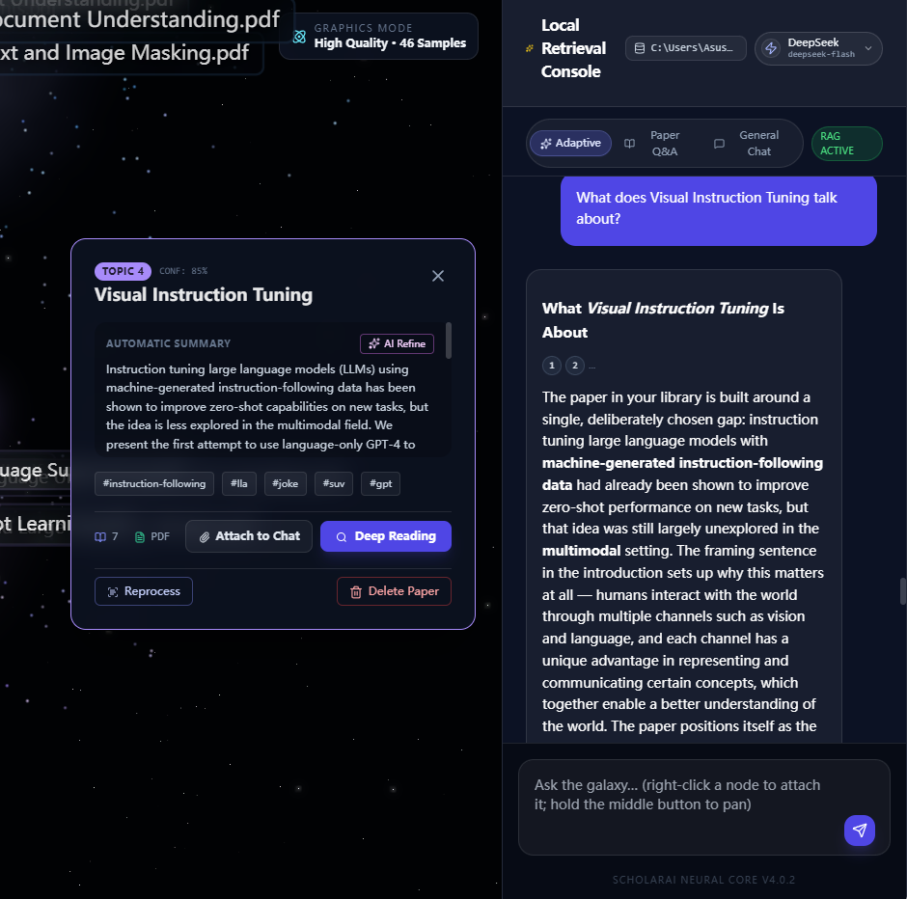
PDF
GALAXAI
VISION
DESIGN
SYSTEM
REVIEW
06
PDF Processing & RAG Engineering
Paper vectors organise the collection. Passage vectors support contextual question answering.
Parse PDF
Prepare text
BGE-M3 + Chroma
Chat panel crop
Native text / OCR
Optional MinerU
Abstract + keywords
Overlapping chunks
Two vector indexes
Local Chroma store
【此处放智能文献问答截图】
Generate answer
Rerank evidence
Retrieve passages
Local / cloud model
Answer + sources
Semantic + lexical
Text quality
Question vector
Paper context
Two indexes, two tasks
Paper vectors map topics. Passage vectors support RAG.
Auto / RAG / Chat modes make retrieval behaviour explicit.
Source evidence needs human review.
PDF-GalaxAI
06 / 10
Notes:
The default embedding model is BAAI/bge-m3, configurable through SCHOLAR_ST_MODEL. Paper embeddings use abstract and keyword text. chunk_text uses a 500-character window and 100-character overlap, preferring sentence boundaries. Indexing filters very short or poor-quality chunks. The vector store has separate scholar_papers and scholar_chunks collections with cosine distance. OCR is optional and falls back to native extraction when Tesseract is unavailable. MinerU requires a separate CLI installation. Auto keywords use corpus TF-IDF, mixed-language tokenisation and MMR diversity; declared keywords remain preserved.
Project sources:
C:/Users/Asus/Desktop/PDF_GalaxAI/backend/text_processing.py
C:/Users/Asus/Desktop/PDF_GalaxAI/backend/chunker.py
C:/Users/Asus/Desktop/PDF_GalaxAI/backend/store.py
C:/Users/Asus/Desktop/PDF_GalaxAI/backend/vector_store.py
C:/Users/Asus/Desktop/PDF_GalaxAI/backend/keyword_extractor.py
C:/Users/Asus/Desktop/PDF_GalaxAI/backend/mineru_parser.py
search_chunks fetches max(top_k*5,20) candidate chunks, then applies a weighted reranking score: 0.72 semantic similarity, 0.18 lexical overlap and 0.10 text quality. The main query endpoint generally selects five chunks, or six in a named-paper search. Auto routing uses retrieval quality and raw semantic scores to choose rag, rag_soft or chat. Forced RAG without chunks can use rag_soft, so the product does not implement a universal strict refusal policy. The backend sends context and recent dialogue to the chosen provider and returns answer, cite_details, provider_used and mode. RAG improves access to evidence but does not eliminate hallucination.
Project sources:
C:/Users/Asus/Desktop/PDF_GalaxAI/backend/store.py
C:/Users/Asus/Desktop/PDF_GalaxAI/backend/api.py
C:/Users/Asus/Desktop/PDF_GalaxAI/backend/llm_client.py
C:/Users/Asus/Desktop/PDF_GalaxAI/frontend/src/api/client.ts
C:/Users/Asus/Desktop/PDF_GalaxAI/frontend/src/ui/App.tsx

Slide 7
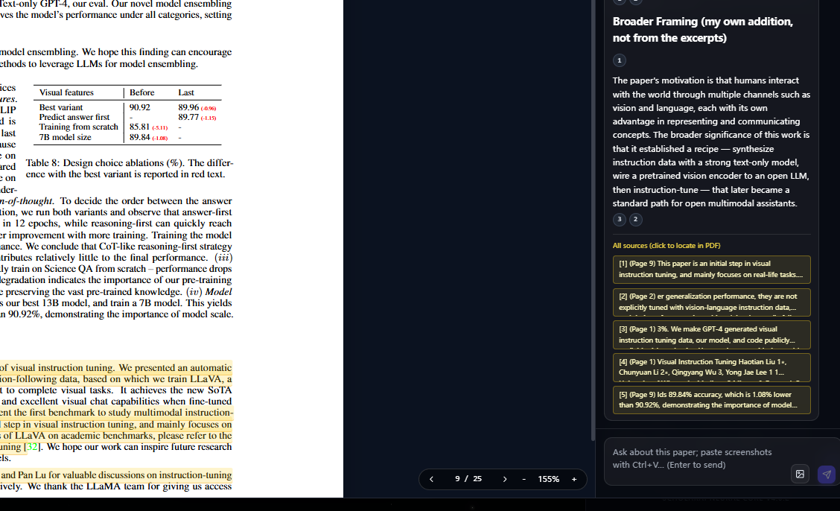
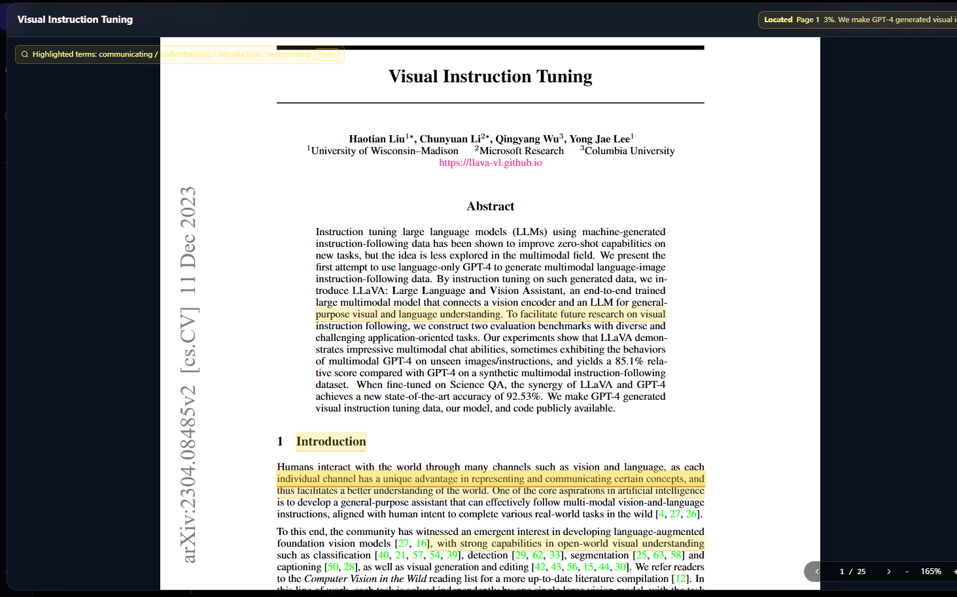
PDF
GALAXAI
VISION
DESIGN
SYSTEM
REVIEW
07
Evidence Tracing & Source Reading
A citation opens the original document and directs attention to candidate supporting text.
16:9
16:9
【此处放回答引用原文跳转截图】
【此处放文献阅读与高亮联动截图】
1 Retrieved passage
2 Page location
3 Reader response
paper_id, chunk_id and snippet
Normalised text and keyword matching
Open the PDF page and highlight terms
PDF-GalaxAI
07 / 10
Notes:
The backend attaches references for the retrieved passages, then locate_snippet_page searches native PDF page text using normalised snippets and a keyword fallback. The main and reader chats render citation chips and source cards. Paragraph-to-source associations use lexical matching with a fallback, not semantic entailment verification. PdfReaderPane highlights matching PDF text-layer items and scrolls to the first hit. OCR-only pages, layout differences, or ambiguous keywords may prevent precise location. Citations expose possible supporting material; they do not prove every generated claim.
Project sources:
C:/Users/Asus/Desktop/PDF_GalaxAI/backend/store.py
C:/Users/Asus/Desktop/PDF_GalaxAI/backend/api.py
C:/Users/Asus/Desktop/PDF_GalaxAI/frontend/src/ui/App.tsx
C:/Users/Asus/Desktop/PDF_GalaxAI/frontend/src/ui/ReaderChat.tsx
C:/Users/Asus/Desktop/PDF_GalaxAI/frontend/src/ui/ReaderModal.tsx
C:/Users/Asus/Desktop/PDF_GalaxAI/frontend/src/ui/PdfReaderPane.tsx

Slide 8
PDF
GALAXAI
VISION
DESIGN
SYSTEM
REVIEW
08
Full-Stack System Architecture
A shared paper identity connects semantic processing, WebGL exploration and evidence-based reading.
React web application
FastAPI service
Inference providers
Vite + TypeScript
Shared paper and interaction state
Upload, graph, query and file APIs
Provider routing and error states
Local Ollama
Cloud Gemini / OpenAI APIs
Interaction modules
Processing modules
Local persistence
Three.js / GLSL galaxy
PDF.js reader and chat
Parsing, chunking, embeddings
KMeans, UMAP/PCA, retrieval
PDF files + JSON metadata
Chroma paper / chunk vectors
Privacy decision: files and vectors stay local. Cloud inference receives the selected context and any submitted image.
User-controlled model integration
Backend API communication
【此处放模型管理与连接测试截图】
【此处放后端接口文档截图】
PDF-GalaxAI
08 / 10
Notes:
The frontend uses REST fetch calls, not a streaming websocket RAG channel. Vite development proxies /api and /files to 127.0.0.1:8000. Backend startup imports inbox PDFs and restores/checks indexes. Files and metadata use local directories and JSON. Chroma telemetry is disabled in VectorStore. Local Ollama is a built-in OpenAI-compatible provider; Gemini and custom providers share the model registry and HTTP client. Cloud inference receives prompt context and vision images when used. Embedding model acquisition may require network access initially. The project is a local research application and does not document production authentication or deployment hardening.
Project sources:
C:/Users/Asus/Desktop/PDF_GalaxAI/vite.config.ts
C:/Users/Asus/Desktop/PDF_GalaxAI/backend/main.py
C:/Users/Asus/Desktop/PDF_GalaxAI/backend/api.py
C:/Users/Asus/Desktop/PDF_GalaxAI/backend/store.py
C:/Users/Asus/Desktop/PDF_GalaxAI/backend/vector_store.py
C:/Users/Asus/Desktop/PDF_GalaxAI/backend/models_registry.py
C:/Users/Asus/Desktop/PDF_GalaxAI/backend/llm_client.py
C:/Users/Asus/Desktop/PDF_GalaxAI/frontend/src/ui/App.tsx
Suggested evidence crops: show the model manager with its provider configuration and connection-test control (hide any API keys). Show the FastAPI /docs page with upload, graph, query and file endpoints. Both are observable software interfaces, while the native diagram explains module relationships. Source anchors: frontend/src/ui/ModelManager.tsx; backend/api.py (FastAPI application and API routes).

Slide 9
PDF
GALAXAI
VISION
DESIGN
SYSTEM
REVIEW
09
Engineering Decisions & Evaluation
Implementation choices and test evidence show what works and what still needs evaluation.
OBSERVED PROBLEM
IMPLEMENTATION DECISION
EVIDENCE / LIMIT
Occlusion and
navigation friction
Quality presets adjust volume samples, particle count and DPR. OrbitControls bounds zoom.
Earlier manual report records improved occlusion. Large-scale FPS remains unmeasured.
Weak keywords and
unreadable PDF text
Preserve declared keywords. Apply stop-word filtering, corpus TF-IDF and diverse selection. Use OCR when needed.
Code implements the pipeline. OCR and layout quality vary across documents.
Unverifiable answers
and disconnected views
Return source snippets and candidate pages. Propagate paper identity into galaxy highlights and the PDF reader.
Source linking exists in code. Matching is heuristic and needs end-to-end validation.
Validation: frontend build passes. Earlier manual tests cover previews, tooltips and nebula visibility.
PDF-GalaxAI
09 / 10
Notes:
Historic reports: DEMO records occlusion, responsiveness and directory sync issues; v1.1.1 records a pass for filename hover, nebula occlusion improvement and preview. The v1.2 folder report labels itself v1.1.1 and records keyboard/preview layout issues without a final resolution table. The current code includes bounded OrbitControls, adaptive rendering presets, quality-aware chunk reranking, keyword filtering, OCR/parser fallbacks, PDF viewer fallback, index warnings, model tests and graph refresh retries. Do not equate code presence with a completed regression pass. No benchmark supports a speed improvement percentage.
Project sources:
C:/Users/Asus/Desktop/PDF_GalaxAI/tests/test_v1/Test_report_v1.md
C:/Users/Asus/Desktop/PDF_GalaxAI/tests/test_v1.1.1/Test_report_v1.1.1.md
C:/Users/Asus/Desktop/PDF_GalaxAI/tests/test_v1.2/Test_report_v1.2.md
C:/Users/Asus/Desktop/PDF_GalaxAI/frontend/src/rendering/GalaxyRenderer.tsx
C:/Users/Asus/Desktop/PDF_GalaxAI/frontend/src/rendering/SemanticNebula.tsx
C:/Users/Asus/Desktop/PDF_GalaxAI/frontend/src/ui/App.tsx
C:/Users/Asus/Desktop/PDF_GalaxAI/backend/keyword_extractor.py
The frontend production build completes and emits a large-bundle warning. The project’s manual test reports cover earlier versions, including preview, tooltip and nebula occlusion checks. A working end-to-end RAG setup requires Chroma, the embedding model and a configured inference provider. Build success does not establish retrieval accuracy or user-efficiency gains. Formal user studies and rendering performance benchmarks remain future evaluation work.
Project sources:
C:/Users/Asus/Desktop/PDF_GalaxAI/package.json
C:/Users/Asus/Desktop/PDF_GalaxAI/backend/requirements.txt
C:/Users/Asus/Desktop/PDF_GalaxAI/tests/test_v1.1.1/Test_report_v1.1.1.md
C:/Users/Asus/Desktop/PDF_GalaxAI/GRAPHICS_RESEARCH.md

Slide 10
PDF
GALAXAI
VISION
DESIGN
SYSTEM
REVIEW
10
Design-Driven
Technological Innovation
I independently designed and developed an application that makes
semantic relationships explorable and original evidence accessible.
Next evaluation
Next engineering step
Compare 3D exploration with lists and 2D graphs. Measure task completion time and usability.
Improve source alignment, test retrieval quality and profile rendering with larger libraries.
[Li Shouchuan]
GitHub
[Add your GitHub URL]
PDF-GalaxAI
10 / 10
Notes:
Personal contribution: independent application-level product design and development, according to the applicant’s explicit statement. Third-party foundations include React, Vite, Three.js, FastAPI, Chroma, PDF.js, BGE-M3 and selected inference models. Proposed evaluations are future work: list/2D/3D comparisons, task completion and usability, retrieval precision and source-alignment accuracy, and graphics performance. No planned metric appears as a completed result.
Project sources:
C:/Users/Asus/Desktop/PDF_GalaxAI/README.md
C:/Users/Asus/Desktop/PDF_GalaxAI/package.json
C:/Users/Asus/Desktop/PDF_GalaxAI/backend/requirements.txt
C:/Users/Asus/Desktop/PDF_GalaxAI/GRAPHICS_RESEARCH.md

