Slide 1

Back-end Class
Chapter 7 – Computer Science

Slide 2

What will we learn today ?
Recursion

Slide 3
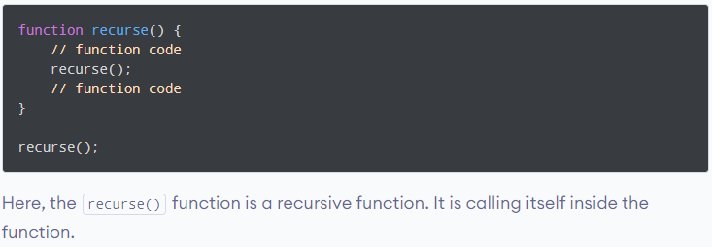
Recursion
What is Recursion ?

Slide 4
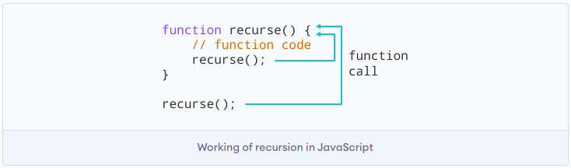

Slide 5
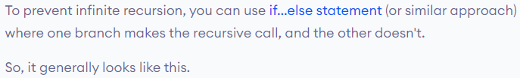
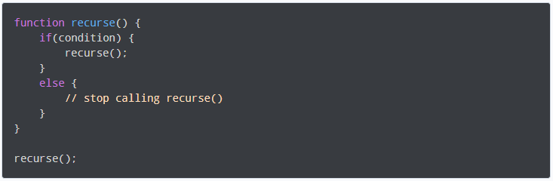

Slide 6

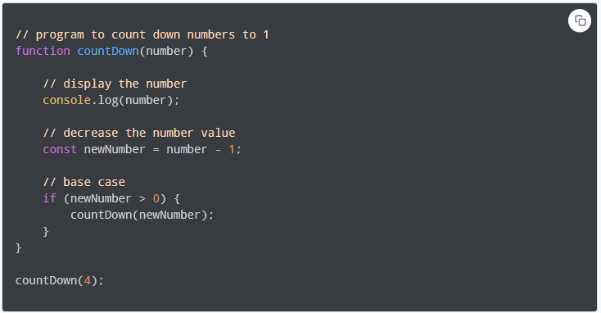

Slide 7
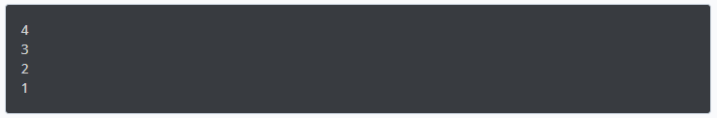

Slide 8
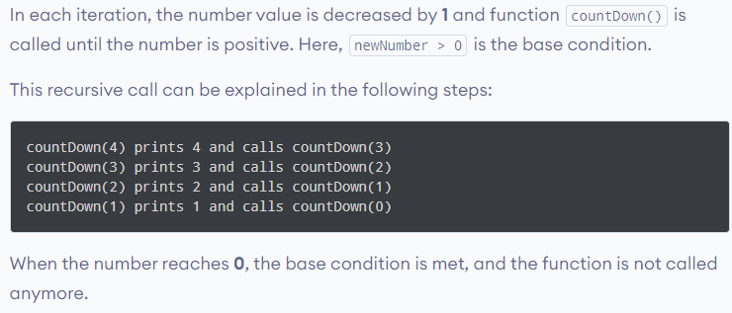

Slide 9

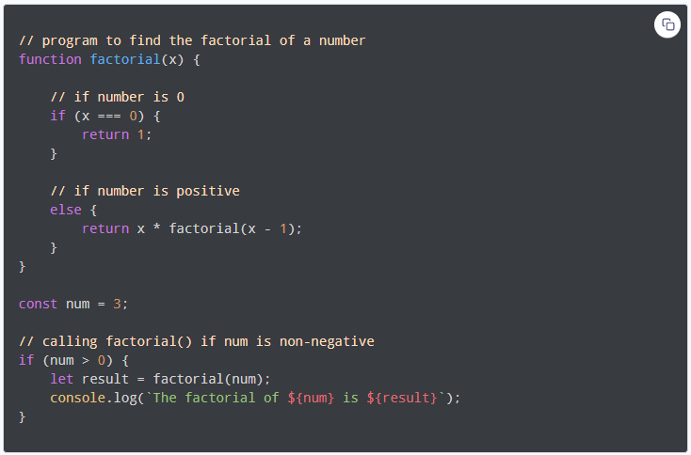

Slide 11
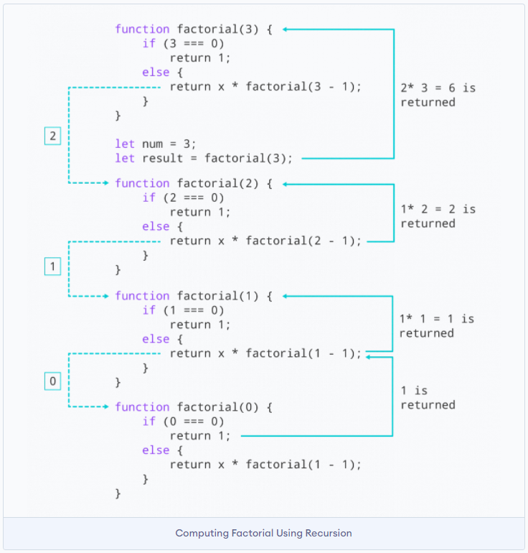

Slide 12
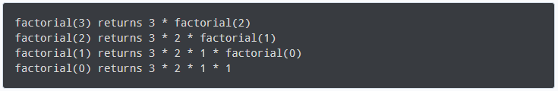
https://www.programiz.com/javascript/recursion

Slide 13
What have we learn today ?
Recursion in Javascript
Recursion is a process of calling itself
recursive function must have condition to stop calling itself
use if else or similar

Slide 14
Thank You

