Slide 1

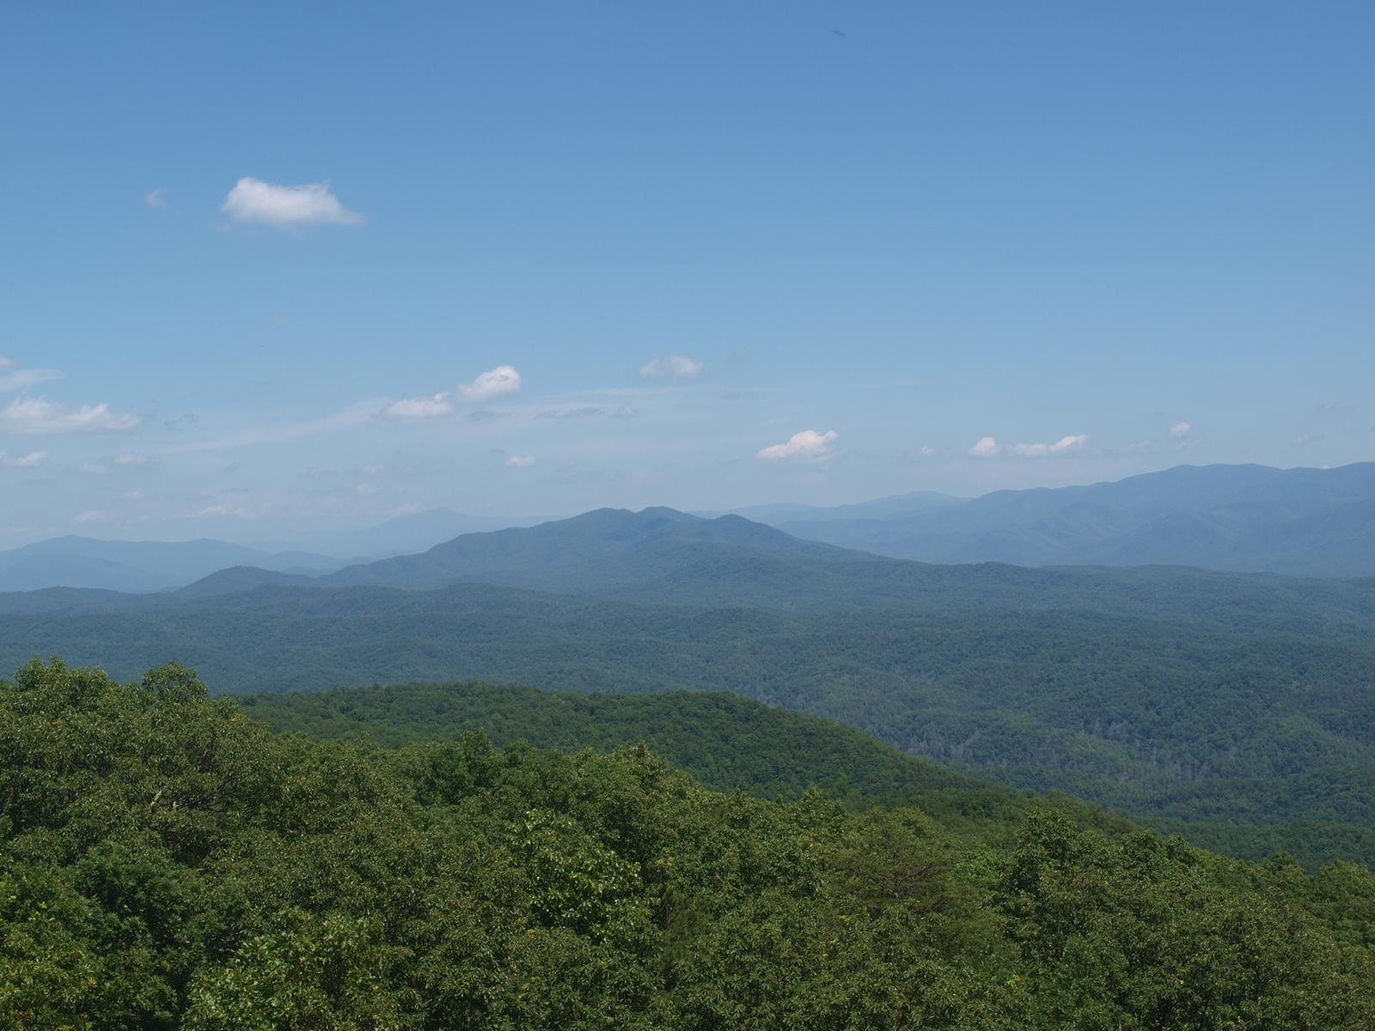
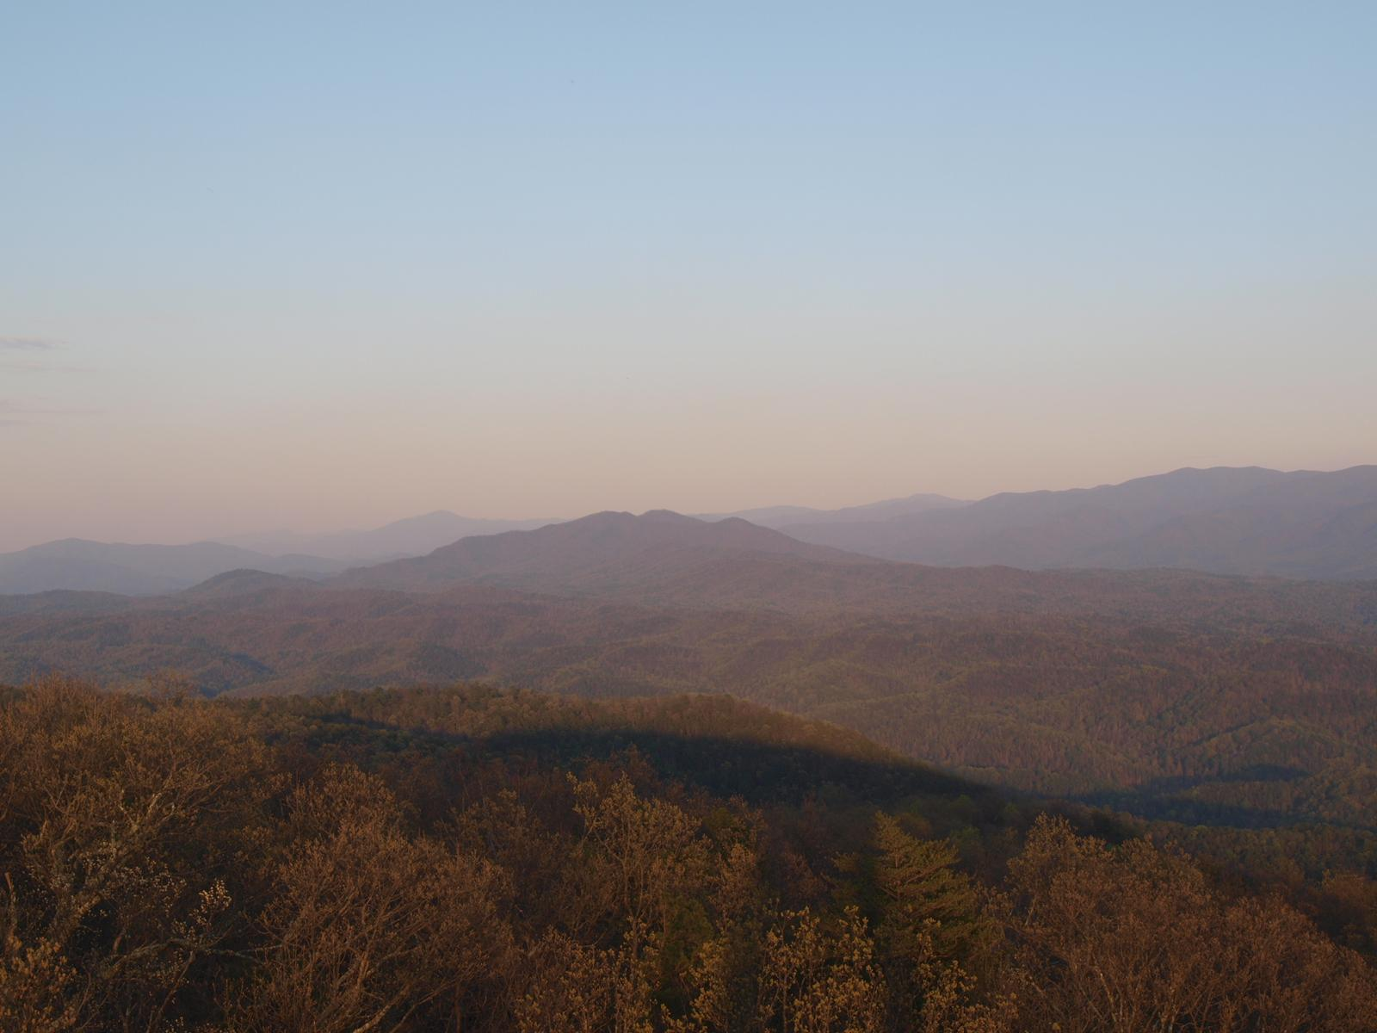
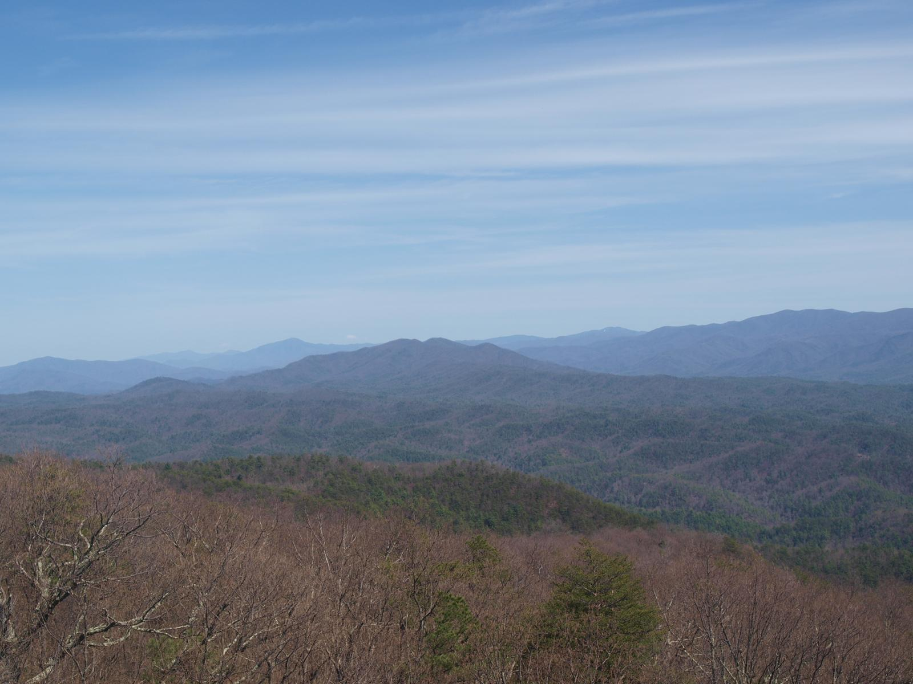
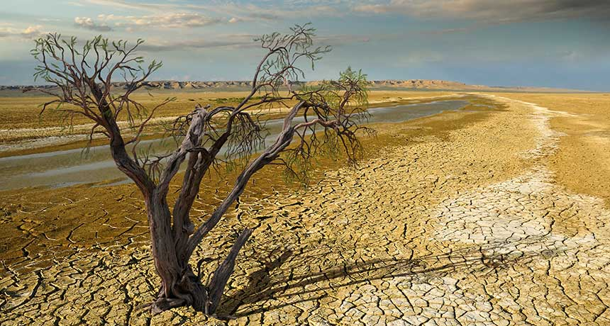
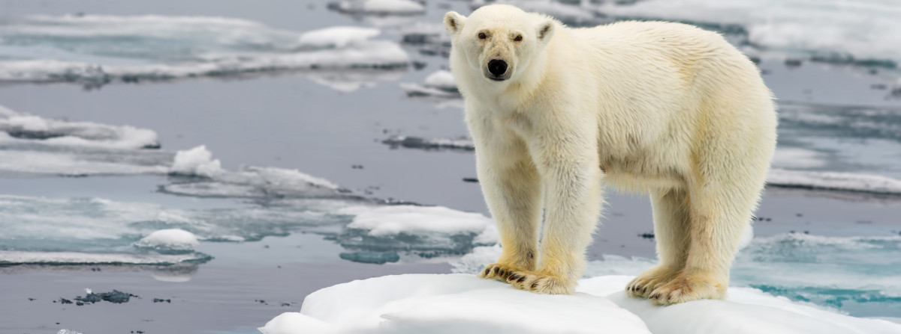

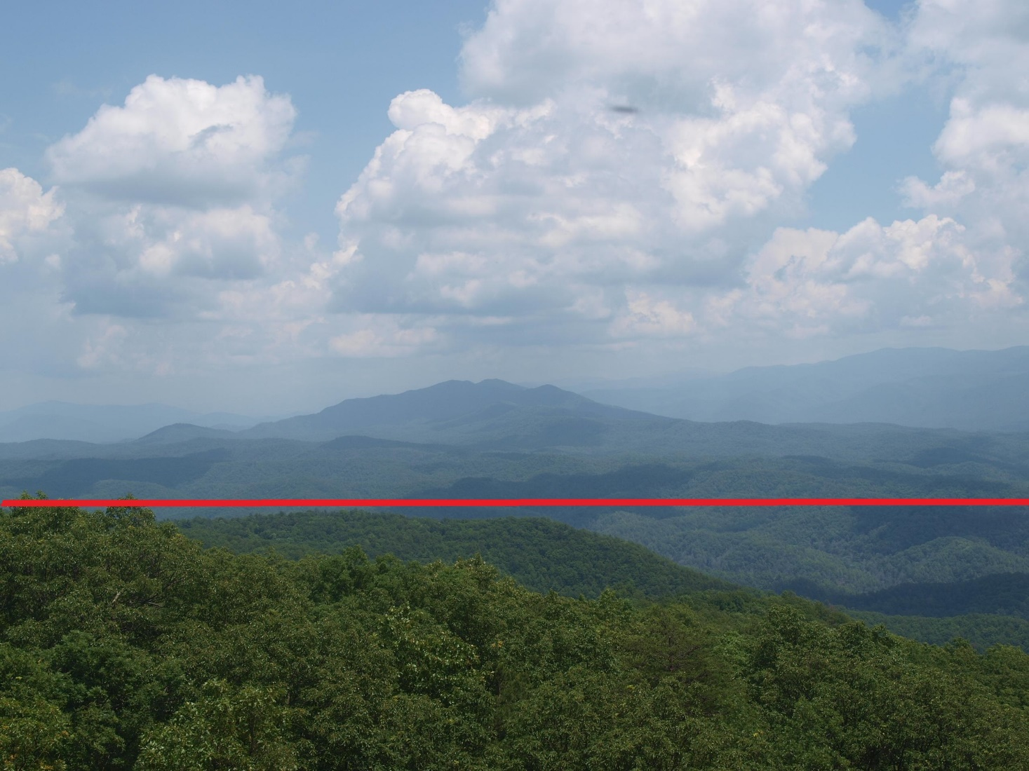
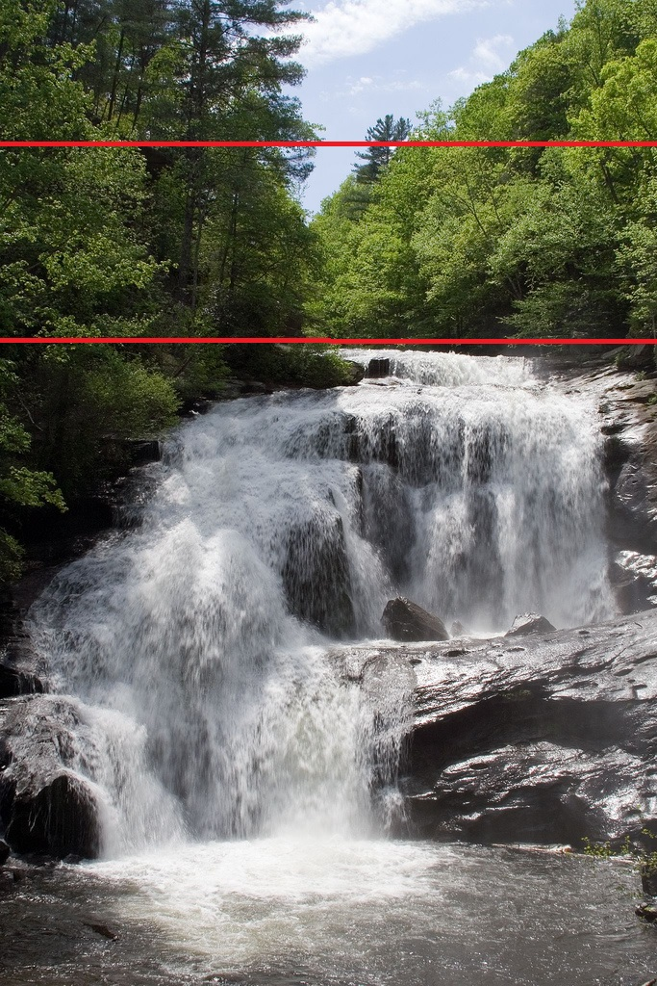

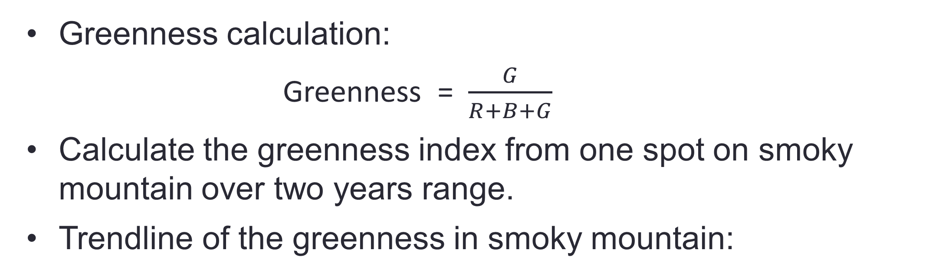
Global Phenology using Social Networks
Yung-Hsiang Lu, Michael A Jenkins, Global Phenology team
Purdue University, West Lafayette
Motivation
Analyze the trend from the data using python. (How plantation change in years. )
Filters added to the photo:
Human Face and Body Detection:
Based on OpenCV Haar Feature-based Cascade Classifiers
Good Running Result:
Waterfall detection:
Based on detection of sudden RGB color changing and dominate color of detected area
Good Running Result:
Climate change is influence the entire human race currently. It affect both our normal life and environment around.
Changes in phenology in response to climate change are occurring throughout the world. Monitoring these changes more efficiently is important.
Reported Bounding Box
Result 1
Result 2
Deep into details
Method of solving The problem
Identify the landmarks as the references of images posted on social networks like Facebook, Twitter, Flickr, etc. Retrieve and save images taken near the landmarks.
Annotate the images with context information (time, date, weather, etc.). Mark the regions in the images relevant to phenology.
Result 1
Result 2
Greenness calculation:
Greenness = $\frac{G}{R+B+G}$
Calculate the greenness index from one spot on smoky mountain over two years range.
Trendline of the greenness in smoky mountain:
long-term goals
Graph of trendline

