Slide 1
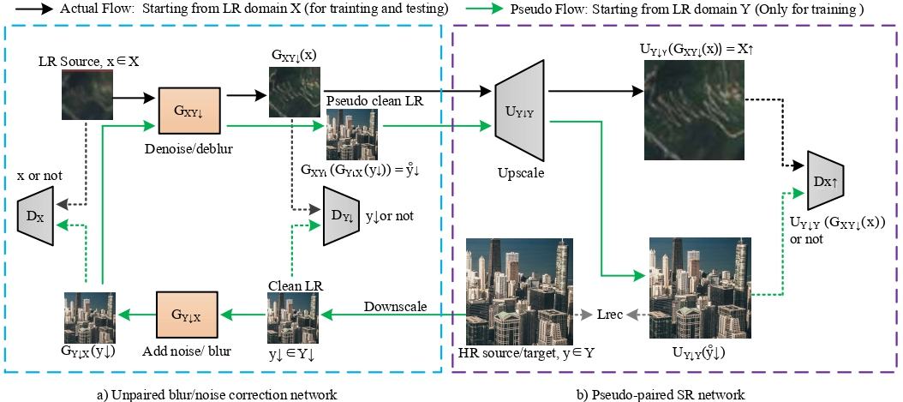
Trans-CycleGAN: (Unpaired Image Super-Resolution using Pseudo-Supervision)
The entire network consists of an unpaired kernel/noise correction network and a pseudo-paired SR network
Noise Correction network：CycleGAN -based unpaired LR ↔ clean LR translation.
The SR network is a paired clean LR → HR mapping

Slide 2
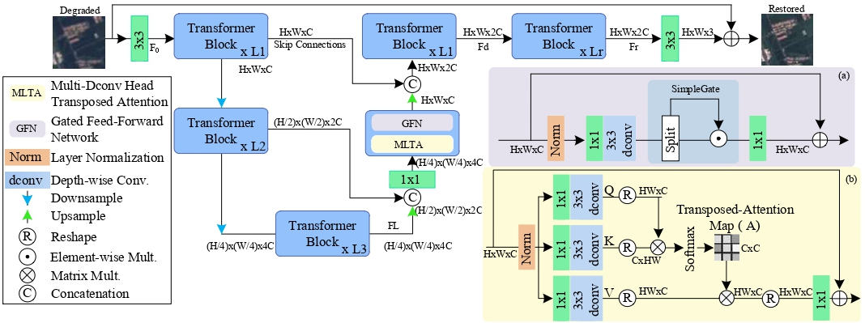
The generator architecture uses Transposed SA-based Transformer with multi-scale local-global representation learning
In conventinal SA, the complexity grows quadratically with the spatial resolution
Apply Transposed SA across channels rather than the spatial dimension, i.e., to compute cross-covariance across channels to generate an attention map encoding the global context implicitly.
in MDTA, we introduce depth-wise convolutions to emphasize on the local context before computing feature covariance to produce the global attention map.

