Slide 1

Enhance Start Command On Z
Min Zhai
April, 2018

Slide 2
Agenda
Presentation
Source Code
Introduce Mechanism
Further More - extension
This project is coded in HLASM, running on mainframe. Currently available on RS27.

Slide 3
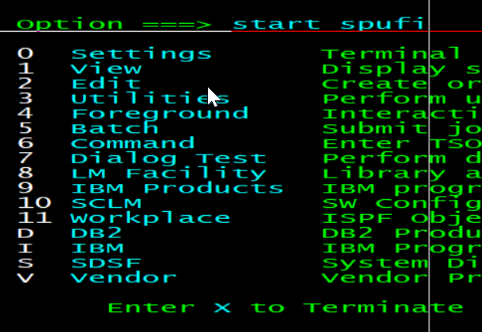
Presentation
Do ‘START SPUFI’

Slide 4
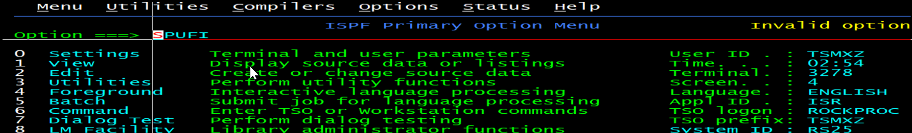
Presentation
Do ‘START SPUFI’ when no this project
You will get ‘Invalid option’ on RS25.
You can access to SPUFI by menu numbers D.3

Slide 5
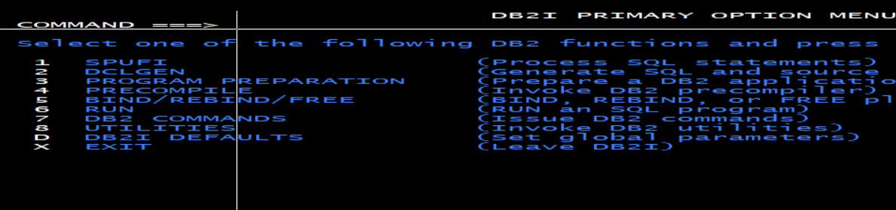
Presentation
Do ‘START SPUFI’ with this project installed
It works on RS27.

Slide 6
Source Code
It is in the library TSMXZ.BUILD.ASM.
BADGUY – Do the enhancement.
HOOKINST - Hook installer. Inject BADGUY to ISPSTRT – START processor.

Slide 7
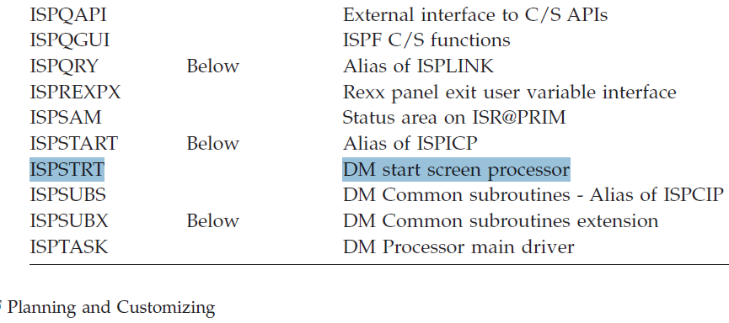
Mechanism

Slide 8
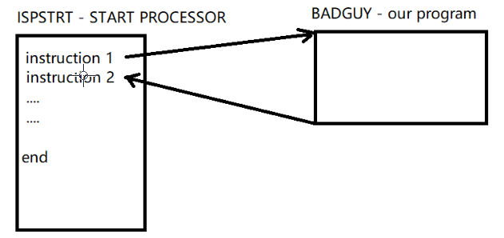
Mechanism
In one word, we hooked the START processor – ISPSTRT, force the control go to our program BADGUY.

Slide 9
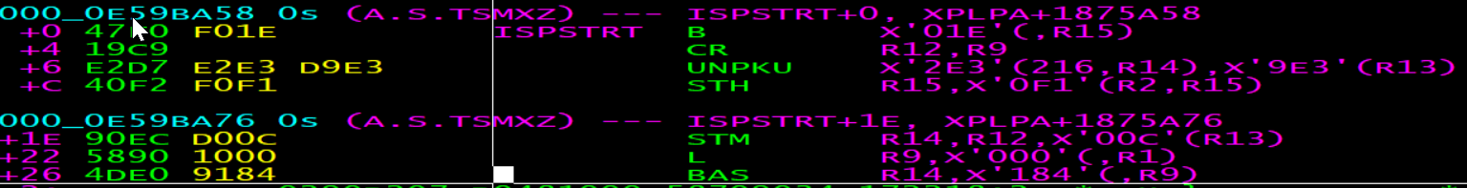
Mechanism
Hook the START processor – ISPSTRT.
Before hook VS after hook

Slide 10
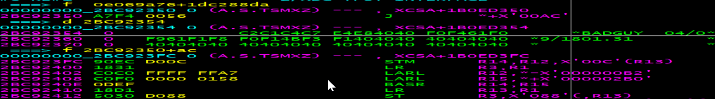
Mechanism
Hook the START processor – ISPSTRT.
JESYSMSG: log message

Slide 11
Mechanism
At the very beginning of the ISPSTRT, R1?+4 points to the parameters following the START command.

Slide 12
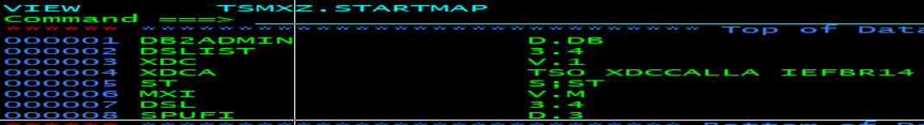
Mechanism
At last what we need to do is just to change the parameters following the START command according to the map specified in the customized configuration file – userid.STARTMAP. If current user doesn’t create this file, the default one TSMXZ.STARTMAP will be used.

Slide 13
Mechanism
Just a reminder:
Once BADGUY gets the control, we must first save the running environment, including GPRS and ARS, for caller(ISPSTRT).
Before going back to caller, restore all the saved
GPRS and ARS.

Slide 14
Further More
Question
Who calls ISPSTRT? And how the parameters pass to ISPSTRT?
Why not intercept the input parameters at the very beginning instead of in ISPSTRT? Can we catch all the input on ISPF? YES, WE CAN！I didn’t implement it, just know where to hook.

Slide 15
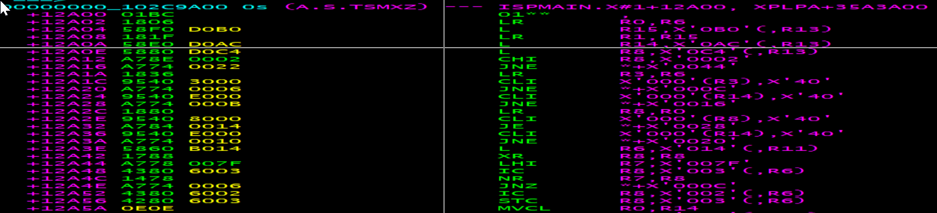
Further More
Copy parameters from ISPMAIN storage to other component’s.
All the input on ISPF option, such as ‘START D.3’/’TSO xxx’/’=3.4’, is in the storage R13?+AC points to. So now you know how it works, why not code something that bad guys should do?

Slide 16
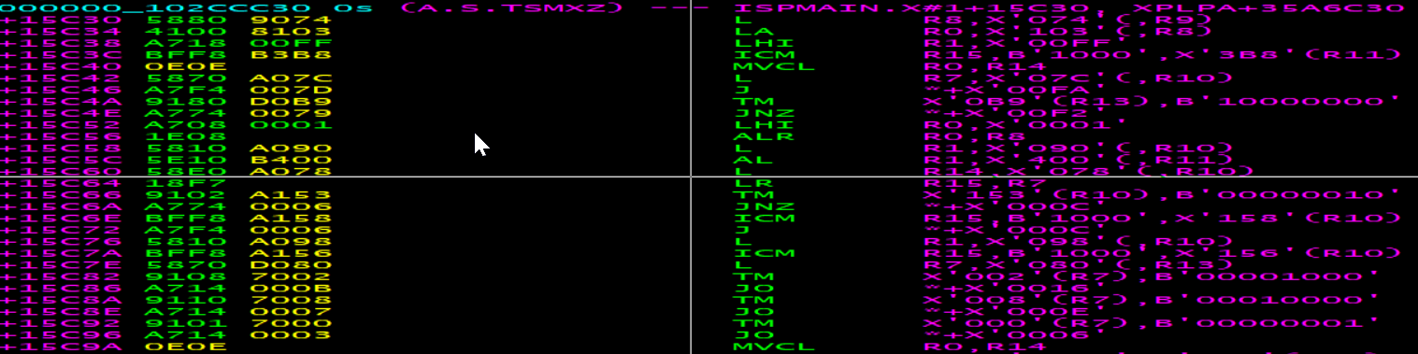
Further More
Another good place we can hook and intercept all the input on ISPF option.

Slide 17
Final Slide
* * * END * * *

