Slide 1
Artificial Intelligence Methods (AE2AIM/COMP2051)
Lec. 02: Combinatorial Problems & Heuristics
Dr. Xinan Chen (Room IAMET 308)
School of Computer Science
The University of Nottingham Ningbo, China
Email: xinan.chen@nottingham.edu.cn
Notes:
Good morning, students. How are you! This is week 3 of our lectures. The topic is combinatorial optimisation problems and simple ways to solve these problems using heuristics.

Slide 2
In this lecture
Combinatorial Problems
Heuristics
Hill climbing
Local Search
Notes:
This is the outline of the lecture. First, we’ll formally introduce the combinatorial optimisation problem. In the previous lecture, I have listed a few classic combinatorial optimisatin problem as examples. Many of them occur in our daily life. We also explained in the last lecture that, in the problem universe, a large proportion of them are very difficult to solve they belong to a class of problems that are believed to be NP-Hard. That means solving these problems optimally requires exponentially growing computational time with respect to the increase in problem size. In many cases, this is not realistic. However, since these problems impact on our daily life, we have to find the best way to solve them. In practice, instead of looking for the optimal solution, we search for the near optimal solution, or the suboptimal solution. For example, if I now want to go to Tianyi Square, without the consideration of the congestions and possible changes of traffic conditions, I should be able to compute a path that allows me to get there in the shortest possible time. However, when the traffic conditions are considered, it is actually very difficult to compute this shortest path. But that does not matter much because what we really care is to find a reasonable path quickly, so long as the travel time is still close to the shortest travel time. So the question is, given an NP-Hard optimsation problem, what are possible ways to obtain a near optimal solution? Very often, we rely on what we call heuristics to solve the problem, which is the 2nd topic of this lecture. So in the second part of this lecture, we are going to focus on two types of basic heuristic search paradigms for this type of problems. They are hill climbing and local search.

Slide 3
Combinatorial Optimisation Problems
使用数学建模和优化方法，在各种条件/约束下，寻找最优的分配、排序、分组、调度方式来处理离散事件的问题。
The problem of using mathematical modelling and optimisation method to find the optimal assignments, sequencing, grouping, scheduling of discrete events under various conditions/constraints. Example problems include:
Finding shortest/cheapest trips (TSP, VRP)
Planning, scheduling, timetabling
Internet data packet routing
Protein structure prediction
Cloud resource allocation
Other…
Mostly NP-Hard!!!
•寻找最短/最便宜路径（如旅行商问题 TSP，车辆路径问题 VRP）
•计划、排程、时间表安排
•网络数据包路由
•蛋白质结构预测
•云资源分配
•其他问题……
Notes:
So formally what is the combinatorial optimsiation problem? Like many other terms, there could be many definitions. This is one of the definitions for your reference. A combinatorial optimsation problem is a type of problem using mathematical modelling and optimsation method to find the optimal assigments, sequencing, grouping and scheduling of discrete events under various conditions/constraints. Let’s look at these key concepts and terms. First, COP is dealing with discrete events. This is in contrast with the continuous optimsation, mostly occurred in control theory. For example, the optimal control of an unmanned aerial vehicle in automation, or fluid dynamics in control theory. In fact, because nowadays, computer is increasingly used in automation and engineering, and from computer systems architecture, we know that computers we use now discrete state machines, right? All data and instructions are represented in 0 and 1s. So in this sense, you can say as soon as you want to use computers and AI to solve any of these optimisation problems, they can be transformed into a discrete event optimisation problems.
Ok, that’s about discrete events. Now, our goal is look for the optimal handling of these events, that means in different problem scenarios, we may either look for the optimal assignments of these events. For example, the whole world is fighting against this terrible virus, there is an optimisation problem of making assignment or allocation of limited medical resources, most of them are discrete resources, for example the number of doctors, nurses. You assign a doctor either to hospital A, or hospital B but you cannot split him or her into fractional parts, say I assign 0.7 of this doctor to hospital A, and 0.3 to hospital B. So you can say medial personnel assignment is a combinatorial optimisation problem. The next type of problems is the sequencing of the discrete events. This are lots of problems. I give you a quick example. Many of you take flights nowadays for travel. At every simple airport, they have many flights each day departing from a single runway. That means you cannot take off or land two flights simultaneously. So flight sequencing in airports is a combinatorial optimsation problem. You goal is to maximize the throughput of the airport. You want to maximise the number of flights that you can handle each day and minimize the waiting time for each flight. The other types of combinatorial optimsation problems including the optimal grouping of the discrete events and scheduling the discrete events. There are lots of examples for this type of problems. For example, vehicle routing problem, university timetabling problem, internet data packet routing among the network, DNA structure folding, cloud computing allocation, and others.
I would emphasize that most combinatorial optimisation problems have various contraints and conditions to be satisfied. Any optimal solution that you look for should take into account these constraints. Otherwise, these solutions are not useable in practice. This looks very obvious but in reality, you see so many research works that either ignore important constraints to simplified them.
Lastly most of combinatorial optimsation problems are NP-Hard. As you learnt from last lecture, NP-Hard problems are theoretically the most difficult set of problems among all the probems. There is no efficient algorithms to solve them to optimality.

Slide 4
Combinatorial Problems – examples
给定多个容量相同的箱子（容量为 V），以及一个由不同大小物品（a_1, …, a_n）组成的物品集合（数量为 n），目标是将所有物品打包进尽可能少数量的箱子中，并且保证每个箱子的容量不被超过。
Bin packing problem
Given bins with the same capacity/size (V) and a set of items (n) with various sizes (a₁,..,a_{n}), pack all items into minimum number of bins such that the capacity of each bin is not exceeded.
Possible applications:
Cloud service allocation, packing
Travelling Salesman Problem (TS)
Given a set of n cities (nodes), determine a path that visits all cities exactly once and return back to depot.
1
D
5
4
2
3
给定一组 n 个城市（节点），目标是找到一条路径，该路径从某个起点出发，恰好访问每个城市一次，最终返回到出发点（Depot）。
Notes:
In the next following slides, I am going to give you a few examples of classic combinatorial optimisation problems. Each of these problems have been extensively studied in the research community, with hundreds of academics paper available. These problems are classic abstraction of many real-life problems. The first problem is bin packing. The definition is very simple – you are given a number of bins with same capacity of V and a set of n items with size of a_i. The problem is to pack all items in the minimum number of bins such that the capacity of each bin is greater or equal to the total size of items packed in that bin. So here we are dealing with discrete events, which are items of different sizes. You cannot split any item into parts and pack them into different bins. The task is to look for the best grouping of these items. So this problem has application in cloud computing, packing in transportation systems.
The second problem is TSP. We have described problem previously. The task is to find a tour of all cities with minimum distance. In this case, you are asked to search for the best permutation of all cities.

Slide 5
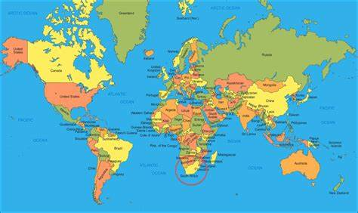
Combinatorial Problems – examples
Graph coloring problem
An assignment of labels traditionally called "colours" to elements of a graph subject to certain constraints.
A way of colouring the vertices of a graph such that no two adjacent vertices share the same colour; this is called a vertex colouring.
Applications:
Shared resource allocations
1
2
6
3
5
4
一种对图中顶点进行着色的方法，使得任意两个相邻的顶点不能使用相同的颜色；这种着色方式称为顶点着色。
Notes:
Graph coloring is a classic combinatorial optimization problem. The problem is to assign labels, or traditionally called colors to elements of a graph subject to certain constraints. By elements of graph, I mean nodes and edges. The fundamental constraint here is that no two adjacent elements share the same color. So in this graph example on the right, if there is an arc between two nodes, we say these two nodes are adjacent to each other, therefore, they cannot share a same color. For example, node 1 is adjacent to node 2, 3 and 6, it cannot share same color with any of them but it can share a same color with node 5. Same condition applies to all other nodes.
So in this problem, nodes are discrete events and each requires a single color or label. The objective is to color all nodes with minimum number of colors. You may wonder why this problem is important. It turns out that this is a fundamental abstraction of many shared resource allocation problems. For example, in the old days, you may have a world map at your home. So there are about 200 countries in the world and you don’t want to assign 200 colors because the differences between colors will be too small. So you want to minimize the number of colors used in this world map. However, at the same time, you want to make sure no adjacent countries have a same color. So China cannot share a color with Indian, Pakistan, or Vietnam.
Another example is the course timetabling, which I will describe in the next slide.

Slide 6
Combinatorial Problems – examples
● 可能的约束条件：
•两个会议/课程不能同时安排在同一个教室。
•一个课程/会议不能同时出现在不同的教室中。
Classroom Assignment Problem
Possible constraints:
Two meetings/classes may not be arranged simultaneously in the same room.
A given class/meeting cannot take place in two different rooms.
Possible objectives:
Find a schedule based on the number of rooms available.
Find a schedule of all meetings/classes that requires the fewest numbers of rooms.
● 可能的目标：
•在给定的教室数量基础上，安排一个合理的课程时间表。
•制定一个最少使用教室数量的完整课程/会议安排计划。
Notes:
Now let’s have a look at the timetabling, or classroom assignment problem. This problem occurs in all universities, schools and hospitals and big organizations.
For example, in a university course timetabling, you have a set of classes which are discrete events and cannot be split. Each of classes is then associated with students and lectures and will require a given time slot and room as resources. Your task is to find an assignment of these classes to time slots and rooms with satisfactory conditions or constraints. For example, as a AIM lecture, I cannot teach another class at the same time when I am teaching AIM, of course I mean the face to fact teaching, not recorded lectures. Also, AIM has around 100 students, you cannot put them all in one session in PMB 306 because it does not have enough seats.
In terms of objectives, you may want to maximize some preferences for lecturers and students. I don’t like 4pm lecture and Amin doesn’t like 9am lecture. Students prefer not to have any teaching on Friday evenings, etc. As you can see, your objective function and constraints can be quite diverse and very difficult to compute.

Slide 7
Combinatorial Problems – examples
Aircraft Scheduling
Train Scheduling
Can you identify discrete events, constraints and objectives for these problems?
离散事件（Discrete Events）：每个航班/列车的出发与到达时间、站点或机场的使用、乘客上下车等。
•约束条件（Constraints）：相同时间段内，一个跑道/轨道不能同时服务两架飞机/列车； 每列火车或飞机的维护时；检查窗口；乘客连接时间的最小要求；人力和资源可用性。
•优化目标（Objectives）：最小化延误；最大化资源利用（如轨道或登机口）；提高准点率；最小化运营成本。
Notes:
Aircraft scheduling is another example. In this problem, typically you are asked to make the best daily schedule for an airline who may have hundreds of aircrafts and provides thousands of flights everyday. So the flights are the discrete events. The task is to decide for each flight the best departure time, pilots, and crew members. There are constraints – for example, an aircraft cannot be deployed to fly two flights simultaneously. Same applies to pilot, and crew members. There are constraints related to working hours by pilots and crew members. There will be restrictions at airports too.
Similarly train scheduling is another example. I am not going to introduce in detail I’ll leave this as a homework for you to identity what the discrete events are in the problem, what are the resources to be assigned, what are the possible constraints, the objectives to optimize.

Slide 8
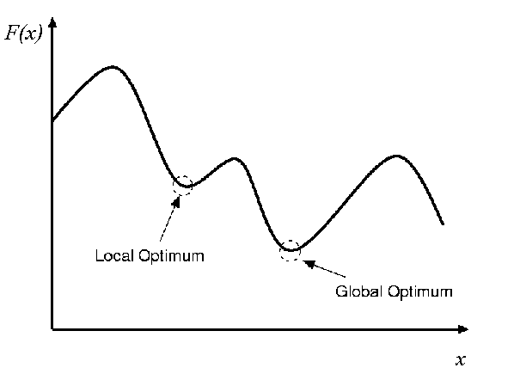
Global Optimisation
Global Optimum: better than all other solutions (best)
Local Optimum: better than all solutions in a certain neighbourhood
•全局最优解（Global Optimum）：优于所有其他解的解，表示最好的解决方案。
•局部最优解（Local Optimum）：在某个邻域范围内优于其他所有解，但可能不是全局最优。
图像形象说明了算法可能陷入局部最优，而无法达到全局最优的问题。
Notes:
So now you have a much better understanding of the combinatorial optimsation problem. Many of these problems are fundamentally important for the advancement of AI when we try to build more intelligent air traffic system, more intelligent railway system, smarter city, smart education, and so on.
Generally speaking, we aim to find the global optimal solution for each problem. By that, we aim to find the best possible solution among all possible solutions. As we said earlier, many of these problems are NP-Hard unfortunately, and finding the global best solution is not computationally possible. When the computational time is limited and it is not possible to evaluate solutions in the entire search space, we should consider what we called a local optimum. A local optimal solution is the best solution among a local region or neighbourhood but is not necessarily the the global best in the entire solution space. If a local optimum solution is only marginally worse than the global best and it takes much less time to obtain, this solution could be a very suitable solution in practice.

Slide 9
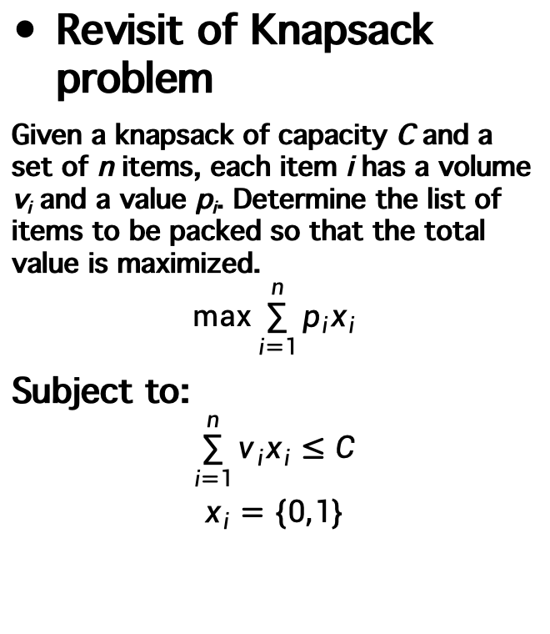
Heuristics for Knapsack Problem
Revisit of Knapsack problem
Given a knapsack of capacity C and a set of n items, each item i has a volume v_{i} and a value p_{i}. Determine the list of items to be packed so that the total value is maximized.
$$\max{\sum_{i=1}^{n}{p_{i}x_{i}}}$$
Subject to:
$$\sum_{i=1}^{n}{v_{i}x_{i}}≤C$$
$$x_{i}=\{0,1\}$$
How to solve this problem?
Global optimal
Local (near) optimal
Notes:
Now let revisit a previously mentioned combinatorial optimisation problem. So the problem is to select a subset of items from a total of n items so that the value is maximized at the same time the capacity of the knapsack is not exceeded. Mathematically, the integer programing formulation can be written as follows: First variables, then obj, and then constraints.
Are we able to solve the problem optimally? Yes by dynamic programming but with exponential growing computational time. If the limited time is permitted, search for the local optimal solution instead by using heuristics which we talk about next slide.

Slide 10
Heuristics
启发式方法是一种来源于人类直觉的经验法则。
A heuristic is a rule of thumb method derived from human intuition.
A heuristic is a search method which seeks good, i.e. near-optimal solutions, at a reasonable cost without being able to guarantee optimality.
Good for solving ill-structured problems, or complex well-structured problems (large-scale combinatorial problems that have many candidate solutions to explore)
•启发式是一种搜索方法，目的是以合理的代价寻找“较好”（即近似最优）的解，但无法保证是最优解。
•启发式方法适合用于解决结构不清晰的问题，或结构复杂但定义明确的问题（比如：大规模组合优化问题，其候选解空间非常庞大）。
Notes:
So what is heuristic? A heuristic is a rule of thumb. Every of us uses heuristics every day except we don’t call it explicitly.
It is a search method that seeks good quality or near-optimal soutions at a resonable cost with out being able to guarantee optimality.

Slide 11
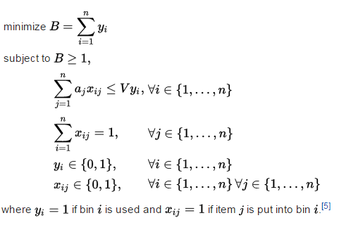
Global Optimisation – Bin Packing
Bin packing problem Given a set of n items, each item j has a size of a_{j}. Pack all items in the minimum number of identical sized bins without violating the capacity of bins (V).
Integer Linear Model - NP-Hard Problem
How do we solve them?
B&B, B&P, DP, etc.
Heuristics
First fit
Best fit
Best pack
Notes:
Simplex algorithm in lecture 2. In lab 2, you will be asked to

Slide 12
Global Optimisation – Bin Packing
•First Fit 算法将每个物品放入第一个能够容纳它的箱子中。
•如果没有任何已有的箱子有足够的空间，则开启一个新箱子。
First Fit
The First Fit algorithm places each item into the first bin that can accommodate it. If no existing bin has sufficient space, open a new bin.
Best Fit
The Best Fit algorithm places each item into the bin with the least remaining space after the item is added but still has enough room to accommodate the item. If no bin can fit the item, open a new bin.
•Best Fit 算法将每个物品放入剩余空间最少但仍能容纳该物品的箱子中。
•如果没有任何已有的箱子能容纳该物品，则开启一个新箱子。
Notes:
Simplex algorithm in lecture 2. In lab 2, you will be asked to

Slide 13


Bin Packing Heuristics – First Fit
Item size: a=[5, 6, 7, 3, 4, 5], Bin capacity:10
$\sum_{j=1}^{n}{a_{j}=}$30
First fit
7
5
6
5
4
3
10
8
6
4
2
0

Slide 14

Bin Packing Heuristics – Best Fit
Item size: a=[5, 6, 7, 3, 4, 5], Bin capacity:10
$\sum_{j=1}^{n}{a_{j}=}$30
Best Fit
7
5
6
5
4
3
10
8
6
4
2
0

Slide 15
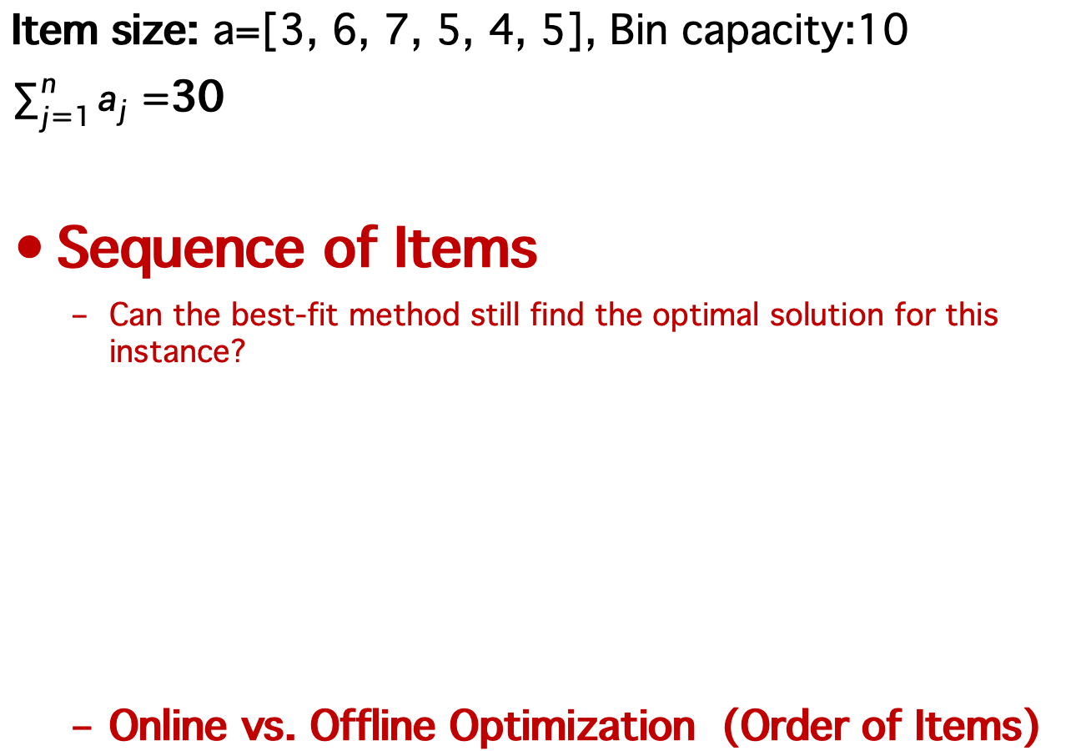
Bin Packing Heuristics – FFD
Item size: a=[3, 6, 7, 5, 4, 5], Bin capacity:10
$\sum_{j=1}^{n}{a_{j}=}$30
Sequence of Items
Can the best-fit method still find the optimal solution for this instance?
Online vs. Offline Optimization (Order of Items)
7
首次适应法（FFD）：
FFD 是将物品按降序排列后，使用首次适应法来进行背包的分配。首先对物品按大小进行排序（从大到小），然后使用首次适应法将它们依次放入背包。
排序后的物品顺序为：7, 6, 5, 5, 4, 3。
6
5
5
4
3
10
8
6
4
2
0

Slide 16
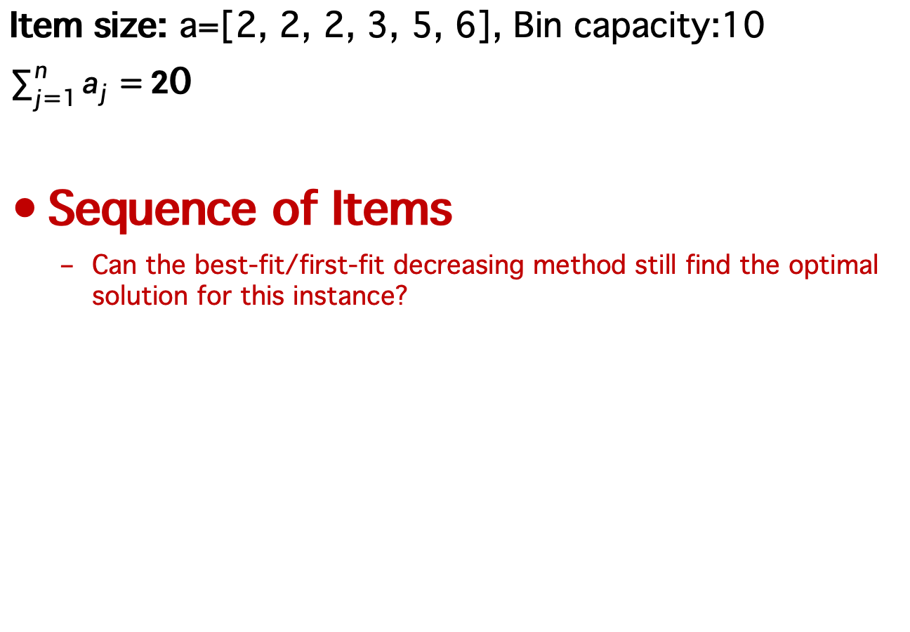
Bin Packing Heuristics – Offline Search
Item size: a=[2, 2, 2, 3, 5, 6], Bin capacity:10
$\sum_{j=1}^{n}{a_{j}=}2$0
Sequence of Items
Can the best-fit/first-fit decreasing method still find the optimal solution for this instance?
5
6
离线搜索（Offline Search）：
在离线搜索方法中，已知所有物品的大小，因此我们可以对物品进行排序，通常是按照从大到小的顺序来排序物品，从而减少背包空间的浪费
3
2
2
2
10
8
6
4
2
0

Slide 17
Online vs. Offline Optimization
离线优化适用于已知全部数据的场景，能够提供更准确和优化的解决方案。
在线优化适用于信息不断更新且决策必须实时做出的场景，解决方案通常不如离线优化精准，但能够动态适应新情况。
Offline Optimization
Definition: Offline optimization involves processing an entire dataset or problem instance at once, with full knowledge of the data beforehand.
Access to all data upfront.
Allows for comprehensive
analysis and planning.
Solutions are generally more optimal.
Online Optimization
Definition: Online optimization deals with data or problems incrementally as they become available, without prior knowledge of future events.
Decisions must be made with partial data.
Adapts to new information dynamically.
Often uses heuristics for real-time decision-making.
在线优化是针对数据或问题在逐步到达时进行处理，不能预知未来信息。
离线优化是在事先已知所有数据的情况下，对整个数据集或问题实例一次性进行处理。
•可提前访问全部数据
•支持全面的分析与规划
•通常能提供更优的解决方案
•决策必须基于部分数据
•能够动态适应新信息
•通常依赖启发式方法进行实时决策

Slide 18
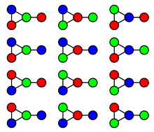
Graph Coloring
k-colouring: Can the vertices of a graph be coloured using k colours so that no two vertices connected by an edge have the same colour?
Chromatic number of a graph: minimum number of colours necessary to colour the vertices of a graph, so that no two vertices connected by an edge have the same colour.
Minimum colouring problem is an NP-hard problem
This graph can be 3-colored in 12 different ways.
指的是将图的所有顶点着色所需的最少颜色数，同时保证相邻顶点颜色不同。

Slide 19
Graph Coloring Heuristics
Saturation Degree
Degree of a vertex: number of edges connected to that vertex.
Saturation degree of a vertex: number of differently colours to which it is adjacent.
Can we use saturation degree in a heuristic to construct a solution to a graph colouring problem?
饱和度
1
2
一个顶点连接的边的数量。
Example:
4
6
3
5
4
与该顶点相邻的顶点中，使用了多少种不同的颜色
1
2
Example:
例子中，顶点 3 的邻接点颜色有两种（蓝、黄），所以饱和度是 2。
6
3
2
5
4

Slide 20
Graph Coloring Heuristics
color1
color2
color3
color4
Max Saturation Degree First
Step 1. Arrange the vertices in decreasing order of their degree.
Step 2. Colour a vertex of maximal degree with colour #1.
Step 3. Choose an uncoloured vertex with maximal saturation degree.
If there is a tie choose any one of the vertices with maximal degree in the uncoloured subgraph
Step 4. Colour the selected vertex using the colour with the lowest possible number (#)
Step 5. If all vertex are coloured then STOP
else go to step 3.
1
2
6
3
5
4

Slide 21
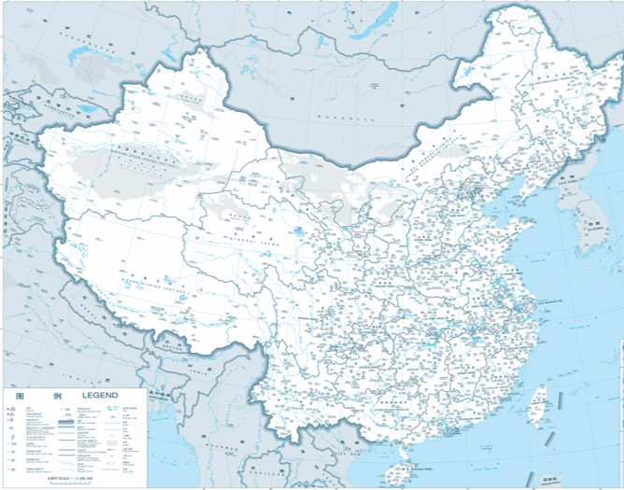
Need for Search Methodologies (e.g. Heuristics, Metaheuristics) – Example
Travelling salesman problem
N=4, 24
N=5, 120
N=7, 5 040
N=10, 3 628 800
N=81, 5.797 x 10¹²⁰
Number of configurations to search from is N!
Number of particles in the universe is in between 10⁷² – 10⁸⁷
Tianhe-2: 30.65 petaflops (one thousand million (10¹⁵) floating-point operations per second) – ~6 x 10⁹⁶ years
阶乘计算：N！
对于大规模组合问题，穷举搜索（brute force）是不可行的，因此我们必须借助：
•启发式方法（Heuristics）
•元启发式算法（Metaheuristics）
如：模拟退火、遗传算法、蚁群算法、粒子群等

Slide 22
Examples – Heuristics for TSP
The nearest neighbour (NN) algorithm
Constructive (Deterministic and Systematic)
Pairwise exchange (2-opt), or Lin–Kernighan heuristics
Perturbative (Stochastic and Local Search)
Notes:
The pairwise exchange or '2-opt' technique involves iteratively removing two edges and replacing these with two different edges that reconnect the fragments created by edge removal into a new and shorter tour. This is a special case of the k-opt method. Note that the label 'Lin–Kernighan' is an often heard misnomer for 2-opt. Lin–Kernighan is actually a more general method.

Slide 23
The nearest neighbour (NN) algorithm
city2
4
city1
10
11
5
6
city4
city3
7

Slide 24
The nearest neighbour (NN) algorithm
<city2>
Select a starting city
city2
city1
city4
city3

Slide 25
The nearest neighbour (NN) algorithm
<city2, >
choose the nearest unvisited city as the next move
city2
4
city1
10
6
city4
city3

Slide 26
The nearest neighbour (NN) algorithm
<city2, city1, >
choose the nearest unvisited city as the next move
city2
4
city1
11
5
city4
city3

Slide 27
The nearest neighbour (NN) algorithm
<city2, city1, city4, >
choose the nearest unvisited city as the next move
city2
4
city1
5
city4
city3
7

Slide 28
The nearest neighbour (NN) algorithm
<city2, city1, city4, city3> : 26
After the choice of the last city, algorithm terminates
city2
4
city1
10
5
city4
city3
7

Slide 29
How about this instance?
How about this instance with 5 cities?
With NN heuristic, starting from c2, what’s the result?
You would get
<c2,c1,c4,c5,c3,c2>
with total distance of 33.
Can we do better?
c2
c1
4
8
5
10
11
6
6
c3
7
c4
4
10
c5

Slide 30
Improving upon simple heuristics
<c2,c1,c4,c5,c3,c2> : 33
Remove two edges and replace them with two different edges, reconnecting the fragments into a new and shorter tour.
city2
4
city1
10
<c2,c1,c5,c4,c3,c2> : 31
5
6
7
city4
city3
4
10
city5
How many possible pairwise exchanges are there in total? 对于 n 个城市，大约有 n(n-3)/2 个有效2-opt交换。
How can each neighbouring solution be evaluated efficiently? 只需重新计算受交换影响的那一部分路径（O(1)更新），而不是整条路径！

Slide 31
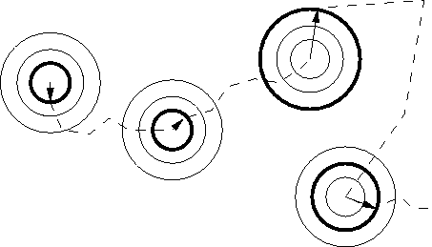
Local Search Methods
局部搜索（Local search） 是一种迭代式方法，通过在解空间中只评估当前解附近的解（即相似解），不断改进当前解。
Local search is an iterative procedure to continuously improve the current solution by evaluating only solutions that are close (similar) to the current solutions.
One or more neighbourhoods are defined, each of which is a subset of the entire solution space.
Common strategies
First descent/ascent
Best descent/ascent
Solution Space
定义一个或多个邻域（neighbourhoods）：
每个邻域是整个解空间的一个子集，表示“当前解的微小变体”。 • 局部搜索只在当前解的邻域中寻找更优解。
•首次下降/上升法（First descent/ascent）：一旦找到一个更优解就立即接受。
•最佳下降/上升法（Best descent/ascent）：考察所有邻域解，选择其中最优的一个

Slide 32
Main Components of Local Search Optimisation Methods
Encoding
Representation (encoding) of candidate solutions
Solution Initialisation (random, heuristics)
Neighbourhood definition (move operators)
Search neighbourhood (random, first descent, best descent, etc.)
Objective (fitness) evaluation
Stopping Criteria
Initialisation
Neighbourhood Definition
Neighbourhood Search
Fitness Evaluation
Stopping Criteria

Slide 33
Local Search: Solution Encoding
Encoding
Binary encoding is the most common
101100101100101011100101
E.g.: Knapsack problem
Integer representation
3 4 5 5 5 4 1 1 2 2 1
E.g.: Assignment problem, personnel rostering problem, timetabling problem
Permutation encoding can be used in ordering problems
1 5 3 2 6 4 7 9 8
E.g.: Travelling salesman problem, sequencing problems
Initialisation
Neighbourhood Definition
Neighbourhood Search
Fitness Evaluation
Stopping Criteria

Slide 34
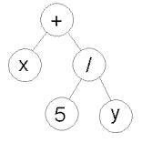
Local Search: Solution Encoding (cont.)
Encoding
Value Encoding
1.2324 5.3243 0.4556 2.3293 2.4545
ABDJEIFJDHDIERJFDLDFLFEGT
<(back), (back), (right), (forward), (left)>
E.g.: Parameter/continuous optimization, DNA sequencing, planning
Nonlinear Encoding
Tree Encoding – Genetic Programming
E.g.: Computers generating heuristics or heuristic components
Initialisation
Neighbourhood Definition
Neighbourhood Search
Fitness Evaluation
( + x ( / 5 y ) )
Stopping Criteria

Slide 35
Local Search: Intialisation
Encoding
c2
Generate an initial solution
Random initialisation
Greedy heuristic
E.g nearest neighbour
Assuming start from c1, with NN heuristic, we generate the following solution
<c1, c2, c4, c5, c3, c1>
with the overall distance of 35, which is not optimal.
4
c1
8
Initialisation
10
5
11
6
Neighbourhood Definition
6
c3
7
c4
4
10
Neighbourhood Search
c5
Fitness Evaluation
Stopping Criteria

Slide 36
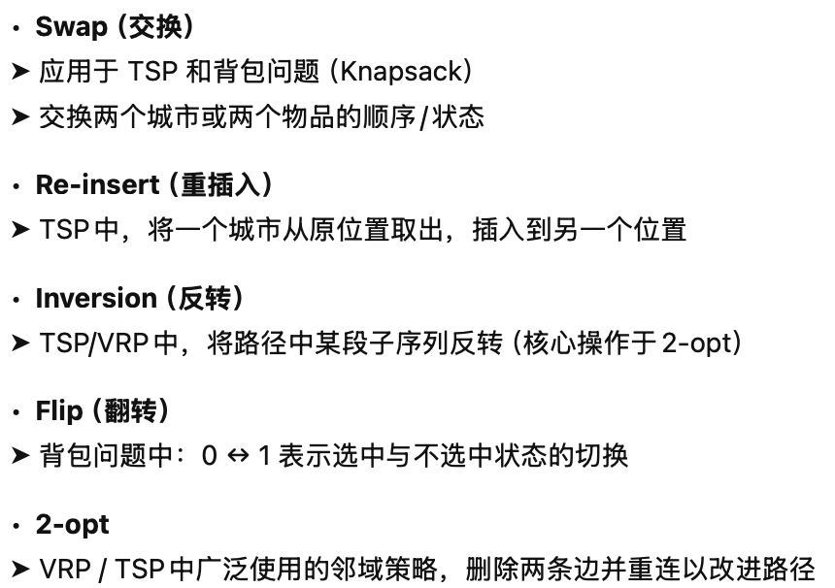
Local Search: Neighbourhood
Encoding
A neighbourhood of a solution s is a set of solutions that can be reached from s by a simple operator (move operator/heuristic)
Swap (TSP, knapsack)
re-insert (TS)
Inversion (TSP, VRP)
flip (knapsack)
2-opt (VRP)
Initialisation
Neighbourhood Definition
c2
4
Neighbourhood Search
c1
8
5
10
11
Fitness Evaluation
6
6
c3
7
c4
Stopping Criteria
4
10
c5

Slide 37
Local Search: Neighbourhood Search
Encoding
Neighbourhood search strategies
Best descent
First descent
Random sampling
Assuming current solution is
<c1, c2, c4, c5, c3, c1>
How to search using the pair swap neighbourhood with first descent strategy?
c2
4
Initialisation
c1
8
5
10
11
Neighbourhood Definition
6
6
c3
7
Neighbourhood Search
c4
4
10
c5
Fitness Evaluation
Stopping Criteria

Slide 38
Local Search: Neighbourhood Search
Encoding
Best descent (or hill climbing)
<c1, c2, c4, c5, c3>, obj: 35
The set of neigbouring solutions are:
<c2, c1, c4, c5, c3>, obj: 33
<c4, c2, c1, c5, c3>, obj: 33
<c5, c2, c4, c1, c3>, obj: 40
<c3, c2, c4, c5, c1>, obj: 37
<c1, c4, c2, c5, c3>, obj: 40
<c1, c5, c4, c2, c3>, obj: 37
<c1, c3, c4, c5, c2>, obj: 34
<c1, c2, c5, c4, c3>, obj: 34
<c1, c2, c3, c5, c4>, obj: 33
<c1, c2, c4, c3, c5>, obj: 33
Say <c4,c2,c1,c5,c3> is chosen as current solution: repeat the above process。
c2
c1
4
Initialisation
8
5
10
11
Neighbourhood Definition
6
6
c3
7
Neighbourhood Search
c4
4
10
c5
Fitness Evaluation
<c2, c4, c1, c5, c3>, obj=37
<c1, c2, c4, c5, c3>, obj=35
<c5, c2, c1, c4, c3>, obj=34
<c3, c2, c1, c5, c4>, obj=31
<c4, c1, c2, c5, c3>, obj=35
…. ….
<c4, c2, c1, c3, c5>, obj=35
Stopping Criteria

Slide 39
Local Search: Neighbourhood Search
Encoding
First descent
Step 1: <c1, c2, c4, c5, c3>, obj: 35
Step 2: find the first neighbouring solution with a better objective value, otherwise stop:
<c2, c1, c4, c5, c3>, obj: 33
Step 3: set current solution as
<c2, c1, c4, c5, c3>, obj: 33, repeat Step 2:
<c1, c2, c4, c5, c3>, obj: 35
<c4, c1, c2, c5, c3>, obj: 34
…
<c2, c4, c1, c5, c3>, obj:37
….
<c2, c1, c5, c4, c3>, obj: 31 found!
No better neighbouring solution can be found anymore, i.e. local optimal. Stop.
c2
c1
4
Initialisation
8
5
10
11
Neighbourhood Definition
6
6
c3
7
Neighbourhood Search
c4
4
10
c5
Fitness Evaluation
Stopping Criteria

Slide 40
Evaluation Function
Encoding
Also referred to as objective, cost, fitness, penalty, etc.
Indicates the quality of a given solution, distinguishing between better and worse individuals
Serves as a major link between the algorithm and the problem being solved
provides an important feedback for the search process
Many types: (non)separable, uni/multi-modal, single/multi-objective, etc.
Initialisation
Neighbourhood Definition
Neighbourhood Search
Fitness Evaluation
Stopping Criteria

Slide 41
Evaluation Function (cont.)
Encoding
Evaluation functions could be computationally expensive
Delta evaluation – only evaluate the difference in objective function between two neighbouring solutions
Exact vs. approximate
Common approaches to constructing approximate models: polynomials, regression, SVMs, etc.
Constructing a globally valid approximate model remains difficult, and so beneficial to selectively use the original evaluation function together with the approximate model
Initialisation
Neighbourhood Definition
Neighbourhood Search
Fitness Evaluation
Stopping Criteria

Slide 42
Evaluation Function – Delta Evaluation
Encoding
Key idea: calculate effects of differences between current search position s and a neighbour s' on the evaluation function value.
Evaluation function values often consist of independent contributions of solution components; hence, f(s') can be efficiently calculated from f(s) by differences between s and s' in terms of solution components.
Crucial for efficient implementation of heuristics/metaheuristics/hyper-heuristics
Initialisation
Neighbourhood Definition
Neighbourhood Search
Fitness Evaluation
Stopping Criteria

Slide 43
Local Search: Delta Evaluation for TSP
Encoding
d1
Initialisation
s
f(s) = Σ
Neighbourhood Definition
d2
Neighbourhood Search
Δ = (n1+n2) – (d1+d2)
Fitness Evaluation
s'
n2
n1
Stopping Criteria
f(s') = Σ + Δ

Slide 44
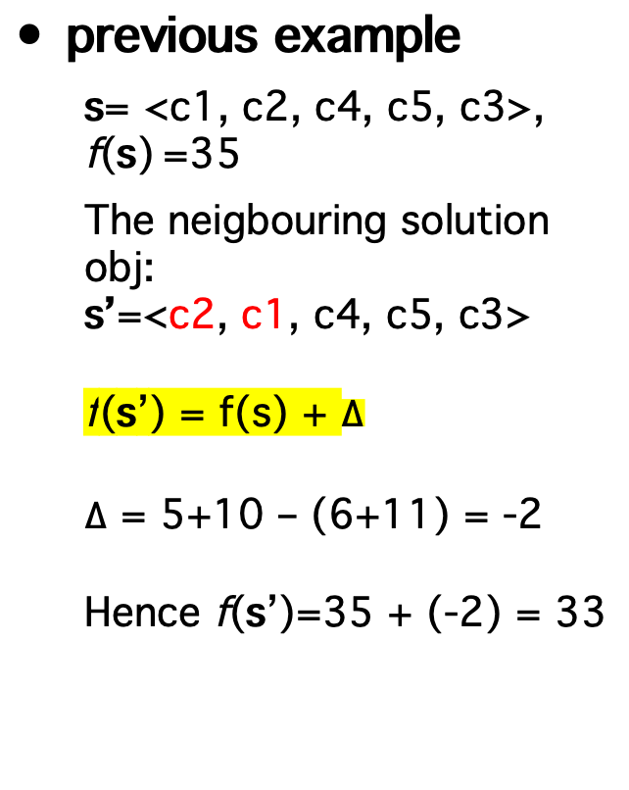
Example: Delta Evaluation for TSP II
Encoding
previous example
s= <c1, c2, c4, c5, c3>, f(s) =35
The neigbouring solution obj:
s’=<c2, c1, c4, c5, c3>
f(s’) = f(s) + $∆$
$∆$ = 5+10 – (6+11) = -2
Hence f(s’)=35 + (-2) = 33
c2
c1
4
Initialisation
5
10
11
Neighbourhood Definition
6
c3
Neighbourhood Search
c4
4
10
c5
Fitness Evaluation
Stopping Criteria

Slide 45

Local Search: Stopping Criteria
Encoding
Common one
No better neighbour can be found (i.e. local optima)
Maximum number of function evaluations or time
Initialisation
Neighbourhood Definition
Neighbourhood Search
Fitness Evaluation
Stopping Criteria

Slide 46
Summary
Encoding
Choosing an appropriate encoding to represent a candidate solution is crucial in heuristic optimisation – avoid duplications
Initialisation could influence the performance of an optimisation algorithm.
Multiple ways to define a neighbourhood structure - problem dependent.
Evaluation function guides the search process and fast evaluation is important.
Experimental studies are crucial for the performance evaluation of different heuristics method.
Initialisation
Neighbourhood Definition
Neighbourhood Search
Fitness Evaluation
Stopping Criteria

Slide 47
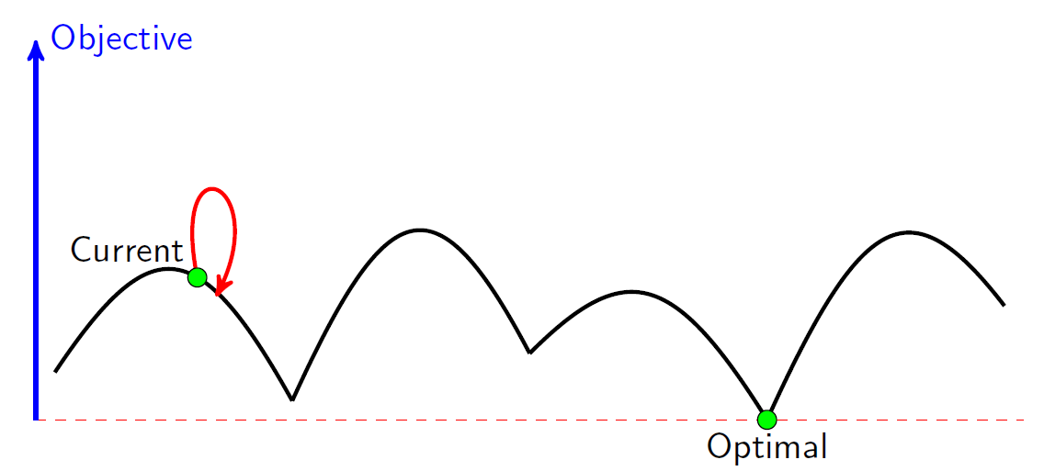
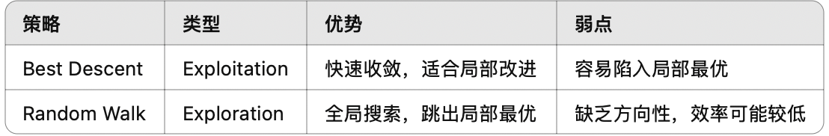
Best Descent vs. Random Walk
A best descent (or hill-climbing) method exploits the best available solution for possible improvement but neglect exploring a large portion of the search space
Random walk (performs search in the search space, sampling new points with equal probability, e.g., random bit flip, random swap) explores the search space thoroughly but misses exploiting promising regions.
exploitation
exploration

Slide 48
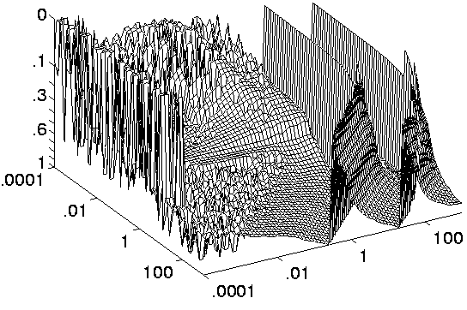
Weaknesses of Hill Climbing
Local Optimum: If all neighboring states are worse or the same. The algorithm will halt even though the solution may be far from satisfactory.
Plateau (neutral space/shoulder): All neighboring states are the same as the current state. In other words the evaluation function is essentially flat. The search will conduct a random walk.
Ridge/valley: The search may oscillate from side to side, making little progress. In each case, the algorithm reaches a point at which no progress is being made. If this happens, an obvious thing to do is start again from a different starting point.
Plateau
Valley
Local Minima
Global Minima

Slide 49
The next lecture
Metaheuristics

