Slide 1
Artificial Intelligence Methods (AE2AIM)
Lec. 03: Metaheuristics
Dr. Xinan Chen(Room IAMET308)
School of Computer Science
The University of Nottingham Ningbo, China
Email: Xinan.Chen@nottingham.edu.cn

Slide 2
Previous lecture
Methods for combinatorial problem
LP + rounding (Integer)
Greedy heuristics - constructive
Local Search (hill climbing) – iterative

Slide 3
In this lecture
Metaheuristics
Definition
Simulated annealing
Tabu Search

Slide 4
Local Search for Knapsack Problem
Data structures
struct item{
int indx;
int p;
int v;
double ratio;
};
struct problem{
int C; //knapsack capacity
int num_of_items;
item* items;
};
struct solution{
int objective;
int cap_left;
struct problem* prob;
int* x;
};
int main()
{
problem* prob = loaddata("knapsack.txt");
solution init_sln=initialise_sol();
print_sol(init_sln);
solution *new_sln;
solution *curt_sln = new solution();
curt_sln->copy_from(init_sln);
for(int k=0; k< NUM_OF_ITERS; k++)
{
new_sln=first_descent(*curt_sln);
if(new_sln)
{
curt_sln->copy_from(*new_sln);
new_sln->free_memoy();
}
}
print_sol(*curt_sln);
//free memory for all pointers
return 0;
}
Notes:
When designing algorithms, it is extremely important to have appropriate data structures.

Slide 5
First Descent Local Search
solution* first_descent(solution &sln)
{//using pair-swaps
int item1, item2;
solution* new_sln = new solution();
new_sln->copy_from(sln);
for(int i=0; i<NUM_OF_ITEMS; i++)
{
if(sln.x[i]>0)
{
item1 =i;
for(int j=0; j<NUM_OF_ITEMS; j++){
if(i!=j && sln.x[j]==0 &&
sln.cap_left + v[item1]>v[j])
{
item2=j;
new_sln->x[item1]= 0;
new_sln->x[item2]= 1; //swap
int delta =p[item2] - p[item1];
if(delta >0)
{
new_sln->objective =
sln.objective + delta ;
new_sln->cap_left =
new_sln->cap_left +
v[item1]-v[item2];
return new_sln;
}
else //restore
{
new_sln->x[item1] = 1;
new_sln->x[item2]=0;
}//endelse
}//endif
}//endfor
}//endif
}//endfor
return NULL;
}
Notes:
Can you work out the code for best descent local search?

Slide 6
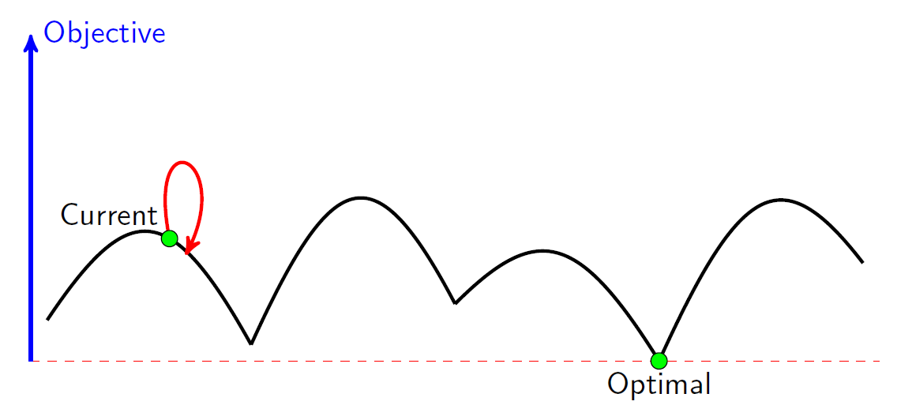
Drawbacks of Hill Climbing
Local Optimum: If all neighboring states are worse or the same. The algorithm will halt even though the solution may be far from satisfactory.
Plateau (neutral space/shoulder): All neighboring states are the same as the current state. In other words the evaluation function is essentially flat. The search will conduct a random walk.
exploitation
exploration

Slide 7
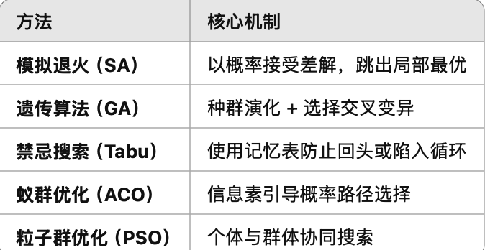
Meta-heuristics
Metaheuristics are solution methods that orchestrate an interaction between local improvement procedures and higher level strategies to create a process capable of escaping from local optima and performing a robust search of a solution space”
Glover and Kochenberger 2003. Handbook of Metaheuristics, Kluwer.
元启发式是一类解决方法，协调了局部改进过程与高层次策略之间的互动，以实现跳出局部最优并在解空间中进行更稳健的搜索

Slide 8
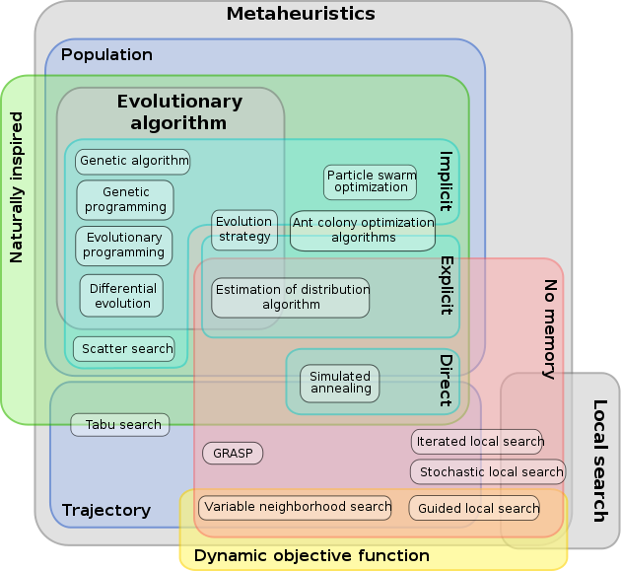
Metaheuristics Family

Slide 9
Simulated Annealing

Slide 10
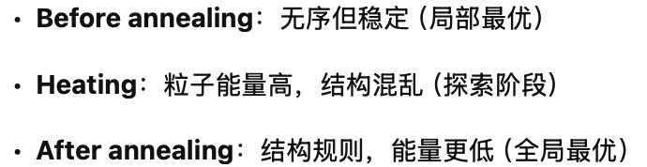
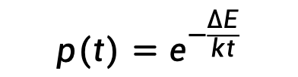
Metal Material Annealing
Annealing is a heat treatment to improve mental properties between ductility and hardness.
To reform new strain-free, uniformed structures.
Particle move from low energy state to high energy state is governed by Metropolis probability (where k is a constant known as Boltzmann constant):
$$p(t)=e^{−\frac{∆E}{kt}}$$
Before annealing
Heating
After annealing
Notes:
Steel industry is a pillar industry in any big country.

Slide 11
Simulated Annealing
Motivated by the physical annealing process
Material is heated and slowly cooled into a uniform structure.
Simulated annealing mimics this process
The first SA algorithm was developed in 1953 (Metropolis).
Kirkpatrick (1982) applied SA to optimisation problems
Kirkpatrick, S , Gelatt, C.D., Vecchi, M.P. 1983. Optimization by Simulated Annealing. Science, vol 220, No. 4598, pp 671-680. [cited 43109 times].

Slide 12
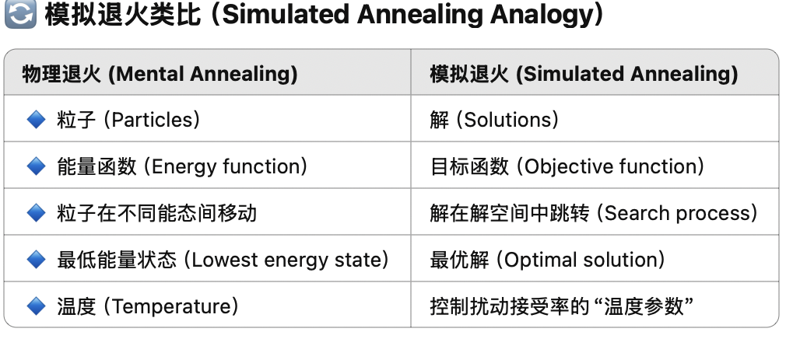
Simulated Annealing Analogy
Mental Annealing | Simulated Annealing
Particles | Solutions
Engery function | Objective function
Particle moves between different engery states | Search process
Lowest energy state | Optimal solution
Temperature | Temperature

Slide 13
SA v.s. Local Search
Local Search
SA
if(delta >0)
{
new_sln->objective =
sln.objective + delta ;
new_sln->cap_left =
new_sln->cap_left +
v[item1]-v[item2];
return new_sln;
}
else //restore
{
new_sln->x[item1] = 1;
new_sln->x[item2]=0;
}//endelse
}//endif
}//endfor
}//endif
}//endfor
return NULL;
}
Compared to hill climbing the main difference is that SA allows downwards steps
Simulated annealing also differs from hill climbing in that a move is selected at random and then decides whether to accept it
In SA better moves are always accepted. Worse moves are not.

Slide 14
SA Algorithm (for minimizing)
Create an initial solution s₀ (often by a greedy heuristic);
Set parameters: starting temperature: t_{s}; stopping temperature: t_{f.} , and a cooling schedule: t = s(t), set current solution s=s₀ and number of repetitions at each temperature, nrep. Define neighbourhood N(s)
while (t>t_{f} && n < K)
while(rep< nrep)
s’=random(N(s)); rep++; r=random(0,1);
δ=f(s’)-f(s);
if (δ <0 || p = exp(-δ /t)> r) set s=s’; endif
update the best solution found so far, s*
endwhile
Update temperature t=s(t). n++; rep=0;
endwhile
return s*

Slide 15

Simulated Annealing
To accept or not to accept – SA?
p = exp(-$\text{δ}$/t) > r
where
δ is change in the evaluation function
t the current temperature
r is a random number between 0 and 1
•温度 t 越高 → 坏解越容易被接受（探索性强）
•温度降低时 → 接受坏解概率变小 → 趋于局部搜索

Slide 16

Simulated Annealing
To accept or not to accept – SA?
The probability of accepting a worse state is a function of both the temperature of the system and the change in the evaluation function.
Small increase in evaluation function is more likely accepted than a large jump.
As the temperature decreases, the probability of accepting worse moves decreases.
If t=0, no worse moves are accepted (i.e. hill climbing)
When t is sufficiently high, all moves are accepted (random walk)
$$p=e^{−\frac{\text{δ}}{t}}$$
•当 t = 0：不接受任何坏解 → 就变成了爬山法（Hill Climbing）
•当 t 非常高：几乎所有解都接受 → 相当于随机游走（Random Walk）
•温度递减过程决定了搜索从全局探索 → 局部精炼

Slide 17
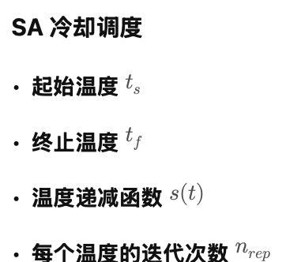
SA Cooling Schedule
Starting Temperature t_{s}
Final Temperature t_{f}
Temperature Decrement s(t)
Iterations at each temperature nrep

Slide 18
SA Cooling Schedule
Starting Temperature
Must be hot enough to allow moves to almost all neighbourhood states (else we are in danger of implementing hill climbing)
Must not be so hot that we conduct a random search for a period of time
Problem is finding a suitable starting temperature is problem-dependent
•必须足够高，以便可以接受几乎所有邻域状态的移动（否则我们可能就只是实现了爬山算法）。
•但不能过高，否则我们将会在一段时间内执行随机搜索。
•问题在于：找到一个合适的起始温度是与具体问题相关的。

Slide 19
SA Cooling Schedule
Starting Temperature
If we know the maximum change in the cost function we can use this to estimate
Start high, reduce quickly until about x% of worse moves are accepted. Use this as the starting temperature
Heat rapidly until a certain percentage are accepted the start cooling
•如果我们知道代价函数的最大变化值，可以用它来估算起始温度。
•可以从较高温度开始，然后迅速降低，直到大约有 x\% 的劣解被接受。此时的温度可作为起始温度。
•或者采用快速加热法，即不断升温直到某个百分比的劣解被接受，再开始冷却过程。

Slide 20
SA Cooling Schedule
Final Temperature
It is usual to let the temperature decrease until it reaches zero However, this can make the algorithm run for a lot longer, especially when a geometric cooling schedule is being used
In practise, it is not necessary to let the temperature reach zero because the chances of accepting a worse move are almost the same as the temperature being equal to zero
Therefore, the stopping criteria can either be a suitably low temperature or when the system is “frozen” at the current temperature (i.e. no better or worse moves are being accepted)
通常会让温度持续降低，直到降为 零。
然而，这可能导致算法运行时间显著延长，尤其是在使用几何冷却策略的情况下。
•实际上，没有必要将温度降到零，
因为在非常低温下接受较差解的概率与温度为零时几乎是一样的。
•因此，停止准则可以是：
✔ 降到一个足够低的温度，或者
✔ 系统在当前温度下已**“冻结”**（即不再接受更优或更差的解）。

Slide 21
SA Cooling Schedule
理论指出，我们应当在每个温度点允许足够多的迭代，使系统在该温度下趋于稳定 —— 这是一个马尔可夫过程（Markov process）。
Temperature cooling functions
Theory states that we should allow enough iterations at each temperature so that the system stabilises at that temperature – Markov process
Unfortunately, theory also states that the number of iterations at each temperature to achieve this might be exponential to the problem size
Two common functions
Geometric t=at
Non-linear t = t/(1 + βt)
Others …
理论也指出，为了达到这种稳定状态，每个温度所需的迭代次数可能会呈指数级增长，与问题规模有关

Slide 22
SA Cooling Schedule - nrep
Iterations at each temperature
An alternative is to dynamically change the number of iterations as the algorithm progresses
At lower temperatures it is important that a large number of iterations are done so that the local optimum can be fully explored
At higher temperatures, the number of iterations can be less
🔹 每个温度的迭代次数（Iterations at each temperature）
•一种替代方法是动态调整迭代次数，随着算法的推进而改变。
•在较低温度下，重要的是进行大量迭代，以便充分探索局部最优解。
•在较高温度下，所需的迭代次数可以相对较少。

Slide 23
SA Modifications - Cooling
If you plot a typical cooling schedule you are likely to find that at high temperatures many solutions are accepted
If you start at too high a temperature a random search is emulated and until the temperature cools sufficiently any solution can be reached and could have been used as a starting position
•如果你绘制一个典型的冷却调度曲线，会发现在高温时会接受大量解。
•如果起始温度设得太高，算法将模拟一种随机搜索，并且在温度足够降低之前，任何解都有可能被接受，从而等同于随便选一个初始解。

Slide 24
SA Modifications - Cooling
At lower temperatures, a plot of the cooling schedule, is likely to show that very few worse moves are accepted; almost making simulated annealing emulate hill climbing
•在较低温度下，绘制冷却调度图可能会显示：几乎没有较差的解被接受；
这会使模拟退火的行为趋近于爬山算法（hill climbing）。
这说明：温度如果过低，算法将缺乏跳出局部最优的能力，失去模拟退火的核心优势。

Slide 25
SA Modifications - Cooling
Taking this one stage further, we can say that simulated annealing does most of its work during the middle stages of the cooling schedule
(Connolly, 1990) suggested annealing at a constant temperature
•更进一步，我们可以说：
模拟退火的大部分搜索效果实际上发生在冷却调度的中间阶段。
•Connolly（1990）曾提出：
可以在恒定温度下执行退火过程。

Slide 26
SA Modifications - Cooling
But what temperature?
It must be high enough to allow movement but not so low that the system is frozen
But, the optimum temperature will vary from one type of problem to another and also from one instance of a problem to another instance of the same problem
•但问题是：该选择什么温度？
•这个温度必须足够高以允许状态移动，但又不能低到使系统“冻结”。
•然而，最优温度因问题类型不同而不同，甚至在同一类问题的不同实例之间也会有所差异。
这强调了温度参数的问题依赖性，说明没有通用的最优温度，

Slide 27
SA Modifications - Cooling
One solution to this problem is to spend some time searching for the optimum temperature and than stay at that temperature for the remainder of the algorithm
The final temperature is chosen as the temperature that returns the best cost function during the search phase
•解决该问题的一种方法是：花一些时间搜索最优温度，然后在算法的剩余过程中保持该温度不变。
•最终温度可以设定为：在搜索阶段带来最佳代价函数值的温度。

Slide 28
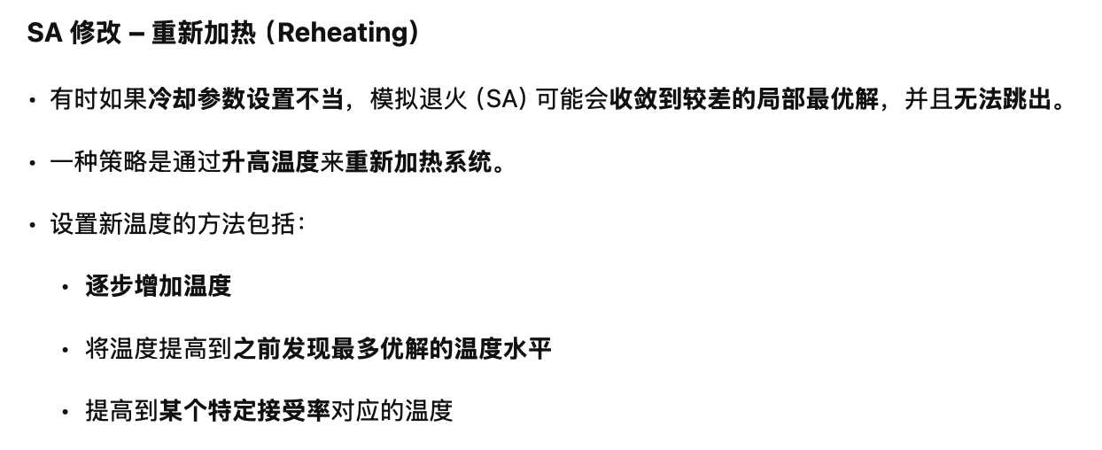
SA Modifications - Reheating
Sometimes when cooling parameters are not set properly, SA may converge to poor local optima and cannot escape.
One strategy is to reheat the system by increase the temperature.
Several ways to set the new temperature
Incremental increase
Increase your temperature to a value where most improving solutions were found previously.
Increase to a level with a specific acceptance ratio.

Slide 29
SA Modifications – Multiple Neighbourhoods
The neighbourhood of any move is normally the same throughout the algorithm but…
The neighbourhood could be changed as the algorithm progresses
For example, a cost function based on penalty values can be used to restrict the neighbourhood if the weights associated with the penalties are adjusted as the algorithm progresses
•在标准模拟退火中，每一步的邻域结构通常保持不变，但……
•邻域结构可以随着算法的进行而改变。
•例如：
可以使用基于惩罚值的代价函数来限制邻域的构造，
如果这些惩罚对应的权重值在算法过程中被动态调整，就能实现邻域范围的自适应控制。

Slide 30

SA Playground
Copy the code from the Moddle
https://moodle.nottingham.ac.uk/pluginfile.php/10867793/mod_folder/content/0/lec03-testcode.py
Run it on your PC or through the website:
https://www.online-python.com/
Try to find better parameters (Cost lower than: 20272.21)
Share your performance in Menti
Compare with classmates and share your parameter tuning, which parameter is most important?
Keep your running record

Slide 31
Exploitation vs. Exploration in SA
•开发（Exploitation）：降低温度（冷却）
•探索（Exploration）：升高温度（加热）
Exploitation: cooling the temperature
Exploration: heating up the temperature
p = e^{-[f (s’) – f (s)] / t}
Cycles!!!
•当前状态处于局部最优（Current）
•若温度设置不当，可能陷入循环（Cycles!!!）
•理想情况应能跳出局部最优，接近全局最优（Optimal）
SA is a memoryless method and may be not capable to prevent cycles if temperature is not set appropriately.
SA 是一种无记忆（memoryless）方法，如果温度设置不当，可能无法避免陷入搜索循环。

Slide 32
Next lecture
Metaheuristics II
Tabu Search
Variable Neighbourhood Search

