Slide 1
Artificial Intelligence Methods (AE2AIM)
Lec. 04: Metaheuristics II
Dr. Xinan Chen (Room IAMET 308)
School of Computer Science
The University of Nottingham Ningbo, China
Email: xinan.chen@nottingham.edu.cn

Slide 2
Previous lecture
•基于概率的接受函数（Probabilistic acceptance function）
•一种从**局部搜索（local search）扩展到随机采样（random sampling）**的广义方法
•通过随机采样搜索邻域解
•**参数（Parameters）**可能较难设定
•无记忆方法 —— 属于马尔可夫过程（Markov process）
Metaheuristics
Motivation
Simulated Annealing
Probablistic acceptance function
A generalised method ranging from local search to random sampling.
Neighbourhoods are searched through random sampling.
Parameters may be difficult to set
Memoryless method – Markov process

Slide 3
In this lecture
Metaheuristics II
Tabu Search
Variable Neighbourhood Search

Slide 4
Tabu Search

Slide 5
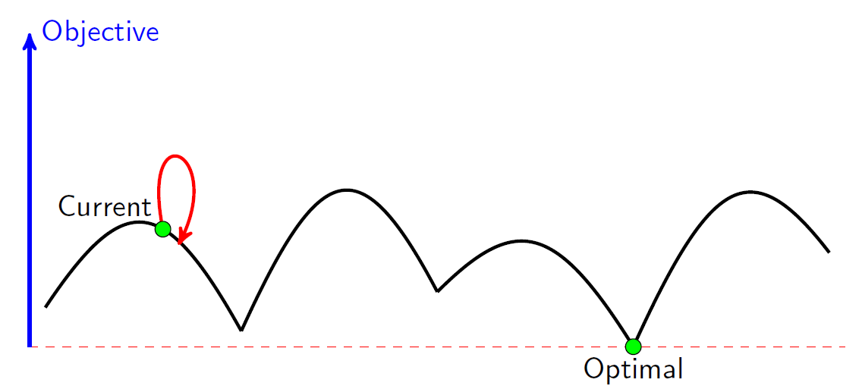
Exploitation vs. Exploration in SA
Exploitation/intensification
cooling the temperature
Exploration/diversification
heating up the temperature
🔸 开发 / 强化（Exploitation / Intensification）
•通过降低温度实现（冷却）
🔹 探索 / 多样化（Exploration / Diversification）
•通过升高温度实现（加热）
p = e^{-[f (s’) – f (s)] / t}
Cycles!!!
SA is a memoryless method and may be not capable to prevent cycles if temperature is not set appropriately.

Slide 6
Tabu Search
Proposed independently by Glover(1986) and Hansen(1986);
Tabu search is “a meta-heuristic superimposed on another heuristic. The overall approach is to avoid entrapment in cycles by forbidding or penalizing moves which take the solution, in the next iteration, to points in the solution space previously visited (hence tabu).”
(1937-2019)
Neumann Theory Prize
INFORMS Impact Prize, 2010.
INFORMS Fellow
Networks named its best paper awards after his name (Glover-Klingman Prize)
禁忌搜索是一种叠加在其他启发式算法上的元启发式算法。
其核心思想是通过禁止或惩罚在下一次迭代中将解带回曾经访问过的位置的操作，
从而避免陷入循环（entrapment in cycles） —— 这也是“tabu”（禁忌）一词的由来。

Slide 7
Tabu Search (continued)
这段内容强调了 Tabu Search 相比模拟退火的最大优势：具备记忆能力，因此更能避免重复和陷入循环。
Accepts non-improving solutions deterministically in order to escape from local optima (where all the neighbouring solutions are non-improving) by guiding a steepest descent local search (or steepest ascent hill climbing ) algorithm;
Uses of memory to:
prevent the search from revisiting previously visited solutions;
explore the unvisited areas of the solution space;
•以确定性方式（deterministically）接受非改进解，
用于跳出局部最优（即所有邻域解都是不可改善的情况），
通过引导最陡下降的局部搜索（或最陡上升的爬山算法）实现搜索。
•使用记忆（memory），目的包括：
•防止搜索重新访问先前已经探索过的解；
•引导搜索进入未探索区域，扩展解空间。

Slide 8
Elements of Tabu Search
Tabu_list (short term memory): to record a limited number of attributes of solutions (moves, selections, assignments, etc.) to be discouraged in order to prevent revisiting a visited solution;
Tabu_tenure: number of iterations a tabu move is considered to remain tabu;
Aspiration criteria: accepting an improving solution even if generated by a tabu move
Similar to SA in always accepting improving solutions, but accepting non-improving ones when there is no improving solution in the neighbourhood;
•Tabu 列表（Tabu_list）（短期记忆 short term memory）：
用于记录一部分解的特征（例如移动、选择、分配等），以阻止或惩罚再次访问已探索过的解。
•禁忌期限（Tabu_tenure）：
某个操作被视为禁忌状态持续的迭代次数。
•许可准则（Aspiration criteria）：
即使该解来自禁忌操作，只要它能改善当前解，也可以接受。
•类似模拟退火（SA），它始终接受更优解，
但在邻域中没有更优解时也允许接受非改进解。

Slide 9
TS Examples – TSP
🔹 最佳下降局部搜索（Best descent LS）
起始解：
<c1, c2, c4, c5, c3>, obj = 35
Best descent LS
<c1, c2, c4, c5, c3>, obj: 35
Iter 1:
Set of neigbouring solutions:
<c2, c1, c4, c5, c3>, obj: 33
<c4, c2, c1, c5, c3>, obj: 33
<c5, c2, c4, c1, c3>, obj: 40
<c3, c2, c4, c5, c1>, obj: 37
<c1, c4, c2, c5, c3>, obj: 40
<c1, c5, c4, c2, c3>, obj: 37
<c1, c3, c4, c5, c2>, obj: 34
<c1, c2, c5, c4, c3>, obj: 34
<c1, c2, c4, c3, c5>, obj: 33
Iter 2:
<c2, c4, c1, c5, c3>, obj=37
<c1, c2, c4, c5, c3>, obj=35 (tabu!)
<c5, c2, c1, c4, c3>, obj=34
<c3, c2, c1, c5, c4>, obj=31
<c4, c1, c2, c5, c3>, obj=35
…. ….
<c4, c2, c1, c3, c5>, obj=35
Neighbourhood swap(c_{i},c_{j})
Tabulist
indx | entry
0 | (c1,c4)
1 | (c3,c4)
2
3
Tabu tenure tten: number of iterations a given tabu element remain tabu!
Often implemented as a list of fixed length with FIFO policy.
🔷 Tabu 有效期（tenure）：禁忌元素保留在列表中的迭代次数
🔷 通常使用固定长度的列表，并采用先进先出（FIFO）策略

Slide 10

TS Examples - Knapsack
Local search Neighbourhood
Pair-wise swap
$\{(i ⟷j) |∀i∈P, ∀j∈U\}$
P: set of packed items
U: set of unpacked items.
Tabulist
Alternative tabulist
禁忌列表（Tabulist）
indx | entry
0 | (1,5)
1 | (2,6)
2 | (4,10)
3 | (9,3)
P | U
1 | 3
2 | 5
4 | 6
9 | 7
 | 8
 | 10
替代禁忌列表
indx | entry
0 | 5
1 | 7
2 | 3
Specifies given set of features not permitted in the current solution.
当前解中禁止包含的特征集合

Slide 11
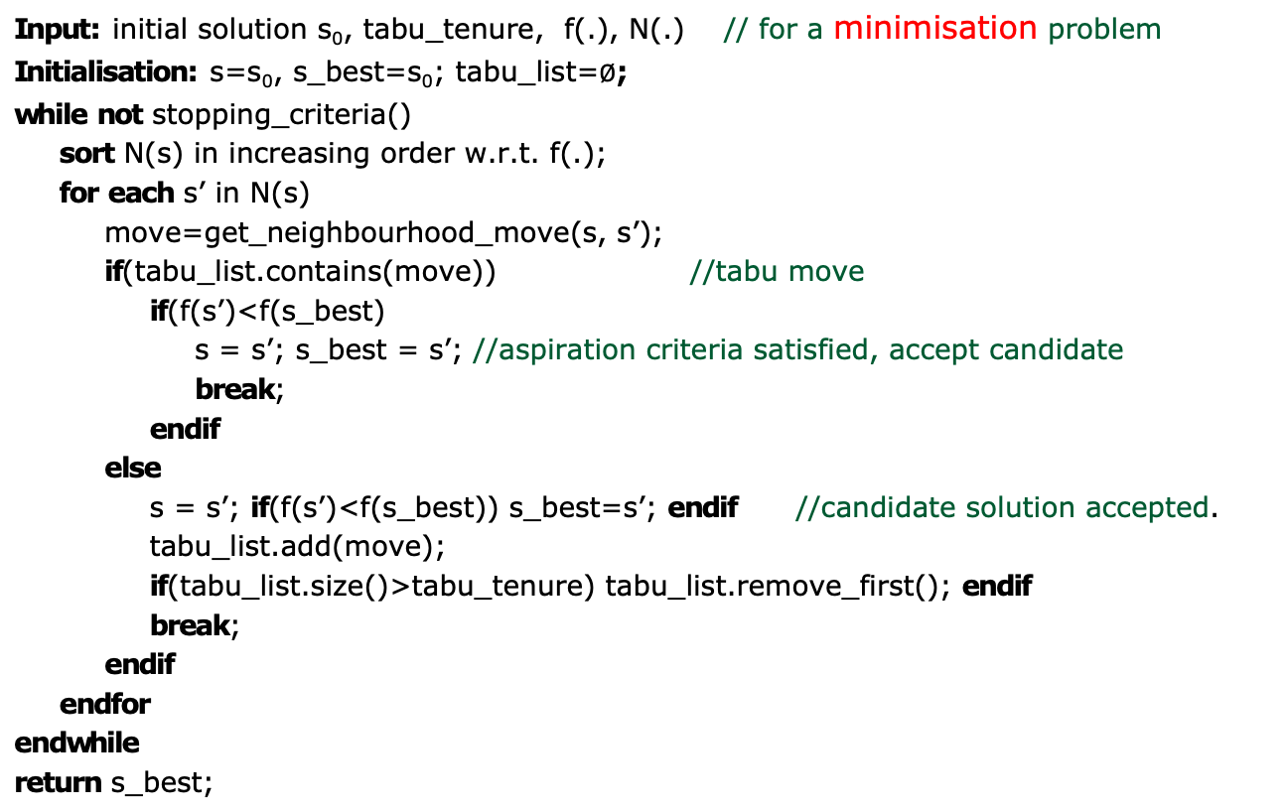
Basic Tabu Search Pseudocode
Input: initial solution s₀, tabu_tenure, f(.), N(.) // for a minimisation problem
Initialisation: s=s₀, s_best=s₀; tabu_list=$∅$;
while not stopping_criteria()
sort N(s) in increasing order w.r.t. f(.);
for each s’ in N(s)
move=get_neighbourhood_move(s, s’);
if(tabu_list.contains(move)) //tabu move
if(f(s’)<f(s_best)
s = s’; s_best = s’; //aspiration criteria satisfied, accept candidate
break;
endif
else
s = s’; if(f(s’)<f(s_best)) s_best=s’; endif //candidate solution accepted.
tabu_list.add(move);
if(tabu_list.size()>tabu_tenure) tabu_list.remove_first(); endif
break;
endif
endfor
endwhile
return s_best;

Slide 12
Elements of Tabu Search (continued)
Long term memory: to record attributes of elite solutions to be used in:
Intensification: giving priority to attributes of a set of elite solutions (usually in weighted probability manner)
Diversification: Discouraging attributes of elite solutions in selection functions in order to diversify the search to other areas of solution space;
长期记忆（Long term memory）：
用于记录优秀解的特征，并用于以下两种策略：
•强化（Intensification）：
优先使用一组优秀解的特征（通常以加权概率的方式）来引导搜索朝已有优秀区域进一步深入。
•多样化（Diversification）：
在选择过程中抑制对优秀解特征的偏好，从而引导搜索跳出当前区域，探索解空间中的其他区域。

Slide 13
Is memory useful during the search?

Slide 14
Uses of memory during the search?
Intelligence needs memory!
Discouraging some patterns in solution: e.g. in knapsack problem, selection of some items may be considered taboo (forbidden).
Information on characteristics of good solutions (or bad solutions!)
•智能需要记忆！
•抑制解中某些模式：
例如在背包问题中，选择某些特定物品可能被视为禁忌（taboo），即应避免使用。
•关于优解（或劣解）的特征信息：
搜索过程中可以记录解的某些关键特征（characteristics），以指导后续优化策略。

Slide 15
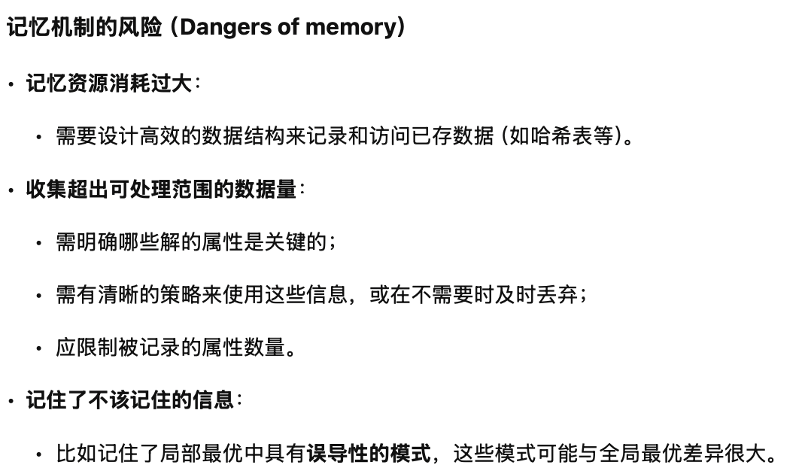
Dangers of memory
Exhaustive usage of memory resources:
Design of efficient data structures to record and access the recorded data efficiently (e.g. hash table)
Collecting more data than could be handled:
Clear understanding of which attributes of solutions are crucial;
Clear strategy on usage of information or their disposal when not needed;
Limited selection of attributes of solutions to be memorised;
Memorising information which should not be remembered:
Misguiding patterns in local optima which are very different from global optimum;

Slide 16
Some TS Extentions
Hybrisizing with other methods
TS + SA
TS + Guided Local Search
TS + Branch & Bound
More advanced memory mechanisms
TS + Deep reinforcement learning
Principal:
Prevent or encourage some good/bad features
•TS + 模拟退火（Simulated Annealing, SA）
•TS + 引导式局部搜索（Guided Local Search）
•TS + 分支限界法（Branch & Bound）
TS + 深度强化学习（Deep Reinforcement Learning）
阻止或鼓励某些好的/坏的特

Slide 17
Variable Neighbourhood Search (VNS)

Slide 18
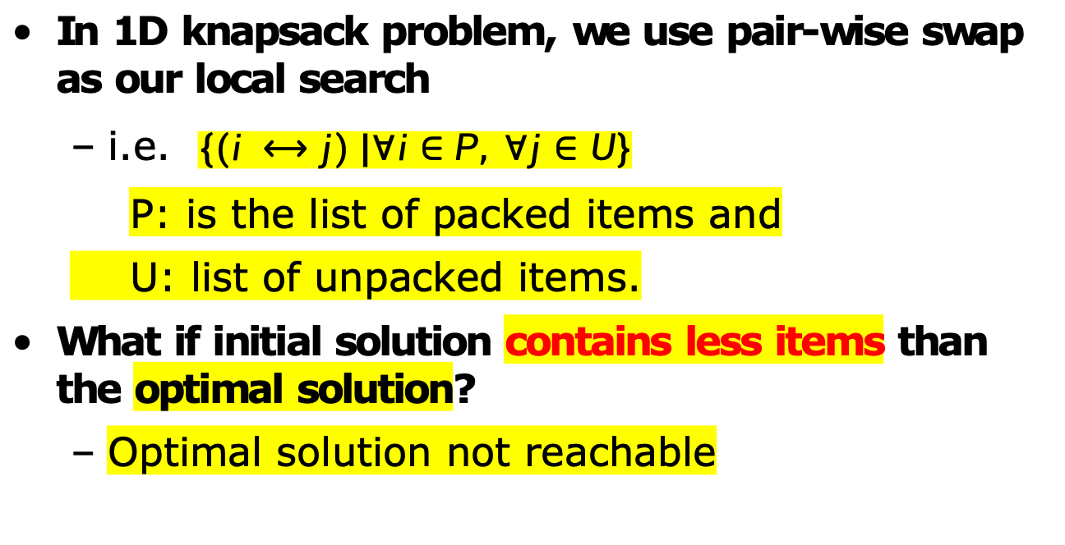
Motivation (I) Reachability of Search Space
In 1D knapsack problem, we use pair-wise swap as our local search
i.e. $\{(i ⟷j) |∀i∈P, ∀j∈U\}$
P: is the list of packed items and
U: list of unpacked items.
What if initial solution contains less items than the optimal solution?
Optimal solution not reachable

Slide 19
Motivation (II) Landscape of Search Space
In bin packing problem
Best fit
搜索空间可能是非连续的、复杂的，不良启发式可能让算法陷入局部最优。
??
500
400
300
200
100
0
25
5
155
50
160
Optimal
442
315
165
180

Slide 20
Motivations
Multiple neighbourhoods exist naturally
Knapsack problem: 1-2 swaps, 2-1 swaps
Bin packing: chained swaps 1->2->3
Constriants may lead to disjointed search space that cannot be reached by single neighbourhood moves.
Non-uniform search space landscapes
Plateau
Ridge/valley
Local optimum of one neighborhood is not necessarily one in another.

Slide 21
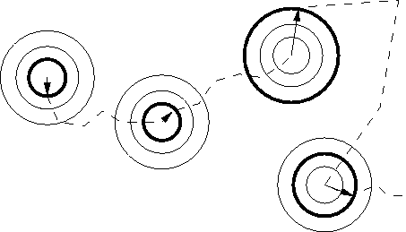
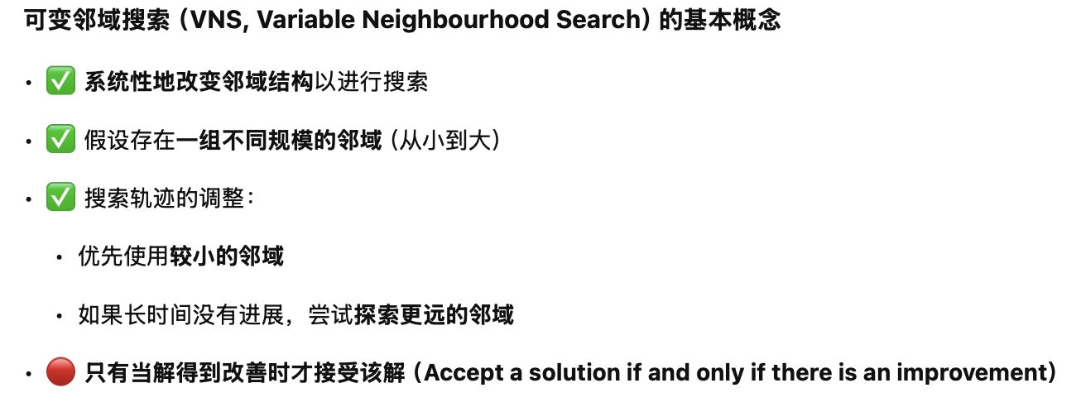
Basic Notions of VNS
Systematic change of the neighbourhood in search
Assumes a set of neighborhood with different sizes.
Change of search trajectory
Preference is given to small sized neighbourhood.
Exploration of increasingly distant neighbourhood if no progress
Accept a solution if and only if there is an improvement
Solution Space
VNS 是一种结构化的多邻域搜索策略，特别适合面对搜索空间割裂或陷入局部最优的场景。

Slide 22
Variable Neighbourhood Search Pseudocode
Input: initial solution s₀, f(.), <N₁(.), …,N_{k}(.)> // for a minimisation problem
Initialisation: s=s₀, s_best=s₀, i=1; // i is neighbourhood index
while not stopping_criteria()
//intensification stage (neighbourhood search)
while (i <=k)
s’=best_descent(N_{i}(s)); //local search
if f(s’) < f(s)
s=s’;
i=1; //switch to the first neighbourhood
continue;
else i++; //next neighbourhood
endif
endwhile
if f(s) < f(s_best) s_best =s; endif //update best solution
s=shaking(s); //diversification stage (shaking) new start point
endwhile
return s_best;

Slide 23
VNS Components
A set of neighbourhoods
How many? What type?
Order of neighbourhoods
Small sized neighbourhood with lower index
Problem dependent
Strategies for changing neighbourhoods
Pseudocode gives one possibility – not always the best
Other? - hyper-heuristics, ALNS
Local search method
Best Descent,
First descent,
Best descent with sampling

Slide 24
Example - TSP
c2
Set of neighbourhoods k-opt
N_{k}(s) is the set of solutions having k edges different from those in s.
Pair-wise swap is a 2-opt.
c1
4
5
10
11
6
c3
c4
4
10
c5

Slide 25
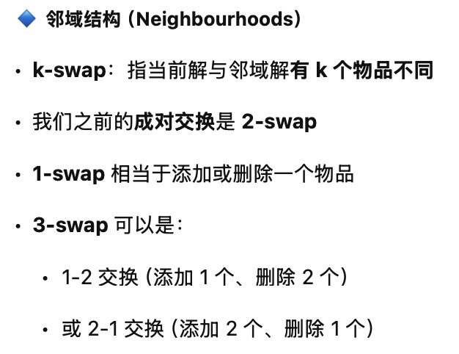
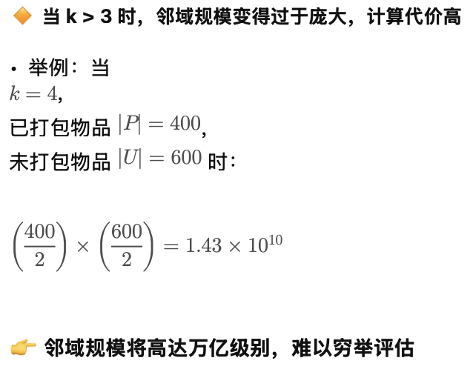
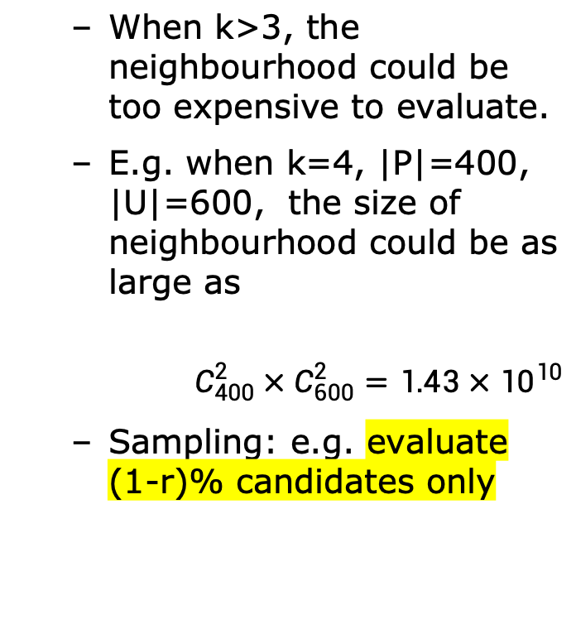
Example - Knapsack
Neighbourhoods
k-swap where k is the number of items different from currnet packing s.
Our previous pair-wise swap is 2-swap.
1-swap is equivelant to addition/removal of an item
3-swap could be 1-2 swaps or 2-1 swaps.
When k>3, the neighbourhood could be too expensive to evaluate.
E.g. when k=4, |P|=400, |U|=600, the size of neighbourhood could be as large as
$$C_{400}^{2}×C_{600}^{2}=1.43×{10}^{10}$$
Sampling: e.g. evaluate (1-r)% candidates only

Slide 26
Extensions of VNS
Reduced VNS
Change Best Descent to First Descent in local search, coupled with maximum computational time as stopping criteria.
Random Sampling
🔹 简化型 VNS（Reduced VNS）
•在局部搜索中，将“最佳下降（Best Descent）”替换为“首次下降（First Descent）”
•与最大计算时间作为终止条件配合使用
随机采样

Slide 27
Extensions of VNS
自适应大规模邻域搜索
Adaptive Large Scale Neighbourhood Search (ALNS) (Ropke & Pisinger, 2006)
Current Solution
Adaptive Selection Mechanisms (VNS)
破坏算子 修复算子
Local Search Neighbourhoods
Destroy Opertors
Repair Opertors
Simulated Annealing (SA)
Acceptance Criteria
S. Ropke, D. Pisinger An adaptive large neighborhood search heuristic for the pickup and delivery problem with time windows. Transportation Science, 40 (4) (2006), pp. 455-472.
doi: http://www.doi.org/10.1287/trsc.1050.0135

Slide 28

Tabu+VNS Playground
Copy the code from the Moddle
https://moodle.nottingham.ac.uk/pluginfile.php/10867793/mod_folder/content/0/lec04_testcode.py
Run it on your PC or through the website:
https://www.online-python.com/
Try to find better parameters (Cost lower than: 9220.62)
Share your performance in Menti
Do not change iteration number.
Compare with classmates and share your parameter tuning, which parameter is most important?
Keep your running record

Slide 29
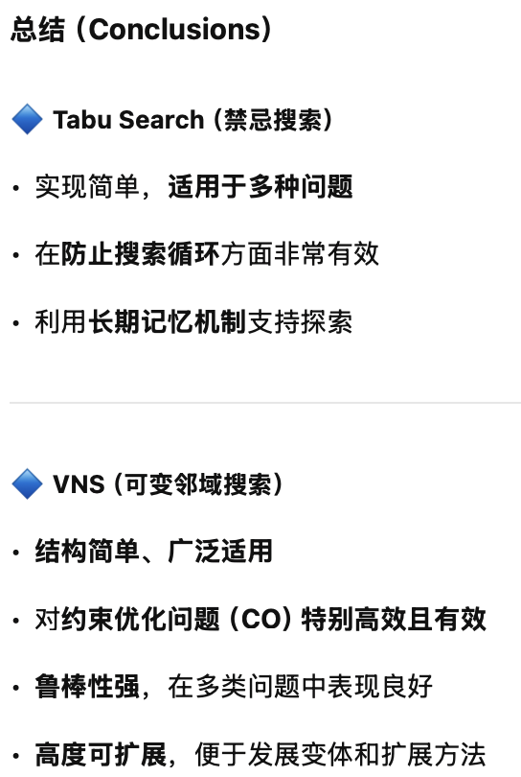
Conclusions
Tabu Search
Simple to implement, general to many problems
Effective in preventing cycling
Exploration through long-term memory
VNS
Simple and largely applicable
Efficient and effective, especially constrained CO problems.
Robust: performs well for various problems
Flexible to extend: allows development of variations/extensions
Tabu Search 更注重“记忆机制”，VNS 更强调“邻域变化策略”，两者在组合优化中互为补充，甚至可融合为混合元启发式。

Slide 30
Next lecture
Population based metaheuristics
Genetic algorithm

