Slide 1
Artificial Intelligence Methods (AE2AIM)
Lec. 05: Metaheuristics II
Professor Ruibin Bai (Room SEB425)
School of Computer Science
The University of Nottingham Ningbo, China
Email: ruibin.bai@nottingham.edu.cn
Web: www.cs.nott.ac.uk/~znzbrbb

Slide 2
Previous lecture
Metaheuristics
Motivation
Simulated Annealing
Probablistic acceptance function
A generalised method ranging from local search to random sampling.
Neighbourhoods are searched through random sampling.
Parameters may be difficult to set
Memoryless method – Markov process

Slide 3
In this lecture
Metaheuristics II
Tabu Search
Variable Neighbourhood Search

Slide 4
Tabu Search

Slide 5
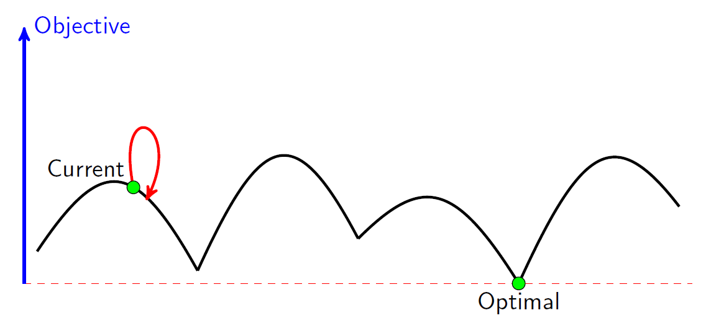
Exploitation vs. Exploration in SA
Exploitation/intensification
cooling the temperature
Exploration/diversification
heating up the temperature
p = e^{-[f (s’) – f (s)] / t}
Cycles!!!
SA is a memoryless method and may be not capable to prevent cycles if temperature is not set appropriately.

Slide 6
Tabu Search
Proposed independently by Glover(1986) and Hansen(1986);
Tabu search is “a meta-heuristic superimposed on another heuristic. The overall approach is to avoid entrapment in cycles by forbidding or penalizing moves which take the solution, in the next iteration, to points in the solution space previously visited (hence tabu).”
(1937-2019)
Neumann Theory Prize
INFORMS Impact Prize, 2010.
INFORMS Fellow
Networks named its best paper awards after his name (Glover-Klingman Prize)

Slide 7
Tabu Search (continued)
Accepts non-improving solutions deterministically in order to escape from local optima (where all the neighbouring solutions are non-improving) by guiding a steepest descent local search (or steepest ascent hill climbing ) algorithm;
Uses of memory to:
prevent the search from revisiting previously visited solutions;
explore the unvisited areas of the solution space;

Slide 8
Elements of Tabu Search
Tabu_list (short term memory): to record a limited number of attributes of solutions (moves, selections, assignments, etc.) to be discouraged in order to prevent revisiting a visited solution;
Tabu_tenure: number of iterations a tabu move is considered to remain tabu;
Aspiration criteria: accepting an improving solution even if generated by a tabu move
Similar to SA in always accepting improving solutions, but accepting non-improving ones when there is no improving solution in the neighbourhood;

Slide 9
TS Examples – TSP
Best descent LS
<c1, c2, c4, c5, c3>, obj: 35
Iter 1:
Set of neigbouring solutions:
<c2, c1, c4, c5, c3>, obj: 33
<c4, c2, c1, c5, c3>, obj: 33
<c5, c2, c4, c1, c3>, obj: 40
<c3, c2, c4, c5, c1>, obj: 37
<c1, c4, c2, c5, c3>, obj: 40
<c1, c5, c4, c2, c3>, obj: 37
<c1, c3, c4, c5, c2>, obj: 34
<c1, c2, c5, c4, c3>, obj: 34
<c1, c2, c4, c3, c5>, obj: 33
Iter 2:
<c2, c4, c1, c5, c3>, obj=37
<c1, c2, c4, c5, c3>, obj=35 (tabu!)
<c5, c2, c1, c4, c3>, obj=34
<c3, c2, c1, c5, c4>, obj=31
<c4, c1, c2, c5, c3>, obj=35
…. ….
<c4, c2, c1, c3, c5>, obj=35
Neighbourhood swap(c_{i},c_{j})
Tabulist
indx | entry
0 | (c1,c4)
1 | (c3,c4)
2
3
Tabu tenure tten: number of iterations a given tabu element remain tabu!
Often implemented as a list of fixed length with FIFO policy.

Slide 10

TS Examples - Knapsack
Local search Neighbourhood
Pair-wise swap
$\{(i ⟷j) |∀i∈P, ∀j∈U\}$
P: set of packed items
U: set of unpacked items.
Tabulist
Alternative tabulist
indx | entry
0 | (1,5)
1 | (2,6)
2 | (4,10)
3 | (9,3)
P | U
1 | 3
2 | 5
4 | 6
9 | 7
 | 8
 | 10
indx | entry
0 | 5
1 | 7
2 | 3
Specifies given set of features not permitted in the current solution.

Slide 11
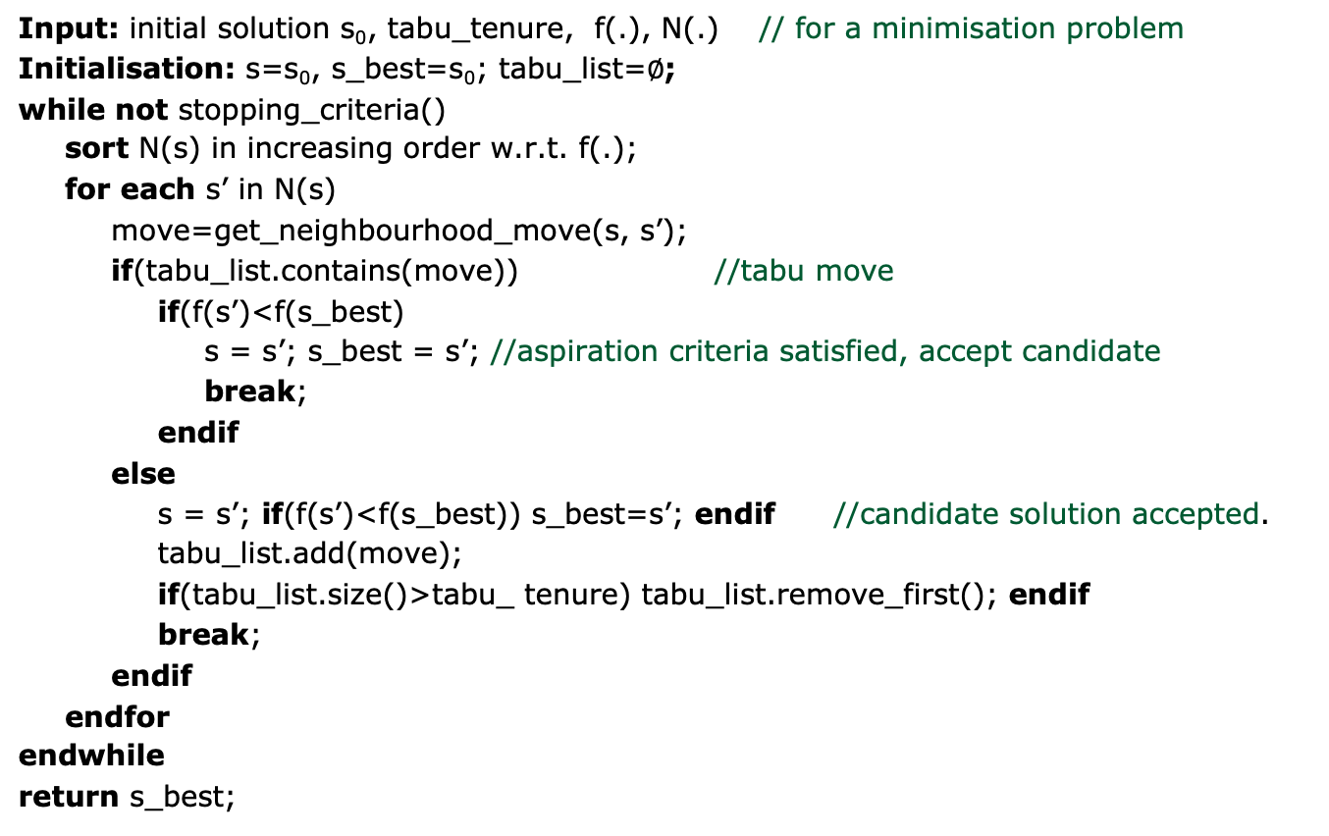
Basic Tabu Search Pseudocode
Input: initial solution s₀, tabu_tenure, f(.), N(.) // for a minimisation problem
Initialisation: s=s₀, s_best=s₀; tabu_list=$∅$;
while not stopping_criteria()
sort N(s) in increasing order w.r.t. f(.);
for each s’ in N(s)
move=get_neighbourhood_move(s, s’);
if(tabu_list.contains(move)) //tabu move
if(f(s’)<f(s_best)
s = s’; s_best = s’; //aspiration criteria satisfied, accept candidate
break;
endif
else
s = s’; if(f(s’)<f(s_best)) s_best=s’; endif //candidate solution accepted.
tabu_list.add(move);
if(tabu_list.size()>tabu_ tenure) tabu_list.remove_first(); endif
break;
endif
endfor
endwhile
return s_best;

Slide 12
Elements of Tabu Search (continued)
Long term memory: to record attributes of elite solutions to be used in:
Intensification: giving priority to attributes of a set of elite solutions (usually in weighted probability manner)
Diversification: Discouraging attributes of elite solutions in selection functions in order to diversify the search to other areas of solution space;

Slide 13
Is memory useful during the search?

Slide 14
Uses of memory during the search?
Intelligence needs memory!
Discouraging some patterns in solution: e.g. in knapsack problem, selection of some items may be considered taboo (forbidden).
Information on characteristics of good solutions (or bad solutions!)

Slide 15
Dangers of memory
Exhaustive usage of memory resources:
Design of efficient data structures to record and access the recorded data efficiently (e.g. hash table)
Collecting more data than could be handled:
Clear understanding of which attributes of solutions are crucial;
Clear strategy on usage of information or their disposal when not needed;
Limited selection of attributes of solutions to be memorised;
Memorising information which should not be remembered:
Misguiding patterns in local optima which are very different from global optimum;

Slide 16
Some TS Extentions
Hybrisizing with other methods
TS + SA
TS + Guided Local Search
TS + Branch & Bound
More advanced memory mechanisms
TS + Deep reinforcement learning

Slide 17
Variable Neighbourhood Search (VNS)

Slide 18
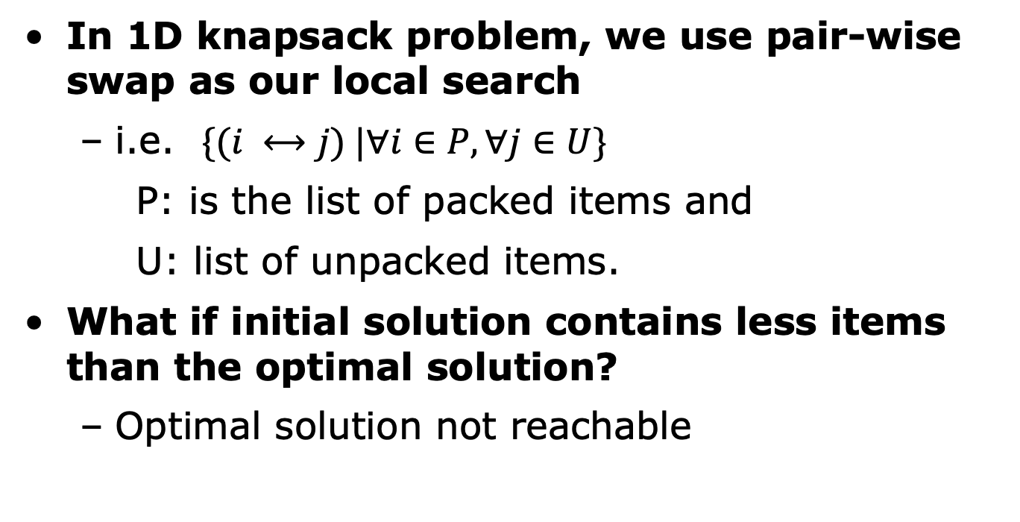
Motivation (I) Reachability of Search Space
In 1D knapsack problem, we use pair-wise swap as our local search
i.e. $\{(i ⟷j) |∀i∈P, ∀j∈U\}$
P: is the list of packed items and
U: list of unpacked items.
What if initial solution contains less items than the optimal solution?
Optimal solution not reachable

Slide 19
Motivation (II) Landscape of Search Space
In bin packing problem
Best fit
??
500
400
300
200
100
0
25
5
155
50
160
Optimal
442
315
165
180

Slide 20
Motivations
Multiple neighbourhoods exist naturally
Knapsack problem: 1-2 swaps, 2-1 swaps
Bin packing: chained swaps 1->2->3
Constriants may lead to disjointed search space that cannot be reached by single neighbourhood moves.
Non-uniform search space landscapes
Plateau
Ridge/valley
Local optimum of one neighborhood is not necessarily one in another.

Slide 21
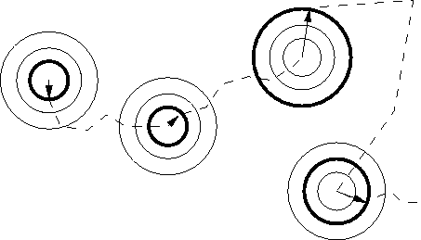
Basic Notions of VNS
Systematic change of the neighbourhood in search
Assumes a set of neighborhood with different sizes.
Change of search trajectory
Preference is given to small sized neighbourhood.
Exploration of increasingly distant neighbourhood if no progress
Accept a solution if and only if there is an improvement
Solution Space

Slide 22
Variable Neighbourhood Search Pseudocode
Input: initial solution s₀, f(.), <N₁(.), …,N_{k}(.)> // for a minimisation problem
Initialisation: s=s₀, s_best=s₀, i=1; // i is neighbourhood index
while not stopping_criteria()
//intensification stage (neighbourhood search)
while (i <=k)
s’=best_descent(N_{i}(s)); //local search
if f(s’) < f(s)
s=s’;
i=1; //switch to the first neighbourhood
continue;
else i++; //next neighbourhood
endif
endwhile
if f(s) < f(s_best) s_best =s; endif //update best solution
s=shaking(s); //diversification stage (shaking)
endwhile
return s_best;

Slide 23
VNS Components
A set of neighbourhoods
How many? What type?
Order of neighbourhoods
Small sized neighbourhood with lower index
Problem dependent
Strategies for changing neighbourhoods
Pseudocode gives one possibility – not always the best
Other? - hyper-heuristics, ALNS
Local search method
Best Descent,
First descent,
Best descent with sampling

Slide 24
Example - TSP
c2
Set of neighbourhoods k-opt
N_{k}(s) is the set of solutions having k edges different from those in s.
Pair-wise swap is a 2-opt.
c1
4
5
10
11
6
c3
c4
4
10
c5

Slide 25
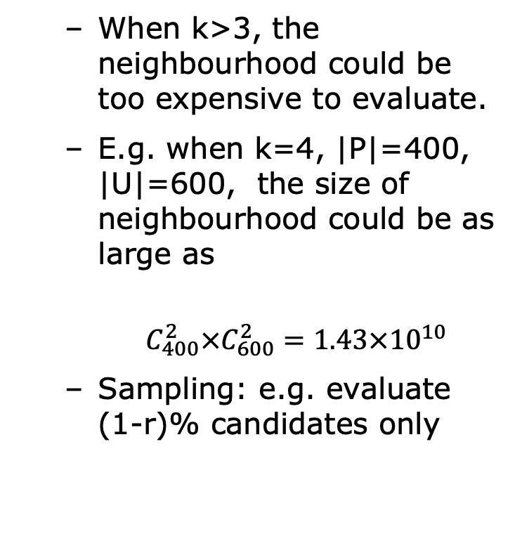
Example - Knapsack
Neighbourhoods
k-swap where k is the number of items different from currnet packing s.
Our previous pair-wise swap is 2-swap.
1-swap is equivelant to addition/removal of an item
3-swap could be 1-2 swaps or 2-1 swaps.
When k>3, the neighbourhood could be too expensive to evaluate.
E.g. when k=4, |P|=400, |U|=600, the size of neighbourhood could be as large as
$$C_{400}^{2}×C_{600}^{2}=1.43×{10}^{10}$$
Sampling: e.g. evaluate (1-r)% candidates only

Slide 26
Extensions of VNS
Reduced VNS
Change Best Descent to First Descent in local search, coupled with maximum computational time as stopping criteria.
Random Sampling

Slide 27
Extensions of VNS
Adaptive Large Scale Neighbourhood Search (ALNS) (Ropke & Pisinger, 2006)
Current Solution
Adaptive Selection Mechanisms
Local Search Neighbourhoods
Destroy Opertors
Repair Opertors
Simulated Annealing
Acceptance Criteria
S. Ropke, D. Pisinger An adaptive large neighborhood search heuristic for the pickup and delivery problem with time windows. Transportation Science, 40 (4) (2006), pp. 455-472.
doi: http://www.doi.org/10.1287/trsc.1050.0135

Slide 28
Conclusions
Tabu Search
Simple to implement, general to many problems
Effective in preventing cycling
Exploration through long-term memory
VNS
Simple and largely applicable
Efficient and effective, especially constrained CO problems.
Robust: performs well for various problems
Flexible to extend: allows development of variations/extensions

Slide 29
Next lecture
Population based metaheuristics
Genetic algorithm

