Slide 1
Artificial Intelligence Methods (AE2AIM)
Lec. 08: ACO & PSO
Dr. Xinan Chen (Room PMB442)
School of Computer Science
The University of Nottingham Ningbo, China
Email: xinan.chen@nottingham.edu.cn

Slide 2
In this lecture
Population-based metaheuristics
Ant Colony Opimisation (ACO)
Particle Swarm Optimisation (PSO)

Slide 3
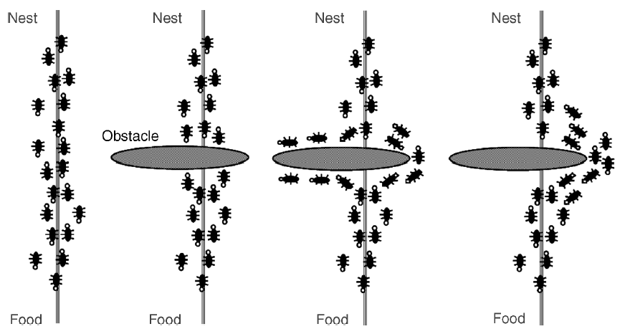
Ant Colony Optimisation

Slide 4
Ant Colony Optimisation
A metaheuritic approach that imitates the cooperative behaviour of real ants.
Pioneered by M. Dorigo.
M. Dorigo. Optimization, learning and natural algorithms. PhD thesis, Politecnico di Milano, Italy, 1992.
Ants share knowledge through traces of a chemical substance, called “pheromone”.
The larger the amount of pheromone on a particular path, the greater the probability that the ants will select the path.
The quantity of pheromone laid by each ant depends on the quality of the path (intensification).
Pheromone evaporates over time (diversification).

Slide 5
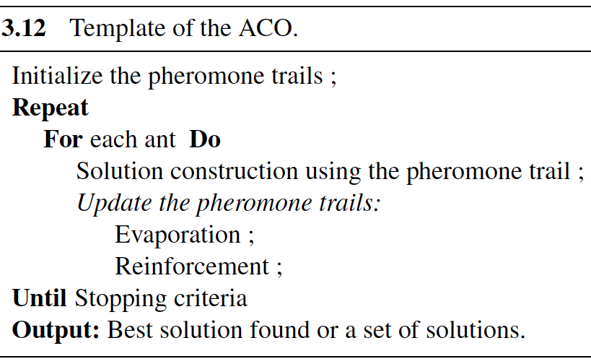
Template of ACO

Slide 6

Solution Construction
Solution construction is done by making use of
Pheromone trails: reflecting the acquired knowledge
Problem-dependent heuristic information
The construction process is stochastic

Slide 7
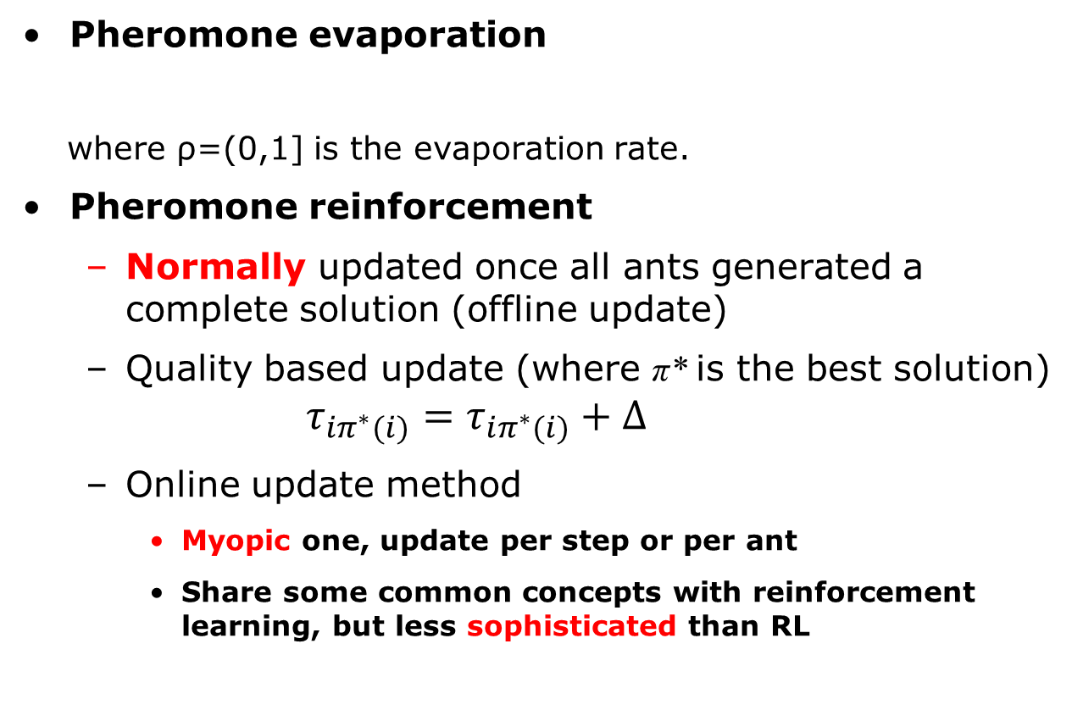
Pheromone Update
Pheromone evaporation
where ρ=(0,1] is the evaporation rate.
Pheromone reinforcement
Normally updated once all ants generated a complete solution (offline update)
Quality based update (where π* is the best solution)
$$τ_{iπ^{∗}(i)}=τ_{iπ^{∗}(i)}+∆$$
Online update method
Myopic one, update per step or per ant
Share some common concepts with reinforcement learning, but less sophisticated than RL

Slide 8
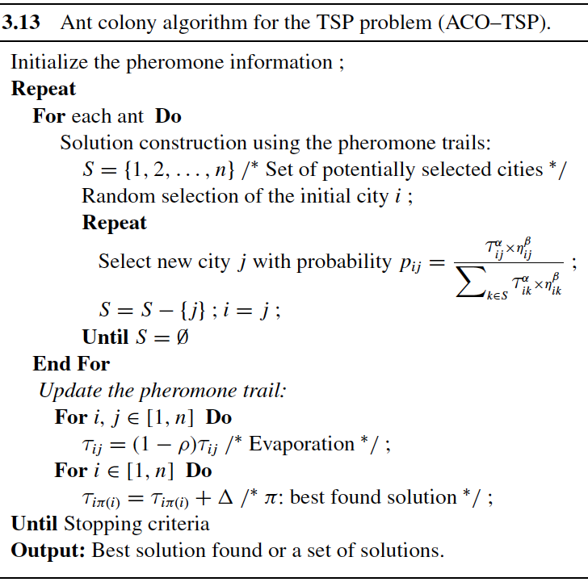
Example: ACO for TSP

Slide 9
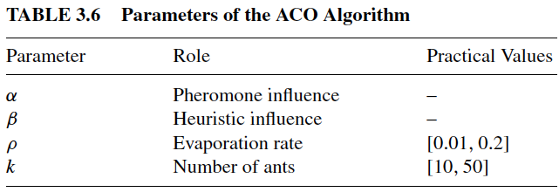
ACO Parameters

Slide 10
Particle Swarm Optimiation (PSO)

Slide 11
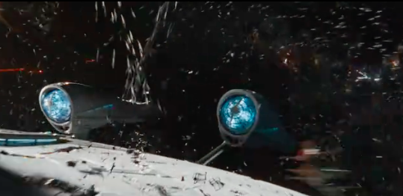
Particle Swarm Optimisation (PSO)
Swarm intelligence
mimics social behaviour of natural organisms.
Bird flocking
Fish schooling
PSO is a metaheuristic that was originally designed for continuous opitmisation problems.
Star Trek Beyond
Swarm Robotics

Slide 12
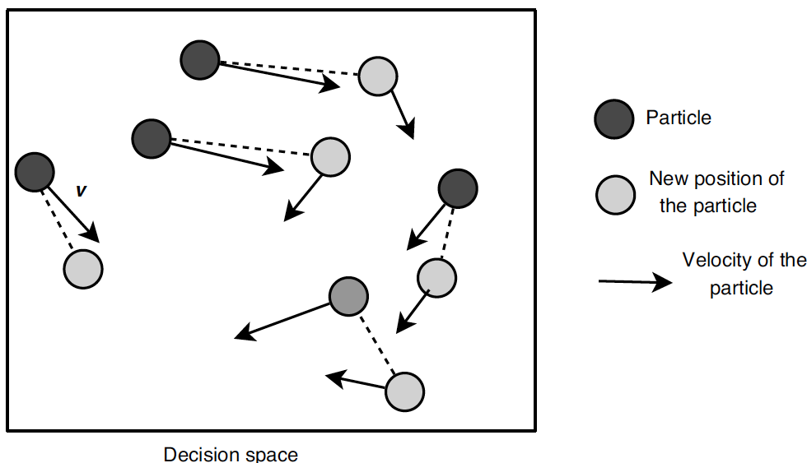
Main Principles of PSO
A swarm with N particles flying around in a D-dimensional search space.
Each particle i is a candidate solution
Solution representation x_{i}=[x_{i}¹, x_{i}², … x_{i}^{D}]
A particle has its own position and velocity
Success of some particles will influence the behaviour of their peers.
Each particle adjusts its position
towards
Personal best (pbest_{i})
Global best (gbest)

Slide 13
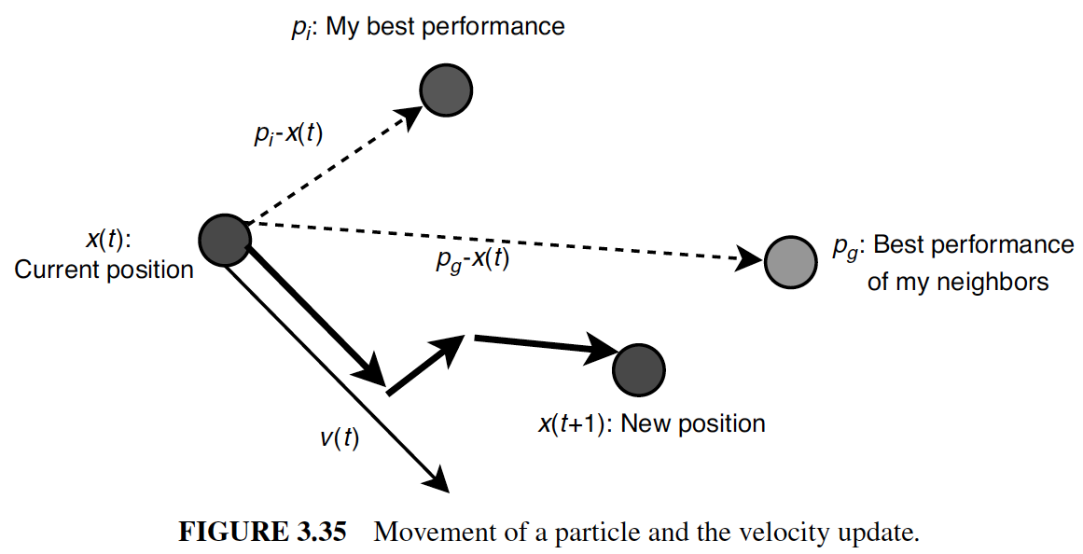
Movement of a Particle

Slide 14
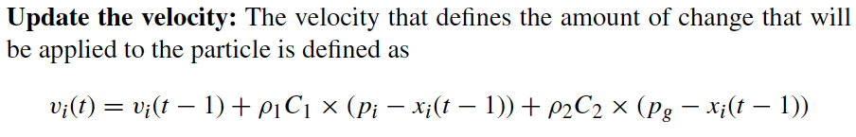
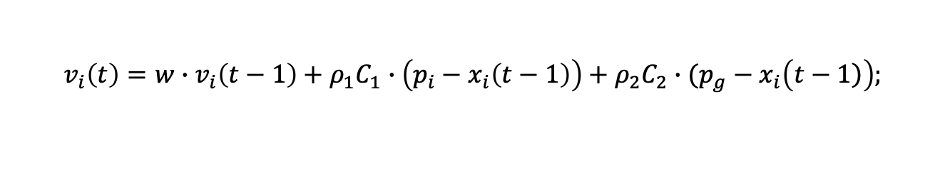
Velocity Update
$$v_{i}\left(t\right)=w∙v_{i}\left(t−1\right)+ρ_{1}C_{1}∙\left(p_{i}−x_{i}\left(t−1\right)\right)+ρ_{2}C_{2}∙(p_{g}−x_{i}\left(\left.t−1\right)\right);$$
ρ1 and ρ2 are two random variables in the range [0, 1].
The constants C1 and C2 represent the learning factors. They represent the attraction that a particle has either toward its own success or toward the success of its neighbors.
The parameter C1 is the cognitive learning factor that represents the attraction that a particle has toward its own success.
The parameter C2 is the social learning factor that represents the attraction that a particle has toward the success of its neighbors.

Slide 15
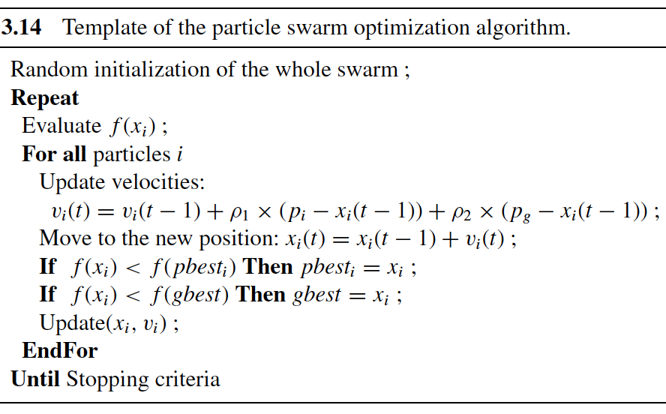
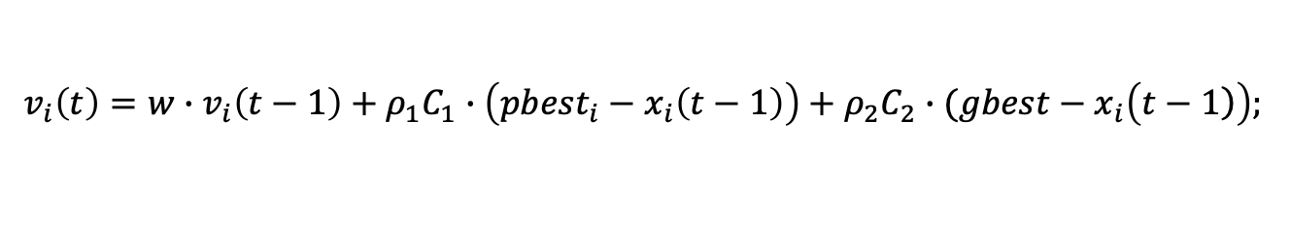
Template of PSO
$$v_{i}\left(t\right)=w∙v_{i}\left(t−1\right)+ρ_{1}C_{1}∙\left({pbest}_{i}−x_{i}\left(t−1\right)\right)+ρ_{2}C_{2}∙(gbest−x_{i}\left(\left.t−1\right)\right);$$

Slide 16
PSO for Combinatorial Optimisation Problems
PSO is traditonally used for continous optimisation problems
Some adaptation is required for discrete problems
Particle position mapping
Velocity models

Slide 17
Mapping from position vector to discrete solutions (1)
Geometric PSO
For binary solution encoding only
Three-parent mask-based crossover
Each parent is associated with a weight, representing the influence in forming the offspring.
Masks are randomly generated based on weights.
p_{g}
p_{i}
x_{i}(t+1)
x_{i}(t)

Slide 18
Mapping from position vector to discrete solutions (2)
Redefine the velocity vector operations
Subtraction (position, position) → velocity
E.g. TSP
p1 = (3,1,2,4,5) p2= (1,2,3,4,5)
v = p1 - p2 = ((1,2),(2,3))
External multiplication c*v?
No abvious way to amplify the velocity, perhaps adding more (random) elements in v.

Slide 19
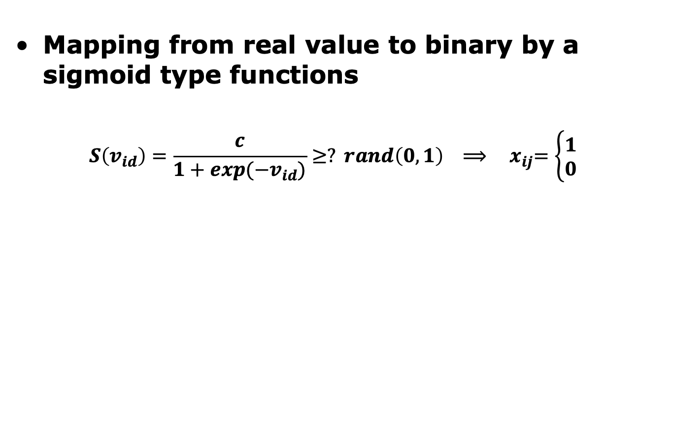
Velocity Models for Discrete Solutions
Mapping from real value to binary by a sigmoid type functions
$$S\left(v_{id}\right)=\frac{c}{1+exp(−v_{id})}≥? rand\left(0,1\right) ⟹ { x}_{ij}=\left\{\begin{aligned}1 \\ 0\end{aligned}\right.$$

Slide 20
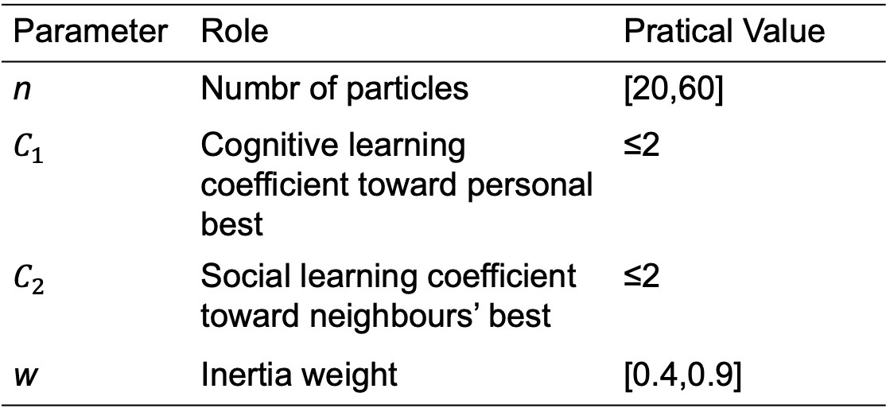
Parameters of the PSO Algorithm
Parameter | Role | Pratical Value
n | Numbr of particles | [20,60]
$C_{1}$ | Cognitive learning coefficient toward personal best | ≤2
$C_{2}$ | Social learning coefficient toward neighbours’ best | ≤2
w | Inertia weight | [0.4,0.9]

Slide 21
Remarks about PSO (1)
Each particle has a
position vector x_{i} of each particle
Each encoding a solution
velocity vector v_{i}
Each particle knows its neighbours’ best previous position and objective value
Each particle remembers its best previous position.

Slide 22
Remarks about PSO (2)
At each step, behaviour of a given particle is influenced by:
its current velocity
how much it trusts itself (w)
attraction from personal best position
How much it trusts its experience (C₁)
attracton from best neighbour’s best previous position.
How much it trust its neighbours. (C₂)

Slide 23
PSO for M-Dim Knapsack Problem
Solution encoding
Position of particle i
where n is the number of items.
Velocity of particle i
Solution decoding
Fitness function
Speed of particle i for j-th decision
Capacity of i-th dimension
Drahoslav Zan and Jiri Jaros. 2014. Solving the Multidimensional Knapsack Problem using a CUDA accelerated PSO. 2014 IEEE Congress on Evolutionary Computation (CEC), July 6-11, 2014, Beijing, China.

Slide 24
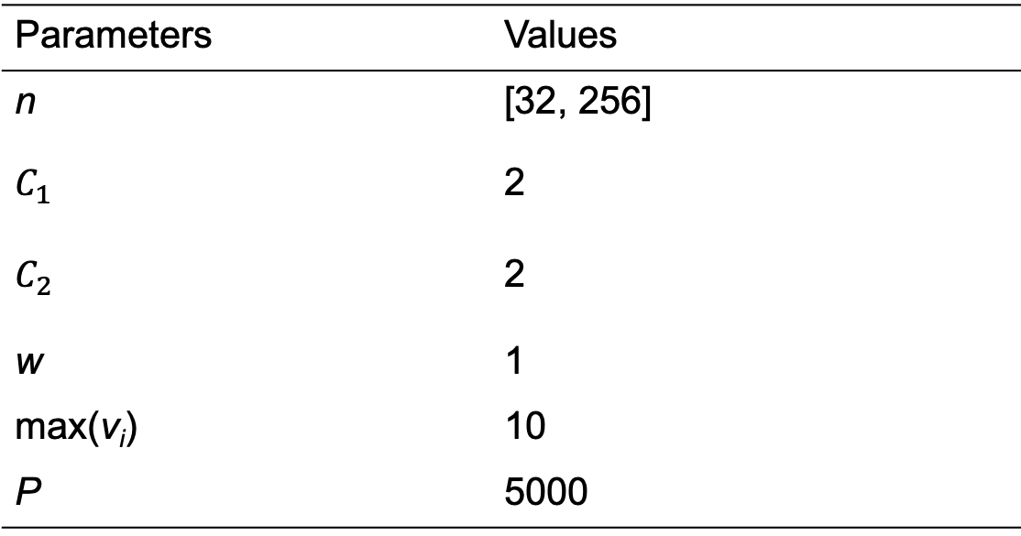
Parameters Setting
Parameters | Values
n | [32, 256]
$C_{1}$ | 2
$C_{2}$ | 2
w | 1
max(v_{i}) | 10
P | 5000

Slide 25
Computational Results

Slide 26
The next lecture
Hyper-heuristics

