Slide 1

Instructor: Dr Qian Zhang
Session 4 (2024)

Slide 2
outlines
Topic one: Definitions and examples of problems (2nd Session)
Problem formulation
Problem representation
Topic two: Problem solving by searching
Uninformed(blind) search algorithms (3rd Session)
Simplest exhaustive search
Breadth first search, depth first search, Uniform cost search
Informed search algorithms (4th Session)
Use of heuristics that apply domain knowledge
Greedy search, A* algorithm,

Slide 3
expectation
Concept of informed search and heuristic function
UCS, Greedy Search, A* Search algorithms
implementation
evaluation
Heuristic function
implementation
evaluation (admissible, domination)

Slide 4
Search Strategies
Two Categories of Strategies
Uninformed/Blind Search
No additional information about states beyond that provided in the problem definition
Informed/Heuristic Search
Uses strategies that know whether one state is more promising than the others in reaching the goal

Slide 5
Blind Search vs. Heuristic Searches
Blind search
Blindly choose where to search in the search tree: BFS or DFS
When problems get large, not practical
Heuristic search
Explore the node which is more likely to lead to the goal state through estimation
Using knowledge, so called informed search
Heuristics: educated guesses, intuitive judgments or simply common sense.
Greedy search, A* search
F
B
C
H
E
G
A
I

Slide 6
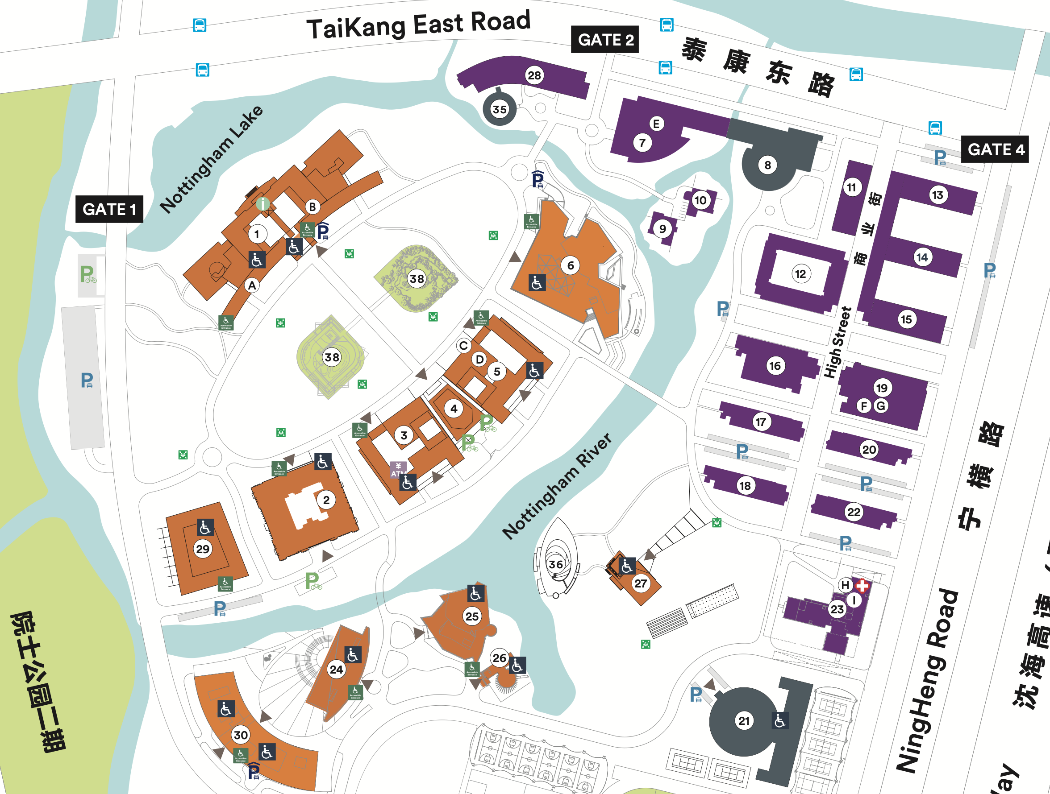
What is heuristic? Example 1
Problem
Finding shortest route from DB to Gate 1
You don’t have map
Blind Search
Travel every road,
Record the distance,
Choose shortest
Quick decision to make
Go west?
Go east?
Go north?
Go south?
Intuitive Judgment

Slide 7

What is heuristic? Example 2
Common sense
Problem
Finding a Book in a Library
Book titled "The Secrets of the Universe"
You‘re not sure where it is, you don’ have access to the information system
Blind Search
Search every floor and section
Search every aisle and shelf
Quick decision to make
Which section?
Which aisle?
Notes:
it's effective to use any relevant knowledge or assumptions you have to narrow down the possibilities and focus your search on the most promising areas.

Slide 8
Heuristic Search
Add domain-specific information to select the best path along which to continue searching
Sometimes known as informed search, it is usually more efficient than blind searches
A heuristic method is particularly used to rapidly come to a solution that is hoped to be close to the best possible answer, or 'optimal solution’ (wikipedia)

Slide 9
Heuristics function
Heuristic function h(n) estimates the “goodness” of a node n
h(n) = estimation of minimal cost path (or distance) from n to a goal state
All domain knowledge used in the search is encoded in h(n), which is computable from the current state
In general, h(n) ≥ 0 for all nodes n and h(n) = 0 implies that n is a goal node

Slide 10
Path cost vs. heuristic cost
g(N)
h(N)
Initial state O
Past Cost (N)
Current state N
Future Cost (N)
Goal state G
Path cost (O, N)
heuristic cost (N, G)
Estimation of future cost
Accumulated cost so far
Path cost (N) = Past Cost (O, N-1) + Action Cost(N-1, N)
Notes:
If I knew what future cost of G was, I will just move to that direction. The problem was solved.
In the reality, I don’t have access to future cost,
But I do have access to some-like I can potentially have access to something else, I am going to call that H of g, that is an estimation of future cost

Slide 11
Uniform Cost Search
In the previous lecture, we saw BFS and DFS operating on trees where all branches have an equal cost, we expand the frontier in a way of FIFO or LIFO
Uniform Cost Search (UCS) is a special case of BFS which can be applied to trees where the costs of each branch vary
UCS works by expanding the lowest cost node on the frontier => Return GENERAL-SEARCH(problem, g )

Slide 12
Uniform Cost and Greedy search
 | Optimal condition | Order of nodes explored
BFS (blind) | Same cost for all branches | Shallower nodes first
UCS (blind) | Cost never decreases | Lowest past cost node first f(n) = g(n)
Greedy Search (informed) | Not optimal | Lowest future cost node first f(n) = h(n)
UCS: always remove the smallest path cost node first
Sort the frontier in an increasing order according to its path cost g(n), or
Search the frontier and remove the node of smallest cost
Greedy Search: remove the smallest future cost node first
Use domain knowledge to do future cost estimation h(n)
How close the node is to the goal state
There is no guarantee that the node explored is the best

Slide 13
Node A is removed from the queue and the revealed node (node G) is added to the queue. The queue is again sorted on path cost. Note, we have now found a goal state but do not recognise it as it is not at the front of the queue. Node B is the cheaper node. Press space.
Node S is removed from the queue and the revealed nodes are added to the queue. The queue is then sorted on path cost. Nodes with cheaper path cost have priority.In this case the queue will be Node A (1), node B (5), followed by node C (15). Press space.
Once node B has been expanded it is removed from the queue and the revealed node (node G) is added. The queue is again sorted on path cost. Note, node G now appears in the queue twice, once as G10 and once as G11. As G10 is at the front of the queue, we now proceed to goal state. Press space.
We now expand the node at the front of the queue, node A. Press space to continue.
We start with our initial state and expand it…
A
A
1
10
5
5
S
S
B
B
G
G
G
G
G
G
The goal state is achieved and the path S-B-G is returned. In relation to path cost, UCS has found the optimal route. Press space to end.
15
C
Press space to begin the search
Size of Queue: 0
Size of Queue: 1
Size of Queue: 3
Size of Queue: 0
Queue: Empty
Queue: S
Queue: A, B, C
Queue: B, G11, C
Queue: G10, G11, C15
Queue: Empty
Nodes expanded: 0
Nodes expanded: 1
Nodes expanded: 2
Nodes expanded: 3
Current action: Waiting….
Current action: Expanding
Current action: Backtracking
Current action: Expanding
FINISHED SEARCH
Current level: n/a
Current level: 0
Current level: 1
Current level: 0
Current level: 1
Current level: 2
UNIFORM COST SEARCH PATTERN

Slide 14
Heuristic Searches – greedy search
Use as an evaluation function f(n) = h(n), sorting nodes by increasing values of f
Selects node to expand believed to be closest (hence “greedy”) to a goal node (i.e., select node with smallest f value)
Not complete
Not optimal, as in the example.
assuming all arc costs are 1, then greedy search will find goal g, which has a solution cost of 5
however, the optimal solution is the path to goal I with cost 3
a
h=2
b
f
h=4
c
h
h=1
h=1
d
h=1
i
h=0
e
h=1
g
h=0
Notes:
Estimation can be wrong

Slide 15
Heuristic Searches – greedy search
Go to the city which is the nearest to the goal city
It is possible to get stuck in an infinite loop: not complete
71
Odarea
Neamt
Iasi
Zerind
151
75
87
92
Arad
140
Sibiu
Fagaras
Vaslui
99
118
80
Timisoara
Rimnicu Vilcea
211
142
Urziceni
98
111
Lugoj
97
Pitesti
85
Hirsova
70
146
Mehadia
101
Bucharest
86
75
Not Complete
Dobreta
138
90
120
Eforie
Craiova
Giurgui
h_{sld}(n) = straight line distance between n and the goal

Slide 16
Heuristic Searches – greedy search
Go to the city which is the nearest to the goal city
Is it optimal, using h to order nodes to be explored?
71
Odarea
Not Optimal
Neamt
Iasi
Zerind
151
75
87
92
Arad
140
Sibiu
Fagaras
Vaslui
99
118
80
Timisoara
Rimnicu Vilcea
211
142
Urziceni
98
111
Lugoj
97
Pitesti
85
Hirsova
70
146
Mehadia
101
Bucharest
86
75
138
90
Dobreta
120
Eforie
Craiova
Giurgui
h_{sld}(n) = straight line distance between n and the goal
16

Slide 17
Greedy Search
Function GREEDY-SEARCH(problem) returns a solution of failure
Return GENERAL-SEARCH(problem, h)
Town | SLD
Arad | 366
Bucharest | 0
Craiova | 160
Dobreta | 242
Eforie | 161
Fagaras | 178
Giurgiu | 77
Hirsova | 151
Iasi | 226
Mehadai | 241
Neamt | 234
Oradea | 380
Pitesti | 98
Rimnicu | 193
Sibiu | 253
Timisoara | 329
Urziceni | 80
Vaslui | 199
Zerind | 374
71
Odarea
Neamt
Iasi
Zerind
151
75
87
92
Arad
140
Sibiu
Fagaras
Vaslui
99
118
80
Timisoara
Rimnicu Vilcea
211
Urziceni
98
111
Lugoj
97
Pitesti
85
Hirsova
70
146
Mehadia
101
Bucharest
86
75
138
90
Dobreta
120
Eforie
Craiova
Giurgui
Performed well, but not optimal

Slide 18
Greedy Search evaluation
It is possible to get stuck in an infinite loop (consider being in Iasi and trying to get to Fagaras) unless mechanism for avoiding repeated states is in place
It is not optimal
It is not complete
Time and space complexity is O(b^{d});
where d is the depth of the search tree

Slide 19
Nodes Expanded
UCS
1.Sibiu
2.Rimnicu
3.Faragas
4.Arad
5.Pitesti
6.Zerind
7.Craiova
8.Timisoara
9.Bucharest 278
GOAL!!
Neamt
286
215
71
Oradea
Zerind
87
Iasi
Fringe in RED with g Visited in BLUE
75
Arad
140
92
Optimal route is (80+97+101) = 278 miles
140
140
118
99
Vaslui
Sibiu
99
Fagaras
Timisoara
142
111
258
80
80
211
Lugoj
Rimnicu
98
369
Urziceni
Hirsova
70
177
86
97
Pitesti
Mehadia
146
101
Bucharest
86
75
138
310 (F)
Dobreta
278 (R,P)
226 (R)
90
336
120
Craiova
Eforie
[315 (R,P)]
Giurgui

Slide 20
Greedy Search vs. UCS
Search here is basically wasted
goal
goal
start
start
UCS
Greedy
Bias “too much”: could miss shorter paths
Want to achieve this but stay: complete and optimal

Slide 21
Heuristic Searches - A* Algorithm
Combines the cost so far and the estimated cost to the goal
f(n) = g(n) + h(n)
g - cost from the initial state to the current state
h - the cost from the current state to a goal state
f - an evaluation of the state: estimated cost of the cheapest solution through n
goal
h₁
g₁
n1
start
n2
h₂
g₂

Slide 22
Heuristic Searches - A* Algorithm
A*: search algorithm to find the shortest path to a goal state using a heuristic
f = g + h
h=0
A* becomes UCS
complete & optimal*, but search undirected
g=0
A* becomes Greedy, lose optimality
*condition: when cost along path never decrease
Return GENERAL-SEARCH(problem, g + h)

Slide 23
Heuristic Searches - A* Algorithm
How to estimate h
Optimal and complete: if the heuristic is admissible.
Admissible: the heuristic must never over estimate the cost to reach the goal
h(n): a valid lower bound on cost to the goal
Fagaras
Town | SLD
… | …
Fagaras | 178
… | …
211
Bucharest
!! Admissible: g (F,B) >= h (F,B)

Slide 24
Straight Line Distances to Bucharest
Straight line distances: an admissible heuristic
Will never overestimate the cost to the goal (no shorter distance between two cities than the straight line distance)
Town | SLD
Arad | 366
Bucharest | 0
Craiova | 160
Dobreta | 242
Eforie | 161
Fagaras | 178
Giurgiu | 77
Hirsova | 151
Iasi | 226
Lugoj | 244
Town | SLD
Mehadai | 241
Neamt | 234
Oradea | 380
Pitesti | 98
Rimnicu | 193
Sibiu | 253
Timisoara | 329
Urziceni | 80
Vaslui | 199
Zerind | 374

Slide 25
ANIMATION OF A*.
Nodes Expanded
1.Sibiu
2.Rimnicu
3.Pitesti
4.Fagaras
5.Bucharest 278 GOAL!!
Neamt
71
Oradea
Zerind
Annotations: g+h=f
Fringe; Visited
87
Iasi
75
Optimal route is (80+97+101) = 278 miles
Arad
140+366=506
92
140
140
118
0+253=253
99+178=277
Vaslui
Sibiu
99
Fagaras
Timisoara
Why not 211?
142
111
80
80+193=273
Lugoj
Rimnicu
211
98
Urziceni
Hirsova
70
177+98=275
86
97
Pitesti
Mehadia
146
101
Bucharest
86
75
138
310+0=310 (F)
Dobreta
278+0=278 (R,P)
226+160=386(R)
90
120
Craiova
Eforie
315+160=475(P)
Giurgui

Slide 26
Neamt
Neamt
71
Oradea
71
Oradea
Zerind
87
Zerind
87
Iasi
Iasi
75
75
Arad
Optimal route is (80+97+101) = 278 miles
92
Arad
Optimal route is (80+97+101) = 278 miles
92
140
140
140
118
Vaslui
140
Vaslui
Sibiu
99
Faragas
118
99
Timisoara
142
Timisoara
Sibiu
Fagaras
80
142
111
211
111
80
Lugoj
Rimnicu
Urziceni
98
Lugoj
Rimnicu
211
98
Hirsova
Urziceni
Hirsova
70
97
Pitesti
86
70
97
Pitesti
86
Mehadia
Mehadia
146
101
Bucharest
86
146
101
Bucharest
86
75
138
75
138
Dobreta
90
Dobreta
90
120
Craiova
Giurgui
Eforie
120
Craiova
Eforie
Giurgui
UCS
A*
Nodes expanded:
1.Sibiu; 2.Rimnicu; 3.Faragas; 4.Arad; 5.Pitesti; 6.Zerind; 7.Craiova; 8.Timisoara; 9.Bucharest 278
Nodes Expanded:
1.Sibiu; 2.Rimnicu; 3.Pitesti; 4.Fagaras; 5.Bucharest 278

Slide 27
In terms of a search tree we could represent this as follows ....
101
Bu
5
97
Ri
Pi
3
278+0 =278
2
80
80+193 =273
177+98 =275
138
Cr
146
Si.
1
99
Cr
315+160 =475
0+253 =253
Fa
4
226+160 =386
99+178 =277
The goal state is achieved. In relation to path cost, A* has found the optimal route with 5 expansions.
211
Bu
140
310+0 =310
Maths: “g + h = f”
Ar
140+366 =506
Press space to begin the search
A* SEARCH TREE

Slide 28
A* - example
Typical solution: about twenty steps
Branching factor 3: ~ 3²⁰ states
Number of states: 9! /2 states
Aim: develop an admissible heuristic in A* that does not over estimate, to find the optimal solution
Initial State
Goal State

Slide 29
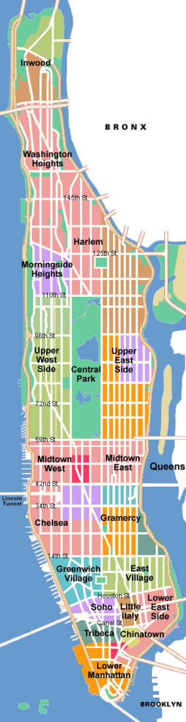
A* - possible heuristics
h₁ = no. of tiles in the wrong position
h₂ = sum of the distances of the tiles to their goal positions using the Manhattan Distance
Admissible heuristics: never over estimate
Both are admissible: which one is better?
h₁ = 4
h₂ = 5

Slide 30
Heuristics in A* Algorithm
h₂ = the sum of the distances of the tiles from their goal positions using the Manhattan Distance (=5)
1 | 3 | 4
8 | 6 | 2
7 |  | 5
5
1 | 2 | 3
8 |  | 4
7 | 6 | 5
1 | 3 | 4
8 |  | 2
7 | 6 | 5
4
1 | 3 | 4
8 | 6 | 2
 | 7 | 5
6
1 | 3 | 4
8 | 6 | 2
7 | 5
6
1 |  | 4
8 | 3 | 2
7 | 6 | 5
5
1 | 3 | 4
 | 8 | 2
7 | 6 | 5
5
1 | 3 | 4
8 | 2
7 | 6 | 5
3
1 | 3
8 | 2 | 4
7 | 6 | 5
2
1 | 3 | 4
8 | 2 | 5
7 | 6
4
1 |  | 3
8 | 2 | 4
7 | 6 | 5
1
What’s wrong with this search? is it A*?

Slide 31
Heuristics in A* Algorithm
h₁ = the number of tiles that are in the wrong position (=4)
1 | 3 | 4
8 | 6 | 2
7 |  | 5
4
1 | 2 | 3
8 |  | 4
7 | 6 | 5
1 | 3 | 4
8 |  | 2
7 | 6 | 5
3
1 | 3 | 4
8 | 6 | 2
 | 7 | 5
5
1 | 3 | 4
8 | 6 | 2
7 | 5
5
1 |  | 4
8 | 3 | 2
7 | 6 | 5
3
1 | 3 | 4
 | 8 | 2
7 | 6 | 5
4
1 | 3 | 4
8 | 2
7 | 6 | 5
3
 | 1 | 4
8 | 3 | 2
7 | 6 | 5
4
1 | 4
8 | 3 | 2
7 | 6 | 5
3
1 | 4 | 2
8 | 3
7 | 6 | 5
3
What’s wrong with this search? is it A*?

Slide 32
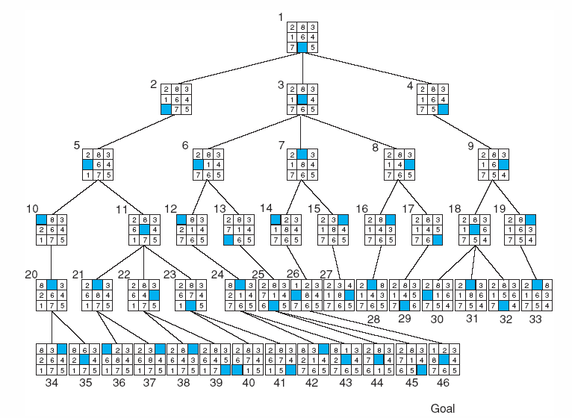
Fig Breadth-first search of the 8-puzzle, showing order in which states were removed from frontier
Luger: Artificial Intelligence, 6th edition. © Pearson Education Limited, 2009

Slide 33
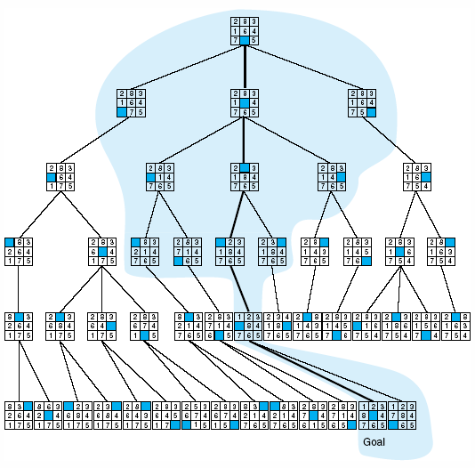
Fig Comparison of state space searched using heuristic search with space searched by breadth-first search. The proportion of the graph searched heuristically is shaded. The optimal search selection is in bold. Heuristic used is f(n) = g(n) + h(n) where h(n) is tiles out of place
Luger: Artificial Intelligence, 6th edition. © Pearson Education Limited, 2009

Slide 34
Informedness
For two A* heuristics h₁ and h₂, if h₁(n) <= h₂(n), for all states n in the search space, we say h₂ dominates h₁ or heuristic h₂ is more informed than h₁.
Domination translate to efficiency: A* using h₂ will never expand more nodes than A* using h₁.
Hence it is always better to use a heuristic function with higher values, provided it does not over-estimate (admissible) and that the computation time for the heuristic is not too large

Slide 35
Effective Branching Factor
Test from 100 runs with varying solution depths using h1 and h2
h₂ looks better: fewer nodes expanded. But why?
Effective branching factor: average no. of branches expanded
Quality of a heuristic: average effective branching factor
A good heuristic
The closer the estimate of the heuristic, the better
Lower average effective branching factor
Admissible

Slide 36
Further Reading
Heuristic searches (Chapter 3.5-3.6 AIMA)
Greedy search
A* Search
Heuristic functions

