Slide 1
COMP 3069 Computer Graphics
Lab 10: Antialiasing
Autumn 2024

Slide 2
Contents
Recognise the jaggies
Write simple OpenGL code for querying the supported number of Multisamples
Write simple GLFW code for enabling Multisampling
Experiment with Multisampling by adjusting the number of samples per pixel
Observe the improved smoothing when using more samples per pixel

Slide 3
Set-up of Lab 10
Using the instructions in Lab 1, create Lab10 project
Copy Lab10.cpp code to the Lab10.cpp in the new project
Copy the camera.h, ModelViewerCamera.h, shader.h, util.h, and window.h and add them to the Header Files
Copy mvp.vert and col.frag, and add them to the Source Files

Slide 4
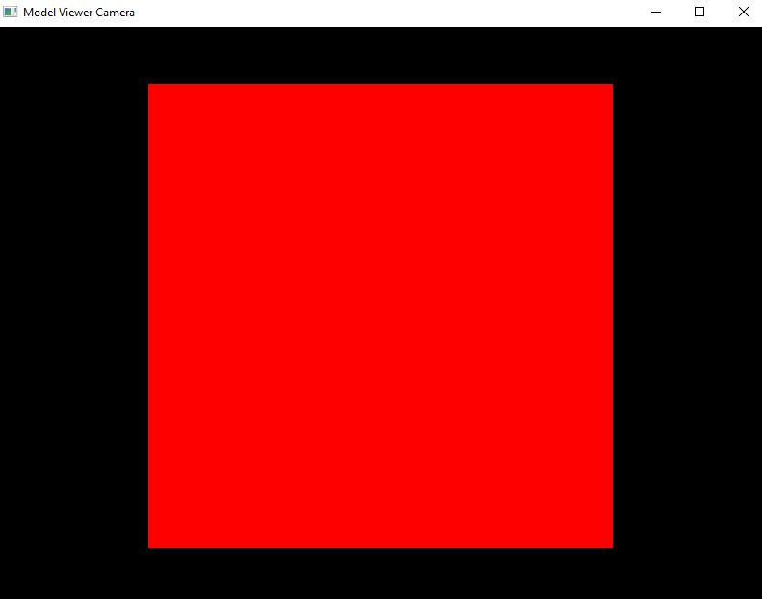
Default Display

Slide 5
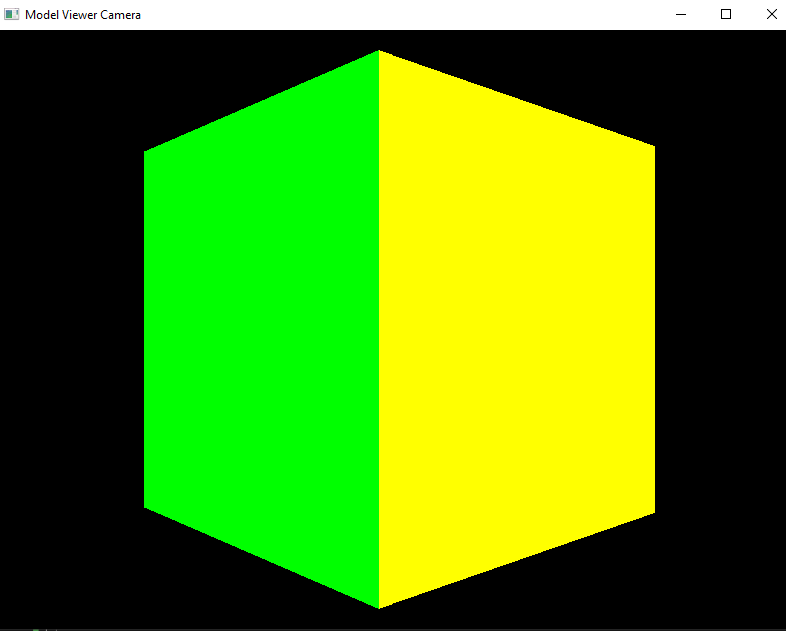
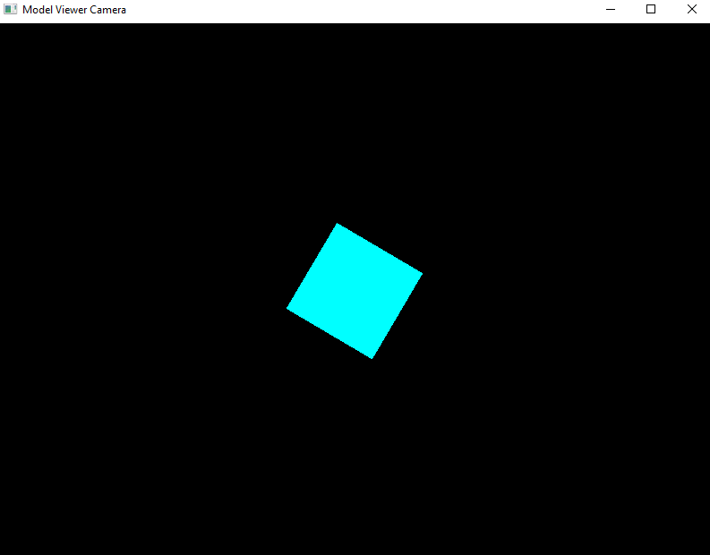
More Displays
You can rotate the camera using the arrow keys, and modify the distance using F and R keys

Slide 6
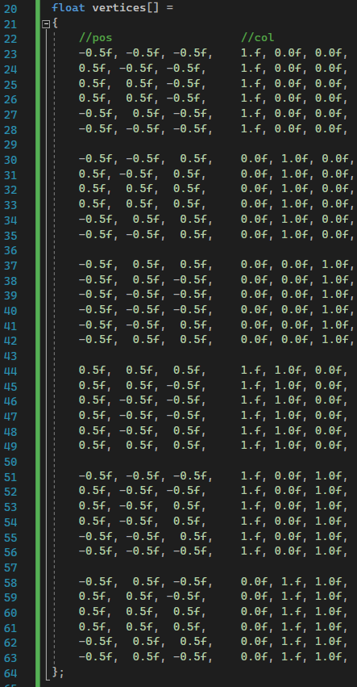
Setup Vertex Attributes

Slide 7
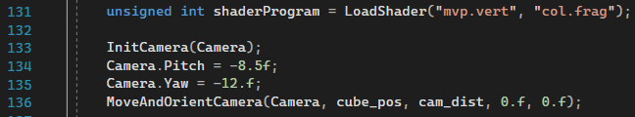
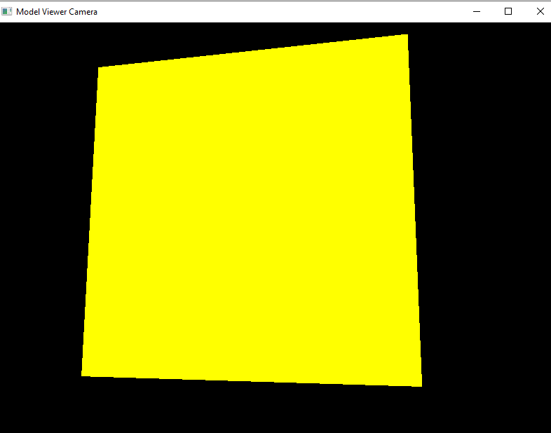
Jaggies
Initialise the camera pitch and yaw
‘jaggies’ are clearly visible

Slide 8
OpenGL glGetIntegerv()
void glGetIntegerv(GLenum pname, GLint * data)
pname is the parameter which we want to query, and data stores the value of the parameter
We use GL_MAX_SAMPLES as pname, which is the maximum supported number of samples for multisampling and is guaranteed to be at least 4

Slide 9
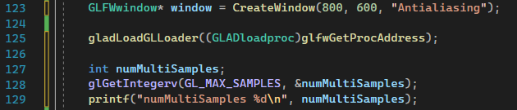
Calling glGetIntegerv()
Print the number of supported Multisamples using printf
glGetIntegerv() is called after a window is created and gladLoadGLLoader() is called

Slide 10

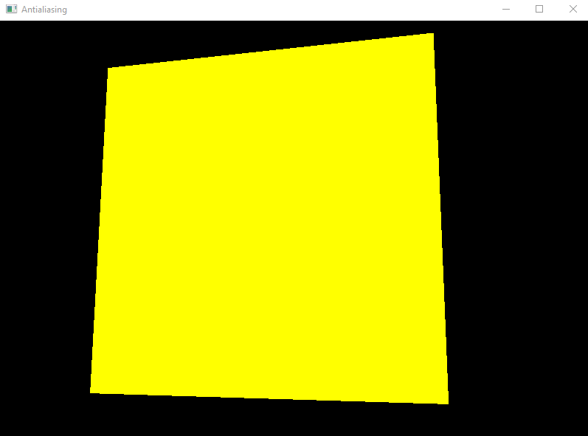
Results after glGetIntegerv()

Slide 11
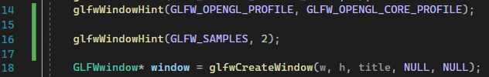
In window.h
In window.h and in the CreateWindow(), add a single line of code to enable 2x Multisampling

Slide 12
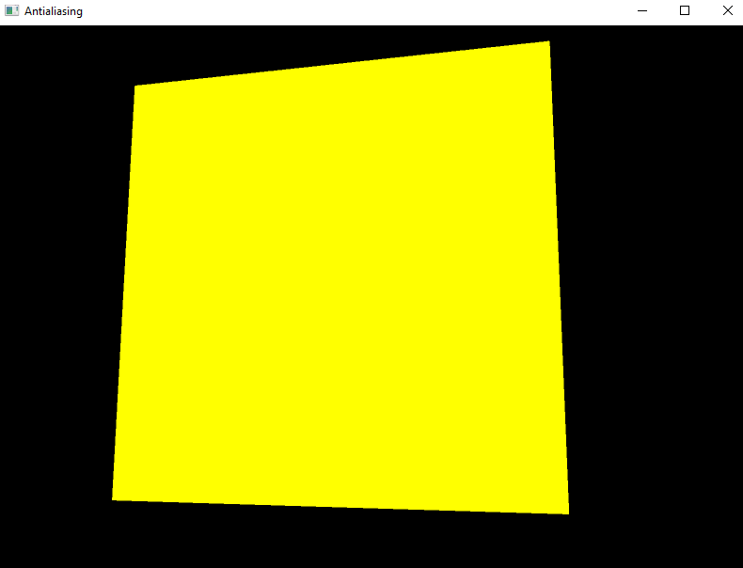
Results after 2*Multisampling

Slide 13

Results after 4*Multisampling

Slide 14
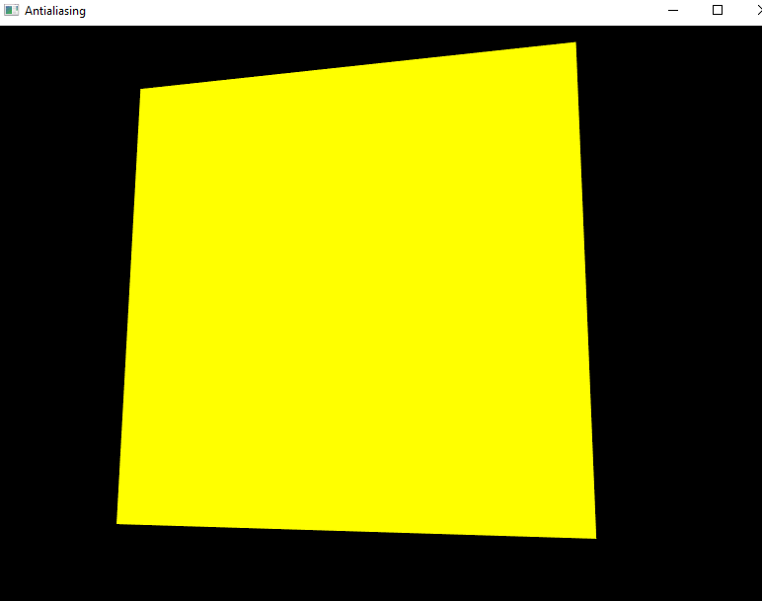
Results after 8*Multisampling

Slide 15
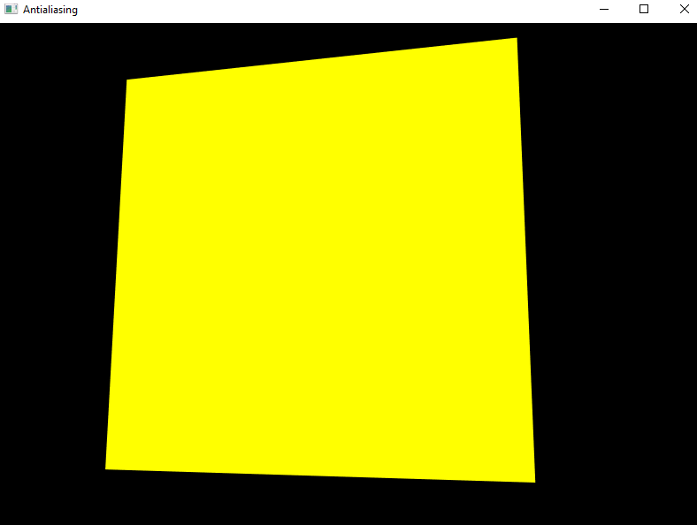
Results after 16*Multisampling

Slide 16
References
COMP3069 Lab10 notes
Interactive Computer Graphics: A Top-Down Approach with Shader-Based OpenGL, Chapter 7

