Slide 1
Professional Ethics in Computing: Seminar 4
Team 22

Slide 2
Project Overview & Ethical Goals
The Research
•Develop a mobile application that supports elderly residents with dementia in their daily activities.
•The app provides:
•Daily prompts (e.g., medicine reminders, meal times)
•Memory support for personal information
•Mental exercises to improve cognitive function.
Research Setting
•Conducted in a care home in Ningbo with around 100 elderly residents.
•Trial approved in principle by the care home; funding sought from Ningbo Municipal Government.
Ethical Goals
•Ensure respect, privacy, and safety of elderly participants.
•Gain informed consent from participants or their legal guardians.
•Follow UNNC Research Ethics Code and China’s PIPL (Data Protection Law).

Slide 3
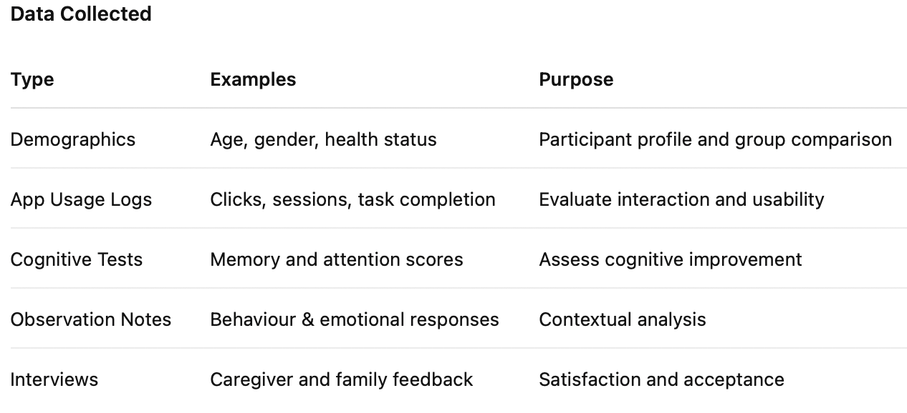
Data Collection & Participants
Participants
•65 years old and above; mild to moderate dementia.
•Recruited via care home administrators and guardians.
•Participation is voluntary and withdrawal is allowed at any time without consequence.

Slide 4
Data Anonymization & Security Measures
Anonymization
•Replace names with participant IDs.
•Remove any identifiers (voice, face, addresses).
•Publish only aggregated statistics — no personal details.
Data Storage & Security
•Encrypted storage on secure UNNC servers within China.
•Access limited to the principal investigator and approved team members.
•Encrypted back-ups kept for 5 years, then securely deleted.
•Transmission via SSL/TLS encryption to prevent leakage.
Third Parties & Transfers
•No commercial sharing or cross-border data transfer.
•Data used solely for academic and non-profit research.

Slide 5
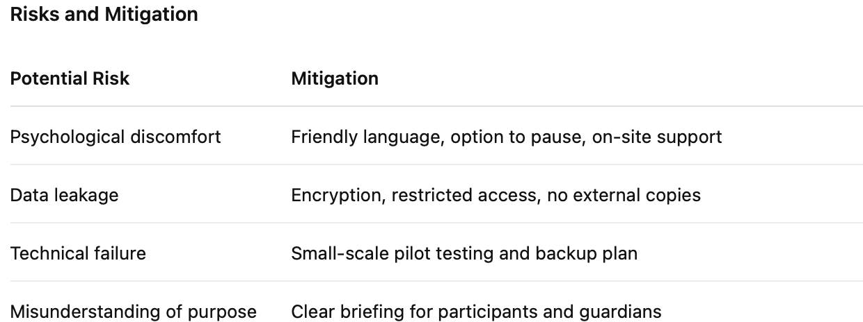
Risks, Legal Compliance & Ethical Rights

Slide 6
Legal and Ethical Framework
• Complies with China’s Personal Information Protection Law (PIPL) and UNNC Research Ethics Code.
• Informed consent forms signed by participants or guardians.
• Participants retain rights to access, correct, or delete their data.
• Research findings reported only in aggregate form for conference publication.
• No identifiable information included in any paper or presentation.
Outcome
This project will advance ethical digital health solutions for China’s ageing population while protecting participants’ rights, privacy, and dignity.

