Slide 1
Predicting 30-day hospital readmissions
By Zhanna Hakhverdyan, PhD
03.09.2020

Slide 2
Q: What’s the problem? A: Unplanned hospital readmissions are expensive
Medicare spends $26B/ year on readmissions
Of which $17B are spent on avoidable readmissions
In 2017 >2500 hospitals paid $564M in penalties for excessive 30-day readmissions
Patient experience and outcome is worse for readmitted patients

Slide 3
Care management programs to the rescue
Hospitals enroll patients at high risk of readmission into Care Management Programs
Care management programs cost money and time
Hospital saves money on readmission costs of correctly identified patients
Hospital wastes money on care management programs targeted at incorrectly identified patients
How do hospitals identify patients at high risk of readmission to optimally allocate limited resources?

Slide 4
Existing solutions vs proposed solution
HOSPITAL score is currently used by many hospitals to score readmission risk
Uses 7 predictive variables for risk score assignment
Proposed solution – machine learning model with a wider array of predictive variables

Slide 5
How much money should the proposed model save to be useful?
Hypothetical possible savings*
HOSPITAL score
Positive prediction rate
False alarm rate
The HOSPITAL score can save ~57% of unplanned 30-day readmission costs
In order to be useful the machine learning model has to save more
* Based on following assumptions: $18k cost for FN patients, $1.5k cost for FP patients, 10% readmission, TPR_HOSPITAL=0.6, FPR_HOSPITAL=0.4

Slide 6
Analysis workflow
1. Data wrangling
4. Final evaluation & interpretation
5. Hospital savings analysis
2. Exploratory data analysis
3. Feature selection & machine learning

Slide 7

1. Data wrangling
Dataset used
MIMIC-III : electronic medical record (EMR) data
Tables | Variables | # of features
ADMISSIONS PATIENTS | demographic Hospital stay | 22
SERVICES CPT_EVENTS | services procedures | 36
LAB_EVENTS | Lab test results | 69
DRG_CODES | diagnosis | 187
Total |  | 314
Python libraries and packages used:
Pandas, NumPy, NLTK, TF-IDF vectorizer

Slide 8
Feature engineering
Tables | Operations performed
ADMISSIONS PATIENTS | Categories were grouped when possible, e.g. ethnicity Categories with < 0.5% examples were grouped with most frequent category One-hot-encoding of categorical variables Calculate prior admissions and length of stay
SERVICES CPT_EVENTS | Calculate the number and type of services Select top 11 services (98%) Calculate the number and type of procedures Pick top 23 procedures (99.8%)
LAB_EVENTS | 3 features per lab test per admission Average, variance, count
DRG_CODES | Concatenate diagnosis descriptions Select words that occur in <50% of fields Encode description field with top 200 words
A number of columns were used as is
Median of the column was imputed for missing values
Columns with > 20% missing values were discarded

Slide 9
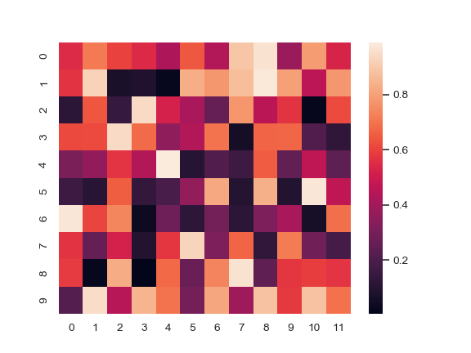
2. Exploratory data analysis
Examine variable relationship to the output label – positive or negative for 30 day readmission
Examine intervariable correlations and relationships
Libraries and packages used: Matplotlib, Seaborn, SciPy(stats)

Slide 10
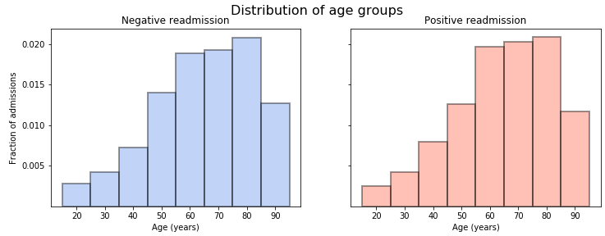
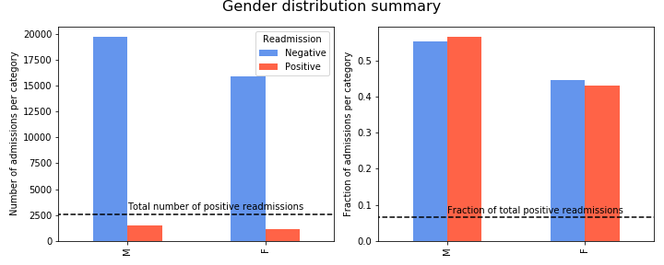
Age and gender distribution of readmitted patients
Patient age is similar in readmitted and non-readmitted groups
More men admitted to hospital overall
No difference in gender proportions in positive readmission group

Slide 11
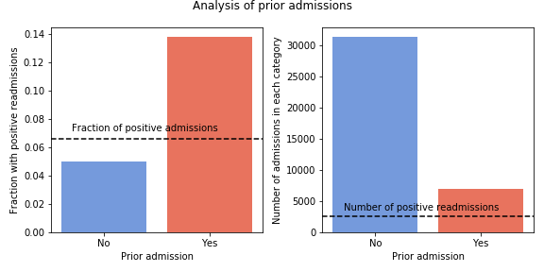
Positive readmissions are likely to have a prior admission within a year
Readmission group | Chi square statistic | P value
Negative | 47 | E-12
Positive | 657 | E-145
Patients in the positive readmission group have significantly more prior admissions
Patients in the negative readmission group have significantly less prior admissions

Slide 12
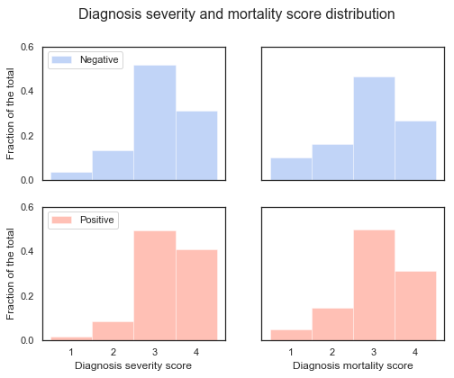
Diagnosis severity and mortality scores are higher for positive readmissions

Slide 13
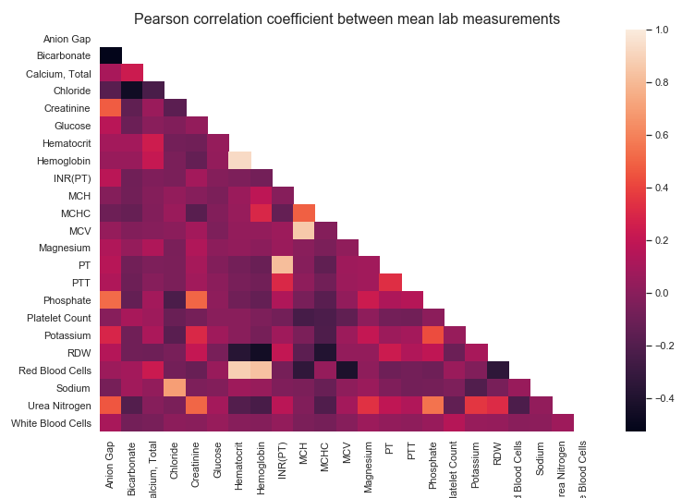
Pearson correlation coefficient identifies linearly correlated columns
Strong positive correlation

Slide 14
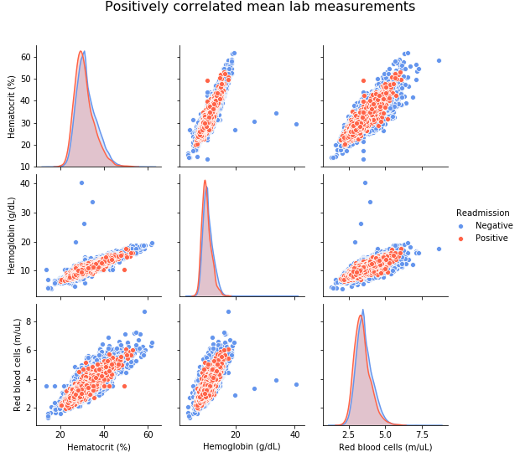
Inspection of positively correlated examples
Positively correlated lab measurements are meaningful
On average, patients who will be readmitted in 30 days have lower hematocrit, hemoglobin and red blood cell measurements

Slide 15
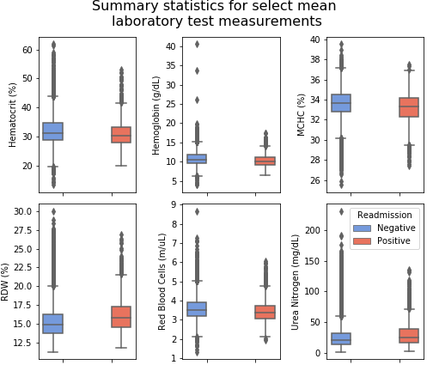
Laboratory test results that are different for positive readmissions
* T test for mean difference of 2 independent samples with unequal variance. P value < 0.01

Slide 16
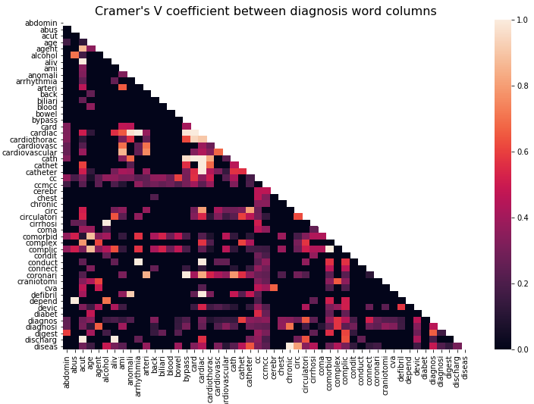
Cramer’s V coefficient identifies strong associations between categorical variables

Slide 17
Manual inspection of diagnosis word associations
Word | Associated words
acut | agent, aliv, complex, discharg
age | comorbid, complic
alcohol | cirrhosi
anomali | cardiac, defibril
arrhythmia | cardiac, conduct
arteri | cardiovascular, coronari
bypass | cardiac, cath, coronari
card | cardiac, cardiothorac, cath
Note, the incomplete words are result of text processing (stemming)
The analysis looks reasonable, e.g. age is associated with comorbid(ities) and complic(ations), alcohol with cirrhosis(s) etc.

Slide 18
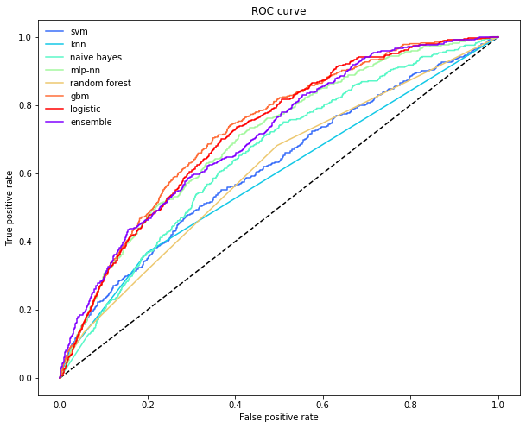
3. Feature selection and machine learning
Define metrics for machine learning model evaluation
Fit a machine learning model with and without feature selection
Fit several machine learning models on reduced feature dataset
Pick a final model based on evaluation metrics

Slide 19
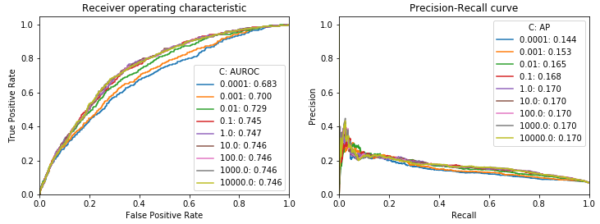
Fit a logistic regression model without feature selection (314 features)
Feature importance determined by the magnitude of coefficients
C is the regularization parameter, high C value = larger coefficients
Smaller C coefficients favor simpler models
The best performance is achieved at C=1, after which there is no further improvement

Slide 20
Feature selection
Eliminate strongly associated features, helps model interpretation
Pearson correlation coefficient = strength of linear correlation between numerical features
Remove redundant variables |Pearson corr. Coef.| >=0.9
Cramer’s C = strength of association between categorical variables
Remove redundant variables Cramer’s C >= 0.9

Slide 21
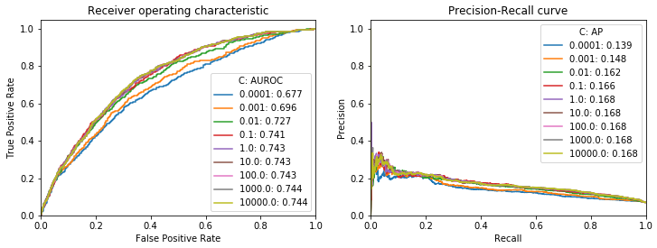
Fit a logistic regression model after feature selection (188 features)
The AUROC and AP are slightly smaller (by 0.04 and 0.02 respectively)
Acceptable trade-off for eliminating ~40% of features
Next, fit other models on reduced feature set

Slide 22
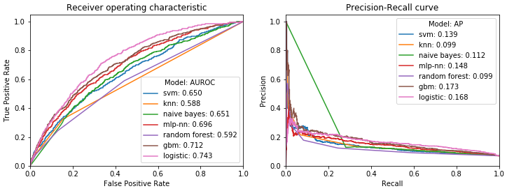
Logistic regression has the best predictive performance
Gradient boosting machine (GBM) has better AP than logistic regression, also smaller AUROC
Logistic regression is a preferable model to GBM (ensemble model)
Proceed the analysis with the logistic regression model

Slide 23
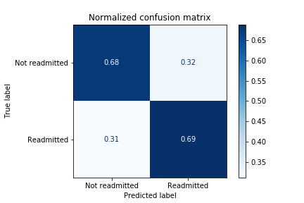
4. Final evaluation & interpretation
Calculate the full classification report
Plot the confusion matrix
Final tally of correct and missed predictions
Interpret feature coefficients
Are the features with largest coefficients meaningful?
Where to go next with this analysis

Slide 24
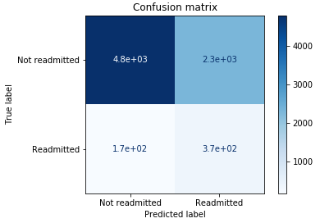
Final logistic regression model metrics
 | precision | recall | f1-score | support
Not readmitted | 0.97 | 0.68 | 0.8 | 7109
Readmitted | 0.14 | 0.69 | 0.23 | 534
accuracy |  |  | 0.68 | 7643
macro avg | 0.55 | 0.69 | 0.51 | 7643
weighted avg | 0.91 | 0.68 | 0.76 | 7643

Slide 25
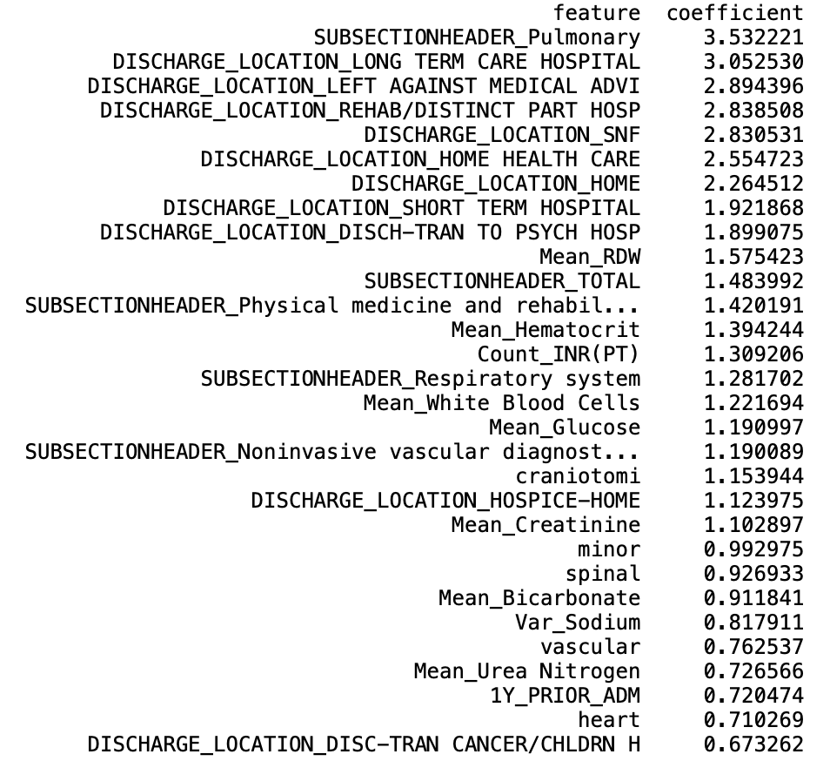
Model coefficient interpretation
Top 30 features for predicting readmission
Discharge locations – especially transfers to other healthcare facilities – indicates more acute condition
Procedures – especially pulmonary and respiratory
Mean lab measurements, indicating chronic conditions, e.g. glucose (diabetes), urea nitrogen (kidney malfunction), hematocrit (anemia), etc.
Diagnosis description words – brain surgery and cardiovascular condition
Prior admission in the proceeding year

Slide 26

5. Hospital savings analysis
Hypothetical possible savings*
Proposed model (73%)
HOSPITAL score (57%)
Positive prediction rate
False alarm rate
The proposed logistic regression model will save the hospital additional 16%, on top of the HOSPITAL score, hence it is worth adopting!
* Based on following assumptions: $18k cost for FN patients, $1.5k cost for FP patients, 10% readmission, TPR_HOSPITAL=0.6, FPR_HOSPITAL=0.4

Slide 27
Future work for improving the model
The presented model suffers from high bias, and (to a much lower degree) high variance
Mean train accuracy 0.688, mean test accuracy 0.677
Proposed solutions:
Add more features, e.g. vital signs, prescriptions
Gather more data
Fit non-linear models
Apply deep learning language models, e.g. BERT on clinical notes

Slide 28

Acknowledgements
Thomas Blanchard (mentor)
Springboard

Slide 29
Evaluation metric definition
True positive rate (TPR) = positive prediction rate, the fraction of admissions followed by 30-day readmission that the model identifies
The higher the TPR, the more $s the hospital saves
False positive rate (FPR) = False alarm rate, the fraction of incorrectly flagged positive readmissions out of total negative readmissions
The higher the FPR, the more $s hospital spends on wrong patients
AUROC = area under receiver operating characteristic curve, a metric which combines TPR & FPR
Higher AUROC, more $s saved
Precision = the fraction of admissions flagged by the model that will actually result readmission
The higher the precision, the less $s hospital spends on wrong patients
Recall = TPR
AP = Average precision, a metric to combine precision and recall
Since the dataset is imbalanced AUROC can give overly optimistic view, hence use both AUROC and AP

