Slide 1
Heartbeat classification with ANN (MIT-BIH dataset)
Zhanna Hakhverdyan
04.30.20

Slide 2
Problem statement
Arrhythmia diagnosis requires many hours worth of ECG signal interpretation
Manual analysis is time and labor intensive
The ECG test administrations are expected to grow
There is a need for reliable automated tools for beat classification

Slide 3
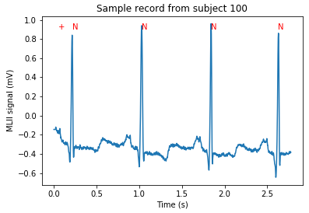
Dataset description
MIT-BIH arrhythmia dataset:
https://physionet.org/content/mitdb/1.0.0/
48 30 min ECG recordings from 47 subjects
2-lead ECG signal
109,000 beat labels

Slide 4
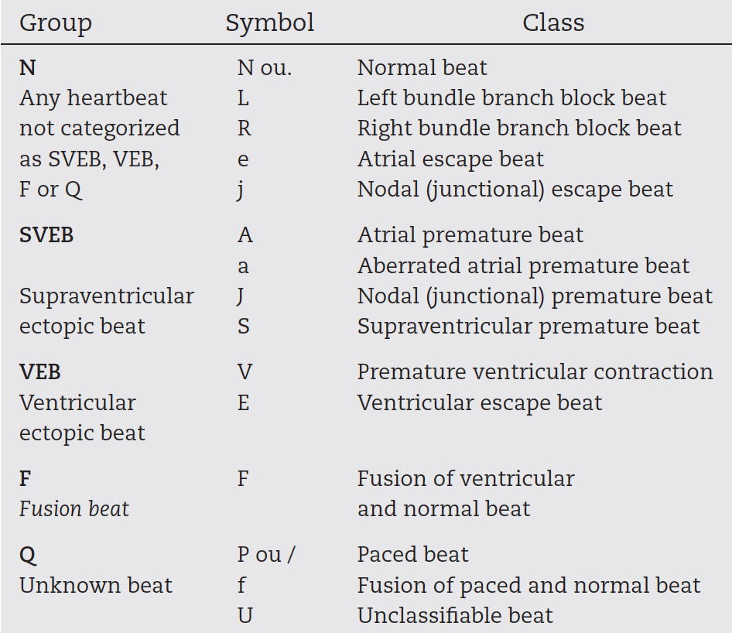
5 standard heartbeat classes*
1.
2.
3.
4.
5.
* Specified in ANSI/AAMI EC57:1998/(R)2008

Slide 5
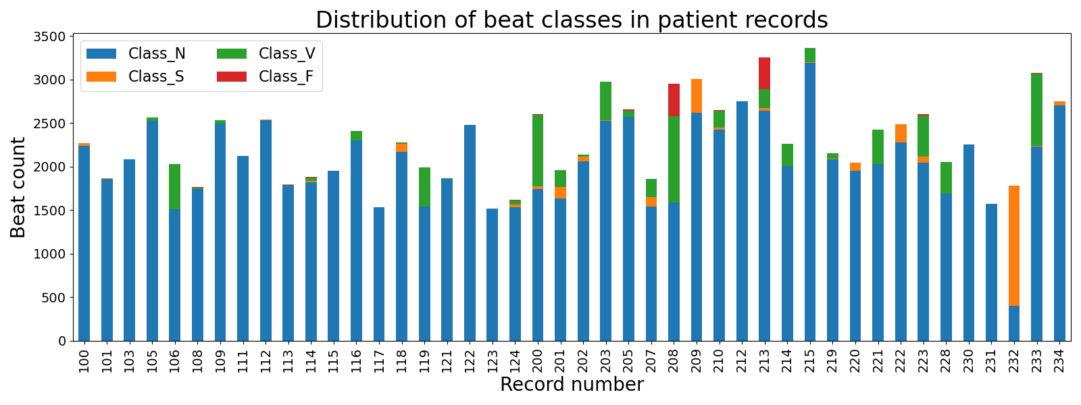
Arrhythmic beats are an unevenly distributed minority
Class | Count | Fraction
N | 90125 | 0.895
S (SVEB) | 2781 | 0.028
V (VEB) | 7009 | 0.070
F | 803 | 0.008
Q | 15 | 0.000 (class excluded, too few)

Slide 6
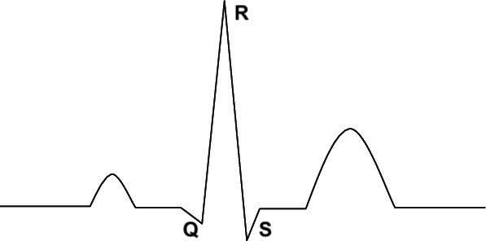
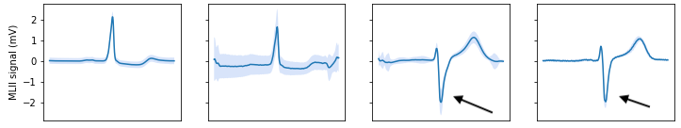
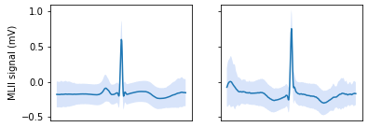
Heartbeat morphology variation
Canonical heartbeat
a. Non-biological, intra-record variation
Average +/- 1 standard deviation, record # 114
N S V F
Baseline drift
Peak inversion
b. Biological, inter-record variation
Average +/- 1 standard deviation, record # 222
N S
Different patient

Slide 7
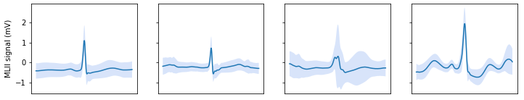
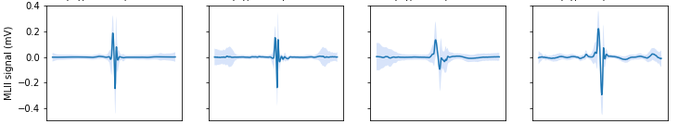
Feature transformation steps
Variation source | Transformation / action
Baseline drift | Take the difference of consecutive points
Peak inversion | Take the absolute value of the signal
Different patients | Split the dataset for training on patient records
Average +/- 1 standard deviation BEFORE
N S V F
Average +/- 1 standard deviation AFTER
N S V F

Slide 8
Split Train, Val, Test sets on records
Dataset | # of records | N count (%) | S count (%) | V count (%) | F count (%)
Train | 30 | 59446 (88.8) | 2330 (3.5) | 4768 (7.1) | 403 (0.6)
Validation | 4 | 9015 (91.4) | 140 (1.4) | 685 (6.9) | 20 (0.2)
Test | 10 | 21664 (90.6) | 311 (1.3) | 1556 (6.5) | 380 (1.6)
Total | 44 | 90125 (89.5) | 2781 (2.8) | 7009 (7.0) | 803 (0.8)
Dataset composition (record #)
Train: 101, 103, 105, 106, 109, 111, 112, 113, 115, 116, 117, 119, 121, 122, 123, 200, 201, 202, 205, 207, 208, 209, 212, 219, 221, 222, 230, 231, 232, 233
Validation: 100, 124, 215, 223
Test: 108, 114, 118, 203, 210, 213, 214, 220, 228, 234

Slide 9
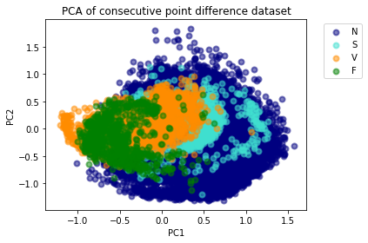
2-dimensional visualization with PCA
PCA of transformed dataset
The 4 classes are not well separated

Slide 10
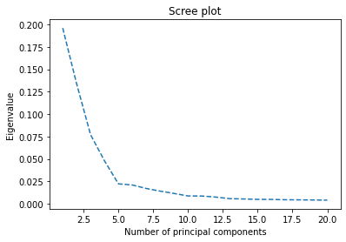
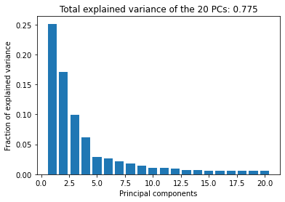
Dimensionality reduction: PCA
The first 5 PCs account for the most variance
The first 20 PCs represent ~80% of variance
Next: apply machine learning models on PCA-transformed dataset (20 PCs)

Slide 11
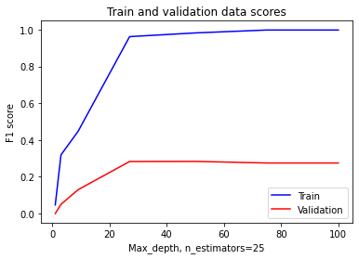
Ensemble models have poor precision and sensitivity
Example learning curves for random forest tuning
Even with extensive tuning ensemble machine learning models had low classification performance (below)
 | V class |  |  |  | S class |  |  |  | F class | All classes
Model/metric* | Se | Pr | FPR | Acc | Se | Pr | FPR | Acc | Se | Sp | Acc
RF | 0.531 | 0.604 | 0.024 | 0.947 | 0.003 | 0.05 | 0.001 | 0.986 | 0 | 0.928 | 0.876
GBC | 0.584 | 0.38 | 0.067 | 0.911 | 0.026 | 0.17 | 0.002 | 0.986 | 0.195 | 0.93 | 0.884
Cardiologist# | 0.652 | 0.5 |  |  | 0.408 | 0.504
* Se – sensitivity, Pr – precision, FPR – false positive rate, Acc – accuracy, Sp - specificity
# https://www.ncbi.nlm.nih.gov/pmc/articles/PMC6784839/

Slide 12
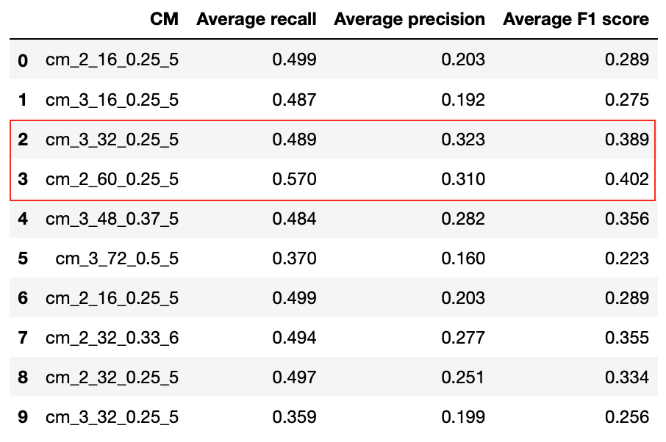
Heartbeat classification works better with convolutional neural nets
Went back to the 360-dimensional dataset before PCA transformation
Trained and tuned convolutional neural nets of various architecture
1-4 layers, 16-72 nodes, 3-6 kernel size, 0.2-0.5 dropout rate

Slide 13
Refined model use case
Expedite and simplify cardiologist review process instead of replacing
Sample beat review workflow:
The model predicts and labels the abnormal beats
Cardiologist reviews all abnormal predictions
With 24-48h recording sensitivity is not an issue
Precision should be as high as possible to save time
Pick a model based on maximum time saving:
Time saving
86%
83%

Slide 14
Best performing model architecture
High level architecture
Input layer
Dropout
All dropout rate 0.25
3 convolution layers each with:
32 filters
kernel size 5
RELU activation
1 maxpool layer
1 dense layer with:
32 nodes
RELU activation
Conv1D
Dropout
3x
MaxPool
Flatten
Dense
Output layer

Slide 15
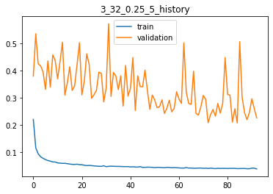
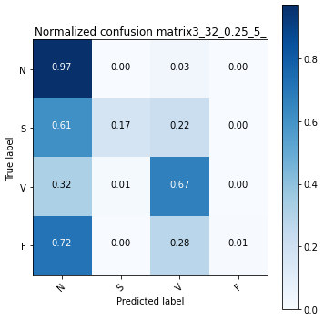
Model training and classification summary
Model has high variance
Expected because of inter-record variation
Longer training did not improve F1 score
Loss
Epochs
S class has poor sensitivity compared to V class
F class is nearly not detected
If all abnormal beats are reviewed 22% extra of the S class and 28% extra of the F class beats will be found

Slide 16
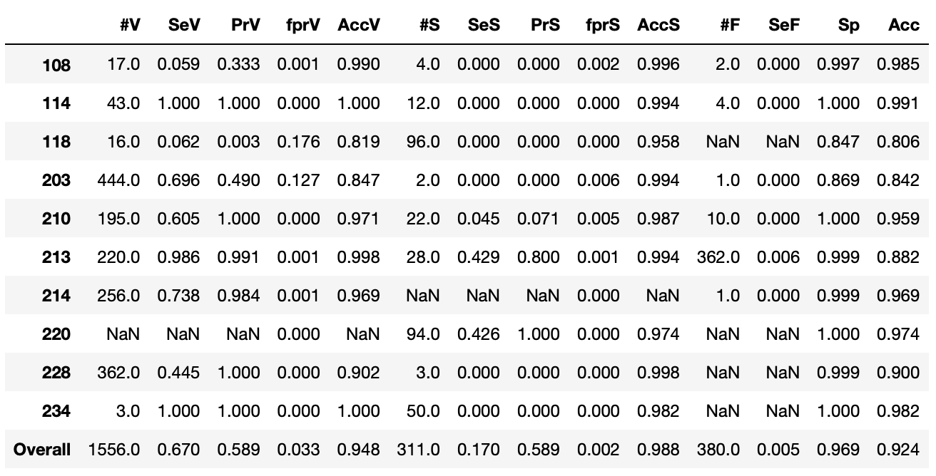
The model has variable but adequate performance for V and S classes
*
* #-count, Se-sensitivity, Pr-precision, fpr-false positive rate, Acc-accuracy, Sp-specificity
poor
adequate
good
inconclusive
Class V identified better than class S
Different records have varying sensitivity and recall for classes V and S
Class F poorly identified across records, probably because ~91% of class F beats belong to 2 records
Overall specificity and accuracy are high for all records because of heavy class imbalance (N class is well predicted)

Slide 17
Model output visualization
Labeled heartbeat records available on Heroku for easy navigation:
https://arrhytmia-detector.herokuapp.com

Slide 18

Acknowledgements
Thomas Blanchard (mentor)
Springboard

