Slide 1
Beaver County Extreme
Advanced Programming Project

Slide 2
Who?
Young athletes
Coaches
Troubled kids/young adults

Slide 3

What
To provide an alternative platform that enhances the skillset of each student athlete in order to build their skillsets in basketball and the classroom in preparation for the collegiate level.

Slide 4
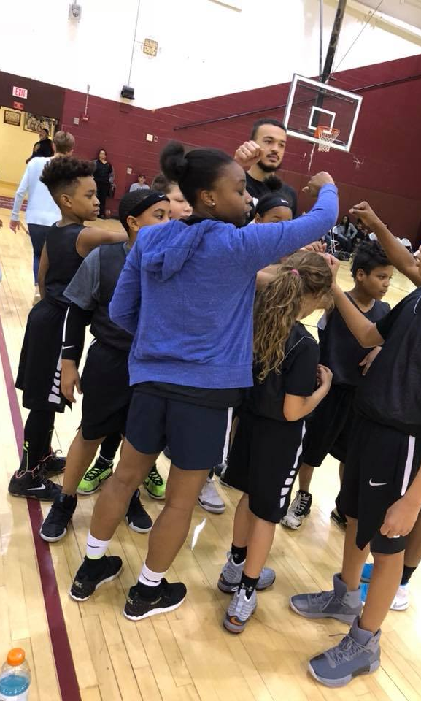
Why?
Not enough money to play for other organizations.
Not asked to play anywhere else.
Struggling in the classroom.
Experience.

Slide 5
HOW?
HTML - Bootstrap
CSS
MySQL
Node.js

Slide 6
issues
Ajax function
Getting the information to display to the database
Comments board with model view controller
Posting more than one event to the homepage.

Slide 7
Contributors
Sam- Application forms, CSS
Zayne- Homepage and Admin Page – HTML, MySQL database
Kenny- Comment Section

Slide 8
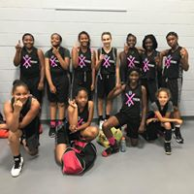
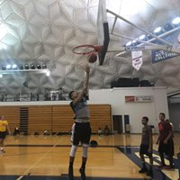
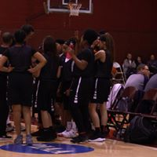
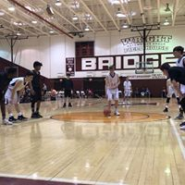

Slide 9

Questions?

