Slide 1

Guided Capstone Project presentation
Big Mountain Resort Pricing Strategy
Bakhyt Zhamankulov
2/21/2024

Slide 2
Addressing Big Mountain Resort's Financial Challenge
Context:
Big Mountain is a modern, well-equipped resort with Annual attendance is about 350,000 people.
Problem:
The current pricing policy does not take into account the infrastructural advantages of the resort, which limits the company's investment strategy.
Main question:
How to maximize resort capitalization to implement a new pricing strategy and cover $1,540,000 in operating costs.

Slide 3
Strategic Pricing Recommendation
Increase ticket prices to $95, marking a 20% increase from the current price.
Potential income of around $24,500,000, comfortably covering operating costs and additional investments.
Optimal cost optimization strategy
Scenario No. 2 (adding a run, increasing the vertical drop by 150 feet, and installing an additional chair lift) will allow us additional increase in ticket revenue to $3,474,638.

Slide 4
Foundation of Our Analysis
Data wrangling: to ensure a high-quality analysis, we conducted thorough data preprocessing and collected relevant statistical information from open sources for each US state, which made it possible to identify additional informative attributes.
Exploratory Data Analysis (EDA): we took a deep dive into our data to check its relevance, identify patterns and trends, which was an important basis for price modeling.
Modelling and training: we built Linear regression and Random Forest models, for each of which we tested various combinations of hyperparameters, features and data preprocessing conditions.

Slide 5
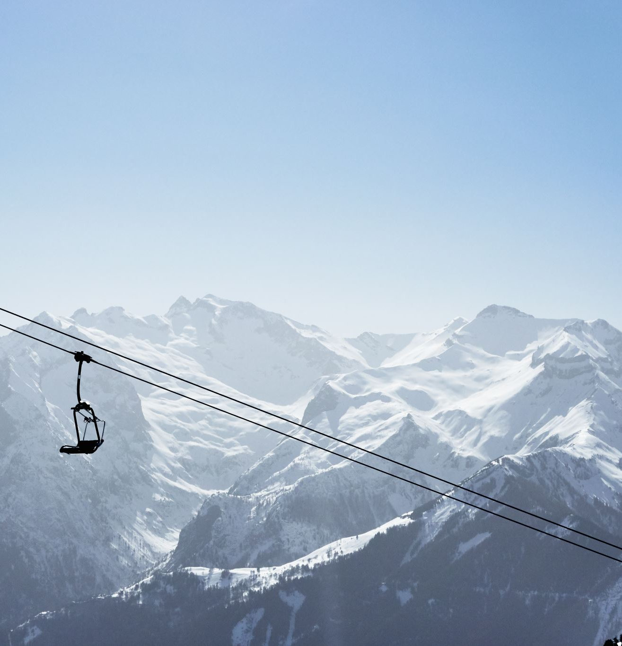
Insights gained through analysis
The final form of data relevant to our business model.
The location of the resort does not affect ticket prices in any way.
Resorts with greater snow cover, vertical drop, more runs, list chairs and quad bikes, as well as night skiing opportunities, have higher ticket prices.
Big Mountain ranks high in almost all infrastructure facilities, which has a serious impact on the attractiveness of the resort.
Big Mountain current prices are more than twice as low as the most expensive resorts in the country (81 vs 180).

Slide 6
Predictive Modeling evaluation
Based on cross-validation testing results, the Random Forest model showed the best performance.
MAE on the train split: 9.64 (on average, the predictions of the model are about $9.64 away from the actual ticket price).
The standard deviation of the MAE scores: 1.35.
MAE on the test split: 9.54 (performance consistent with the cross-validation results).
Four key attributes were identified that have the greatest influence on price prediction: snow cover, vertical drop, runs and quad bikes.

Slide 7

Summary
Our model provides valuable business analytics, as it allows you to take into account market conditions when forming a pricing policy.
If applied correctly, we will be able to increase the company's profits by maximizing the use of our facilities.
However, our predicted price is based on the assumption of an ideal market and relevant prices for other resorts.
To increase the accuracy of the model, as well as create the reliable pricing development strategy, we need additional information, including data of operating costs of maintaining the facilities.

