Slide 1
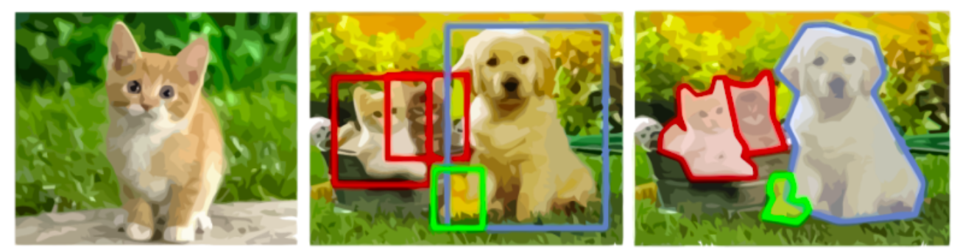
Cat
图像分类
目标检测
图像分割

Slide 2
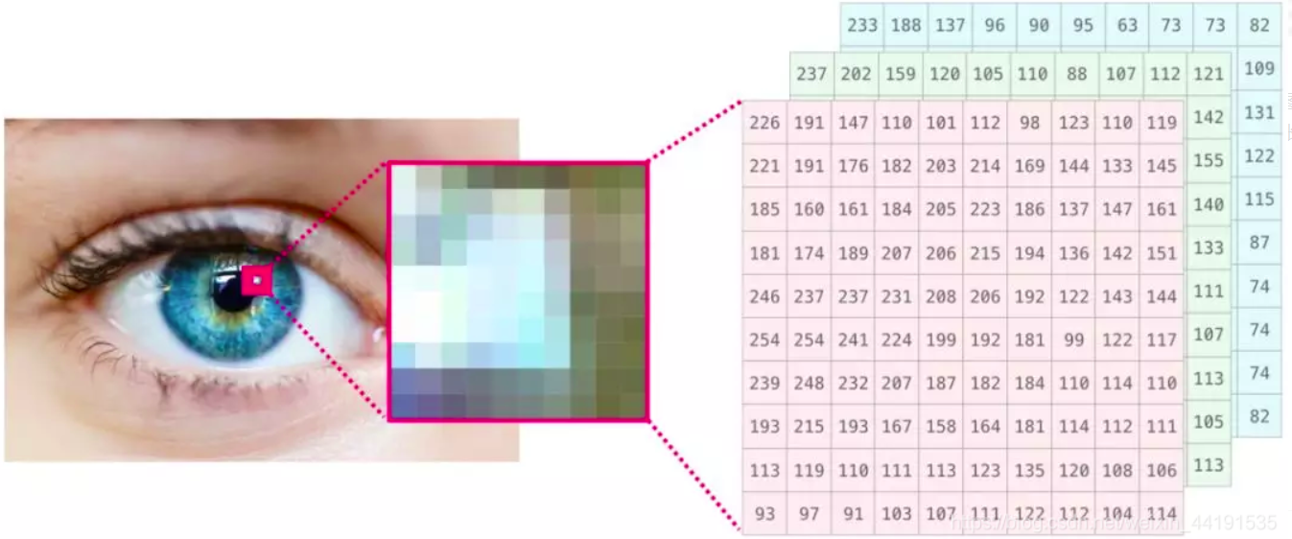
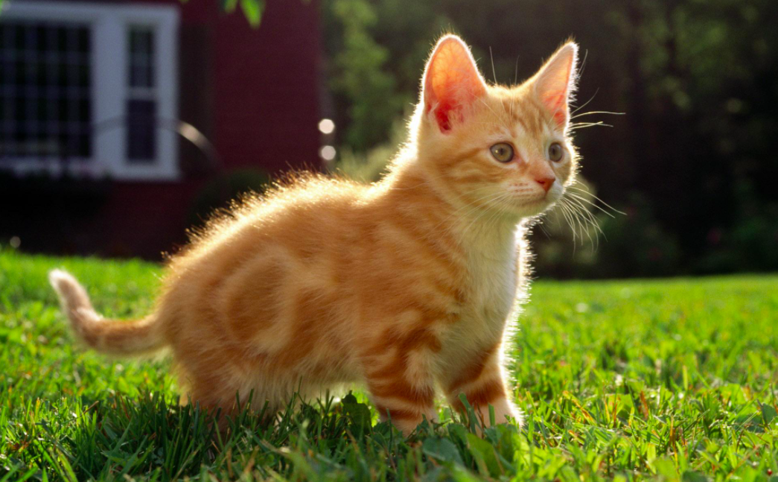

Slide 3
1 | 1 | 1 | 0 | 0
0 | 1 | 1 | 1 | 0
0 | 0 | 1 | 1 | 1
0 | 0 | 1 | 1 | 1
0 | 1 | 1 | 0 | 0
1 | 0 | 1
0 | 1 | 1
1 | 0 | 1
Kernel
Image

Slide 4
1 | 1 | 1
0 | 1 | 1
0 | 0 | 1
1 | 0 | 1
0 | 1 | 0
1 | 0 | 1
4
.*
hadamard
product
Output Image
1 | 1 | 1 | 0 | 0
0 | 1 | 1 | 1 | 0
0 | 0 | 1 | 1 | 1
0 | 0 | 1 | 1 | 1
0 | 1 | 1 | 0 | 0
1 | 0 | 1
0 | 1 | 0
1 | 0 | 1
Kernel
Image

Slide 5
1 | 1 | 1 | 0 | 0
0 | 1 | 1 | 1 | 0
0 | 0 | 1 | 1 | 1
0 | 0 | 1 | 1 | 1
0 | 1 | 1 | 0 | 0
1 | 0 | 1
0 | 1 | 0
1 | 0 | 1
4 | 3 | 4
2 | 4 | 3
2 | 3 | 4
.*
hadamard
product
Kernel
Convolved Image
Image

Slide 6
0 | 0 | 0 | 0 | 0 | 0 | 0
0 | 1 | 1 | 1 | 0 | 0 | 0
0 | 0 | 1 | 1 | 1 | 0 | 0
0 | 0 | 0 | 1 | 1 | 1 | 0
0 | 0 | 0 | 1 | 1 | 1 | 0
0 | 0 | 1 | 1 | 0 | 0 | 0
0 | 0 | 0 | 0 | 0 | 0 | 0
2 | 2 | 3 | 1 | 1
1 | 4 | 3 | 4 | 1
1 | 2 | 4 | 3 | 3
1 | 2 | 3 | 4 | 2
0 | 2 | 2 | 2 | 1
1 | 0 | 1
0 | 1 | 0
1 | 0 | 1
.*
hadamard
product
Kernel
Convolved Image
0 | 0 | 0 | 0 | 0 | 0 | 0
0 | 1 | 1 | 1 | 0 | 0 | 0
0 | 0 | 1 | 1 | 1 | 0 | 0
0 | 0 | 0 | 1 | 1 | 1 | 0
0 | 0 | 0 | 1 | 1 | 1 | 0
0 | 0 | 1 | 1 | 0 | 0 | 0
0 | 0 | 0 | 0 | 0 | 0 | 0
1 | 1 | 1 | 0 | 0
0 | 1 | 1 | 1 | 0
0 | 0 | 1 | 1 | 1
0 | 0 | 1 | 1 | 1
0 | 1 | 1 | 0 | 0
Padding
Padding Image
Image

Slide 7
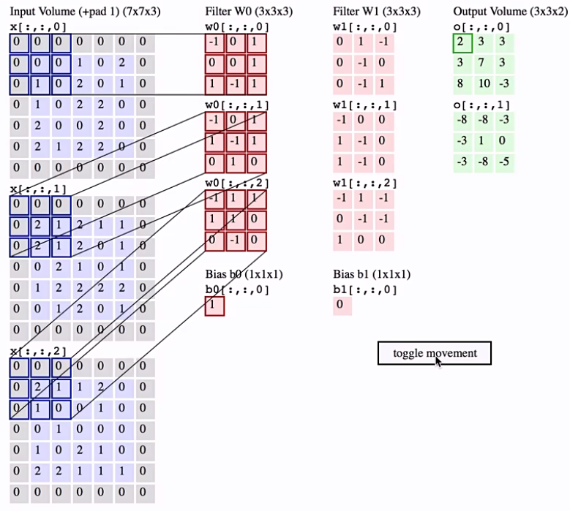
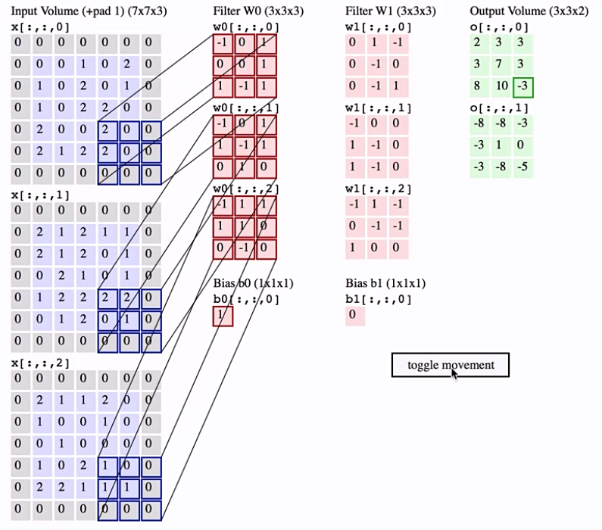

Slide 8
