Slide 1


Version Control & Continuous Integration
Dr. Zhamri Che Ani
Universiti Utara Malaysia
Malaysia

Slide 2
Why Version Control?
Have you ever named files like:
assignment_final.docx
assignment_final_v2.docx
assignment_final_REAL.docx
What happens if:
Your laptop crashes?
Your team overwrite your work?
You want to go back to yesterday’s version?

Slide 3
What is Version Control?
Tracks changes in files
Allows collaboration
Maintains history
Enables rollback

Slide 4
Industry Standard Tools
Git
Created by Linus Torvalds
Distributed Version Control System
Fast, lightweight, powerful
GitHub
Cloud hosting for Git repositories
Enables collaboration
Pull Requests
CI/CD integration

Slide 5
Human-Readable Version Numbers
In real projects, we use:
v1.0.0
v1.1.0
v1.1.1
v2.0.0
Format:
MAJOR.MINOR.PATCH

Slide 6
Version Number: MAJOR
MAJOR (1.x.x → 2.0.0)
Breaking changes
API changes
Backwards incompatible
Example:
Removing a method
Changing database structure

Slide 7
Version Number: MINOR
MINOR (1.1.0 → 1.2.0)
New feature added
Example:
Add a login feature
Add new API endpoint

Slide 8
Version Number: PATCH
PATCH (1.1.1 → 1.1.2)
Bug fixes
Small improvements
Example:
Fix the null pointer bug
Fix UI typo

Slide 9
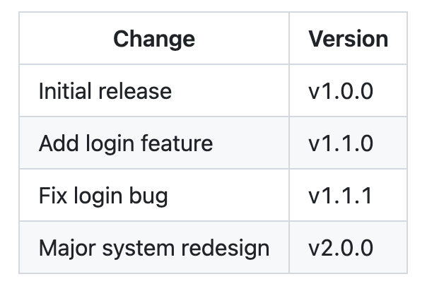
Real Industry Example

Slide 10
Where Do We Store the Version Number?
Common places:
pom.xml (Maven)
package.json (Node)
application.properties
Git tag

Slide 11
What is CI/CD?
CI = Continuous Integration
CD = Continuous Delivery / Continuous Deployment
CI/CD is a practice and automation pipeline (that builds, tests, and deploys code) used in software development

Slide 12
Continuous Integration (CI) in Practice
Developers frequently push code to a shared repository (e.g., GitHub).
Each push triggers:
Automatic build
Automated testing
Goal: Detect errors early.
Example tools:
GitHub Actions
GitLab CI
Jenkins

Slide 13
What is DevOps?
DevOps is much bigger.
Dev = Development
Ops = Operations
DevOps = Culture + Practices + Tools

Slide 14
DevOps Includes:
CI/CD
Infrastructure as Code (IaC)
Monitoring
Logging
Containerization
Cloud deployment
Team collaboration

Slide 15
DevOps Tools
Example:
Docker
Kubernetes
Terraform
Prometheus

Slide 16
Key Difference
DevOps is a collaborative software engineering approach integrating development and operations to improve deployment frequency, reliability, and system stability.
CI/CD is an automated software delivery practice enabling frequent integration, testing, and deployment of code changes.

Slide 17
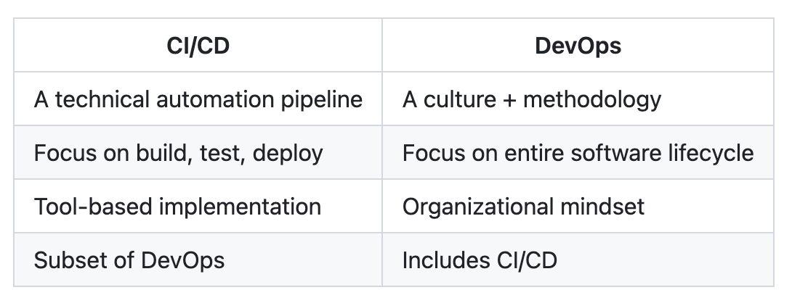
CI/CD vs DevOps
Analogy
DevOps = a car factory
CI/CD = the automated assembly line inside that factory

Slide 18
What is a Workflow?
A workflow is a defined automation process triggered by an event.
Example triggers:
push
pull_request
schedule
manual

Slide 19
Example in GitHub Actions
name: Java CI
on:
push:
branches: [ "main" ]
jobs:
build:
runs-on: ubuntu-latest
steps:
- run: mvn test

Slide 20
What is a Workflow?
That entire YAML file = workflow
It defines:
When to run
What jobs to run
What steps to execute

Slide 21
What is a Pipeline?
A pipeline is the complete CI/CD process that code goes through.
Typical pipeline stages:
Build
Test
Package
Deploy
Monitor

Slide 22
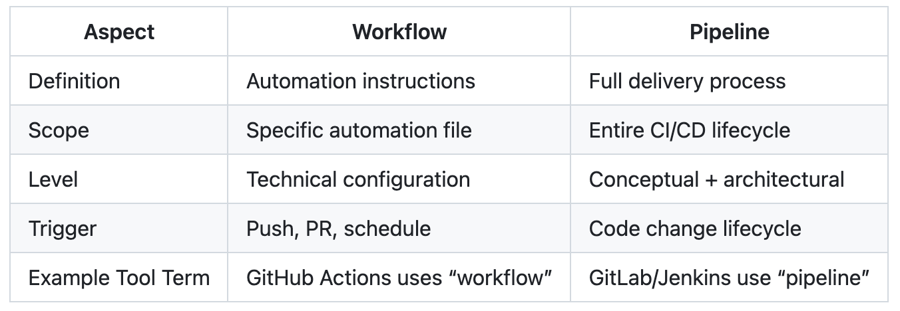
Workflow vs Pipeline
Workflow = Implementation detail
Pipeline = Process flow

Slide 23
Workflow vs Pipeline
Analogy (Airport)
Pipeline = Entire journey (check-in → security → boarding → flight
→ landing)
Workflow = Instructions for security officers on what to check

Slide 24
Technical View
In GitHub:
A repository can have multiple workflows
Together, they form the CI/CD pipeline

Slide 25
Example:
ci.yml → Build & test workflow
deploy.yml → Deployment workflow
security.yml → Code scanning workflow
All combined = Your delivery pipeline

Slide 26
Thank You So Much
Terima Kasih Banyak
Q & A

