Slide 1
ECE 570 Project
Haoran Zhang

Slide 2
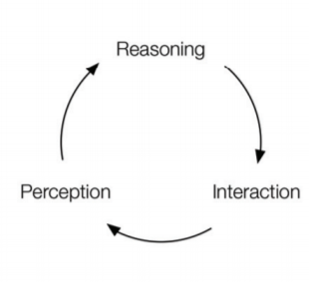
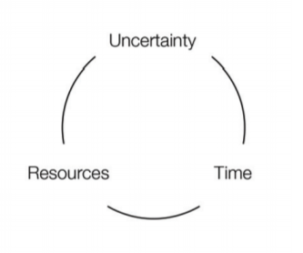
Learning Machines
Problem: How to best design multiple-machine systems that learns for applications
LM: autonomous self-regulating open reasoning machines that actively learns in a decentralized manner, over multiple domains
LM System
LM Algorithm

Slide 3

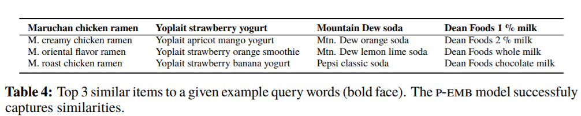
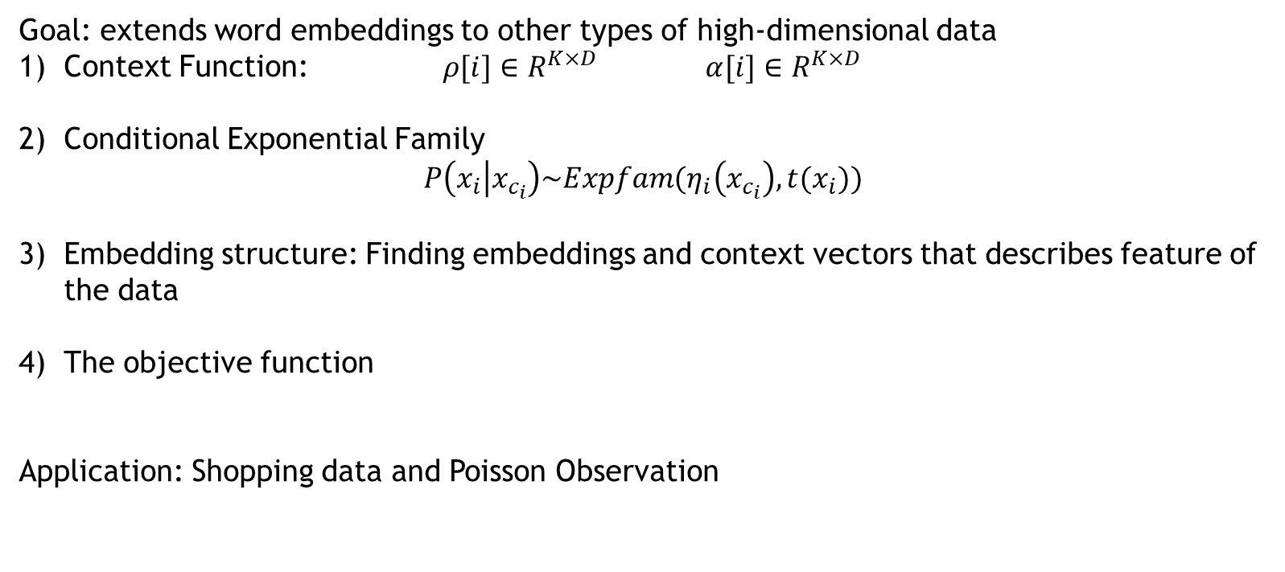
Exponential Family Embeddings
Goal: extends word embeddings to other types of high-dimensional data
Context Function: $ρ[i]∈R^{K×D}$ $α[i]∈R^{K×D}$
2) Conditional Exponential Family
$$P\left(x_{i} | x_{c_{i}}\right)\sim Expfam(η_{i}\left(x_{c_{i}}\right),t(x_{i}))$$
Embedding structure: Finding embeddings and context vectors that describes feature of the data
The objective function
Application: Shopping data and Poisson Observation

Slide 4
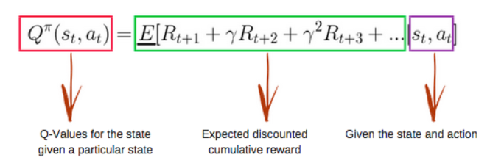
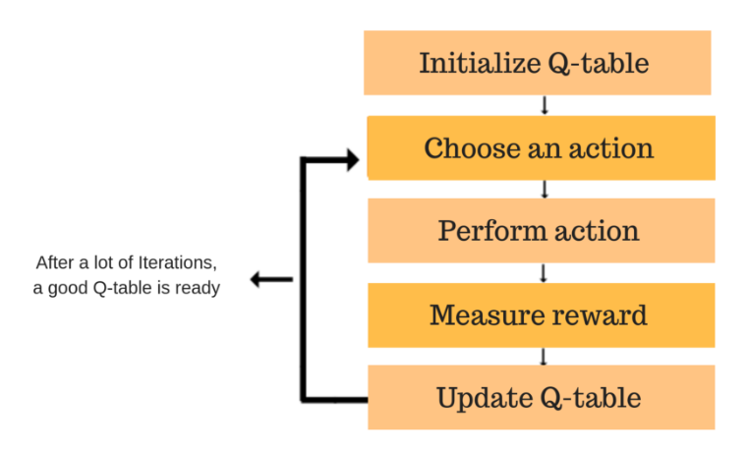
Deep Reinforcement Learning with Double Q-Learning
Introducing Q-learning:
 | Action1 | Action2 | …
State 1
State 2
State 3
State 4
…

Slide 5

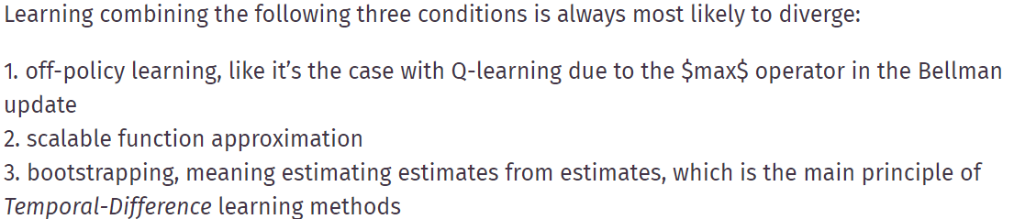
Deep Reinforcement Learning with Double Q-Learning
Approximate Q-function:
Purpose of DQN:
Clipping the TD-error to a fixed interval of [-1,1]
Experience replay
Replacing one single network by the use of two separate networks, one online network and one target network

Slide 6


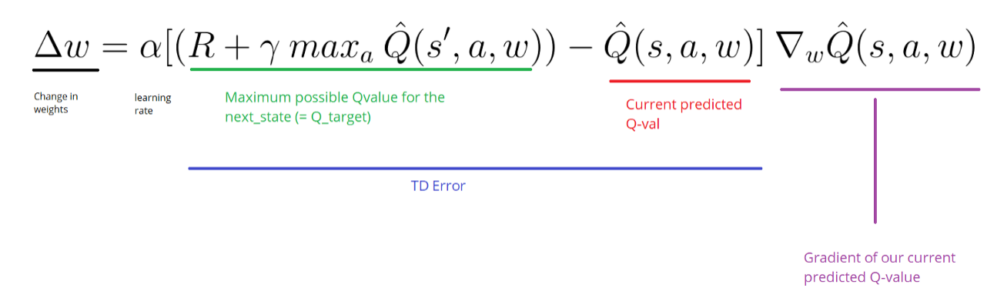
Deep Reinforcement Learning with Double Q-Learning
Q function:
Target Q function:
TD error function:

Slide 7
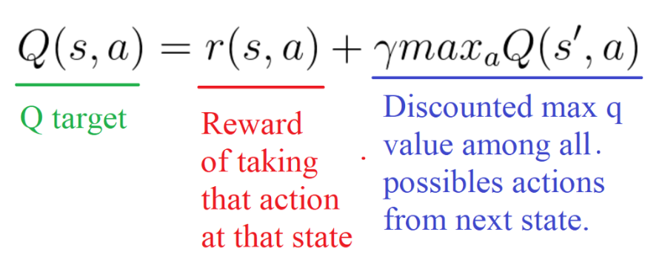
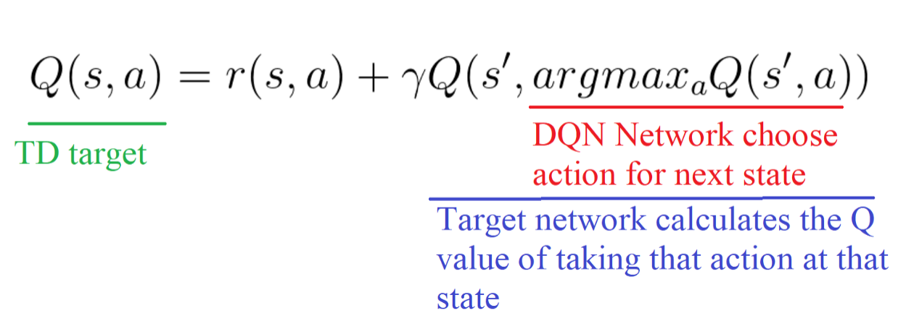
Deep Reinforcement Learning with Double Q-Learning
Problem: The popular DQN algorithm could overestimate action values under conditions

Slide 8
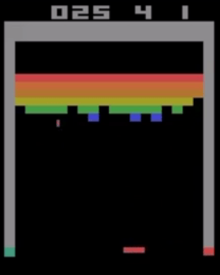
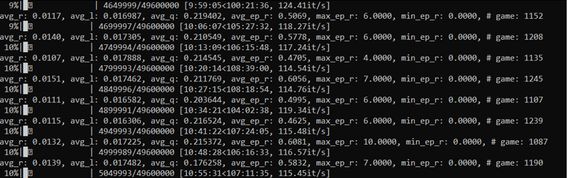
My Implementation

