Slide 1
Mobile Robot
Localization and Mapping using the Kalman Filter
15-491 : CMRoboBits: Creating an Intelligent AIBO Robot
Paul E. Rybski

Slide 2
Mobile Robot Localization
Where am I?
Given a map, determine the robot’s location
  Landmark locations are known, but the robot’s position is not
  From sensor readings, the robot must be able to infer its most likely position on the field
  Example : where are the AIBOs on the soccer field?

Slide 3
Mobile Robot Mapping
What does the world look like?
Robot is unaware of its environment
The robot must explore the world and determine its structure
  Most often, this is combined with localization
  Robot must update its location wrt the landmarks
  Known in the literature as Simultaneous Localization and Mapping, or Concurrent Localization and Mapping : SLAM (CLM)
  Example : AIBOs are placed in an unknown environment and must learn the locations of the landmarks (An interesting project idea?)

Slide 4
Bayesian Filter
Why should you care?
  Robot and environmental state estimation is a fundamental problem!
Nearly all algorithms that exist for spatial reasoning make use of this approach
  If you’re working in mobile robotics, you’ll see it over and over!
  Very important to understand and appreciate
Efficient state estimator
  Recursively compute the robot’s current state based on the previous state of the robot
What is the robot’s state?

Slide 5
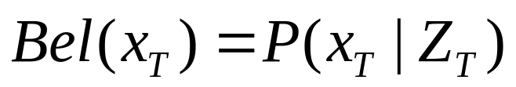
Bayesian Filter
Estimate state x from data d
  What is the probability of the robot being at x?
x could be robot location, map information, locations of targets, etc…
d could be sensor readings such as range, actions, odometry from encoders, etc…)
This is a general formalism that does not depend on the particular probability representation
Bayes filter recursively computes the posterior distribution:

Slide 6
What is a Posterior Distribution?

Slide 7
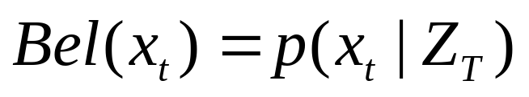
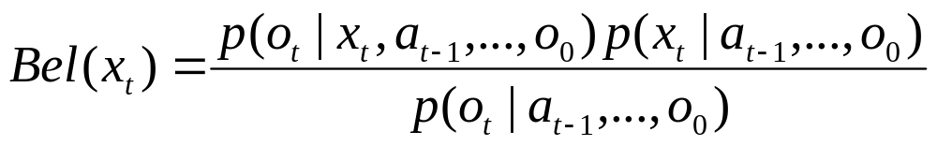
Derivation of the Bayesian Filter (slightly different notation from before)
Estimation of the robot’s state given the data:
The robot’s data, Z, is expanded into two types: observations o_{i} and actions a_{i}
Invoking the Bayesian theorem

Slide 8

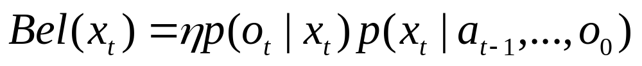
Derivation of the Bayesian Filter
Denominator is constant relative to x_{t}
First-order Markov assumption shortens first term:
Expanding the last term (theorem of total probability):

Slide 9
Derivation of the Bayesian Filter
First-order Markov assumption shortens middle term:
Finally, substituting the definition of Bel(x_{t-1}):
The above is the probability distribution that must be estimated from the robot’s data

Slide 10
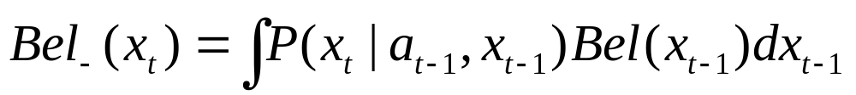
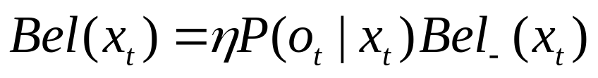
Iterating the Bayesian Filter
Propagate the motion model:
Update the sensor model:
Compute the current state estimate before taking a sensor reading by integrating over all possible previous state estimates and applying the motion model
Compute the current state estimate by taking a sensor reading and multiplying by the current estimate based on the most recent motion history

Slide 11
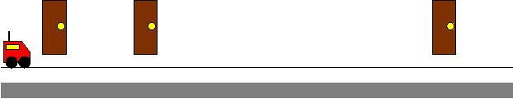
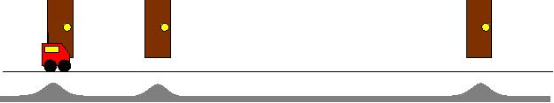
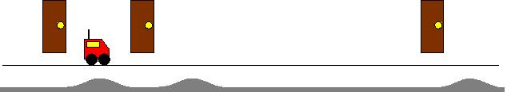
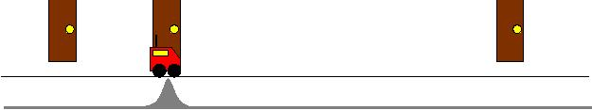
Localization
Initial state
detects nothing:
Moves and
detects landmark:
Moves and
detects nothing:
Moves and
detects landmark:

Slide 12
Bayesian Filter : Requirements for Implementation
Representation for the belief function
Update equations
Motion model
Sensor model
Initial belief state

Slide 13


Representation of the Belief Function
Sample-based representations
  e.g. Particle filters
Parametric representations

Slide 14
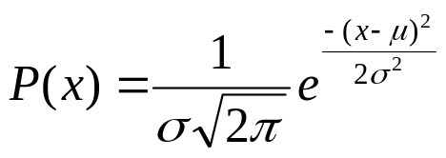
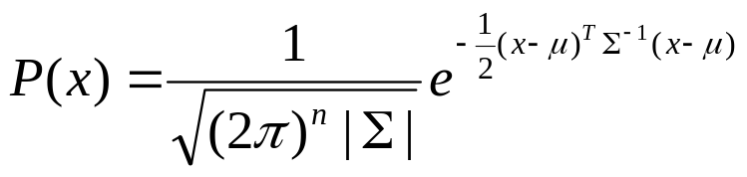
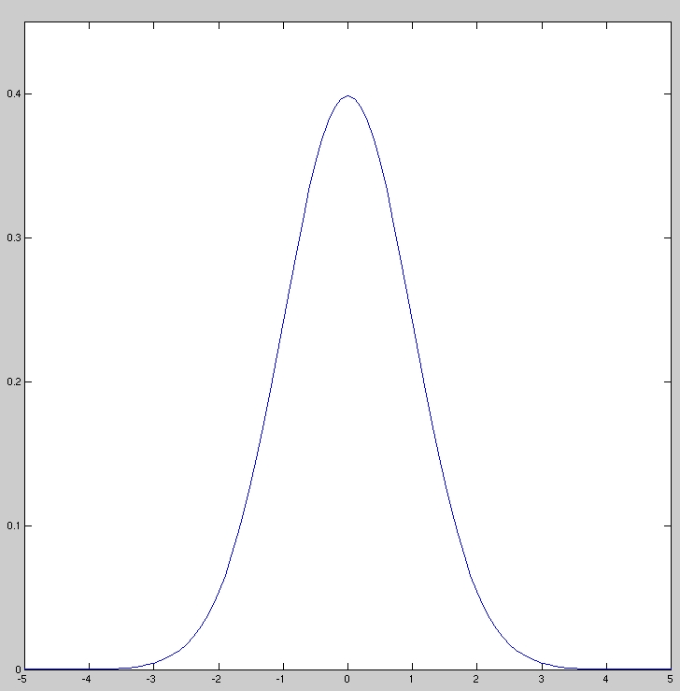
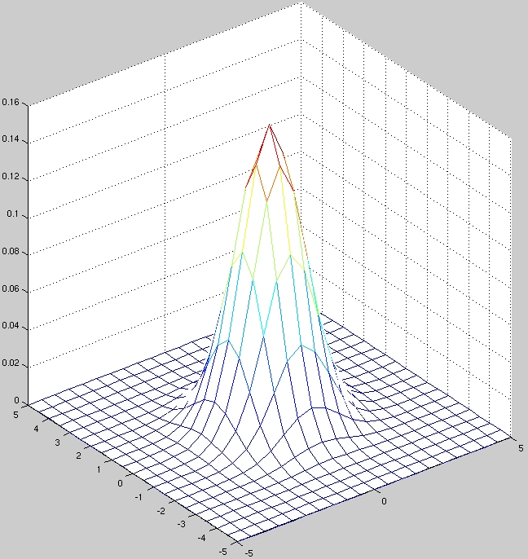
Example of a Parameterized Bayesian Filter : Kalman Filter
Kalman filters (KF) represent posterior belief by a
Gaussian (normal) distribution
A 1-d Gaussian
distribution is given by:
An n-d Gaussian
distribution is given by:

Slide 15
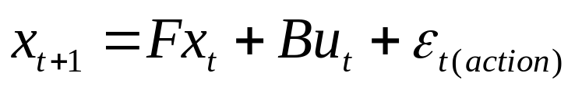
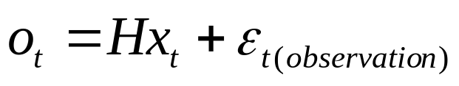
Kalman Filter : a Bayesian Filter
Initial belief Bel(x₀) is a Gaussian distribution
  What do we do for an unknown starting position?
State at time t+1 is a linear function of state at time t:
Observations are linear in the state:
Error terms are zero-mean random variables which are normally distributed
These assumptions guarantee that the posterior belief is Gaussian
  The Kalman Filter is an efficient algorithm to compute the posterior
  Normally, an update of this nature would require a matrix inversion (similar to a least squares estimator)
  The Kalman Filter avoids this computationally complex operation

Slide 16
The Kalman Filter
Motion model is Gaussian…
Sensor model is Gaussian…
Each belief function is uniquely characterized by its mean μ and covariance matrix Σ
Computing the posterior means computing a new mean μ and covariance Σ from old data using actions and sensor readings
What are the key limitations?
1) Unimodal distribution
2) Linear assumptions

Slide 17
What we know…
What we don’t know…
We know what the control inputs of our process are
  We know what we’ve told the system to do and have a model for what the expected output should be if everything works right
We don’t know what the noise in the system truly is
  We can only estimate what the noise might be and try to put some sort of upper bound on it
When estimating the state of a system, we try to find a set of values that comes as close to the truth as possible
  There will always be some mismatch between our estimate of the system and the true state of the system itself. We just try to figure out how much mismatch there is and try to get the best estimate possible

Slide 18
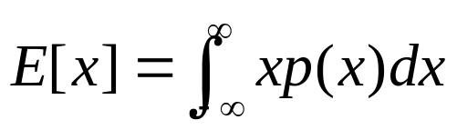


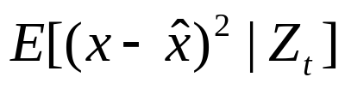
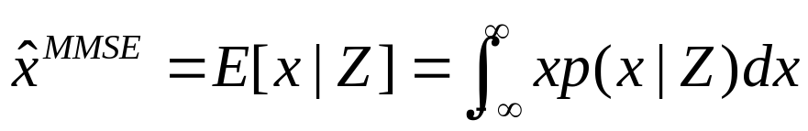
Minimum Mean Square Error
Reminder: the expected value, or mean value, of a
Continuous random variable x is defined as:
Minimum Mean Square Error
What is the mean of this distribution?
This is difficult to obtain exactly. With our approximations,
we can get the estimate
…such that
is minimized.
According to the Fundamental Theorem of Estimation Theory
this estimate is:

Slide 19
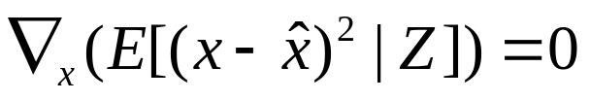
Fundamental Theorem of Estimation Theory
The minimum mean square error estimator equals the expected (mean) value of x conditioned on the observations Z
The minimum mean square error term is quadratic:
  Its minimum can be found by taking the derivative of the function w.r.t x and setting that value to 0.
It is interesting to note that when they use the Gaussian assumption, Maximum Posteriori estimators and MMSE estimators find the same value for the parameters.
  This is because mean and the mode of a Gaussian distribution are the same.

Slide 20


Kalman Filter Components
(also known as: Way Too Many Variables…)
Linear discrete time dynamic system (motion model)
State
Control input
Process noise
State transition
function
Control input
function
Noise input
function with covariance Q
Measurement equation (sensor model)
Sensor reading
State
Sensor noise with covariance R
Sensor function
Note:Write these down!!!

Slide 21

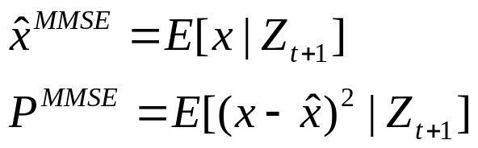
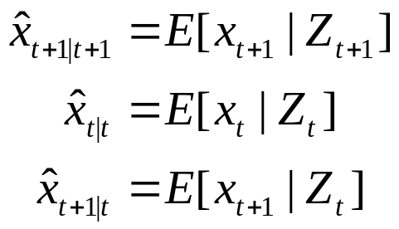
Computing the MMSE Estimate of the State and Covariance
Given a set of measurements:
According to the Fundamental Theorem of Estimation, the state
and covariance will be:
We will now use the following notation:

Slide 22


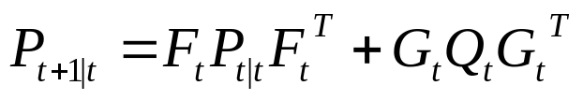
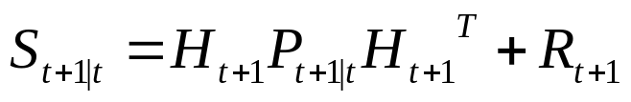
Computing the MMSE Estimate of the State and Covariance
What is the minimum mean square error estimate
of the system state and covariance?
Estimate of the state variables
Estimate of the sensor reading
Covariance matrix for the state
Covariance matrix for the sensors

Slide 23
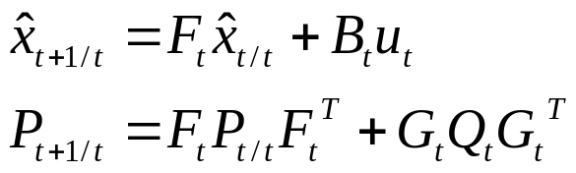
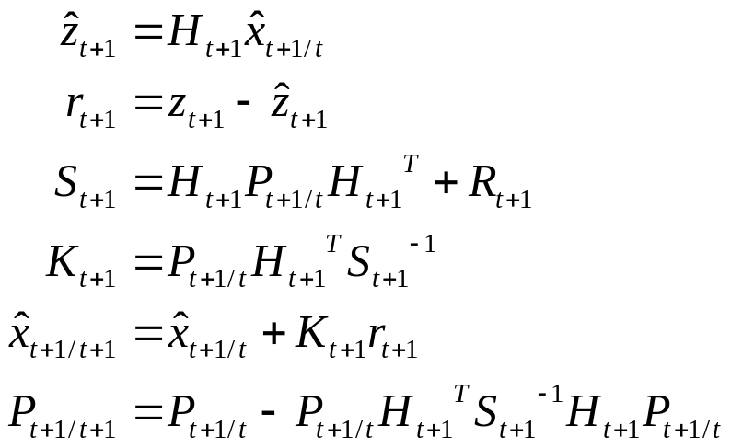
At last! The Kalman Filter…
Propagation (motion model):
Update (sensor model):

Slide 24
…but what does that mean in English?!?
Propagation (motion model):
- State estimate is updated from system dynamics
- Uncertainty estimate GROWS
Update (sensor model):
- Compute expected value of sensor reading
- Compute the difference between expected and “true”
- Compute covariance of sensor reading
- Compute the Kalman Gain (how much to correct est.)
- Multiply residual times gain to correct state estimate
- Uncertainty estimate SHRINKS

Slide 25
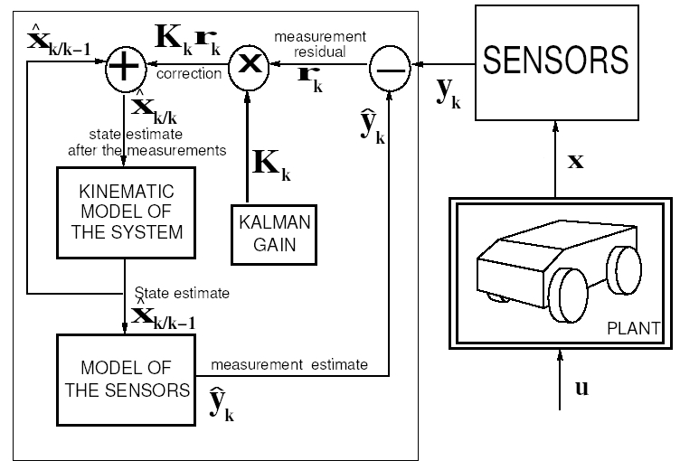
Kalman Filter Block Diagram

Slide 26
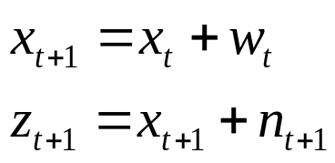
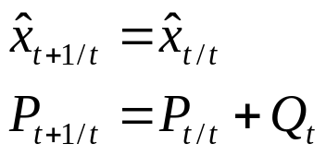
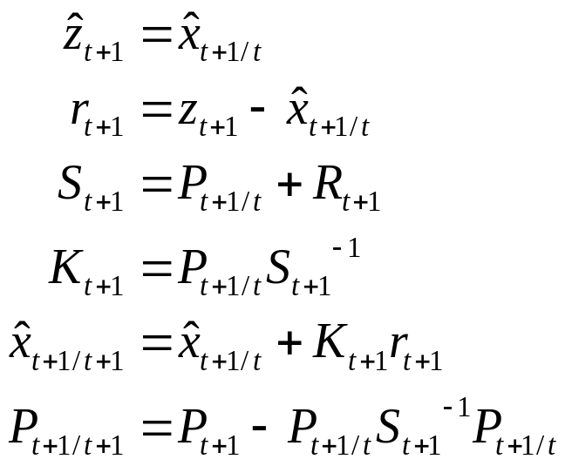
Example 1: Simple 1D Linear System
Given: F=G=H=1, u=0
Initial state estimate = 0
Linear system:
Unknown noise
parameters
Propagation:
Update:

Slide 27
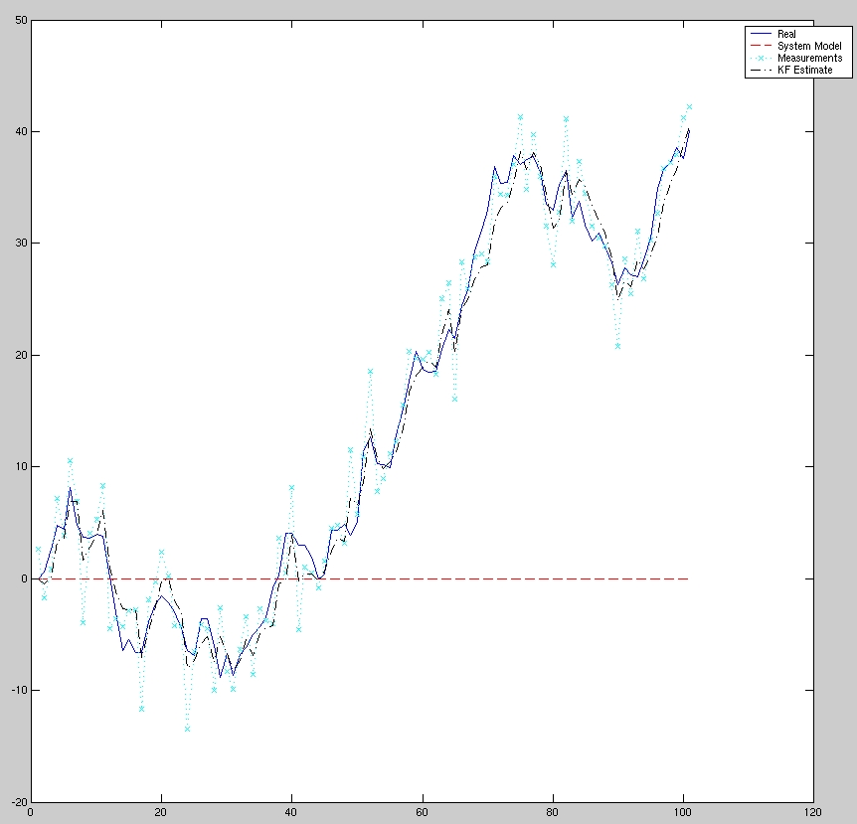
State Estimate

Slide 28
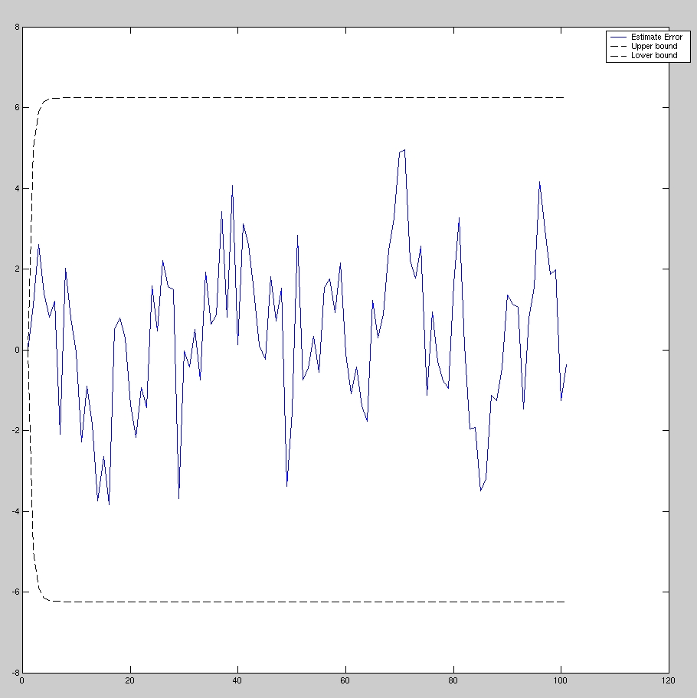
State Estimation Error vs 3σ Region of Confidence

Slide 29
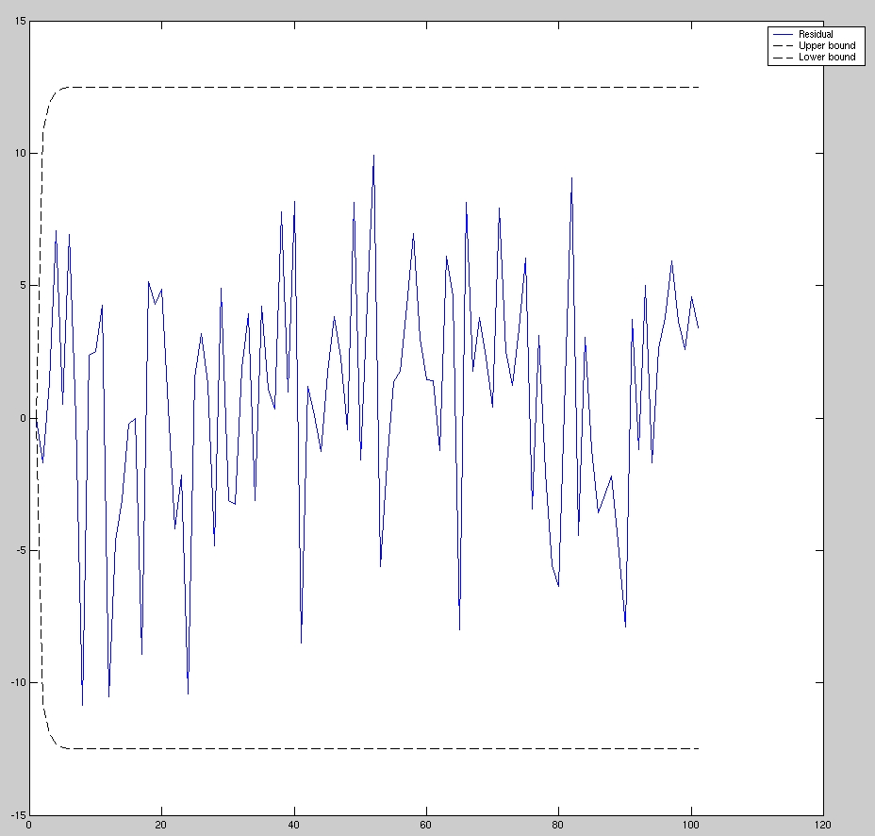
Sensor Residual vs 3σ Region of Confidence

Slide 30
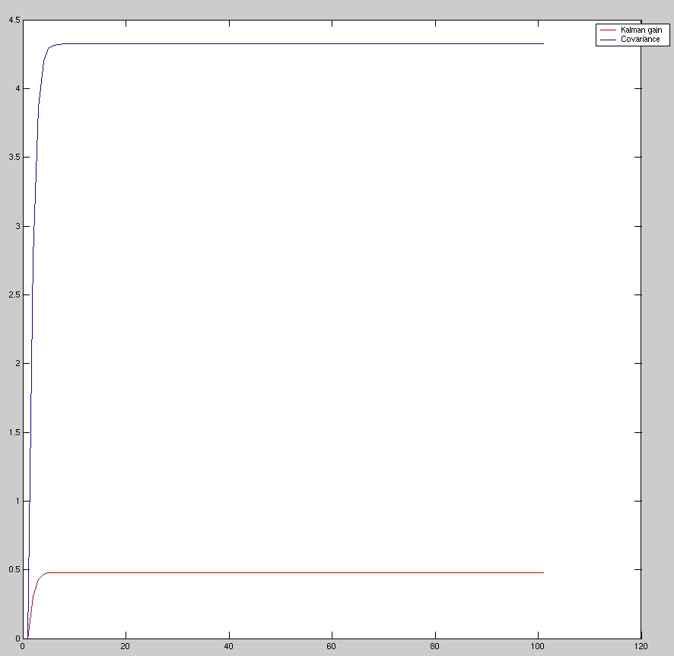
Kalman Gain and State Covariance

Slide 31
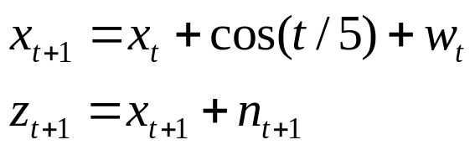
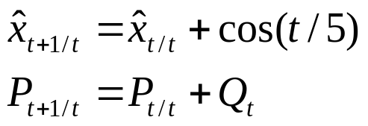
Example 2: Simple 1D Linear System with Erroneous Start
Given: F=G=H=1, u=cos(t/5)
Initial state estimate = 20
Linear system:
Unknown noise
parameters
Propagation:
Update: (no change)

Slide 32
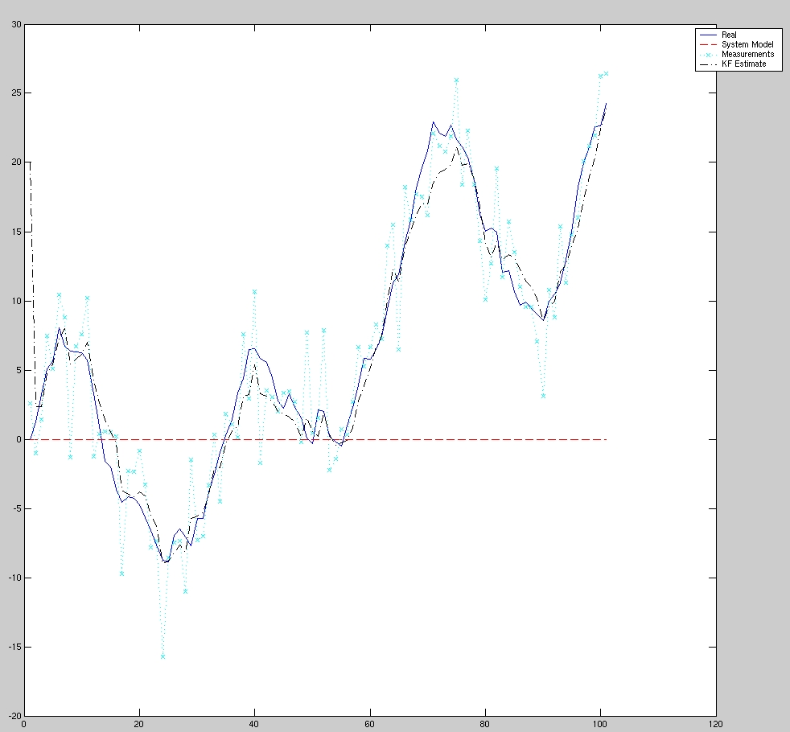
State Estimate

Slide 33
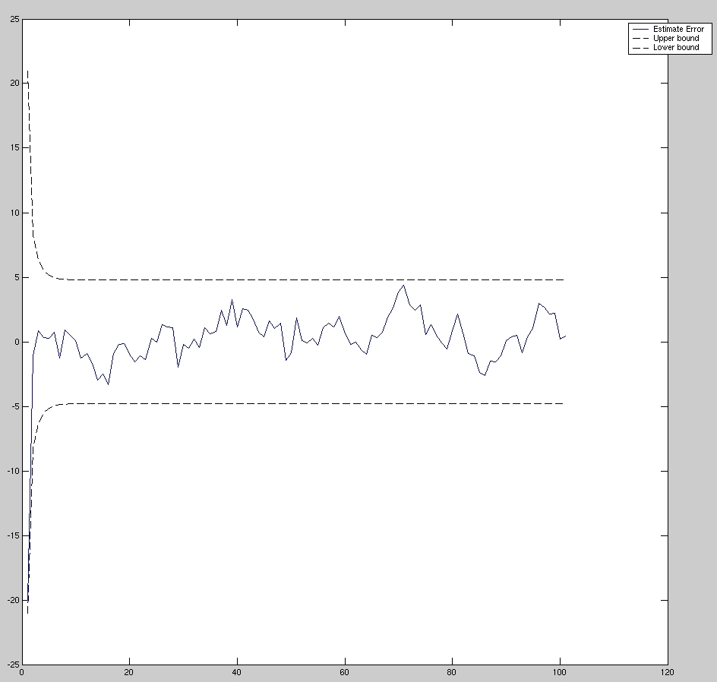
State Estimation Error vs 3σ Region of Confidence

Slide 34
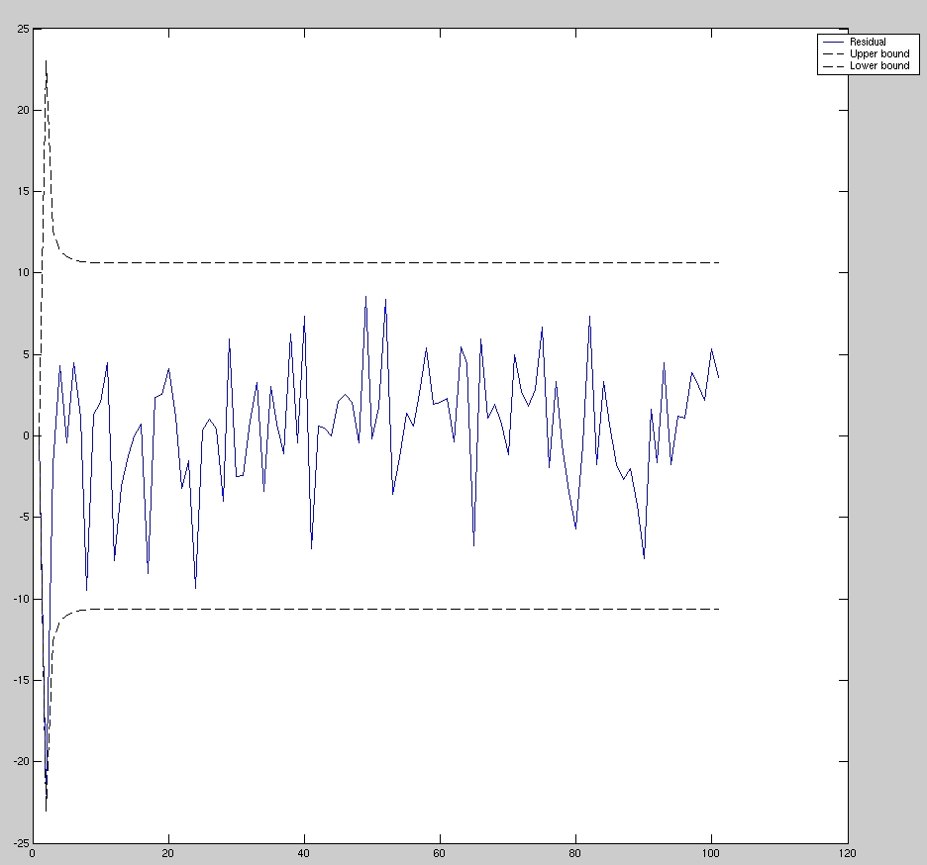
Sensor Residual vs 3σ Region of Confidence

Slide 35
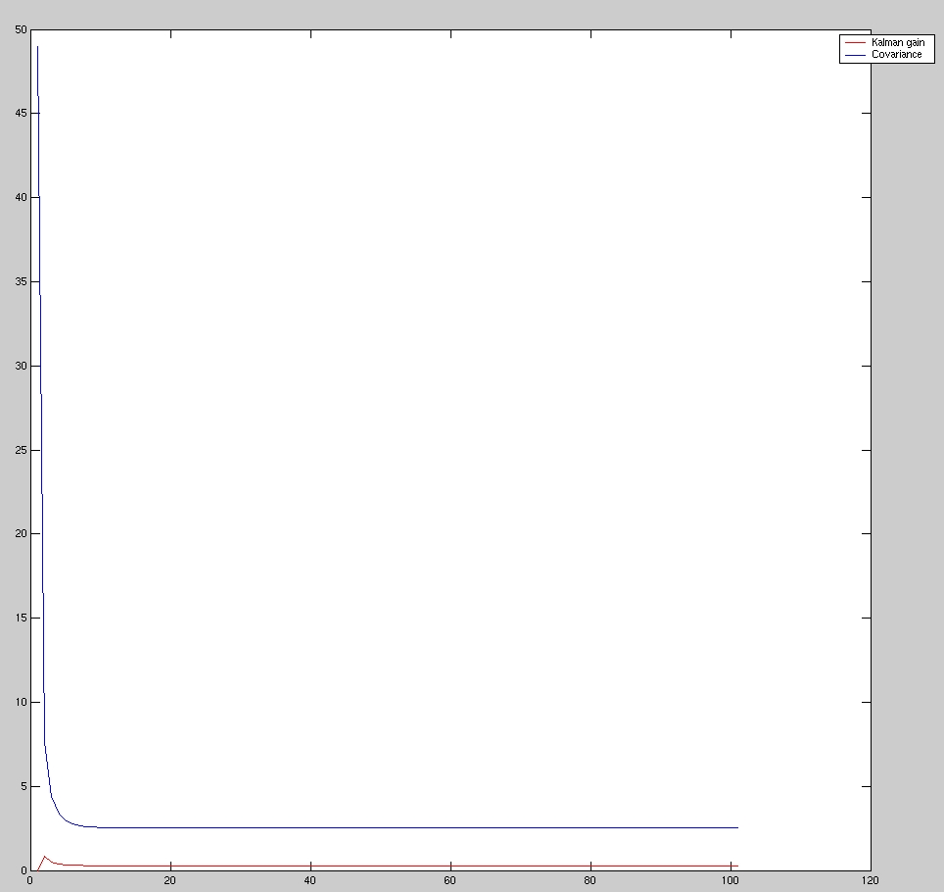
Kalman Gain and State Covariance

Slide 36
Some observations
The larger the error, the smaller the effect on the final state estimate
  If process uncertainty is larger, sensor updates will dominate state estimate
  If sensor uncertainty is larger, process propagation will dominate state estimate
Improper estimates of the state and/or sensor covariance may result in a rapidly diverging estimator
  As a rule of thumb, the residuals must always be bounded within a ±3σ region of uncertainty
  This measures the “health” of the filter
Many propagation cycles can happen between updates

Slide 37
Using the Kalman Filter for Mobile Robots
Sensor modeling
  The odometry estimate is not a reflection of the robot’s control system is rather treated as a sensor
  Instead of directly measuring the error in the state vector (such as when doing tracking), the error in the state must be estimated
  This is referred to as the Indirect Kalman Filter
State vector for robot moving in 2D
  The state vector is 3x1: [x,y,θ]
  The covariance matrix is 3x3
Problem: Mobile robot dynamics are NOT linear

Slide 38
Problems with the
Linear Model Assumption
Many systems of interest are highly non-linear, such as mobile robots
In order to model such systems, a linear process model must be generated out of the non-linear system dynamics
The Extended Kalman filter is a method by which the state propagation equations and the sensor models can be linearized about the current state estimate
Linearization will increase the state error residual because it is not the best estimate

Slide 39
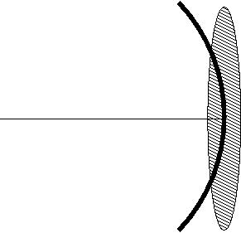
Approximating Robot Motion Uncertainty with a Gaussian

Slide 40
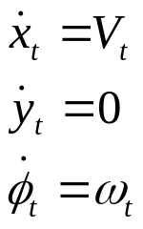
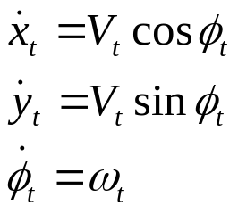
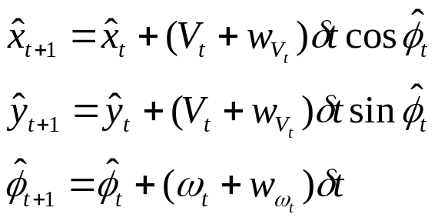
Linearized Motion Model for a Robot
Y
From a robot-centric perspective, the velocities look like this:
y
x
R
v
ω
From the global perspective, the velocities look like this:
G
X
The discrete time state estimate (including noise) looks like this:
Problem! We don’t know linear and rotational velocity errors. The state estimate will rapidly diverge if this is the only source of information!

Slide 41
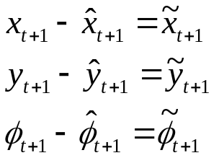
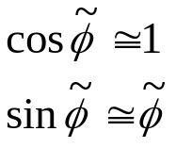
Linearized Motion Model for a Robot
Now, we have to compute the covariance matrix propagation
equations.
The indirect Kalman filter derives the pose equations from the
estimated error of the state:
In order to linearize the system, the following small-angle
assumptions are made:

Slide 42
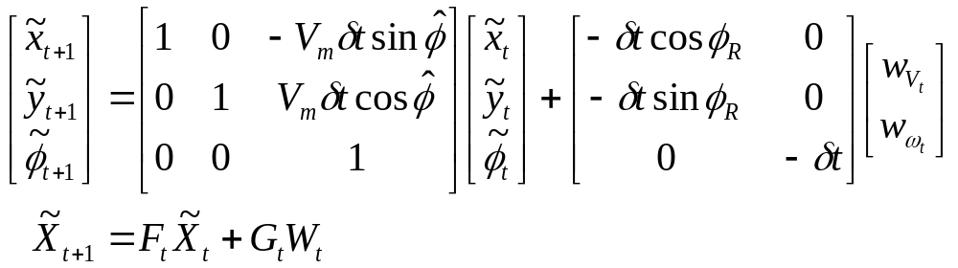

Linearized Motion Model for a Robot
From the error-state propagation equation, we can obtain the
State propagation and noise input functions F and G :
From these values, we can easily compute the standard covariance propagation equation:

Slide 43
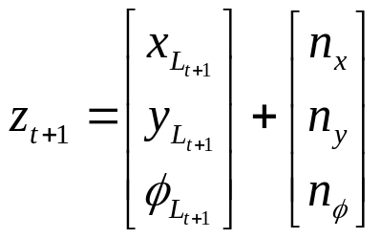
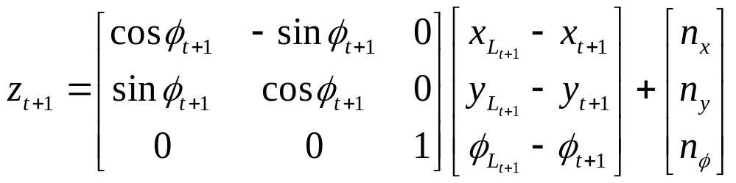
Sensor Model for a Robot with a Perfect Map
Y
From the robot, the measurement looks like this:
L
y
x
R
z
From a global perspective, the measurement looks like:
G
X
The measurement equation is nonlinear and must also be linearized!

Slide 44
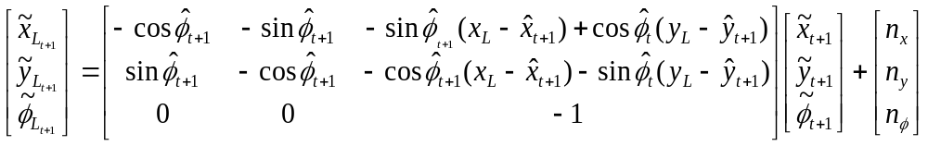
Sensor Model for a Robot with a Perfect Map
Now, we have to compute the linearized sensor function. Once
again, we make use of the indirect Kalman filter where the error in the reading must be estimated.
In order to linearize the system, the following small-angle
assumptions are made:
The final expression for the error in the sensor reading is:

Slide 45


Updating the State Vector
Propagation only
Propagation and update

Slide 46

Simulated Results Pose Uncertainty with no Updates

Slide 47
Simulated Results Pose Uncertainty with Updates

Slide 48


Extended Kalman Filter for SLAM
State vector
  Expanded to contain entries for all landmarks positions:
  State vector can be grown as new landmarks are discovered
  Covariance matrix is also expanded

Slide 49

Extended Kalman Filter for SLAM
Kinematic equations for landmark propagation

Slide 50

Extended Kalman Filter for SLAM
Sensor equations for update:
Very powerful because covariance update records shared information between landmarks and robot positions

Slide 51

EKF for SLAM

Slide 52


Enhancements to EKF
Iterated Extended Kalman Filter
State and
covariance update
Iterate state update
equation until
convergence

Slide 53
Enhancements to the EKF
Multiple hypothesis tracking
  Multiple Kalman filters are used to track the data
  Multi-Gaussian approach allows for representation of arbitrary probability densities
  Consistent hypothesis are tracked while highly inconsistent hypotheses are dropped
  Similar in spirit to particle filter, but orders of magnitude fewer filters are tracked as compared to the particle filter

