Slide 1
CGT 511
FINAL PRESENTATION
CGT 511
Measurement of Interpersonal Distance
in Virtual Reality Space
Alex Stamm
Yexin Wang
Wenyu Zhang
Ali Baigelenov

Slide 2
Hypothesis
Social interpersonal distance differs between virtual and real world environments in collaborative conversational settings.
Allowing users to communicate with one another in virtual reality will increase their presence in the VR environment.
Notes:
Wenyu

Slide 3
The hypothesis we propose differs from previous works:
Previous work has focused on only a minimum distance that should separate two virtual agents and how far the agent should stay within a range of distances from other agents in the non-verbal virtual environment. ［1］

Slide 4
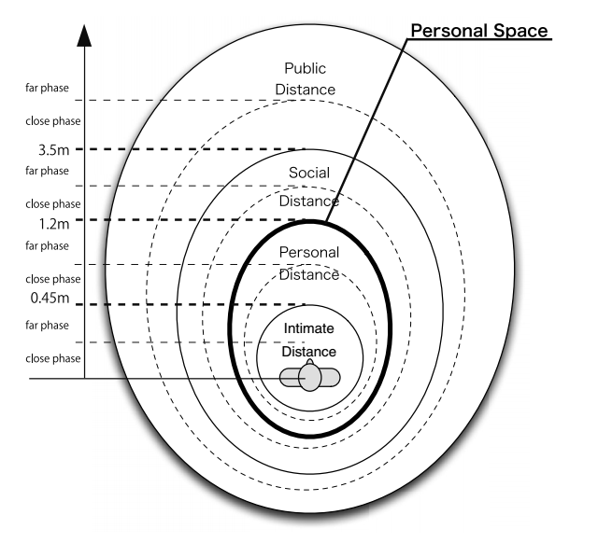
Theory foundation
Measurement of Interpersonal Distance in Collaborative Virtual Environmentsis the study of human use of space and the effects that population density has on behaviour, communication, and social interaction.［1］
Every person holds a mobile territory unconsciously is called personal space.

Slide 5
Experiment Design
Testing people from different countries and background and mix them to in groups
Let participants do free talking in VR environment and make them feel as relaxed as they would communicate in real world
In the end the participants will finish a questionnaire about their overall feelings
Collect data from participants’ questionnaire and analyze the data
Notes:
Wenyu

Slide 6
Experiment Development
SteamVR SDK
Network
Custom network solution for Vive involving a LAN setup
Voice
Custom VoIP solution for communication in VR - in the game engine environment
Requires two computers to run two HTC Vive’s simultaneously

Slide 7
Equipment
HTC Vives X 2
Computers X2
Lab Space X 2
Headphones X 2
Experiment
Participants
8 pairs of people. 5 pairs are from the same country and others are from differing countries.
Notes:
Wenyu

Slide 8
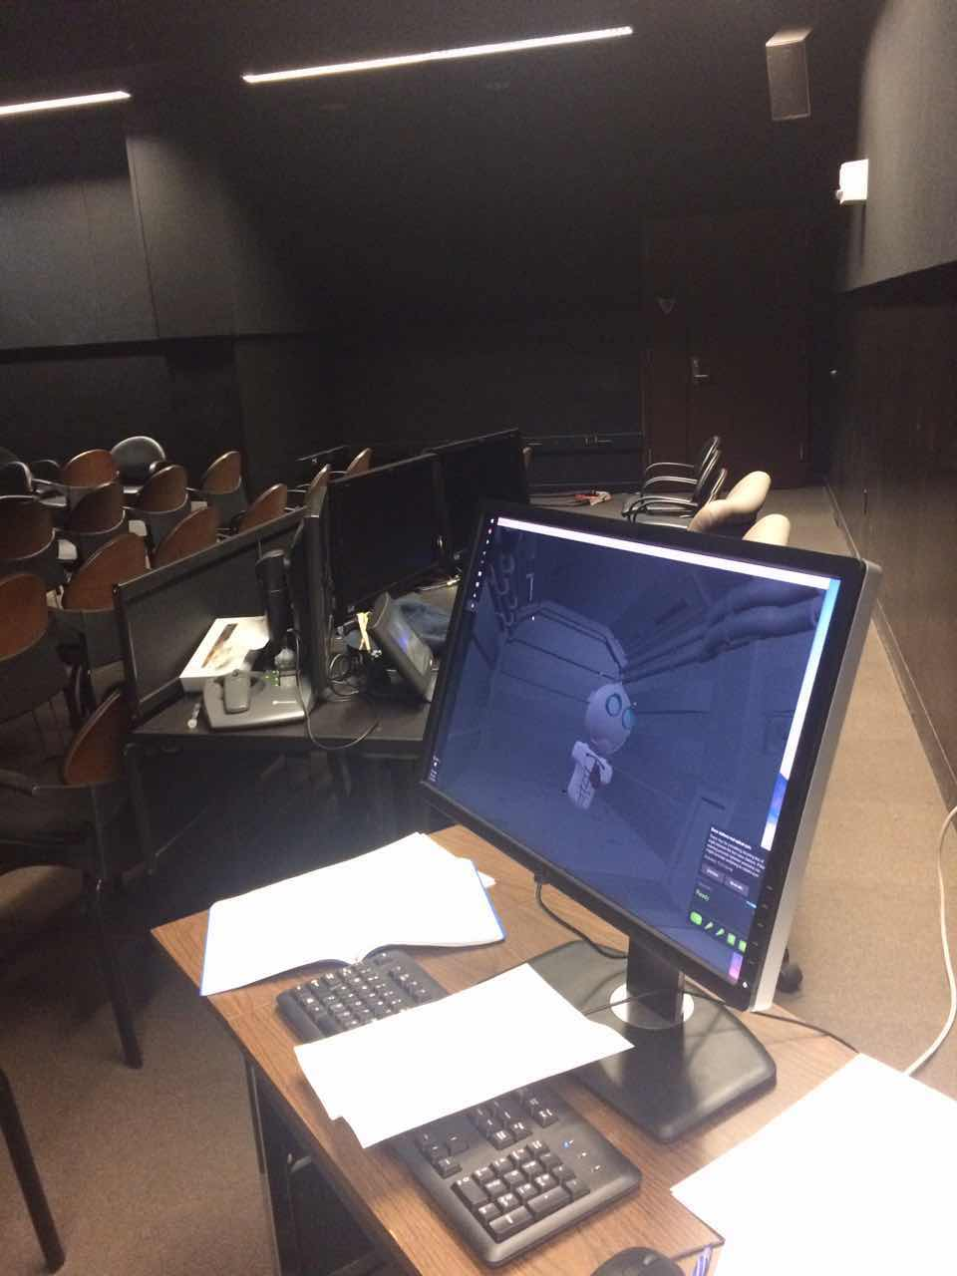
Notes:
Wenyu

Slide 9
Research teamwork
Ali: Take notes and do the general observation
Wenyu: Provide instructions and handling questionnaire
Alex: Provide instructions and troubleshoot program errors
Yexin: Audio recording and take photos
Experiment

Slide 10
Experiment procedure: pre-task
Hold a short setup discussion with the participant, explaining to them the purpose of the research and what task they will be performing. Here we will also explain how to use the equipment and a short explanation about how to maneuver in the environment.
All the participants are assigned into different teams. They are expected to come from different countries to exclude the cultural bias [3].
The participants need to fill a demographic survey.

Slide 11
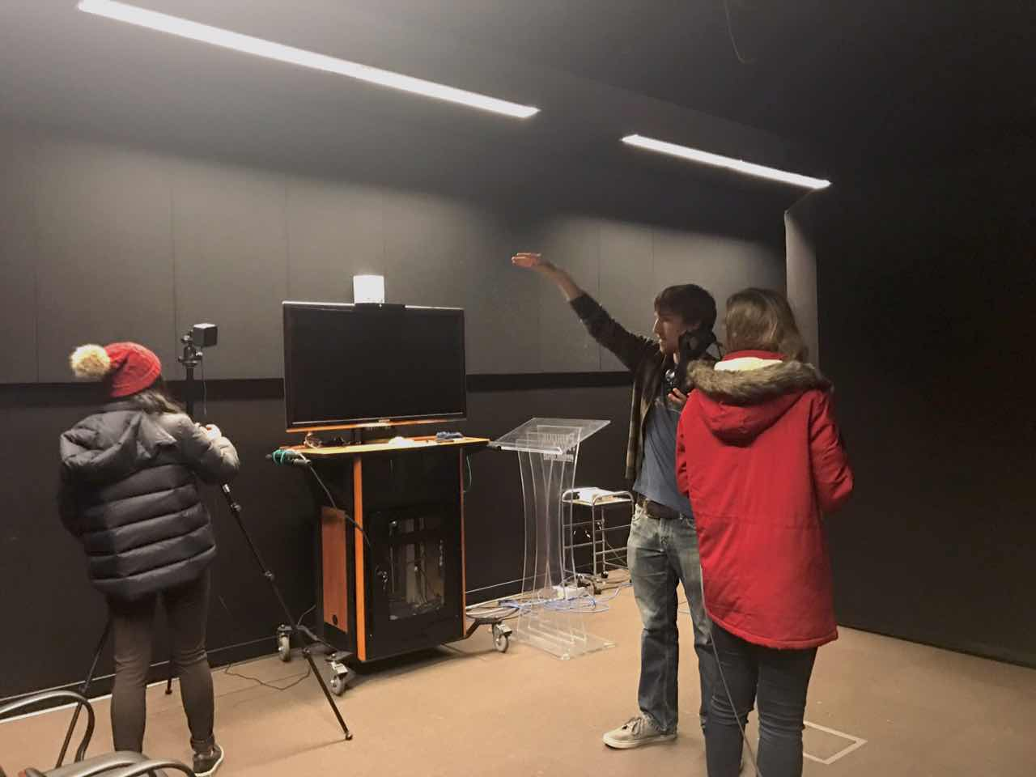

Slide 12
Experiment procedure
During the task:
Experiment procedure: during task
Participants are asked to have a chat for 2 minutes in the VR world. The observer raises questions about how they feel at each important spot. (Eg. The time when people start to mediate their distance and stop walking forward.)
The position information is automatically captured in the process.
Notes:
2 kinds of data are collected, we got the qualitative data from the interview and the observation, from which we got the feedback about how people feel about the immersions and the systems, also we tried to get some clues for the further improvements. We collected the quantitative data about the distance information between pairs, which is crucial to our results.

Slide 13
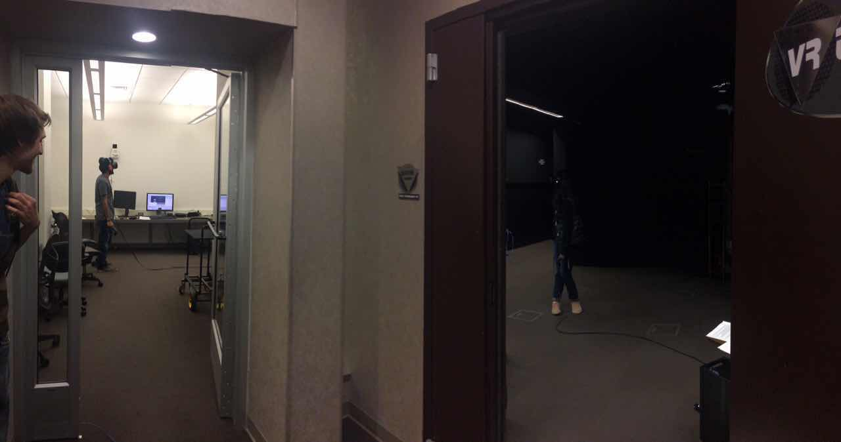

Slide 14
Experiment procedure
During the task:
Experiment procedure： post-task
Participants are asked to fill out a questionnaire about their whole experience.
Some short interviews are conducted to generate some feedback on the overall user’s experience.

Slide 15
Data Analysis
We summarized all the data from the questionnaire and classified the questions
Diagnostic and Usability Factors
Collect all the values, calculate mean, and standard deviation
Create bar graphs based on Mean Value from Diagnostics and Usability.
Create distance over time graph for players’ movements
Notes:
Wenyu

Slide 16
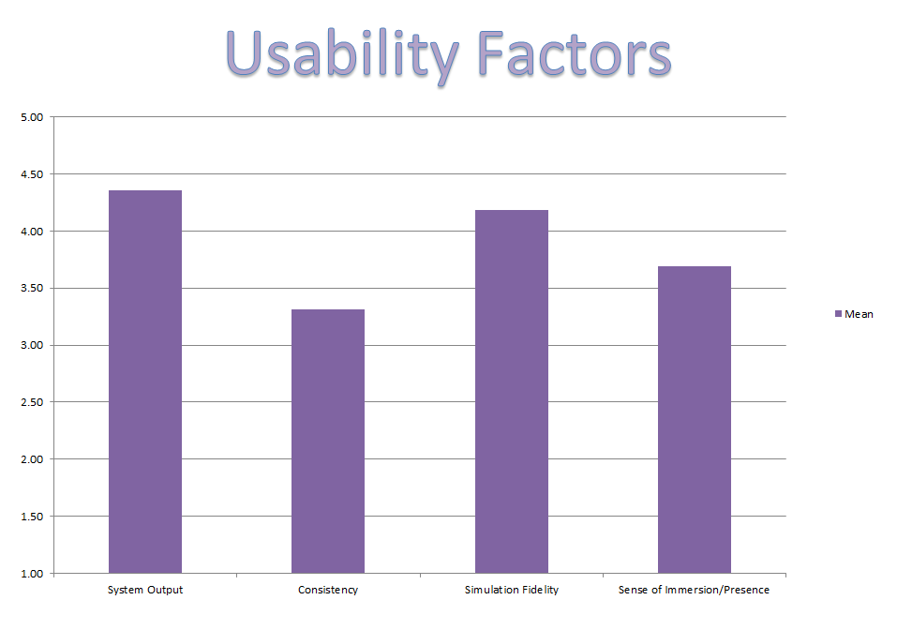
Usability
Factors

Slide 17
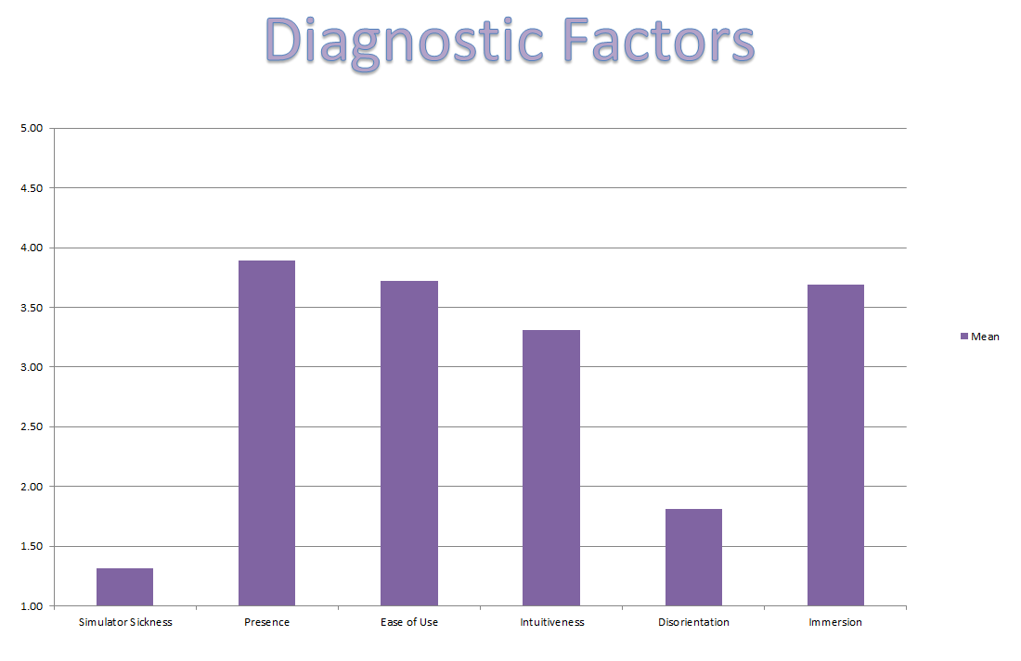
Diagnostic Factors

Slide 18
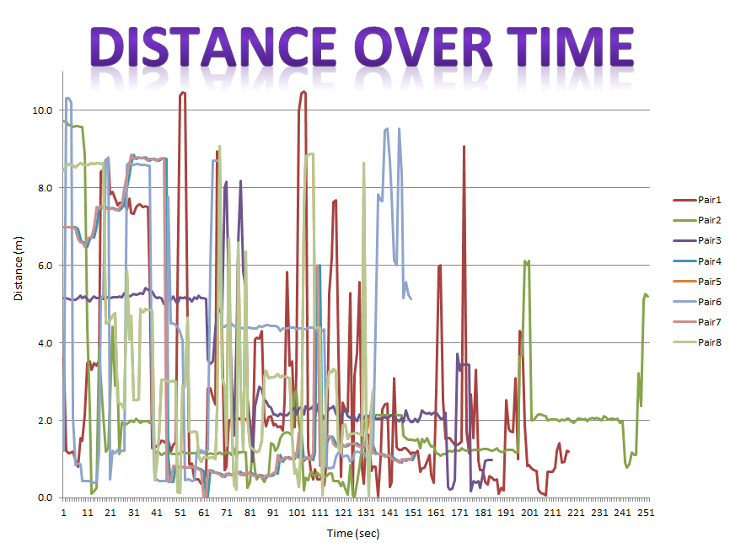
Distance

Slide 19
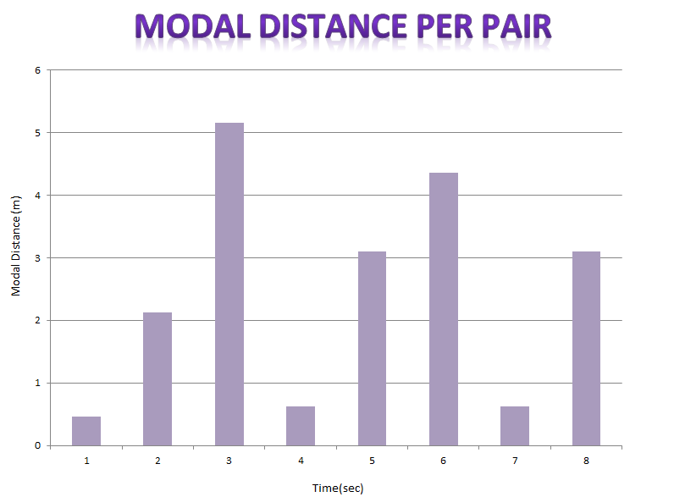
Average Communicative Distance
2.44 m
Pair Number

Slide 20
Calculations:
We calculate the mode of the distance between pairs to record the distance that people keep the longest time.
After getting the mode of the distance of each group we calculate the average number
Finally, we compare this number with the personal space model to find that it is bigger than the range of the personal space.

Slide 21
2.44 m

Slide 22




Quotes

Slide 23






Quotes

Slide 24




Quotes

Slide 25


Data Analysis

Slide 26
Improvements
Video recording of Virtual Environment itself
More thorough explanation of how various controls work
Explaining what participants need to do more clearly
Collect data more efficiently, organize it by number, and watch out for lost data
Keep track of the distance of each user when they begin/end the conversation
More post-test conversations
Make conversational setting the size of the physical room (no teleportation)

Slide 27
Reference:
Laga, H., & Amaoka, T. (2009, December). Modeling the spatial behavior of virtual agents in groups for non-verbal communication in virtual worlds. In Proceedings of the 3rd International Universal Communication Symposium(pp. 154-159). ACM.
Adams, H., Thompson, C., Thomas, D., Sharis, F., Jernigan, C. G., Moore, C., & Williams, B. (2015, September). The effect of interpersonal familiarity on cooperation in a virtual environment. In Proceedings of the ACM IGGRAPH Symposium on Applied Perception (pp. 138-138). ACM.

Slide 28
https://vimeo.com/191842243

Slide 29
Questions?

Slide 30
Thank you

