Slide 1
The Command Line,
Text Processing, and Git
Applied Bioinformatics · Week 1, Session 1
Department of Biology
Notes:
38 min of slides (plus ~9 min first-day admin on slides 2-7)utes. Blocks: why the shell and how it works (20), text processing on real data (30), git (20), open and close (5).
Assume genuine beginners. Several students will never have opened a terminal. Say that out loud early and without condescension — it defuses a lot of anxiety in the room.
Have a terminal open and projected the whole session. Every slide with a dark block is something you should actually type. Typos are useful: let them see you make one and recover.
Promise at the start: by the end of the hour everyone will have a git repository with a commit in it.

Slide 2
Course Staff
Shirley Li, Ph.D
Bioinformatician, Tufts TTS Research Technology
xue.li37@tufts.edu
Yucheng Zhang, Ph.D
Senior Bioinformatics Engineer
Tufts TTS Research Technology
yucheng.zhang@tufts.edu

Slide 3
Course Structure
Lecture
Homework
Exam
Final project

Slide 4
Deliverables
Class Participation: 10%
Homework: 30%
Exam: 20%
Final Project: 40%

Slide 5
AI Policy
AI is widely used in bioinformatics research and practice.
For this course, minimize AI use in homework assignments.
You can use AI to conduct analysis, but writing report with AI is not allowed.
If you use AI to solve the homework for you, you are not going to learn anything.
You are encouraged to use AI responsibly in your future work.
Always use AI as an assistant and do not replace thinking with AI.

Slide 6
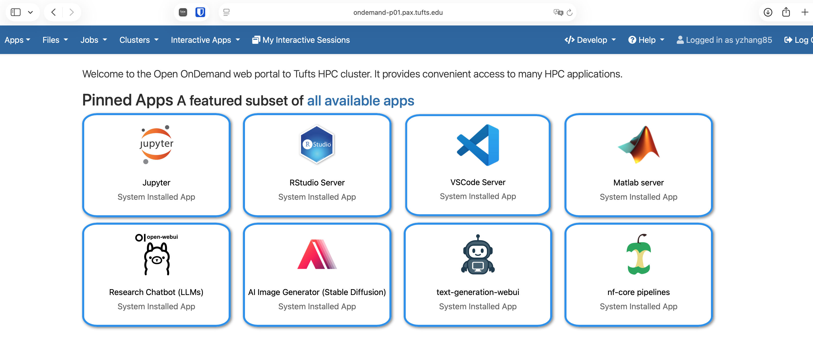
Computing Environment
https://ondemand-prod.pax.tufts.edu

Slide 7
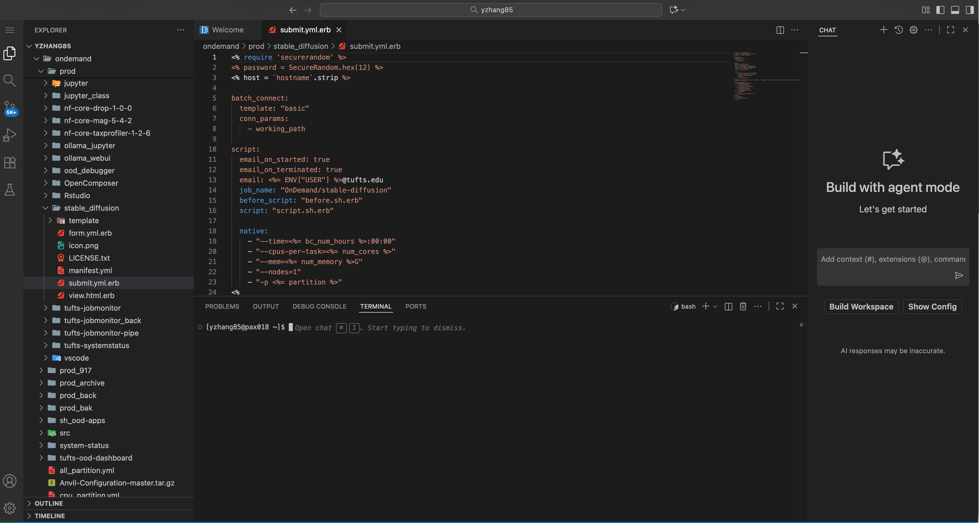
VS Code

Slide 8
Today, and what you will have at the end
OPENING
1
How the shell works
Commands, paths, and the handful of verbs you use every day
2
Text processing
grep, awk and sed on a real annotation file
3
Git from day one
init, add, commit, ignore, branch, push
You will leave with a git repository containing your first commit.
Notes:
1 min. Flag that block 2 is the longest. Students expect git to dominate; text processing is what they will use every single day.
Session 2 this week is HPC, SLURM, conda and containers. Say so, so nobody panics that the cluster has not been mentioned.

Slide 9
Anatomy of a command
THE SHELL
$ ls -lh --color=auto /cluster/tufts/
ls
the command
The program you want to run.
Conventions, not rules
Order of options rarely matters.
Arguments usually come last.
Spaces separate things, so filenames with spaces cause pain.
-lh
short options
Single dash, single letters. They bundle: -lh is -l plus -h.
--color=auto
long option
Double dash, whole word, sometimes with a value.
/cluster/tufts/
argument
What the command should act on.
Notes:
1 min. The bundling point (-lh) is worth stating explicitly; beginners often type -l -h and wonder why other people's commands look different.
The filenames-with-spaces warning pays off within a week, when someone names a directory 'RNA seq data' and nothing works. Tell them to use underscores now.

Slide 10
Where you are, and how to say where you want to go
THE SHELL
/
the root. Everything hangs off this.
Absolute vs. relative
cluster/home/
/cluster/tufts/biocontainers
starts at / — always means the same place
user01/
your home, also written ~
data/counts.tsv
depends entirely on where you are standing
cluster/tufts/mylab
user01/
your folder in your research group
Four shortcuts worth memorising now
~
your home directory
$ pwd
.
right here
/cluster/home/user01
..
one level up
$ cd ../../tufts/mylab/user01
# relative, and fragile
-
the last place you were
$ cd /cluster/tufts/mylab/user01
# absolute, boring, correct
Notes:
2 min. Draw the tree on the board as well; the spatial metaphor takes a few repetitions to stick.
'cd -' is a small gift that students love. So is tab completion — demonstrate it now and repeatedly. Most beginner frustration is retyping long paths by hand.
Mention the scratch warning: data there is deleted on a schedule. Someone loses work to this every year.

Slide 11
Ten commands cover most of your day
THE SHELL
Command | What it does | The flag you will actually use
pwd | Print where you are | —
ls | List what is here | -lh long listing, readable sizes
cd | Change directory | cd with no argument goes home
less | Page through a file | q to quit, / to search, G to end
head / tail | First or last lines | -n 20 how many lines
wc | Count lines, words, bytes | -l lines only
mkdir | Make a directory | -p make parents too, no error if it exists
cp / mv | Copy or move | -r recursive, for directories
rm | Delete. Permanently. | see the next slide before using this
Notes:
1 min. Do not read the table. Type four or five of these live instead and let the table be the reference they photograph.
'less' deserves ten seconds of demo: open a large file, scroll, search with /, quit with q. Students get trapped in less and panic.
The closing line matters for morale. Beginners assume fluent users have memorised everything.

Slide 12
rm has no undo
THE SHELL
There is no recycle bin, no Ctrl+Z, and on most clusters no snapshot. Deleted means gone.
This is the single most common way students lose a week of work, and it is entirely preventable.
# Before deleting with a wildcard, look first:
The one that really hurts
$ ls *.tmp
rm -rf $PROJECT/*
run1.tmp run2.tmp run3.tmp
If $PROJECT is unset or empty, that line becomes rm -rf /* and tries to delete everything you have permission to touch. Always echo a variable before you delete with it.
# Same line, one word changed:
$ rm *.tmp
Four habits that will save you
Run ls with the exact pattern first, then edit the line to say rm.
Use rm -i while you are learning. The prompt is worth the annoyance.
Never use rm -rf on a path you have not just printed.
Keep raw data read-only: chmod -w. You will thank yourself.
Notes:
1 min. Be serious here rather than jokey. Somebody in the room will do this within a month.
Tell a real story if you have one. Everyone who has worked on a cluster does.
The chmod -w habit for raw data is the single best piece of advice on this slide. Reinforce it in Week 2 when they download public data.

Slide 13
Three errors, three completely different problems
THE SHELL
bash: flye: command not found
The shell could not find a program by that name.
It is not installed, or the module is not loaded, or your conda environment is not activated. Nothing to do with your file.
No such file or directory
The program ran. It could not find the file you named.
Check your path and your spelling. Run ls on the directory. Usually a typo or a wrong working directory.
Permission denied
The program ran, found the file, and was not allowed to touch it.
Check ls -l. You may be writing to a read-only share, or trying to execute something that is not executable.
Read the error before you search for it. Most of them tell you exactly what is wrong.
Notes:
3 min. This slide prevents more office-hours traffic than any other in the session.
Cause one of these live on purpose: type 'flyy' instead of 'flye' and read the error out loud together.
Note honestly that man pages are written for people who already know the answer. That is why tldr exists and why searching the error text is legitimate.

Slide 14
Look at a file without opening all of it
TEXT PROCESSING
$ head -n 4 sample_R1.fastq
Compressed files
@A00534:398:HGVF7DSX3:1:1101:5900:1063 1:N:0:ATCACG
zcat reads.fastq.gz | head -n 4
zless reads.fastq.gz
GATTACAGGCGTGAACCACCGCGCCCGGCCTTTTTAAGTAGCTGGG
+
Never gunzip a FASTQ just to look at it. Almost every bioinformatics tool reads .gz directly, and decompressing a run will fill your quota.
FFFFFFF:FFFFFFFFFFFFFFFF,FFFFFFFFFF:FFF,FF:FFF
$ wc -l sample_R1.fastq
4000000 sample_R1.fastq # so 1,000,000 reads
zcat big.gz | head sometimes prints a broken-pipe warning. That is head closing the tap early. It is normal.
Do not cat a 40 GB file.
cat writes the whole thing to your screen and there is no graceful way to stop it on a slow connection. less is lazy, it reads only the part you are looking at, so it opens a 40 GB file instantly. Use less for exploring, head for peeking, and cat only for small files or for feeding a pipe.
Notes:
2 min. The wc -l / 4 arithmetic connects directly to Week 2's FASTQ slide. Say so.
Demonstrate less on something large and show q, /, G and g. Getting trapped in less is a rite of passage worth skipping.
The broken-pipe note prevents a recurring support question.

Slide 15
The pipe: the idea that makes the shell powerful
TEXT PROCESSING
zcat reads.gz
|
grep pattern
|
sort
|
uniq -c
The standard output of each command becomes the standard input of the next. Nothing is written to disk in between.
# How many reads start with the adapter sequence?
Why this matters
$ zcat sample_R1.fastq.gz | awk 'NR%4==2' | grep -c '^AGATCGGAAGAG'
No intermediate files to name, track or delete.
Works on files larger than your disk.
Each stage is a small tool you can test on its own.
18423
Build pipelines one stage at a time.
Run the first command, look at the output, then add the next pipe.
Notes:
2 min. Build the example live, one pipe at a time, showing the intermediate output at each stage. That is both the demonstration and the advice.
The NR%4==2 trick pulls out sequence lines only — it reappears on slide 20, so flag it lightly now without explaining awk yet.
'Works on files larger than your disk' genuinely surprises people. Dwell on it for a moment.

Slide 16
Redirection, and the one that eats your file
TEXT PROCESSING
>
send output to a file
Overwrites without warning or confirmation.
The classic disaster
>>
append to a file
Safe. Adds to the end.
$ sort samples.txt > samples.txt
$ wc -l samples.txt
0 samples.txt
2>
send errors to a file
Errors travel on a separate stream, remember.
The shell creates and empties the output file before sort ever starts reading. Your file is gone, and nothing warned you.
&>
send both to a file
Useful for job logs on the cluster.
Write to a new filename, always. Disk is cheaper than your afternoon.
<
read input from a file
Rarely needed; most tools take a filename.
On the cluster you will write #SBATCH --output=logs/%j.out for exactly this reason: when a job fails at 3 a.m., the log is the only witness.
Notes:
2 min. Demonstrate the sort disaster on a throwaway file. It is more convincing than describing it, and it takes ten seconds.
The stderr point pays off in Session 2 when SLURM job logs come up. Foreshadow lightly.

Slide 17
The file we will interrogate for the next six slides
TEXT PROCESSING
A GFF3 annotation file. Nine tab-separated columns, one line per feature, comment lines start with #.
##gff-version 3
I sgd gene 335 649 . + . ID=gene:YAL069W
I sgd mRNA 335 649 . + . ID=transcript:YAL069W_mRNA
I sgd exon 335 649 . + . Parent=transcript:YAL069W_mRNA
II sgd gene 1000 2000 . - . ID=gene:YBL001C
II sgd exon 1000 2000 . - . Parent=transcript:YBL001C_mRNA
$1
$2
$3
$4
$5
$6
$7
$8
$9
seqid
source
type
start
end
score
strand
phase
attributes
GFF3 coordinates are 1-based and inclusive, so a feature's length is $5 − $4 + 1. BED is 0-based and half-open, where length is $3 − $2. Mixing them up is a silent, extremely common off-by-one error.
Notes:
3 min. Spend the time. Everything in the next six slides refers back to these column numbers.
The 1-based vs 0-based point is one of the highest-value facts in the whole course, and it comes back in Week 3 with coordinate systems and in Week 7 with peak files. Say that it will come back.
Have this file open in a terminal, not just on the slide.

Slide 18
grep: give me the lines that match
TEXT PROCESSING
grep [options] PATTERN file
Two anchors worth learning today
^ start of the line
$ end of the line
-c
count matching lines instead of printing them
grep '^>' finds FASTA headers, because a header is the only line that begins with a greater-than sign. grep '^#' finds comment lines. Nearly every useful grep in bioinformatics uses one of these.
-v
invert: give me the lines that do NOT match
-i
ignore case
Quote your patterns
-n
show line numbers
Always put the pattern in single quotes. Otherwise the shell tries to interpret characters like *, $ and ^ before grep ever sees them — and you get a confusing result rather than an error.
-w
match whole words only
-E
extended regular expressions
Notes:
2 min. -v is the one beginners forget and then use constantly — stripping headers and comments is a daily task.
The quoting advice prevents a whole class of mysterious bugs. Demonstrate the failure: grep ^> without quotes will redirect output into a file called '>' or hang waiting for input.

Slide 19
grep, three real questions
TEXT PROCESSING
How many sequences are in this FASTA?
$ grep -c '^>' genome.fa
Counts header lines. A FASTA record has exactly one.
25
Drop the comment lines from a GFF3
$ grep -v '^#' anno.gff3 | head -n 2
-v inverts the match. This is the first stage of almost every GFF pipeline.
chr1 ensembl gene 11869 14409 ...
chr1 ensembl mRNA 11869 14409 ...
Find one gene, and only that gene
Without -w you also match TP53BP1, TP53I3 and TP53INP1.
$ grep -w 'TP53' anno.gff3 | wc -l → 14
$ grep 'TP53' anno.gff3 | wc -l → 39
Notes:
2 min. Run all three live on a real annotation file.
The TP53 example is the one to labour. Ask the room what could go wrong before revealing the second number — someone usually spots it, and it lands far better coming from a student.
This generalises: every silent bioinformatics error is a query that was looser than the question.

Slide 20
The counting idiom you will use forever
TEXT PROCESSING
... | cut -f3 | sort | uniq -c | sort -rn | head
cut -f3
pull out column 3 only
$ grep -v '^#' anno.gff3 \
| cut -f3 | sort | uniq -c | sort -rn
sort
put identical values next to each other
185432 exon
142339 CDS
uniq -c
collapse runs of identical lines, with a count
95421 mRNA
58721 five_prime_UTR
sort -rn
sort by that count, numerically, descending
20047 gene
125 pseudogene
uniq only collapses lines that are already adjacent. Without the sort in front of it you get nonsense and not an error message, just a wrong answer. This is the single most common mistake with this idiom.
Notes:
3 min. Make them watch what happens without the sort. Run it both ways on the same file; the wrong version looks plausible, which is the point.
Note that the gene count here (about 20,000) is a sanity check in itself — if a human annotation gives you 200,000 genes, something is wrong with the file or your command, and this one-liner is how you find out.

Slide 21
awk: when you need columns and arithmetic
TEXT PROCESSING
awk 'pattern { action }' file
When to reach for awk instead of grep
You care about a specific column, not the whole line.
You need to compare a number: $5 > 1000.
You need to add things up across lines.
The thing you are matching could appear in the wrong column.
For every line: if the pattern is true, do the action. Leave out the pattern and it runs on every line; leave out the action and it prints matching lines.
$1, $2, $3…
the columns, numbered from one
$0
the whole line
NF
number of fields on this line
NR
the line number, counting from one
awk is a complete programming language. You will use about four percent of it, forever, and that is entirely respectable.
-F'\t'
set the separator — essential for GFF and VCF
END { }
run this once, after the last line
Notes:
2 min. Do not teach awk as a language. Teach it as four idioms they will copy.
The default separator is whitespace, which silently breaks on GFF attribute columns containing spaces. -F'\t' is not optional for tabular bioinformatics formats — say it twice.
Reassure them about the last line. Students feel they should master awk; almost nobody has.

Slide 22
awk, four one-liners worth keeping
TEXT PROCESSING
Count genes
Pattern only, no action. Matching lines are printed.
$ awk -F'\t' '$3=="gene"' anno.gff3 | wc -l
20047
Total exonic bases
The +1 is because GFF3 is 1-based inclusive. Leave it out and you undercount by one base per exon.
$ awk -F'\t' '$3=="exon" {s += $5-$4+1} END {print s}' anno.gff3
84129552
Long features only
Comparison in the pattern. grep cannot do this at all.
$ awk -F'\t' '$3=="gene" && $5-$4 > 100000' anno.gff3 | wc -l
1832
Count reads in a FASTQ
Every fourth line starting at line one is a header. Safer than dividing wc -l by four, which breaks silently on a truncated file. Keep this one — it returns in Week 2.
$ awk 'NR%4==1' reads.fastq | wc -l
1000000
Notes:
3 min. These four are the ones to put on a cheat sheet. Tell students to copy them now.
The off-by-one in example two is the single most valuable detail on this slide. Ask them why the +1 is there before you explain it, and refer back to slide 15.
Example four vs dividing by four: a truncated FASTQ gives a wrong answer silently with division and an obviously odd answer with NR%4. That distinction — failing loudly rather than quietly — is a theme worth naming.

Slide 23
sed: change something on every line
TEXT PROCESSING
sed 's/old/new/g' file
The task you will actually use it for
Ensembl calls it I. UCSC calls it chrI. Your reference genome and your annotation file disagree, so every tool reports zero overlaps and none of them tells you why.
s
substitute
/old/
what to find
$ sed '/^#/!s/^/chr/' anno.gff3 > anno_chr.gff3
/new/
what to put there
g
every occurrence on the line, not just the first
The /^#/! matters: a bare s/^/chr/ also prefixes the ## header lines, producing chr##gff-version 3 and breaking the file.
This exact mismatch silently corrupts RNA-seq and variant analyses, and it comes back in Week 3 under annotation versions and coordinate systems.
sed -i edits the file in place, with no copy and no confirmation. Use sed -i.bak so you get one, at least until the command is right.
Notes:
2 min. The chr-prefix problem is real, ubiquitous, and costs people days. Tell them it will happen to them.
Note that renaming chromosomes with sed is a last resort rather than good practice — the better fix is to use matching references throughout. But everyone does it, so do it correctly.
Do not teach sed addresses or regex groups. They will look it up when they need it.

Slide 24
Git is not a backup. It is a record of what you did
GIT FROM DAY ONE
Everyone has this folder
What git answers instead
analysis.R
analysis_v2.R
analysis_final.R
analysis_final_FIXED.R
analysis_final_FIXED_usethis.R
analysis_final_FIXED_usethis_OLD.R
What exactly changed, line by line?
When, and in what order?
Why? because you wrote it down at the time.
Can I go back to the version that produced figure 3? Yes.
Which one made figure 3?
Notes:
1 min. Ask the room who recognises the left-hand folder. Every hand goes up, including yours.
Resist teaching git as a theory of directed acyclic graphs. Teach it as: write down what you did, so future-you and your reviewers can check.
The 'available on request' line is worth saying slowly. It is the whole argument for the course's reproducibility thread.

Slide 25
Three places a file can be
GIT FROM DAY ONE
Working directory
→
Staging area
→
Repository
The files you can see and edit. Where you actually do the work.
git add
A list of changes you have chosen to include in the next commit.
git commit
The permanent, timestamped history. Commits live here.
git status tells you, at any moment, which of the three places every file is in. Run it constantly. It is the single most useful command in git.
Notes:
2 min. Do not over-explain staging. Give permission to ignore it at first — that permission is what stops beginners from stalling here.
'Run git status constantly' is the most practical advice in the git block. Repeat it on the next slide when you demo.

Slide 26
.gitignore is not optional in bioinformatics
GIT FROM DAY ONE
Never commit data.
What belongs in a repository
GitHub warns above 50 MB and refuses above 100 MB. One FASTQ file is bigger than your entire repository should be.
Scripts, notebooks, configuration, sample sheets
environment.yml or a container definition
A README that says how to get the data
Small result tables somebody might want to check
# .gitignore
*.fastq
*.fastq.gz
*.bam
Write it before your first commit
*.bai
*.fa
Once a large file is in the history, adding it to .gitignore does nothing, because it is already recorded in every clone forever. Removing it means rewriting history, which is unpleasant and, on a shared repository, rude.
data/
results/
work/
.snakemake/
Notes:
2 min. This is the slide that prevents a support ticket per student per semester.
Emphasise the ordering: .gitignore first, then git init's first commit. Students who learn this backwards learn it painfully.
Mention that the pattern 'commit the recipe, not the ingredients' is the same idea as the Week 3 homework's rule about not committing FASTQ files.

Slide 27
GitHub is a website. Git is the tool
GIT FROM DAY ONE
Your machine
GitHub
git push →
The full repository, including the entire history. Git works completely offline, commits do not need a network.
A copy on somebody else's computer, with a web interface bolted on. Convenient, not magic, and not the only option.
← git pull
$ git remote add origin git@github.com:jsmith/hw1-shell.git
$ git push -u origin main
# and on another machine, or for a classmate:
$ git clone git@github.com:jsmith/hw1-shell.git
Set up an SSH key today rather than typing a token every push.
Notes:
1 min. The git-versus-GitHub distinction matters more than it sounds: students who conflate them think their work is unsafe without internet, and get confused when GitHub is down.
Be very explicit about the submission rule. Every semester someone commits diligently and never pushes.
SSH key setup is a five-minute job that saves everyone hours. Put the link in the chat now.

