Slide 1

Logistic Regression

Slide 2
Logistic Regression
Classification of the problem is a problem,
where the variable y that you want to predict is valued
Algorithm called logistic regression,
which is one of the most popular and most widely used learning algorithms today.
Linear regression is the procedure that estimates the coefficients of the linear equation, involving one or more independent variables that best predict the value of the dependent variable which should be quantitative.
Logistic regression is similar to a linear regression but is suited to models where the dependent variable is dichotomous. Logistic regression coefficients can be used to estimate odds ratios for each of the independent variables in the model.

Slide 3
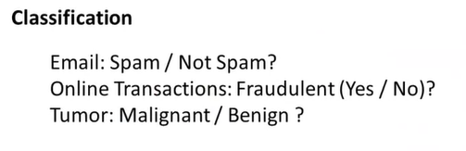
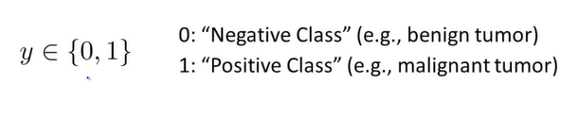
The assignment of the two classes to positive and negative to zero and one is somewhat arbitrary and it doesn't really matter!
This is BINARY CLASSIFICATION PROBLEMS.
But there are also MULTICLASS CLASSIFICATION PROBLEMS.

Slide 4
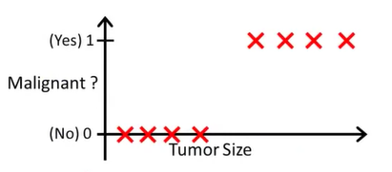
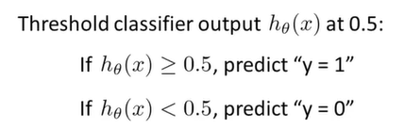

How do we develop a classification algorithm?
$$h_{θ}\left(x\right)= θ^{T}x$$
Positive value
Negative value
How to make a predictions?
In this particular example, it looks like linear regression is actually
doing something reasonable…..

Slide 5
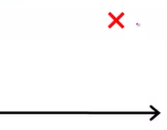
Let us consider another case.
This example really isn't giving us any new information.
There should be no surprise to the learning algorithm.
Positive value
Negative value
If you now run linear regression, you instead get a straight line fit to the data.
So, applying linear regression to a classification problem often isn't a great idea.

Slide 6
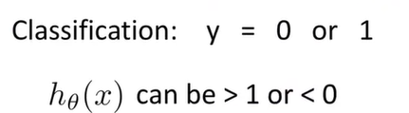

More details
For classification we know that y is either zero or one.
But if you are using linear regression where the hypothesis
can output values that are much larger than one or less than zero,
even if all of your training examples have labels y equals zero or one.

Slide 7
Logistic Regression Model

Slide 8




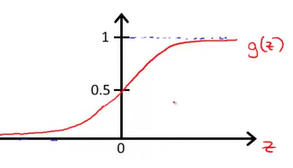

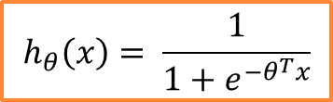
Hypothesis Representation
1. We would like our classifier to output values that are between 0 and 1
2. For linear regression, this was the form of a hypothesis:
For logistic regression:
$$h_{θ}\left(x\right)= \frac{1}{1+e^{−θ^{T}x}}$$
Given a training set we need to a pick a value for
the parameters theta and this hypothesis will then let us make predictions

Slide 9
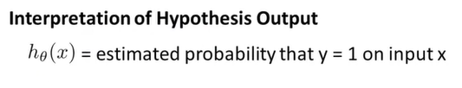
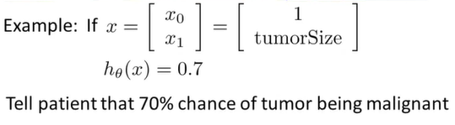



hypothesis outputs some number - treat that number as
the estimated probability that y is equal to one on a new input, example x
The tumor classification example:
In math:
$$h_{θ}\left(x\right)=p(y=1|x;θ)$$
So:

Slide 10
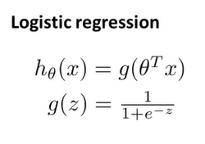
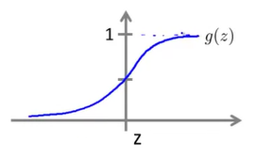
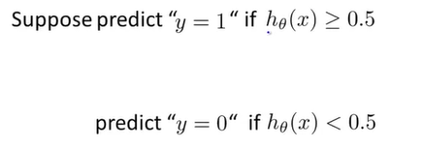



Decision boundary
= $p(y=1|x;θ)$
g(z)≥0.5 when z ≥ 0 =>$h_{θ}\left(x\right)=g\left(θ^{T}x\right) \text{≥0.5}$ =>$θ^{T}x$≥ 0
$θ^{T}x$ ≥ 0
g(z)<0.5 when z< 0 =>$h_{θ}\left(x\right)=g\left(θ^{T}x\right)\text{<0.5}$ =>$θ^{T}x$<0
$θ^{T}x$< 0

Slide 11
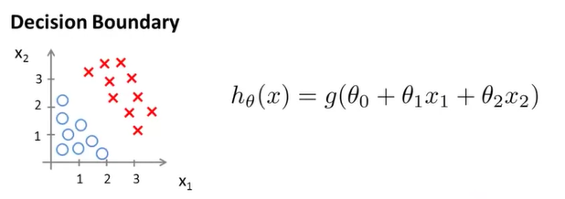





Suppose we end up choosing the following values for the parameters:
$$θ= \begin{matrix}−3 \\ 1 \\ 1\end{matrix}$$
y=0
Decision boundary
=>$x_{1}+x_{2}$≥3
$$θ^{T}x$$
${Predict "\text{y}\text{ = 0}" if x}_{1}+x_{2}<$3

Slide 12
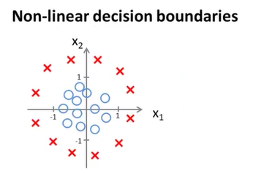
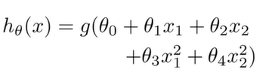



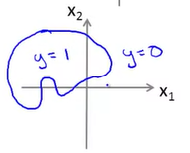

=-1
=0
=0
y=1
y=1
1=
1=
let's say that varied procedure to be specified, I end up choosing theta:
y=1
y=1
Decision boundary
$${x_{}^{2}}_{1}+{x_{}^{2}}_{2} ≥1 ⇒ if to plot {x_{}^{2}}_{1}+{x_{}^{2}}_{2}=1$$
$$⇒$$

Slide 13
Cost Function (the parameters of theta for the logistic compression)

Slide 14
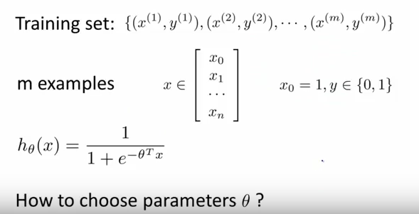
COST FUNCTION

Slide 15



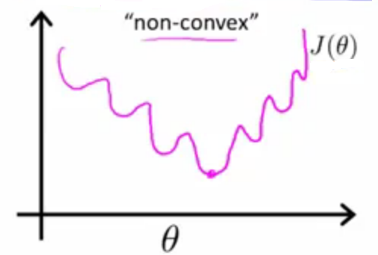
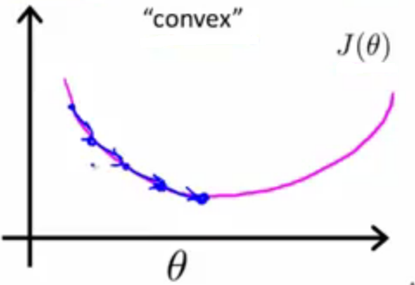
Logistic Regression:
J(θ)=
What we actually want is:

Slide 16
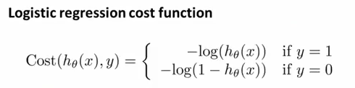
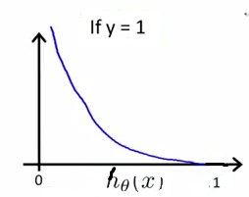
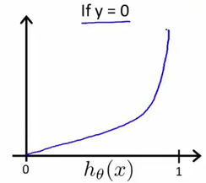
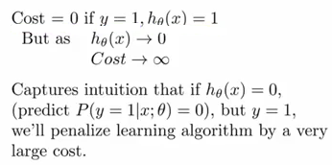
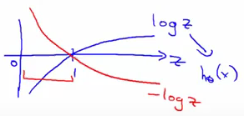

Slide 17
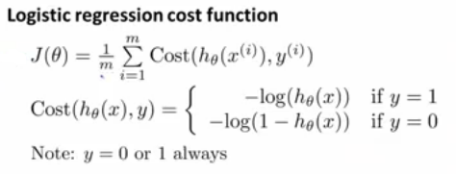

Slide 18
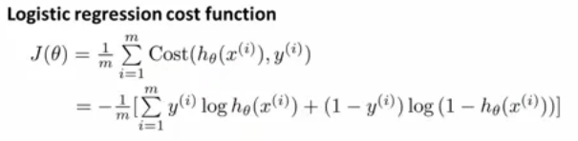

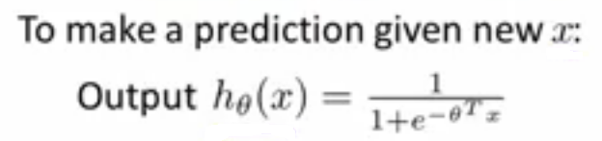

Slide 19
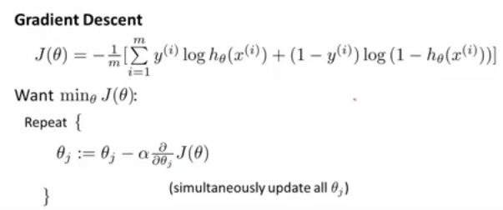


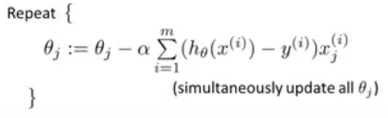
DO NOT
FORGET
ABOUT
FEATURES SCALING!
BUT:
Algorithm looks identical to linear regression!

Slide 20
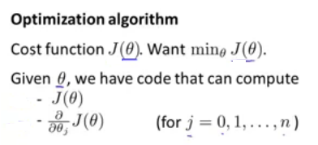
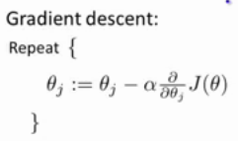
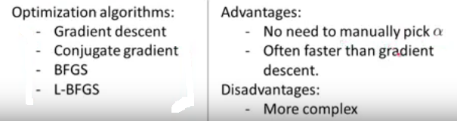
Advance optimization

Slide 21
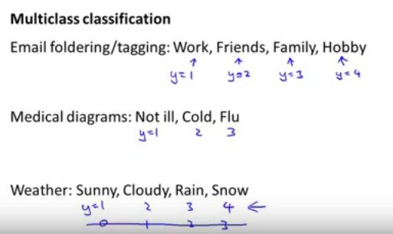
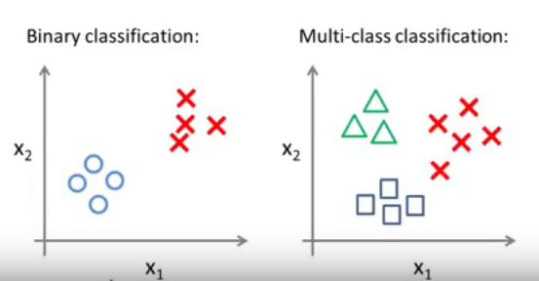

Slide 22
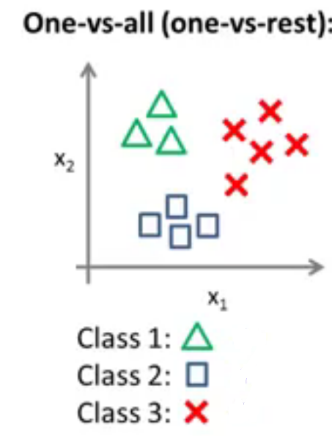
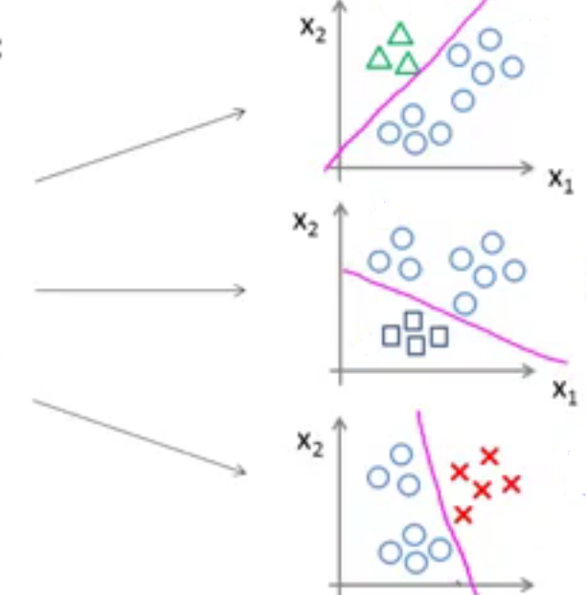


Slide 23
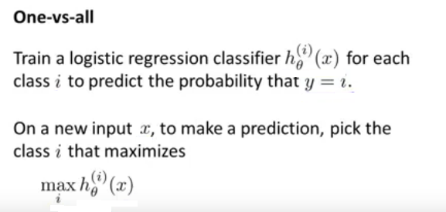

Slide 24
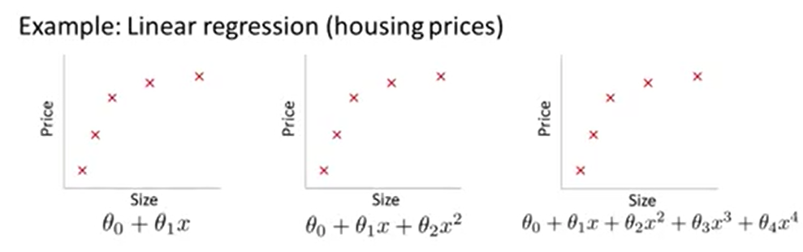
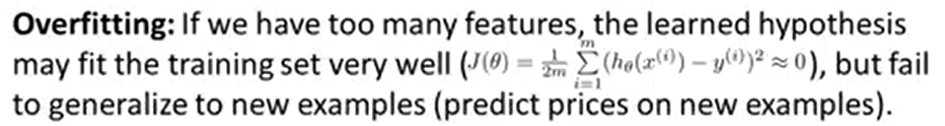
Regularization
Underfit or “High bias”
Overfit or “High variance”

Slide 25
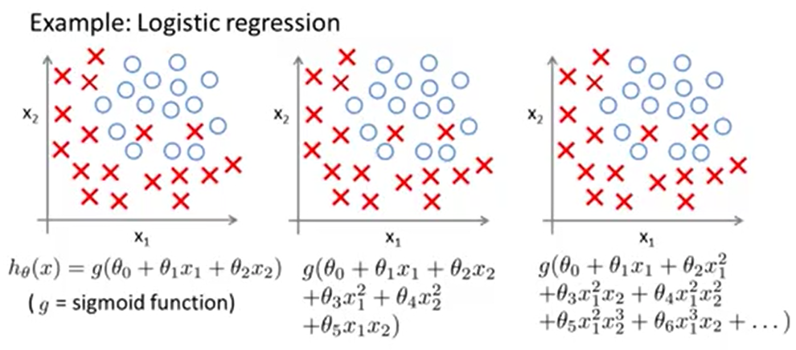
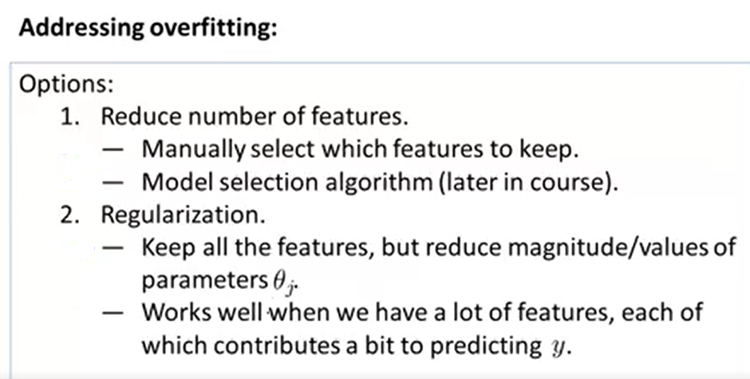

Slide 26
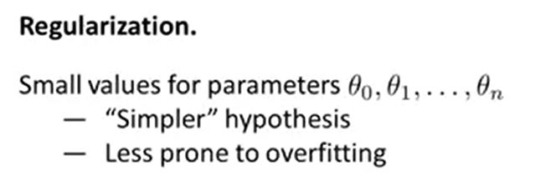
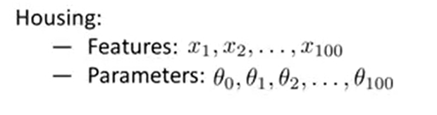
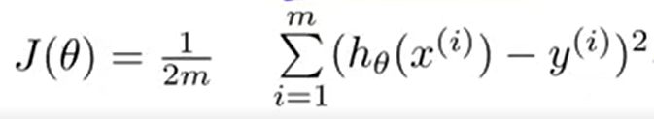

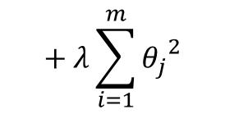
Penalizing
(to make small).
Except $θ_{0}$
$$+ λ\sum_{i=1}^{m}{{θ_{j}}^{2}}$$
Regularization parameter

Slide 27
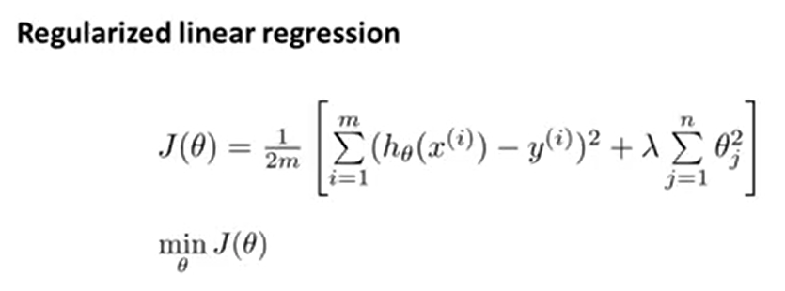
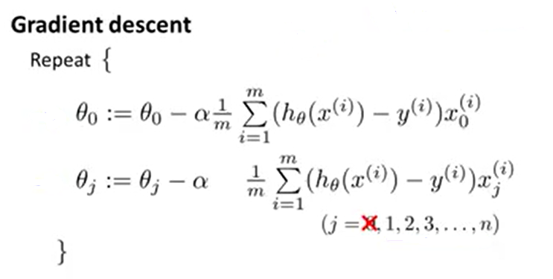


$$\frac{δ}{δΘ_{j}}{J(Θ}_{j})$$
+ $\frac{λ}{m}Θ_{j}$

Slide 28
Regularization parameter (lambda)
When choosing a lambda value, the goal is to strike the right balance between simplicity and training-data fit:
If your lambda value is too high, your model will be simple, but you run the risk of underfitting your data. Your model won't learn enough about the training data to make useful predictions.
If your lambda value is too low, your model will be more complex, and you run the risk of overfitting your data. Your model will learn too much about the particularities of the training data, and won't be able to generalize to new data.
Note: Setting lambda to zero removes regularization completely. In this case, training focuses exclusively on minimizing loss, which poses the highest possible overfitting risk.
The ideal value of lambda produces a model that generalizes well to new, previously unseen data. Unfortunately, that ideal value of lambda is data-dependent, so you'll need to do some tuning.

Slide 29



Regularized normal equation
Even in case of non-invertibility, regularization take care of it

Slide 30


+ $\frac{λ}{2m}\sum_{j=1}^{n}{Θ_{j}}$

Slide 31




+ $\frac{λ}{2}Θ_{j}$
$$\frac{∂}{∂θ_{j}}J(θ_{j})$$
$$h_{θ}\left(x\right)= \frac{1}{1+e^{θ^{T}x}}$$

