Slide 1
Python Crash Course
Numpy & MatplotLib

Slide 2
Scientific Python?
Extra features required:
  fast, multidimensional arrays
  libraries of reliable, tested scientiﬁc functions
  plotting tools

Slide 3
Arrays – Numerical Python (Numpy)
Lists ok for storing small amounts of one-dimensional data
>>> a = [1,3,5,7,9]
>>> print(a[2:4])
[5, 7]
>>> b = [[1, 3, 5, 7, 9], [2, 4, 6, 8, 10]]
>>> print(b[0])
[1, 3, 5, 7, 9]
>>> print(b[1][2:4])
[6, 8]
>>> a = [1,3,5,7,9]
>>> b = [3,5,6,7,9]
>>> c = a + b
>>> print c
[1, 3, 5, 7, 9, 3, 5, 6, 7, 9]
But, can’t use directly with arithmetical operators (+, -, *, /, …)
Need efﬁcient arrays with arithmetic and better multidimensional tools
Numpy
Similar to lists, but much more capable, except ﬁxed size
>>> import numpy

Slide 4
Numpy – N-dimensional Array manpulations
The fundamental library needed for scientific computing with Python is called NumPy. This Open Source library contains:
a powerful N-dimensional array object
advanced array slicing methods (to select array elements)
convenient array reshaping methods
and it even contains 3 libraries with numerical routines:
basic linear algebra functions
basic Fourier transforms
sophisticated random number capabilities
NumPy can be extended with C-code for functions where performance is highly time critical. In addition, tools are provided for integrating existing Fortran code. NumPy is a hybrid of the older NumArray and Numeric packages, and is meant to replace them both.

Slide 5
Numpy - ndarray
NumPy's main object is the homogeneous multidimensional array called ndarray.
  This is a table of elements (usually numbers), all of the same type, indexed by a tuple of positive integers. Typical examples of multidimensional arrays include vectors, matrices, images and spreadsheets.
  Dimensions usually called axes, number of axes is the rank
>>> a = numpy.array([1,3,5,7,9])
>>> b = numpy.array([3,5,6,7,9])
>>> c = a + b
>>> print c
[4, 8, 11, 14, 18]
[7, 5, -1] An array of rank 1 i.e. It has 1 axis of length 3
[ [ 1.5, 0.2, -3.7] , An array of rank 2 i.e. It has 2 axes, the first
[ 0.1, 1.7, 2.9] ] length 3, the second of length 3 (a matrix
with 2 rows and 3 columns

Slide 6
Numpy – ndarray attributes
ndarray.ndim
  the number of axes (dimensions) of the array i.e. the rank.
ndarray.shape
  the dimensions of the array. This is a tuple of integers indicating the size of the array in each dimension. For a matrix with n rows and m columns, shape will be (n,m). The length of the shape tuple is therefore the rank, or number of dimensions, ndim.
ndarray.size
  the total number of elements of the array, equal to the product of the elements of shape.
ndarray.dtype
  an object describing the type of the elements in the array. One can create or specify dtype's using standard Python types. NumPy provides many, for example bool_, character, int_, int8, int16, int32, int64, float_, float8, float16, float32, float64, complex_, complex64, object_.
ndarray.itemsize
  the size in bytes of each element of the array. E.g. for elements of type float64, itemsize is 8 (=64/8), while complex32 has itemsize 4 (=32/8) (equivalent to ndarray.dtype.itemsize).
ndarray.data
  the buffer containing the actual elements of the array. Normally, we won't need to use this attribute because we will access the elements in an array using indexing facilities.

Slide 7
Numpy – array creation and use
>>> import numpy
>>> l = [[1, 2, 3], [3, 6, 9], [2, 4, 6]] # create a list
>>> a = numpy.array(l) # convert a list to an array
>>> print(a)
[[1 2 3]
[3 6 9]
[2 4 6]]
>>> a.shape
(3, 3)
>>> print(a.dtype) # get type of an array
int32
>>> print(a[0]) # this is just like a list of lists
[1 2 3]
>>> print(a[1, 2]) # arrays can be given comma separated indices
9
>>> print(a[1, 1:3]) # and slices
[6 9]
>>> print(a[:,1])
[2 6 4]

Slide 8
Numpy – array creation and use
>>> a[1, 2] = 7
>>> print(a)
[[1 2 3]
[3 6 7]
[2 4 6]]
>>> a[:, 0] = [0, 9, 8]
>>> print(a)
[[0 2 3]
[9 6 7]
[8 4 6]]
>>> b = numpy.zeros(5)
>>> print(b)
[ 0. 0. 0. 0. 0.]
>>> b.dtype
dtype(‘float64’)
>>> n = 1000
>>> my_int_array = numpy.zeros(n, dtype=numpy.int)
>>> my_int_array.dtype
dtype(‘int32’)

Slide 9
Numpy – array creation and use
>>> c = numpy.ones(4)
>>> print(c)
[ 1. 1. 1. 1. ]
>>> d = numpy.arange(5) # just like range()
>>> print(d)
[0 1 2 3 4]
>>> d[1] = 9.7
>>> print(d) # arrays keep their type even if elements changed
[0 9 2 3 4]
>>> print(d*0.4) # operations create a new array, with new type
[ 0. 3.6 0.8 1.2 1.6]
>>> d = numpy.arange(5, dtype=numpy.float)
>>> print(d)
[ 0. 1. 2. 3. 4.]
>>> numpy.arange(3, 7, 0.5) # arbitrary start, stop and step
array([ 3. , 3.5, 4. , 4.5, 5. , 5.5, 6. , 6.5])

Slide 10
Numpy – array methods
>>> arr.sum()
45
>>> arr.mean()
4.5
>>> arr.std()
2.8722813232690143
>>> arr.max()
9
>>> arr.min()
0
>>> div_by_3.all()
False
>>> div_by_3.any()
True
>>> div_by_3.sum()
3
>>> div_by_3.nonzero()
(array([2, 5, 8]),)

Slide 11
Numpy – array mathematics
>>> a = np.array([1,2,3], float)
>>> b = np.array([5,2,6], float)
>>> a + b
array([6., 4., 9.])
>>> a – b
array([-4., 0., -3.])
>>> a * b
array([5., 4., 18.])
>>> b / a
array([5., 1., 2.])
>>> a % b
array([1., 0., 3.])
>>> b**a
array([5., 4., 216.])
>>> a = np.array([[1, 2], [3, 4], [5, 6]], float)
>>> b = np.array([-1, 3], float)
>>> a
array([[ 1., 2.],
[ 3., 4.],
[ 5., 6.]])
>>> b
array([-1., 3.])
>>> a + b
array([[ 0., 5.],
[ 2., 7.],
[ 4., 9.]])

Slide 12
Numpy – array functions
Most array methods have equivalent functions
>>> arr.sum()
45
>>> numpy.sum(arr)
45
Ufuncs provide many element-by-element math, trig., etc. operations
  e.g., add(x1, x2), absolute(x), log10(x), sin(x), logical_and(x1, x2)
See http://numpy.scipy.org

Slide 13
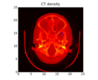


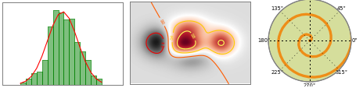
SCIENTIFIC VISUALISATION FOR PYTHON

Slide 14
Plotting - matplotlib
User friendly, but powerful, plotting capabilites for python
http://matplotlib.sourceforge.net/
Once installed (default at Observatory)
>>> import pylab
Settings can be customised by editing ~/.matplotlib/matplotlibrc
  default font, colours, layout, etc.
Helpful website
  many examples

Slide 15
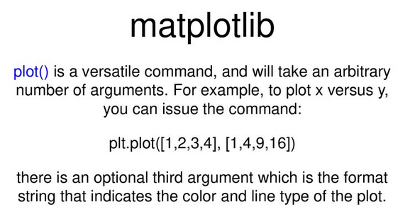

Slide 16
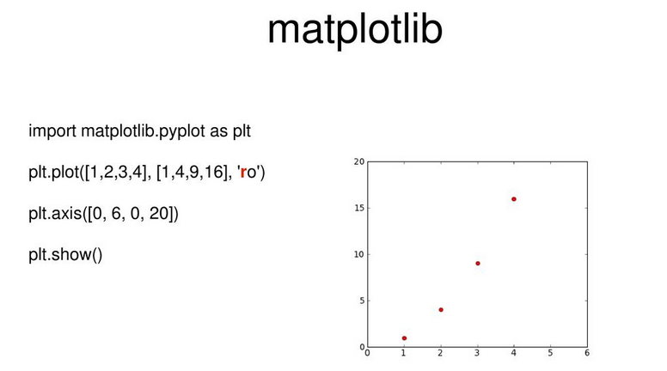

Slide 17
Pylab and Pyplot
$ python
Python 2.7.3 (default, Aug 9 2012, 17:23:57)
[GCC 4.7.1 20120720 (Red Hat 4.7.1-5)] on linux2
Type "help", "copyright", "credits" or "license" for more information.
>>> import matplotlib.pyplot as plt
>>> plt.plot([1,2,3,4])
[<matplotlib.lines.Line2D object at 0x1fe53d0>]
>>> plt.ylabel('some numbers')
<matplotlib.text.Texy object at 0x1d6ad90>
>>> plt.show()
$ ipython –-pylab
Python 2.7.3 (default, Aug 9 2012, 17:23:57)
Type "copyright", "credits" or "license" for more information.
IPython 0.13.2 -- An enhanced Interactive Python.
? -> Introduction and overview of IPython's features.
%quickref -> Quick reference.
help -> Python's own help system.
object? -> Details about 'object', use 'object??' for extra details.
Welcome to pylab, a matplotlib-based Python environment [backen: GTKAgg].
For more information, type ‘help(pylab)’
In [1]: plot([1,2,3,4])

Slide 18
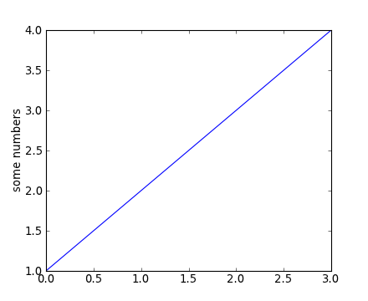
Matplotlib.pyplot basic example
matplotlib.pyplot is a collection of command style functions that make matplotlib work like MATLAB. Each pyplot unction makes some change to a figure: eg, create a figure, create a plotting area in a figure, plot some lines in a plotting area, decorate the plot with labels, etc....
import matplotlib.pyplot as plt plt.plot([1,2,3,4])
plt.ylabel('some numbers')
plt.show()

Slide 19
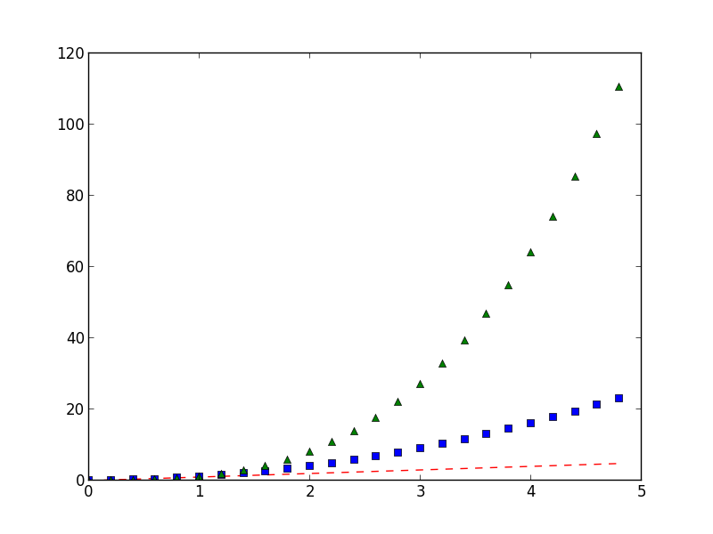
Matplotlib.pyplot basic example
Generally, you will use numpy arrays. In fact, all sequences are converted to numpy arrays internally. The example below illustrates a plotting several lines with different format styles in one command using arrays.
import numpy as np
import matplotlib.pyplot as plt
# evenly sampled time at 200ms intervals
t = np.arange(0., 5., 0.2)
# red dashes, blue squares and green triangles plt.plot(t, t, 'r--', t, t**2, 'bs', t, t**3, 'g^')

Slide 20
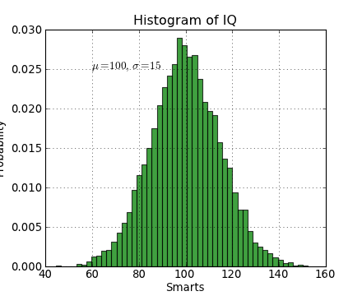
Matplotlib.pyplot example
import numpy as np
import matplotlib.pyplot as plt
mu, sigma = 100, 15
x = mu + sigma * np.random.randn(10000)
# the histogram of the data
n, bins, patches = plt.hist(x, 50, normed=1, facecolor='g', alpha=0.75)
plt.xlabel('Smarts')
plt.ylabel('Probability')
plt.title('Histogram of IQ')
plt.text(60, .025, r'$\mu=100,\ \sigma=15$')
plt.axis([40, 160, 0, 0.03])
plt.grid(True)
Working with text.
The text() command can be used to add text in an arbitrary location, and the xlabel(), ylabel() and title() are used to add text in the indicated locations.

Slide 21
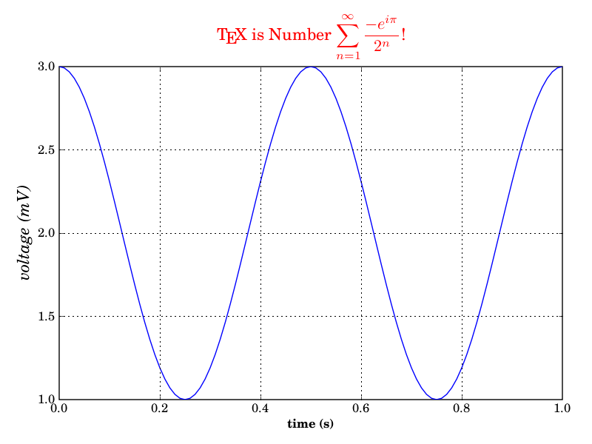
Matplotlib.pyplot example
Using TeX.
from matplotlib import rc
from matplotlib.numerix import arange, cos, pi
from pylab import figure, axes, plot, xlabel,
ylabel, title, grid, savefig, show
rc('text', usetex=True)
figure(1)
ax = axes([0.1, 0.1, 0.8, 0.7])
t = arange(0.0, 1.0+0.01, 0.01)
s = cos(2*2*pi*t)+2
plot(t, s)
xlabel(r'\textbf{time (s)}')
ylabel(r'\textit{voltage (mV)}',fontsize=16)
title(r"\TeX\ is Number $\displaystyle\sum_{n=1}^\infty\frac{-e^{i\pi}}{2^n}$!", fontsize=16, color='r')
grid(True)
savefig('tex_demo')
show()

