Slide 1
Report on Ovarian Cancer TCGA data miRNA array vs Seq
02/19/2013

Slide 2
Data
miRNA array
All primary tumor samples:
799 miRNA, 569 samples
miRNA-seq
All primary tumor samples:
705 miRNA, 452 samples

Slide 3
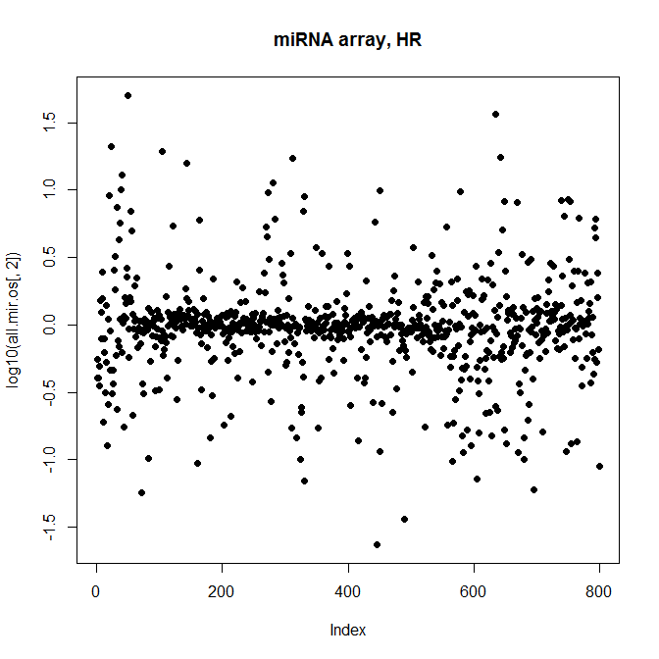
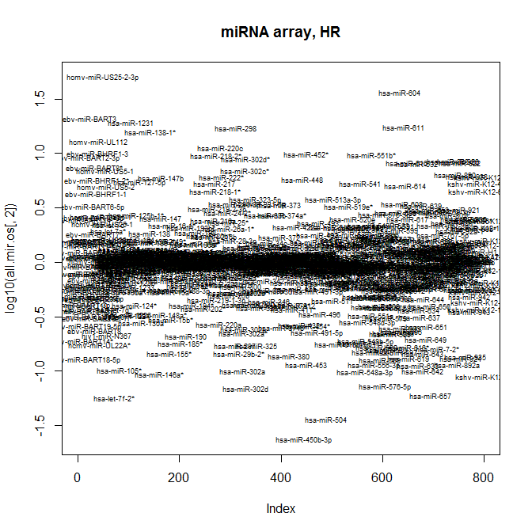
Overall Survival
Primary tumor, microarray, 799 miRNAs
HR (log10)

Slide 4
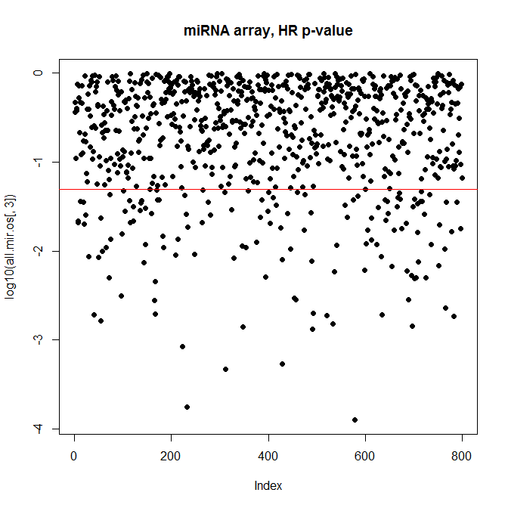
Primary tumor, microarray, 799 miRNAs
Significance of HR
 | p < 0.05 | p >= 0.05
Among all 799 miRNAs | 141 | 658
Non-human miRNA (no “hsa-”) | 15 | 61
Human miRNA | 126 | 597
Human miRNA, no suffix | 75 (60%) | 325 (54%)
Human miRNA, -5p | 13 (10%) | 65 (11%)
Human miRNA, -3p | 9 (7%) | 71 (12%)
Human miRNA, * | 29 (23%) | 136 (23%)

Slide 5
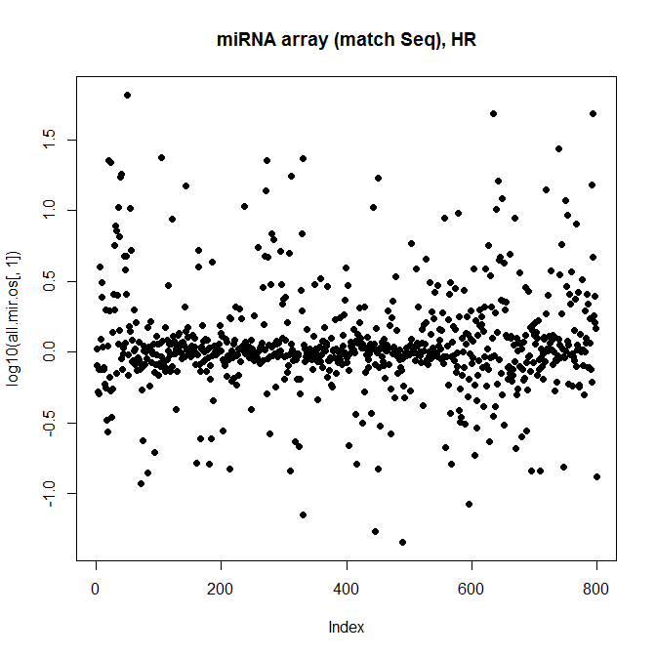
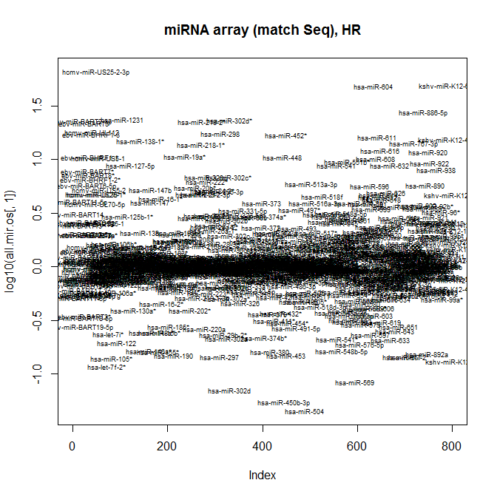
On samples (n=452) that exist in Seq
Primary tumor, microarray, 799 miRNAs
Patient samples (n=452) that exist in miRNA-seq data
HR (log10)

Slide 6
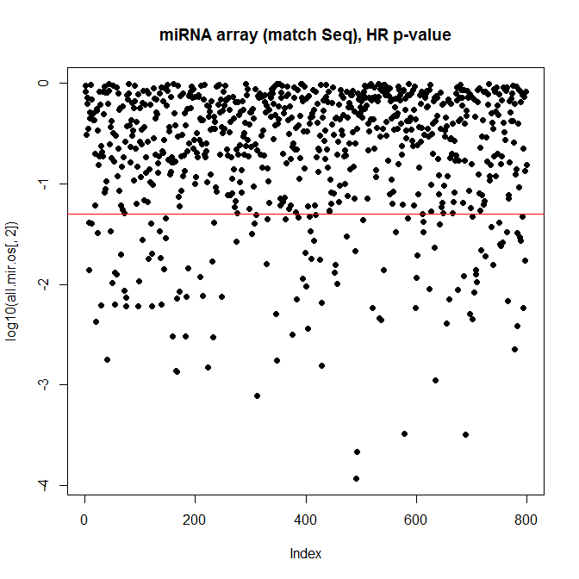
Primary tumor, microarray, 799 miRNAs
Patient samples (n=452) that exist in miRNA-seq data
Significance of HR
 | p < 0.05 | p >= 0.05 | Total
Among all 799 miRNAs | 123 | 676 | 799
Non-human miRNA (no “hsa-”) | 19 | 57 | 76
Human miRNA | 104 | 619 | 723
Human miRNA, no suffix | 64 (61.5%) | 336 (54%) | 400
Human miRNA, -5p | 13 (12.5%) | 65 (11%) | 78
Human miRNA, -3p | 7 (7%) | 73 (12%) | 80
Human miRNA, * | 20 (19%) | 145 (23%) | 165

Slide 7
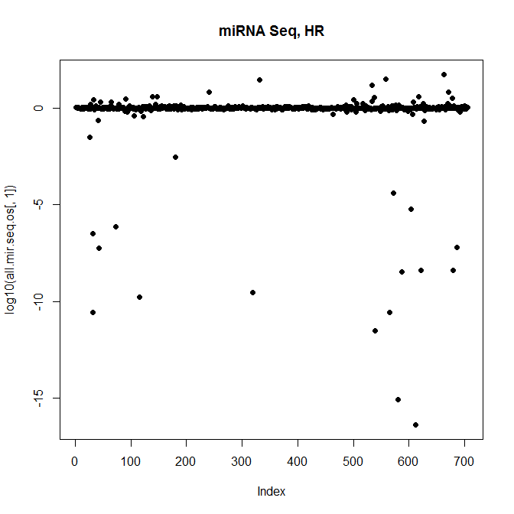
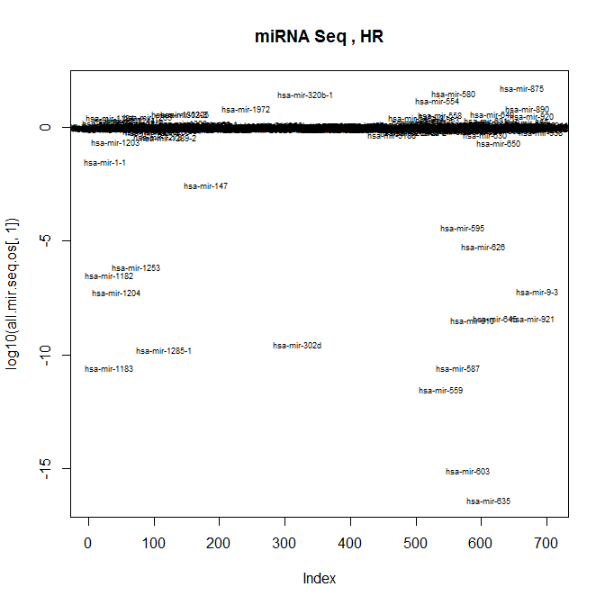
miRNA-seq (n=452) (Quan-Norm, Log)
Primary tumor, miRNA-seq, 705 miRNAs
Patient samples (n=452)
HR (log10)

Slide 8
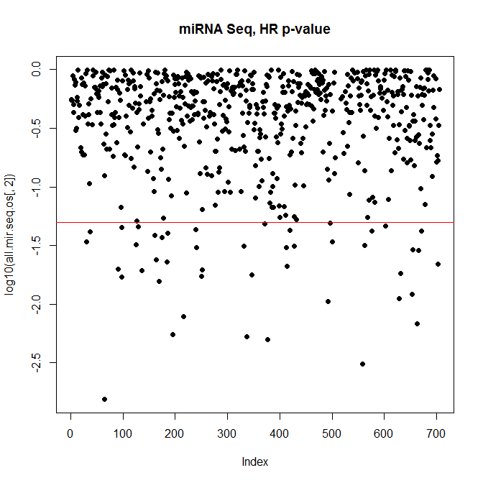
Primary tumor, miRNA-seq, 705 miRNAs
Significance of HR
 | p < 0.05 | p >= 0.05 | NA
Among all 705miRNAs | 45 | 578 | 82
Non-human miRNA (no “hsa-”) | 0 | 0
Human miRNA | 45 | 578
Human miRNA, no suffix | 0 | 0
Human miRNA, -5p | 0 | 0
Human miRNA, -3p | 0 | 0
Human miRNA, * | 0 | 0
> intersect(rownames(sig.all.mir.os), rownames(sig.all.mir.seq.os))
[1] "hsa-miR-135b" "hsa-miR-148a" "hsa-miR-374b" "hsa-miR-377" "hsa-miR-493" "hsa-miR-545"
[7] "hsa-miR-625" "hsa-miR-652"

Slide 9
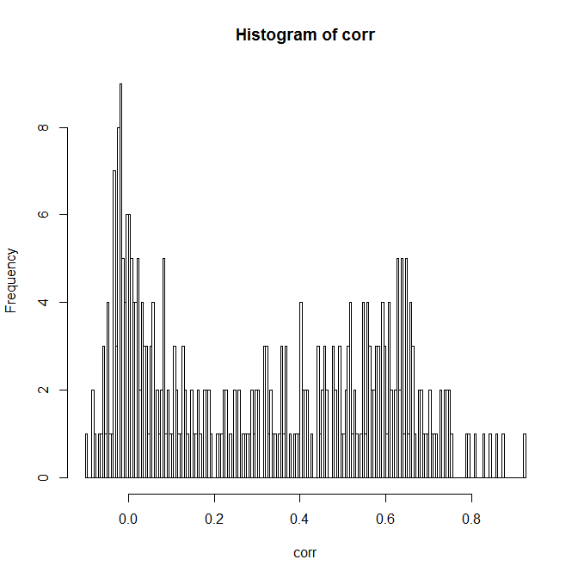
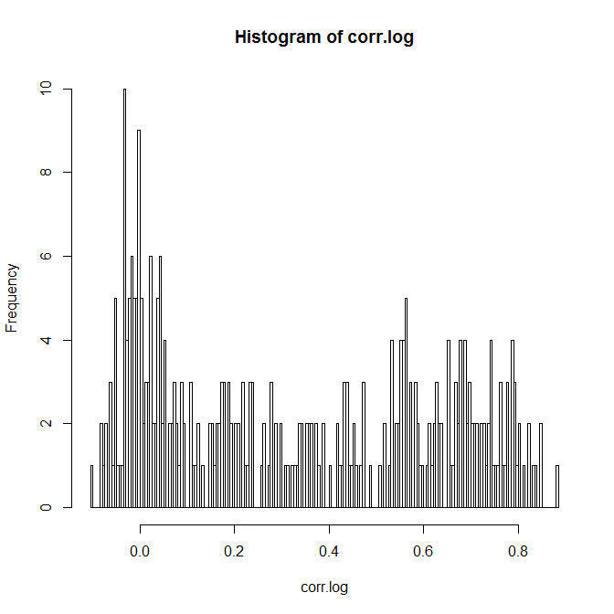
Coherence of miRNA vs miRNA-Seq
359 miRNAs exact matched by name

Slide 10
Summary

Slide 11
Comparison of P-value (Univariate Cox)
Primary tumor, microarray, 799 miRNAs
Patient samples (n=452) that exist in miRNA-seq data
Primary tumor, miRNA-seq, 705 miRNAs
Significance of HR
123 miRNAs with p < 0.05
45 miRNAs with p < 0.05
8 miRNA overlap
"hsa-miR-135b" "hsa-miR-148a" "hsa-miR-374b" "hsa-miR-377" "hsa-miR-493" "hsa-miR-545"
"hsa-miR-625" "hsa-miR-652"

Slide 12
Coherence (Pearson Correlation) of miRNA vs miRNA-Seq
359 miRNAs exact matched by name

