Slide 1


Explain, Then Forget:
Recommendation Unlearning under
Asymmetric Access Constraint
Haichao Zhang^{1,2}, Chong Zhang^{1,2}, Wen Wang¹, Shi Qiu¹, Peiyu Hu^{1,2}, Jia Wang^{1,2†}
¹Xi'an Jiaotong-Liverpool University, China / ²University of Liverpool, United Kingdom
† Corresponding author
ICDM 2026
Notes:
Hello everyone. I'm Haichao Zhang from Xi'an Jiaotong-Liverpool University. Today I'll present our work on recommendation unlearning under limited model access.
We look at a practical problem: a user wants us to forget an interaction, but we don't control the model that uses it. Our approach first explains the recommendation, then uses that explanation to adjust the ranking.
SOURCE / VERIFICATION (not spoken)
Paper p. 1, title and author block.

Slide 2
CONTENTS
01
Motivation
Recommendation unlearning with limited model access
02
Contributions
The CEU framework and its two components
03
Method
Counterfactual support, CCI and URA
04
Experiments
Recommendation utility, forgetting and efficiency
05
Conclusions
Findings, scope and open questions
Notes:
I'll start with the access problem and our contributions, then spend most of the talk on the method. I'll explain how we identify the interactions behind a recommendation and how we use that information when a forgetting request arrives.
After that, I'll briefly cover the experiments and discuss the limits of the approach.
SOURCE / VERIFICATION (not spoken)
Paper Sections I–V.

Slide 3
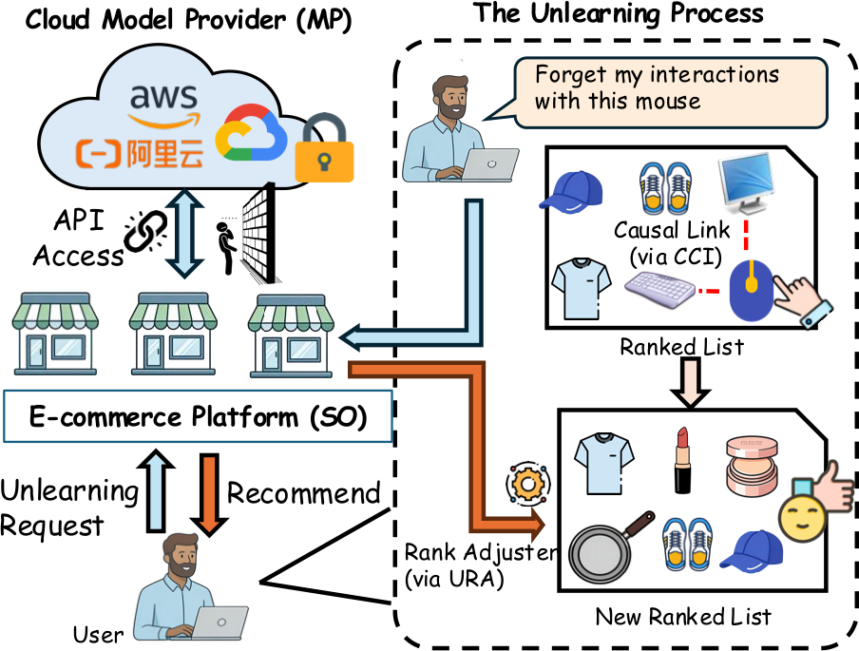
1.1
Motivation
Motivation
Contributions
Method
Experiments
Conclusions
One unwanted interaction can support many recommendations
Reduce its influence while preserving the user’s other interests.
3 / 20
Notes:
Imagine a user clicks on a computer mouse by mistake. The recommender may interpret that click as an interest in gaming accessories and start suggesting related products.
Later, the user asks us to forget the click. Simply hiding that mouse leaves a problem: the same interaction may still be supporting other recommendations.
We want to reduce that influence while keeping the user's other interests intact. That means identifying which recommendations actually depend on the unwanted interaction, rather than changing the whole list.
SOURCE / VERIFICATION (not spoken)
Paper §I and Fig. 1; supplied introduction.pdf.

Slide 4
1.2
Asymmetric model access
Model provider (MP)
Service operator (SO)
Motivation
Trains and hosts the recommender
Accesses model internals
Computes causal attributions
Runs the application
Receives forgetting requests
Controls the final ranking
Contributions
Method
Experiments
Access constraint
Conclusions
The operator cannot update the hosted model’s parameters.
Provider cooperation: support sets and weights are available through an attribution API.
4 / 20
Notes:
Now consider a platform that uses a remotely hosted recommendation model. The model provider trains and hosts it. The service operator runs the application and gets recommendations through an API.
The user sends the forgetting request to the operator, but the operator cannot update the model's parameters. The request and the ability to change the model sit with different parties. This is the asymmetric access constraint.
Our approach assumes that the provider cooperates by supplying explanations through an attribution API. The operator can use those explanations to change the final ranking without receiving the model's weights or gradients.
SOURCE / VERIFICATION (not spoken)
Paper §I and §III-A. CCI is hosted by the model provider and exposed through a dedicated attribution API.

Slide 5
1.3
Existing unlearning methods
Method | Required access
Retraining | Full model or affected partitions
Fine tuning | Selected model components
Influence correction | Model parameters
Motivation
Contributions
Method
Experiments
Conclusions
These methods require model changes beyond the operator’s access.
CEU intervenes on ranking scores using provider-side explanations.
5 / 20
Notes:
Most existing methods need some form of model update. Retraining rebuilds the model or the affected partitions. Fine tuning changes selected components. Influence-based methods estimate a correction to the parameters.
These approaches have different costs, but each requires access the operator does not have. We therefore focus on the ranking scores, which the operator can control. The remaining question is how to decide which scores to change, and by how much.
SOURCE / VERIFICATION (not spoken)
Paper §I and §IV-A baselines. The categories require parameter access or provider-side updates. Output control and explanatory API motivate CEU.

Slide 6
2.1
Contributions
A framework for asymmetric access
Motivation
Provider-side explanation and operator-side ranking control.
Contributions
Method
Causal Contribution Identifier (CCI)
A sparse support set and contribution weights for each candidate.
Experiments
Conclusions
Unlearning-driven Rank Adjuster (URA)
A targeted score adjustment based on the forgotten interaction.
6 / 20
Notes:
We propose an explain-then-forget framework that separates provider-side explanation from operator-side score adjustment.
The Causal Contribution Identifier, or CCI, finds a small set of historical interactions that support each recommendation. It also assigns a contribution weight to each interaction.
The Unlearning-driven Rank Adjuster, or URA, uses those weights when a user asks to forget an interaction. It adjusts the affected scores and produces a new ranking. The experiments examine whether this division of work preserves useful recommendations while reducing membership evidence and online cost.
SOURCE / VERIFICATION (not spoken)
Paper §I contributions and §III-A–C. Contribution wording is a talk-level synthesis, not a formal guarantee of deletion.

Slide 7
2.2
Unlearning objectives
Training interactions = Forgetting set + Retained set
Motivation
Contributions
Forgetting effectiveness: remaining membership evidence in the outputs.
Utility: recommendation quality on the retained data.
Efficiency: time and computation for the intervention.
Method
Experiments
Conclusions
Empirical reference: a model retrained using only the retained interactions.
7 / 20
Notes:
We split the training interactions into those to forget and those to retain. A model retrained on the retained interactions gives us a reference for comparison.
We assess forgetting, recommendation utility, and computation time together. For forgetting, we test whether an attacker can still infer that a forgotten interaction was part of the training data. For utility, we check whether the remaining recommendations are useful.
That joint evaluation matters. An attack can become less accurate simply because the ranking has been badly damaged. We need to reduce the unwanted signal while preserving the information we still want to use.
SOURCE / VERIFICATION (not spoken)
Paper §II-A, G1–G3. Retraining on the retained set is an empirical reference.

Slide 8
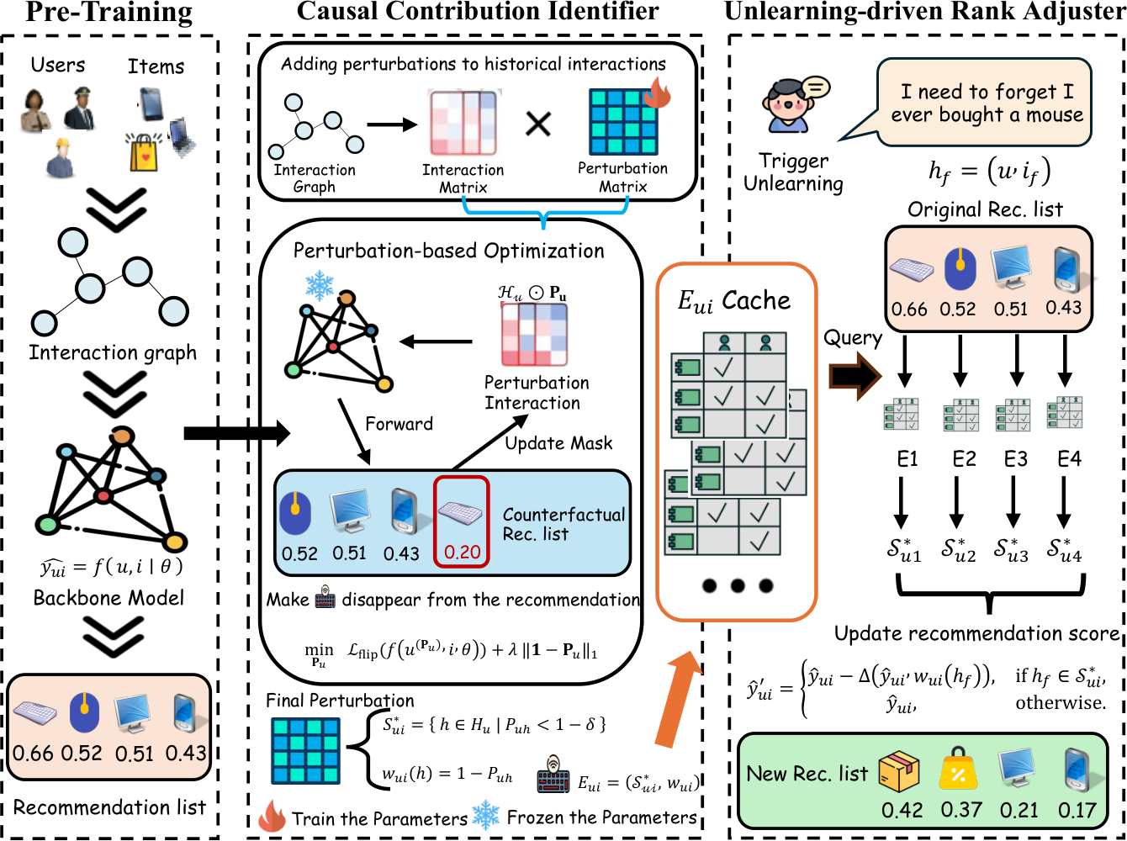
3.1
The CEU framework
Motivation
Contributions
Method
Experiments
Conclusions
CCI at the provider. URA at the operator. The pretrained model stays fixed.
8 / 20
Notes:
This diagram shows the full framework, which we call Causal Explanation-based Unlearning, or CEU.
The provider starts with a user and a candidate item. It identifies the historical interactions supporting that recommendation and returns their contribution weights. When a forgetting request arrives, the operator checks those explanations, adjusts the relevant scores, and sorts the candidates again.
The pretrained recommender stays fixed throughout. I'll now go through the explanation stage, then show how its output determines the ranking adjustment.
SOURCE / VERIFICATION (not spoken)
Paper §III-A and Fig. 3; supplied framework.pdf.

Slide 9
3.2
Counterfactual support
Motivation
Would this item still be recommended if part
of the user’s history were suppressed?
Contributions
Method
Counterfactual support set
Experiments
A small subset of historical interactions whose suppression
changes the target score or its top-K decision.
Conclusions
CCI approximates the subset search with a sparse continuous mask under the fixed recommender.
9 / 20
Notes:
For one recommended item, we ask what would happen if we suppressed part of the user's history. Would its score change enough for it to leave the top-K list?
We look for a small set of interactions that can produce that change. This gives us a counterfactual explanation of the recommendation, relative to the fixed model.
Searching every possible subset would be expensive. We approximate that search with a continuous mask and a sparsity objective. The support set comes from this optimization, rather than from an exhaustive search or a guarantee of fully identified causality.
SOURCE / VERIFICATION (not spoken)
Paper §III-B1. The implementation uses a sparse continuous-mask approximation to the minimum-support objective.

Slide 10
3.3
A continuous history mask
Motivation
One mask value per interaction
History | Mask P | 1 − P
h₁ | 1.0 | 0.0
h₂ | 0.8 | 0.2
h₃ | 0.2 | 0.8
P = 1 retains the interaction.
A smaller P suppresses it.
Contributions
Method
Experiments
Contribution
Conclusions
w(h) = 1 − P(h)
Illustrative values. CCI optimizes the mask, while model parameters stay fixed.
10 / 20
Notes:
Each historical interaction gets a mask value between zero and one. A value of one keeps it fully active. Lower values suppress its contribution to the counterfactual user representation.
The table gives a simple example. The masks are one, zero point eight, and zero point two. Subtracting each from one gives contribution weights of zero, zero point two, and zero point eight.
We optimize these mask values to explain one candidate item. The recommender's parameters stay fixed. The provider still needs model access to compute the explanation, even though it does not update the model.
SOURCE / VERIFICATION (not spoken)
Paper §III-B2. Mask example [1.0,0.8,0.2] is illustrative, not fitted data; contribution w=1−P.

Slide 11
3.4
Learning a sparse explanation
A decision flip with a sparse change
Motivation
L(P) = Lflip(P; θ) + λ ‖1 − P‖₁
Contributions
Method
Flip loss
Experiments
max(0, margin + masked target score − boundary score)
Conclusions
Boundary: the original item at rank K + 1.
Sparsity penalty
Discourage unnecessary changes to the history.
The provider minimizes L(P) with gradients. The recommender’s θ remains fixed.
11 / 20
Notes:
The objective balances a change in the recommendation against the size of the change to the history.
The flip loss pushes the masked target score below a boundary with a positive margin. We use the original score at rank K plus one as that boundary. Once the margin condition is met, this part of the loss becomes zero.
The L-one penalty discourages large or widespread changes to the mask. Lambda controls its weight relative to the flip loss. The provider minimizes the combined objective using gradients, updating only the mask.
SOURCE / VERIFICATION (not spoken)
Paper §III-B2 and Algorithm1: max(0,m+f(u^(P),i|θ)−f(u,i_K+1|θ))+λ||1−P||1.

Slide 12
3.5
The attribution interface
Support membership
Motivation
S*ᵤᵢ = { h ∈ Hᵤ : P(h) < 1 − δ }
Contributions
Method
Contribution weights
Experiments
wᵤᵢ(h) = 1 − P(h)
Conclusions
API output: Eᵤᵢ = (S*ᵤᵢ, wᵤᵢ)
One explanation per user and candidate item. The operator receives no model parameters.
12 / 20
Notes:
After optimization, we turn the mask into an explanation the operator can use. Each contribution weight is one minus the corresponding mask value. We include an interaction in the support set when its weight exceeds the small threshold delta.
The threshold decides membership of the set. The weight describes the strength of the attributed contribution. These serve different purposes.
The API returns both for each user and candidate item. The operator can then check whether the interaction to be forgotten belongs to the support set, and retrieve its weight. It does not need the underlying parameters or gradients.
SOURCE / VERIFICATION (not spoken)
Paper §III-B2, Eq. support threshold P_uh<1−δ, w_ui(h)=1−P_uh. E_ui=(S*_ui,w_ui).

Slide 13
3.6
Unlearning-driven rank adjustment
For a forgotten interaction h and each candidate item:
Motivation
Contributions
If h belongs to the support set
Method
y′ = y (1 − α w(h))
Experiments
Conclusions
Otherwise, y′ = y
α controls the adjustment strength. Sort y′ to obtain the new ranking.
13 / 20
Notes:
Suppose a user now asks us to forget one interaction. For each candidate item, the operator checks its support set. If the interaction is outside that set, the score stays unchanged.
If it belongs to the set, we multiply the original score by one minus alpha times its contribution weight. A larger weight produces a stronger adjustment, and alpha sets the overall intervention strength.
We then sort the adjusted scores to obtain the new ranking. With the explanations available, this stage needs only score calculations and sorting. It does not require another model update.
SOURCE / VERIFICATION (not spoken)
Paper §III-C and Appendix Algorithm 2. The displayed multiplicative rule applies when h_f is in S*_ui.

Slide 14
3.7
An example of score adjustment
Illustrative example with α = 0.5
Motivation
Candidate | Score y | Weight w | Adjusted y′
A | 0.90 | 0.80 | 0.54
B | 0.80 | 0.00 | 0.80
C | 0.70 | 0.20 | 0.63
Contributions
Method
Experiments
Conclusions
Original ranking: A, B, C
Adjusted ranking: B, C, A
B has no attributed dependence on the forgotten interaction and keeps its original score.
14 / 20
Notes:
Here alpha is one half. Start with candidate A. Its original score is zero point nine, and its contribution weight is zero point eight. Applying the rule gives an adjusted score of zero point five four.
Candidate B has weight zero, so it keeps its score of zero point eight.
For candidate C, a score of zero point seven and a weight of zero point two give zero point six three.
The ranking changes from A, B, C to B, C, A. B is preserved because the forgotten interaction does not support it. This is an illustrative example of the rule.
SOURCE / VERIFICATION (not spoken)
Illustrative arithmetic, not an experimental result. α=0.5; y′=y(1−αw). A: 0.9→0.54; B: 0.8→0.8; C: 0.7→0.63.

Slide 15
3.8
The forgetting request workflow
Explanation preparation at the provider
Motivation
Produce candidate scores and explanations.
Cache explanations ahead of time, or compute them on demand.
Contributions
Method
Request handling at the operator
Experiments
Retrieve each candidate’s support set and weights.
Adjust scores supported by the forgotten interaction.
Sort the adjusted scores and return the new list.
Conclusions
Preparation has a separate cost. Explanations must match the current model and candidate context.
15 / 20
Notes:
In deployment, the provider produces the candidate scores and explanations. It can prepare explanations ahead of time and cache them, or compute them when needed.
When a request arrives, the operator retrieves the explanations for the current candidates, checks the support sets, adjusts the relevant scores, and returns the new ranking.
Caching makes that online path inexpensive, but explanation preparation still has a cost. The explanations must also match the current model and candidate context. If that context changes, the cache may need to be refreshed.
SOURCE / VERIFICATION (not spoken)
Paper §III-C and §IV-D, CCI offline/on-demand deployment. Cache freshness is a practical implication, not a reported experiment.

Slide 16
4.1
Recommendation utility and forgetting
LightGCN, 1% forgetting
Motivation
Dataset | HR@10 Origin | HR@10 CEU | MIA ACC Origin | MIA ACC CEU
ML-1M | 0.7680 | 0.7584 | 0.9678 | 0.4789
Netflix | 0.8647 | 0.8627 | 0.9885 | 0.5581
Contributions
Method
Experiments
Conclusions
Utility remains close to the original model.
Membership evidence falls, with residual gaps in some settings.
MIA chance reference: 0.5. The full study uses BPR / LightGCN on three datasets.
16 / 20
Notes:
I'll keep the experimental summary brief. We evaluate BPR and LightGCN on three datasets. The two rows here use LightGCN with one percent of interactions forgotten.
On MovieLens one M, hit ratio at ten changes from about seventy-six point eight percent to seventy-five point eight percent. Membership-attack accuracy falls from about ninety-six point eight percent to forty-seven point nine percent.
Netflix also shows little change in recommendation utility and much lower attack accuracy. Its attack accuracy remains above the fifty-percent chance reference, however. The results show a useful balance between utility and forgetting, with residual gaps in some settings.
SOURCE / VERIFICATION (not spoken)
Paper TablesI andIII. LightGCN1% ML1M HR .7680→.7584, ACC .9678→.4789; Netflix HR .8647→.8627, ACC .9885→.5581. ML100K LightGCN1%ACC .7370 vsRetrain .5342.

Slide 17
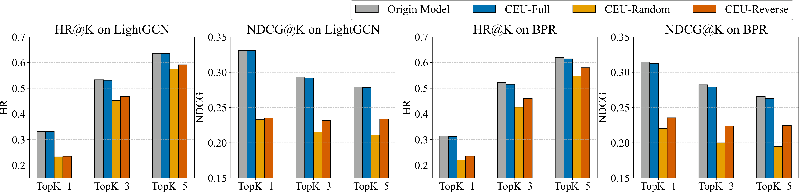
4.2
Efficiency and causal targeting
Online latency: 0.34–6.37 s
Motivation
9.31–52.74× faster than the next best method in the latency table.
Contributions
Method
Experiments
Conclusions
CCI preparation is separate: 3.10–10.10 s/user on RTX 4090. Online timings assume explanations are available.
17 / 20
Notes:
With explanations already available, online latency ranges from zero point three four to six point three seven seconds. In the latency table, that is roughly nine to fifty-three times faster than the next best method, depending on the setting.
Preparation is measured separately. Computing the explanations takes about three to ten seconds per user on an RTX forty ninety. Those costs should be kept separate when interpreting the online speedup.
The ablation compares our targeting with random penalties and penalties on unrelated candidates. Those alternatives damage recommendation utility much more. The explanation matters because it helps the operator choose where to intervene.
SOURCE / VERIFICATION (not spoken)
Paper TableV online0.34–6.37s, speedup9.31–52.74x; TableIV per-userCCI3.10–10.10s onRTX4090. Fig4 exp4_utility axesK1,3,5; trends only.

Slide 18
5.1
Scope and limitations
Cooperative deployment
Motivation
The provider supplies model-side attributions through an API.
Contributions
Method
Intervention on observable outputs
Scores and rankings change. Model parameters remain fixed.
The evidence is empirical, without certified deletion from weights.
Experiments
Conclusions
Open questions
Stronger attackers, cache refresh and sequential forgetting requests.
18 / 20
Notes:
This framework requires the provider to supply attributions. An API that returns scores alone is not enough.
The intervention changes observable scores and rankings while leaving model parameters in place. The causal explanation motivates the adjustment, but the paper does not establish full causal identification or certified deletion from the weights.
Our evidence comes from recommendation quality, membership attacks, timing, and ablations. Stronger attackers, cache refresh, and long sequences of forgetting requests remain questions for further evaluation.
SOURCE / VERIFICATION (not spoken)
Paper §II-B explicitly says causally motivated rather than fully identified. §III-A provider-hosted CCI. TableIII residual gaps. Appendix ratios scope.

Slide 19
5.2
Conclusions
Asymmetric access separates the forgetting request from control of model parameters.
Counterfactual explanations identify which candidates to adjust and the strength of the adjustment.
Targeted score adjustment preserves useful recommendations and reduces online cost in the reported experiments.
Motivation
Contributions
Method
Experiments
Conclusions
Explanation quality is central to the utility–forgetting balance.
19 / 20
Notes:
The main idea is to explain the recommendation before changing it. When model access is split between a provider and an operator, those explanations give the operator information it can act on.
They identify the candidates supported by the unwanted interaction and guide the size of the score adjustment. In our experiments, this preserves useful recommendations while reducing membership evidence and keeping the online stage inexpensive.
The quality of the explanation is central to that balance. With that interface, the operator has a way to respond to a forgetting request without updating the model.
SOURCE / VERIFICATION (not spoken)
Paper §V; synthesis grounded in method and reported experiments.

Slide 20

THANK YOU
5.3 Thank you
Motivation
Contributions
Method
Experiments
Conclusions
Haichao Zhang
github.com/zhang-haichao/Explain-and-Forget
haichao.zhang22@student.xjtlu.edu.cn
20 / 20
Notes:
Thank you for listening. The code and my contact details are shown here.
SOURCE / VERIFICATION (not spoken)
Paper author/contact block and code URL. GitHub link is from the supplied paper, not an independent implementation verification.

