Slide 1


Explaining Graph Recommendations
via Counterfactual Support Sets
Haichao Zhang¹,², Chong Zhang¹,², Can Wang¹, Shi Qiu³, Jia Wang¹,²
¹ Xi’an Jiaotong-Liverpool University ² University of Liverpool
³ New York University
ICONIP 2026 · Melbourne
Notes:
Hello everyone. Today I'll talk about how we can explain a graph recommendation by testing which parts of a user's history it depends on.
Our method is called CoSRec. The main idea is simple: keep the trained recommender fixed, remove a small set of historical interactions, and check whether the recommendation changes.

Slide 2
CONTENTS
01
Motivation
Which history does a recommendation depend on?
02
Contributions
A testable support set and a post-hoc explainer
03
Method
Local mask, ranking objective and discrete verification
04
Experiments
Replacement success and list preservation
05
Conclusions
Main findings and scope
Notes:
I'll start with the motivation and our main contributions. Most of the talk will focus on how CoSRec works, from the history mask to the final verification step. I'll then briefly show the experimental results and finish with the main takeaways.

Slide 3
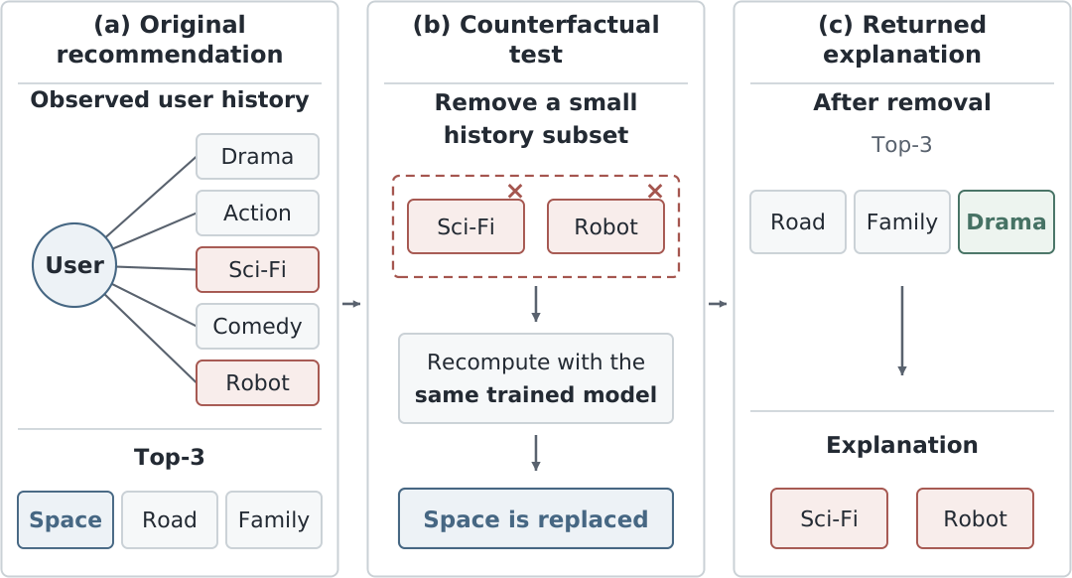
1.1
Which history supports a recommendation?
Motivation
Contributions
Method
Experiments
Conclusions
Remove a small history subset → recompute → check the recommendation
3 / 20
Notes:
Suppose a system recommends a space movie. The user has watched several kinds of movies, including science fiction and robot movies. Those two interests sound like a reasonable explanation. But does the model actually depend on those interactions?
The figure shows a direct test. We remove the science fiction and robot interactions, run the same trained model again, and inspect the new list. Here, the space movie is replaced while the other two items remain. The removed interactions therefore form a support set for the original recommendation under this model.
The explanation is tied to a change that we can check.

Slide 4
1.2
Relevance and model dependence
Relevance-based evidence
Counterfactual support
Motivation
Similar items
Important neighbors
Attention or influence scores
A small set of past interactions
whose removal changes
the recommendation
Contributions
Method
Experiments
Which evidence looks related?
Would the output change
without this evidence?
Conclusions
The test concerns the model’s dependence on the selected set
4 / 20
Notes:
Many explanations point to similar items, important neighbors, or influential paths. They help us see which evidence is related to a recommendation. However, a high relevance score does not by itself tell us whether removing that evidence would change the result.
CoSRec asks a more specific question: which small group of the user's past interactions can we remove to change this recommendation? This is a group-level test. It does not mean that every selected interaction would change the result on its own.
We are explaining the trained model's behavior under a graph intervention. We are not making a claim about what caused the user's real preferences.

Slide 5
1.3
A score decrease may leave the ranking unchanged
Illustrative Top-1 scores
Motivation
Original
Score decreases
Ranking changes
Contributions
Target
Target
Target
Method
0.90
0.85
0.75
Experiments
Candidate
Candidate
Candidate
0.80
0.80
0.82
Conclusions
Target remains Top-1
Target remains Top-1
Candidate is Top-1
Optimize the score gap between the target and plausible alternatives
5 / 20
Notes:
Recommendation adds another challenge: the output is a ranking. Consider this simple example. The target item starts with a score of zero point nine, and an alternative scores zero point eight. If an intervention lowers the target score to zero point eight five, the target is still first. Its score has changed, but the recommendation has not.
To replace the target, we need the alternative to move above it. This is why CoSRec uses a ranking objective that compares the original items with plausible replacement candidates. At the same time, we want a small intervention, so that we can inspect the explanation and preserve much of the surrounding list.

Slide 6
2.1
Contributions
01
A testable explanation task
Motivation
Find a small history subset whose removal changes the recommendation.
Contributions
02
A post-hoc user-local explainer
Method
Learn retention values while keeping the graph recommender fixed.
Experiments
Conclusions
03
A ranking-aware, sparse search
Balance replacement and compactness, then verify actual edge deletion.
6 / 20
Notes:
Our contributions have three parts. First, we formulate the explanation as a small set of user-history edges whose removal changes the recommendation. This gives us a clear test for whether an explanation works.
Second, we propose a post-hoc method that learns a continuous retention mask for the target user's history while keeping the recommender's parameters fixed.
Third, we combine a ranking loss with a sparsity penalty, then verify the selected edges on the actual graph. In the experiments, this approach gives higher all-user replacement success than the compared baselines, while retaining high overlap with the original recommendation list.

Slide 7
3.1
The explanation task
Input
Output
Motivation
Interaction graph A
Frozen recommender f_{Θ}
Target user u and history H_{u}
Support set S_{u} ⊆ H_{u}
Learned weights w_{u}(i)
Contributions
Method
Experiments
minimize |S_{u}| where S_{u} ⊆ H_{u}
subject to: Top-K after removing S_{u} ≠ original Top-K
Conclusions
Validity
Sparsity
Specificity
Change the target result
Keep the set small
Preserve list overlap
7 / 20
Notes:
The input is an interaction graph, a trained graph recommender, and a target user. We first record the user's original top-K list. We can then remove edges only from that user's observed history; the other users' edges stay in place.
The ideal objective is to find the smallest history subset whose removal changes the top-K result. The output contains this support set and a weight for each selected interaction.
There are three things we care about: validity, meaning the target result changes; sparsity, meaning the set is small; and specificity, measured by how much of the broader recommendation list is preserved. The practical method approximates the subset search, so it does not guarantee the globally smallest explanation.

Slide 8
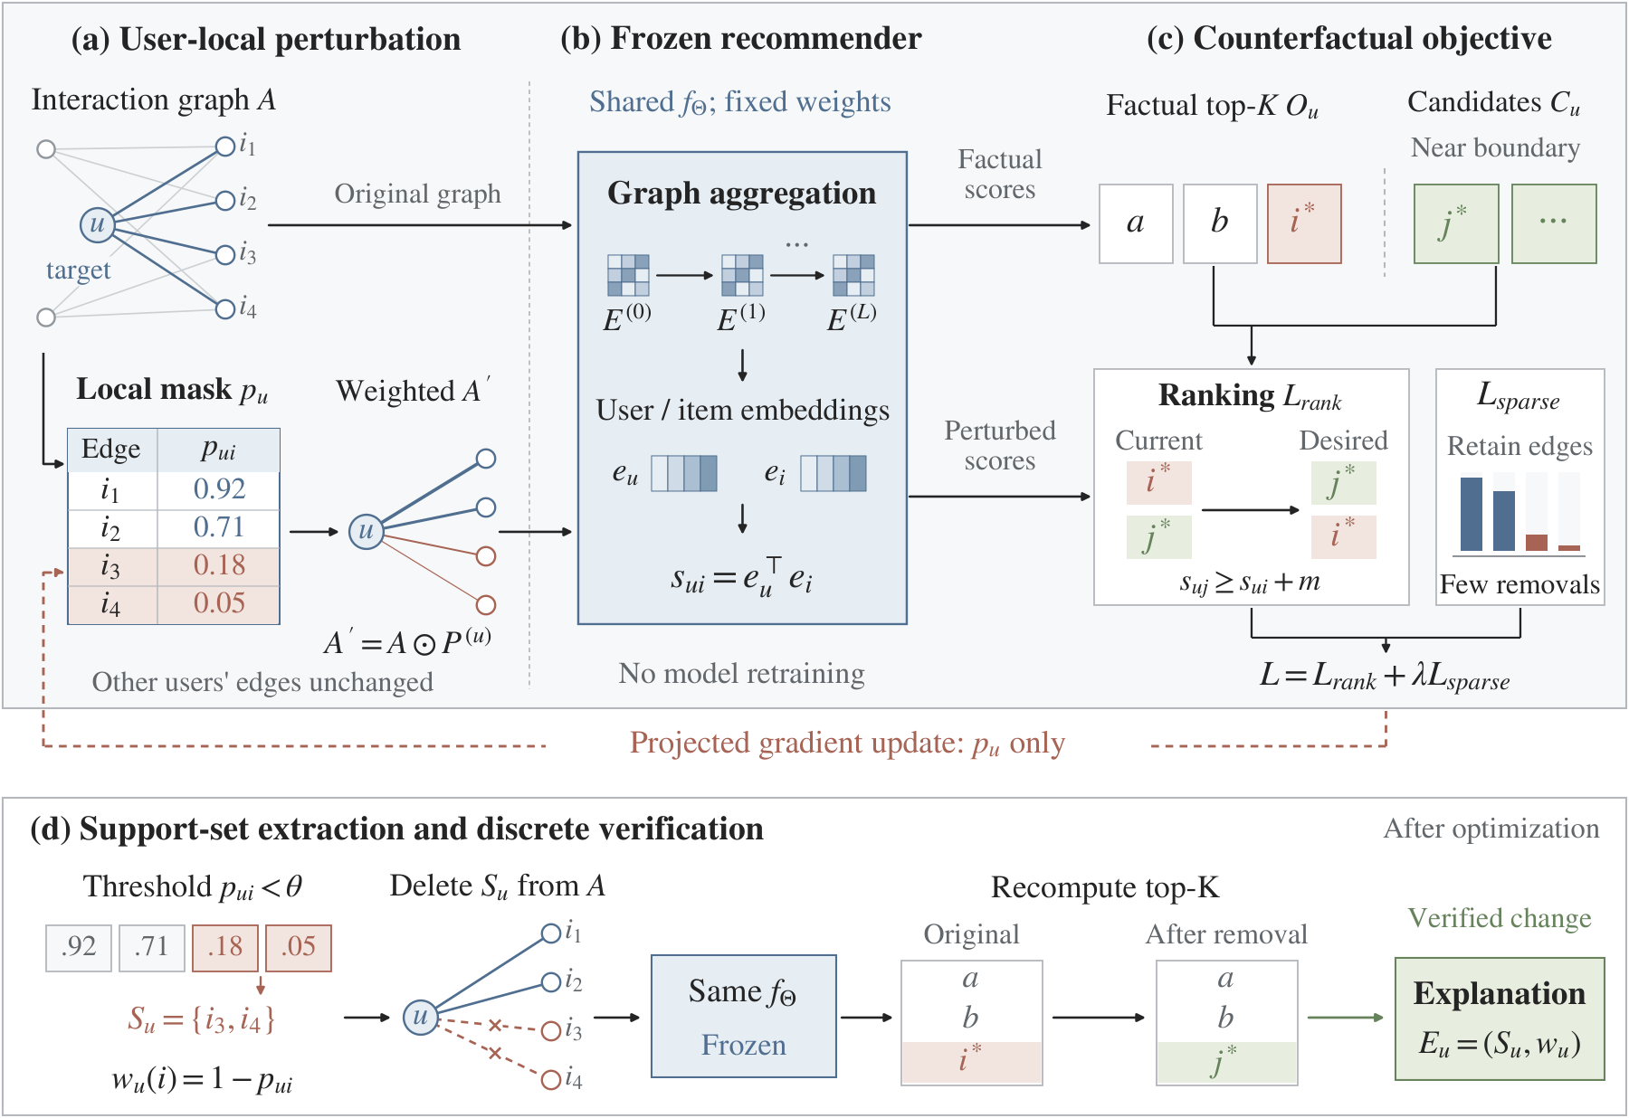
3.2
CoSRec overview
Motivation
Contributions
Method
Experiments
Conclusions
8 / 20
Notes:
This figure shows the full pipeline. On the left, we assign one retention value to each edge in the target user's history. These values create a weighted version of the graph.
In the middle, the same frozen recommender evaluates the graph and produces new scores. On the right, the ranking objective encourages replacement candidates to outrank the original items, while the sparsity term discourages unnecessary changes. Gradients update the mask only.
The bottom row is essential. After optimization, we turn the soft mask into actual edge removals and recompute the recommendation. The continuous search proposes an explanation; the discrete test checks whether it really changes the output.

Slide 9
3.3
A user-local retention mask
One retention value per history edge
Motivation
i₁
Edge | Retention p
i₁ | 0.92
i₂ | 0.71
i₃ | 0.18
i₄ | 0.05
Contributions
Method
i₂
u
Experiments
i₃
Conclusions
i₄
A′ = A ⊙ P^{(u)}
p = 1: retain p ≈ 0: weaken
9 / 20
Notes:
Let's look more closely at the mask. Each historical interaction gets a value p between zero and one. One keeps the edge fully active, and a value near zero strongly weakens it. Initially, all values are one, so the search starts from the original graph.
The values shown here are illustrative. The first two edges retain most of their weight, while the last two are strongly reduced. We apply these values by multiplying the graph edge weights by the mask.
Only the target user's history is edited. This keeps the explanation connected to interactions that the user can recognize. It also limits the number of learned variables to the size of that user's history.

Slide 10
3.4
Fixed parameters, graph-dependent scores
Same learned parameters Θ
Motivation
Contributions
Graph A
Graph propagation
Scores s(A)
Method
Frozen f_{Θ}
Experiments
Graph A′
Graph propagation
Scores s(A′)
Conclusions
s_{ui}(A′) = e_{u}(A′)^{T} e_{i}(A′)
Gradients flow to the mask; graph inference is recomputed
10 / 20
Notes:
Keeping the parameters fixed does not mean the scores stay fixed. In a graph recommender such as LightGCN, the graph controls how information is passed between users and items. Changing edge weights changes that computation, which can change the resulting embeddings and scores.
We therefore run graph inference again using the perturbed graph, with the same learned model parameters. The score is still the inner product of the user and item embeddings, but those embeddings now reflect the changed graph.
CoSRec needs gradients through this computation to update the mask. The method is therefore designed for a differentiable graph recommender with the required model access.

Slide 11
3.5
The counterfactual ranking objective
Original recommendations O_{u}
Replacement candidates C_{u}
Motivation
Items in the factual Top-K list
High-scoring, unobserved items
near the Top-K boundary
Contributions
Method
L_{rank} = mean [ m + s_{ui}(A′) − s_{uj}(A′) ]₊
Experiments
Average over i ∈ O_{u} and j ∈ C_{u} [x]₊ = max(0, x)
Conclusions
Zero pairwise loss when: candidate score ≥ original score + m
Illustrative margin: m = 0.05
11 / 20
Notes:
We choose high-scoring replacement candidates near the top-K boundary. They must be unobserved items, and they must be outside the original recommendation set. These candidates provide a concrete alternative for the ranking test.
For each original item and candidate pair, the loss compares their scores on the perturbed graph. The expression inside the brackets is the margin plus the original item's score minus the candidate's score. We keep this value when it is positive and otherwise use zero, then average over the pairs.
For example, a margin of zero point zero five means that the candidate should beat the original item by at least that amount. The goal is a relative ranking change, rather than an isolated drop in the target score.

Slide 12
3.6
Keeping the explanation small
Penalize removal intensity
Motivation
L_{sparse} = (1 / |H_{u}|) ∑ (1 − p_{ui})
Contributions
Sum over the target user’s history i ∈ H_{u}
Method
L = L_{rank} + λ L_{sparse}
Experiments
Conclusions
Smaller λ
Larger λ
Stronger intervention
Replacement may be easier
Fewer suppressed edges
More of the history is retained
Stability is evaluated after intervention; it is not a separate loss term
12 / 20
Notes:
The ranking loss alone could encourage a large change to the user's history. To limit that change, we add a sparsity penalty. For each edge, one minus p is its removal intensity. The sparsity loss is the average of these intensities across the user's history.
The total objective is the ranking loss plus lambda times the sparsity loss. A larger lambda makes edge suppression more costly, so it favors smaller interventions. A smaller lambda allows stronger changes that may make replacement easier.
This is a soft penalty during optimization. We still need to select actual edges and test the final graph. List stability is evaluated afterward; it is not a separate term in this objective.

Slide 13
3.7
Optimizing the mask
Initialize p = 1 on the target user’s observed edges
Motivation
Contributions
Build weighted graph
Run fixed f_{Θ}
Evaluate loss
Method
A′ = A ⊙ P^{(u)}
Compute item scores
L_{rank} + λ L_{sparse}
Experiments
Conclusions
Update p ← clip_{[0,1]}(p − η ∇_{p}L)
Repeat the loop for T steps · update mask variables only
13 / 20
Notes:
The optimization loop is straightforward. We build the weighted graph from the current mask, run the frozen recommender, and calculate the combined loss. We then take a gradient step on the retention values and clip them back into the interval from zero to one.
This is projected gradient descent. The projection simply keeps every retention value within its allowed range. We repeat the loop for the specified number of steps.
The learned variables belong only to the target user's history, but each step still uses the graph recommender to compute scores. Throughout this process, the model parameters stay fixed. We are searching for an explanation of the existing model, rather than training a new recommender.

Slide 14
3.8
Extract the set, then verify it
S_{u} = { i ∈ H_{u} : p_{ui} < θ } w_{u}(i) = 1 − p_{ui}
Motivation
Edge | Retention p | Weight 1 − p | Selected?
i₁ | 0.92 | 0.08 | No
i₂ | 0.71 | 0.29 | No
i₃ | 0.18 | 0.82 | Yes
i₄ | 0.05 | 0.95 | Yes
Contributions
Method
Experiments
Conclusions
Illustrative threshold θ = 0.5 → S_{u} = {i₃, i₄}
Delete S_{u} from A → run the same f_{Θ} → accept only if Top-K changes
14 / 20
Notes:
After optimization, we select the edges whose retention values fall below a threshold. With the illustrative threshold of zero point five, the last two edges enter the support set. Their weights are one minus their retention values, giving zero point eight two and zero point nine five.
These weights describe the learned mask. They are useful for ordering the selected interactions, but they are not probabilities that an interaction caused a recommendation.
We then return to the original graph, delete the selected edges completely, and recompute the top-K result using the same model. We count the explanation as valid only if that result changes. A successful soft-mask optimization alone is not enough.

Slide 15
3.9
A verified user-level explanation
MovieLens 100K · User #53 · local rank window 5–7
Motivation
Rank | Original window | After removing support
5 | Chasing Amy (1997) | Chasing Amy (1997)
6 | Bio-Dome (1996) | Bio-Dome (1996)
7 | The African Queen (1951) | French Twist (1995)
Contributions
Method
Experiments
Conclusions
Removed historical interactions
White Squall (1996)
w = 0.9900
Rumble in the Bronx (1995)
w = 0.3981
The Bridge on the River Kwai (1957)
w = 0.3955
15 / 20
Notes:
Here is a real example from MovieLens 100K. For user fifty-three, we inspect the local window at ranks five to seven. The target is The African Queen. CoSRec selects three historical interactions: White Squall, Rumble in the Bronx, and The Bridge on the River Kwai.
After those three edges are removed, French Twist replaces the target in this window. Chasing Amy and Bio-Dome stay in their positions. This gives us both the concrete history edits and the checked ranking change.
The rows here show overall ranks five to seven. This is a local window from the recommendation list, rather than the user's top-three recommendations.

Slide 16
4.1
Experimental setting
Frozen LightGCN · binarized interactions · 80/20 train-test split
Motivation
Dataset | Users | Items | Interactions
ML-100K | 943 | 1,682 | 100,000
ML-1M | 6,040 | 3,900 | 1,000,000
Contributions
Method
Experiments
Success@1
Stability@10
Conclusions
Fraction of evaluated users
whose Top-1 changes
Top-10 item overlap
before and after deletion
All-user comparison: 943 ML-100K users · equal edge-removal budgets
16 / 20
Notes:
I'll keep the experimental part brief. We use LightGCN on MovieLens 100K and MovieLens 1M, with ratings converted to interactions and an eighty-twenty train-test split.
The all-user comparison covers all nine hundred and forty-three users in MovieLens 100K. All methods use the same frozen backbone and remove the same number of the target user's history edges at each budget.
We measure success by whether the target recommendation changes. Stability at ten is the fraction of items shared by the original and new top-ten lists. It measures item overlap, so a high value does not imply that every shared item keeps exactly the same rank.

Slide 17
4.2
All-user replacement success
All 943 ML-100K users · percentages · same frozen LightGCN
Motivation
Method | 5% budget Success@1 | 5% budget Stability@10 | 10% budget Success@1 | 10% budget Stability@10
Random | 1.48 | 98.39 | 2.23 | 97.65
High-Degree | 1.59 | 98.41 | 2.65 | 97.26
Attention-proxy | 5.73 | 97.60 | 9.86 | 95.81
FIA | 6.89 | 96.82 | 12.20 | 94.52
CoSRec | 13.47 | 95.66 | 22.16 | 93.15
Contributions
Method
Experiments
Conclusions
At 10% budget: +9.96 percentage points Success@1 over FIA
Higher replacement success, with somewhat lower list overlap
17 / 20
Notes:
This is the main comparison across all users. At a five-percent budget, CoSRec changes the top recommendation for thirteen point four seven percent of users, compared with six point eight nine percent for FIA.
At a ten-percent budget, success rises to twenty-two point one six percent, while FIA reaches twelve point two zero percent. CoSRec also keeps ninety-three point one five percent top-ten overlap at this budget.
The trade-off is visible in the table: CoSRec changes more target recommendations, with somewhat lower stability than the baselines. The results support stronger targeted intervention under the tested budgets, while also showing that many users' top recommendations remain unchanged.

Slide 18
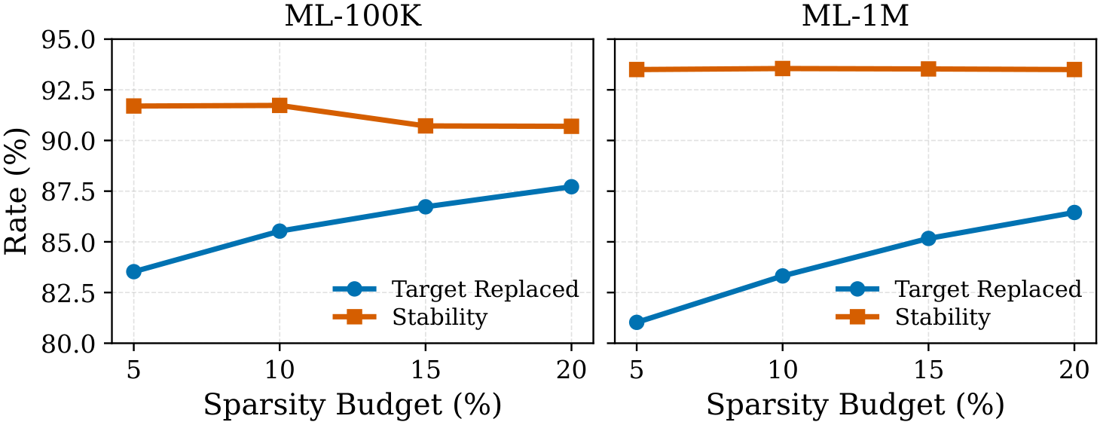
4.3
Budget trade-off on sampled cases
Selected susceptible targets with near-boundary alternatives
Motivation
Contributions
Method
Experiments
Conclusions
At 20% budget: 87.72% / 86.45% replaced; Stability@10 > 90%
These replacement rates apply to sampled cases, not the all-user evaluation
18 / 20
Notes:
The paper also studies selected target cases with nearby alternatives around the ranking boundary. This is a different evaluation group from the all-user comparison, which explains the much higher replacement rates here.
As the removal budget increases from five to twenty percent, target replacement becomes more frequent on both datasets. At twenty percent, replacement reaches about eighty-eight percent on MovieLens 100K and eighty-six percent on MovieLens 1M, with stability above ninety percent in both cases.
These results show the budget trade-off on susceptible cases. They should be read within that setting, rather than as success rates for the full user population.

Slide 19
5.1
Conclusions
Explain through intervention
Motivation
A small set of user-history edges makes the model’s dependence testable.
Contributions
Search, then check
Method
Learn a ranking-aware sparse mask; verify the selected edges by deletion.
Experiments
Empirical evidence
Conclusions
Higher all-user replacement success, while retaining high top-10 overlap.
Scope: model-level dependence · gradient access · approximate subset search
19 / 20
Notes:
The main takeaway is that we can explain a graph recommendation through a small, directly testable change to user history. CoSRec learns a local retention mask, balances replacement against sparsity, and checks the resulting support set with actual edge removal.
This makes the explanation specific: we can name the interactions we removed and show how the ranking changed. The experiments show higher all-user replacement success than the compared baselines, alongside high list overlap.
The scope is model-level dependence. The method requires gradient access, and the continuous search does not guarantee a globally minimal support set. Within that scope, it offers a practical way to connect a recommendation explanation to a verifiable model response.

Slide 20

THANK YOU
5.2 Thank you
Motivation
Contributions
Method
Experiments
Conclusions
Haichao Zhang
github.com/zhang-haichao/CoSRec
haichao.zhang22@student.xjtlu.edu.cn
20 / 20
Notes:
Thank you for listening. The code is available at the link on the screen.

