Slide 1


Controllable Generative Recommendation
via Guided Token Refinement
Haichao Zhang¹˒², Zhixuan Liang³, Chong Zhang¹˒², Zixi Chen¹, Wen Wang¹, Jia Wang¹˒²
¹ Xi’an Jiaotong-Liverpool University ² University of Liverpool
³ The Hong Kong Polytechnic University
ICDM 2026
Notes:
Hello everyone. I'm Haichao Zhang from Xi'an Jiaotong-Liverpool University. Today I'll talk about ReGen, our approach to controllable generative recommendation.
Suppose a user wants more varied recommendations, but still expects relevant items. We want to make that adjustment while the model is generating, without having to retrain it.
Source: Camera-ready PDF, p. 1, title and abstract.

Slide 2
CONTENTS
01
Motivation
Changing goals and fixed decoding decisions
02
Contributions
Parallel refinement with semantic guidance
03
Method
Guidance, token repair and valid candidate search
04
Experiments
Accuracy, diversity and the cost of refinement
05
Conclusions
Main findings and scope
Notes:
I'll start with the problem and our main contributions, then spend most of the talk on the method. After that, I'll show the accuracy and diversity results and discuss where the approach still has limits.
Source: Camera-ready PDF, Sections I, IV, V, VI and VII.

Slide 3
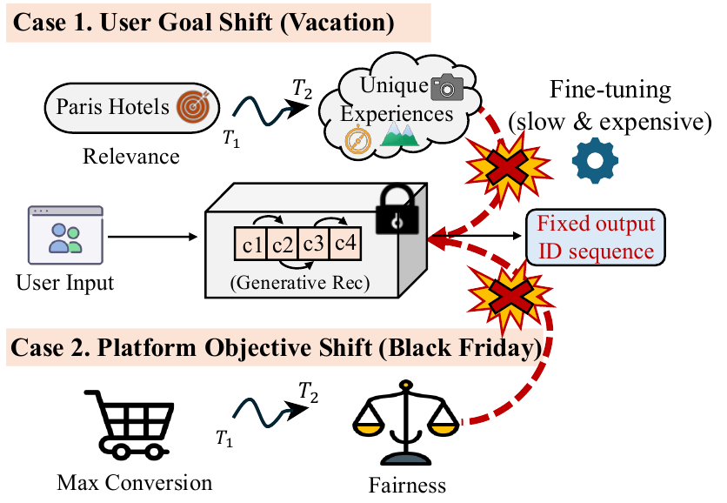
1.1
Changing recommendation goals
A user’s goal can change
Motivation
Relevant Paris hotels
More unusual local experiences
Contributions
Method
Experiments
Conclusions
The control should change at inference time.
This study evaluates diversity control. Fairness is a motivating use case.
3 / 25
Notes:
Imagine you're planning a trip to Paris. At first, you want a hotel that closely matches your preferences. After browsing several similar options, you may want to explore something different, perhaps a less familiar neighborhood or a local experience.
Your history still tells us what you like. What has changed is how much variety you want in the next set of recommendations.
A platform may also change its objective during a promotion. We'd like to adjust generation directly, so we study diversity control at inference time.
Source: Camera-ready PDF, p. 1, Introduction and Fig. 1.

Slide 4
1.2
Why control is difficult
Control strategy | What limits adaptation
Training-time control | A new objective may require parameter updates
Re-ranking a fixed pool | It cannot recover items absent from the pool
Autoregressive intervention | An early prefix constrains later token choices
Motivation
Contributions
Method
Experiments
Conclusions
A changed semantic direction affects the whole ID
Coarse and fine tokens must remain compatible with a real catalog item.
4 / 25
Notes:
Different control strategies run into different limits. If control is built into the model during training, changing the objective may require another parameter update. Re-ranking is easier to adjust, but it can only choose among the items already in its candidate pool.
With autoregressive generation, there's also a structural problem. The model commits to the early tokens before it generates the later ones. Changing an early semantic choice can leave the remaining details inconsistent.
A semantic ID has to match a catalog item. Individually plausible tokens can form a combination that matches nothing.
Source: Camera-ready PDF, pp. 1–2, Introduction.

Slide 5
1.3
Semantic IDs and the control opportunity
Item metadata is encoded with Sentence-T5 and quantized by an RQ-VAE.
Motivation
Contributions
x = (c₁, c₂, c₃, c₄) eᵢ ≈ Σₗ e(cₗ)
Method
Semantic level | Role in ReGen
Earlier codebooks | Coarse semantic anchors for control
Later codebooks | Finer details to reconstruct and refine
Experiments
Conclusions
Implementation: 4 residual codebooks, 256 codes per level, 32 dimensions per code.
5 / 25
Notes:
Each item has a semantic ID made up of four tokens. We first encode its title and metadata with Sentence T five, then use a residual quantizer to turn that embedding into discrete codes.
The earlier codes capture coarser semantics, while later codes add detail. We use that structure to guide the broad semantic choice and then reconstruct the details around it.
Each level has two hundred and fifty-six codes. Their learned semantic organization affects how well guidance works.
Source: Camera-ready PDF, p. 3, IV-A1, Eq. (3); p. 6, V-B(a).

Slide 6
2.1
Contributions
Parallel iterative generation
Motivation
A bidirectional masked predictor can revisit Semantic ID tokens.
Contributions
Hierarchical Logit Guidance
Method
Control coarse semantic logits at inference time with fixed model parameters.
Experiments
Conclusions
Confidence-aware refinement with a valid-path search
Repair uncertain tokens and retain catalog-compatible beam candidates.
6 / 25
Notes:
This leads to the design of ReGen. We use a bidirectional masked predictor so that token choices can be revisited across generation rounds.
We then guide the coarse semantic logits at inference time. The trained parameters stay fixed as we change the control strength.
We repair uncertain details under that guidance and keep the search on valid catalog paths.
Source: Camera-ready PDF, p. 2, contribution list; Section IV.

Slide 7
2.2
The controllable inference problem
Inputs and output
Motivation
User history Xᵤ, control objective y and guidance strength λ
Output: a ranked list of k catalog items
Contributions
Method
Φᵧ(x) = log pθ(x | Xᵤ) + λ log p(y | x, Sᵤ), x ∈ T
Experiments
Preference utility
Control compatibility
Conclusions
T: the set of catalog-valid Semantic IDs
Training and inference have different roles
Train the masked backbone beforehand. Adjust control during inference without updating θ.
7 / 25
Notes:
Here is the inference problem more formally. We have a user's history and a control objective, such as diversity. We want a ranked list of existing items that remains useful to that user.
The first term in the equation measures preference utility. The second measures how well an item fits the control objective. Lambda sets the strength of that second term, and the valid set limits the search to catalog IDs.
We train the tokenizer and backbone beforehand. Training-free control refers to changing guidance without further parameter updates.
Source: Camera-ready PDF, p. 3, Problem Statement, Eqs. (1)–(2); p. 7, V-B(b).

Slide 8
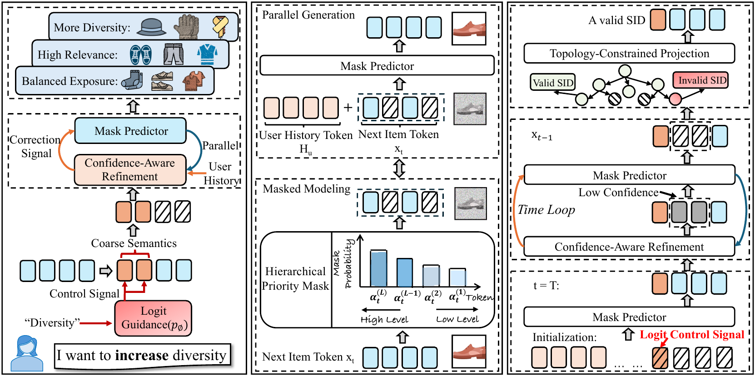
3.1
The ReGen framework
Motivation
Contributions
Method
Experiments
Conclusions
Guidance changes coarse semantics. Refinement repairs details. The trie constrains candidate search.
8 / 25
Notes:
This diagram brings the pieces together. On the left is the control signal. In the middle is the masked predictor, and on the right is the refinement loop.
We begin with a masked target ID and the user's history. The predictor produces token distributions, and guidance adjusts the coarse semantic choices.
We then revisit uncertain positions while keeping compatible catalog paths in the search. Several candidates survive across rounds. At the end, we map them to items and build the recommendation list.
Source: Camera-ready PDF, p. 4, Fig. 2; Sections IV-A–D.

Slide 9
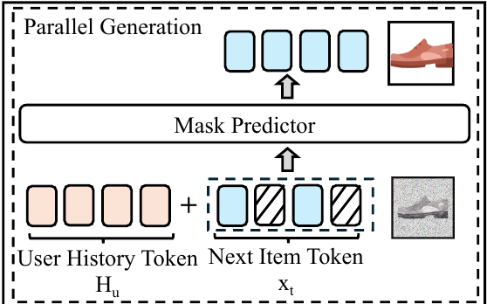
3.2
Parallel masked prediction
Input
Motivation
History Xᵤ and a partially specified target ID
Contributions
Method
Output
Experiments
[Z⁽¹⁾, …, Z⁽ᴸ⁾] = fθ(x, Xᵤ)
Conclusions
All masked positions use bidirectional context.
A parallel prediction round can condition on fixed tokens on either side of a masked position.
9 / 25
Notes:
The predictor is a bidirectional Transformer. Its input contains the user's semantic history and a target ID with some known tokens and some masks.
In one forward pass, it produces logits for every target position. Each masked position can use the known tokens on both sides, including a coarse token selected under guidance.
So when the semantic direction changes, the model can fill in details that fit the new context. We still use several refinement rounds and a constrained search. Parallel prediction refers to what the backbone does within each round.
Source: Camera-ready PDF, pp. 3–4, IV-A2–3, Eqs. (4)–(5).

Slide 10
3.3
Learning to reconstruct fine details
Hierarchical priority masking during training
Motivation
Level | Training mask
c₁ (coarse) | Less often
c₄ (fine) | More often
α₁ < α₂ < α₃ < α₄
Contributions
Method
Lower masking probability for coarse tokens
Higher masking probability for fine tokens
Experiments
Conclusions
The model learns to fill details conditioned on stable high-level semantics.
Training mask probabilities αₗ differ from the confidence threshold τₜ used during inference.
10 / 25
Notes:
We train the model to work with these coarse semantic anchors. During training, we mask coarse tokens less often than fine tokens.
The model often sees the coarse context while it learns to reconstruct masked details.
These are training probabilities. Later, during inference, a confidence threshold decides which tokens to revisit. Those are separate masking decisions, even though both use the same masked predictor.
Source: Camera-ready PDF, p. 4, IV-A3, hierarchical priority masking paragraph.

Slide 11
3.4
Hierarchical Logit Guidance
Penalize frequently visited semantic regions
Motivation
sᵧ⁽ˡ⁾[v] = −log(1 + Countₗ(v, Sᵤ))
Contributions
Method
Countₗ(v, Sᵤ): occurrences of token v at level l in the user’s history
Experiments
Apply guidance to the first K coarse levels
Conclusions
Z̃⁽ˡ⁾ = Z⁽ˡ⁾ + λsᵧ⁽ˡ⁾ for l ≤ K
Deeper logits remain unshifted. The predictor reconstructs their tokens under the guided context.
11 / 25
Notes:
For diversity control, we count how often each coarse token appears in the user's history. A frequent token receives a larger penalty. An unseen token receives zero.
The score is minus the log of one plus the count. We multiply it by lambda and add it to the logits at the first K coarse levels.
This makes less familiar semantic regions more likely. We leave the deeper logits unshifted and let the predictor complete the details under the guided context. Lambda lets us adjust how strongly the history penalty influences generation.
Source: Camera-ready PDF, p. 5, IV-B1, Eqs. (6)–(7).

Slide 12
3.5
A numerical example of guidance
Illustrative coarse-token scores with λ = 1 and K = 1
Motivation
Token | History count | Base logit Z | Penalty sᵧ | Guided logit
A | 9 | 3.000 | −2.303 | 0.697
B | 1 | 2.200 | −0.693 | 1.507
C | 0 | 1.000 | 0.000 | 1.000
Contributions
Method
Experiments
Conclusions
Base preference: A
Guided preference: B
Softmax preserves logit order. These toy values illustrate Eq. (6)–(7), not experimental results.
12 / 25
Notes:
Let's look at the numbers with one controlled level and lambda set to one. Token A starts with the highest logit, three, but it appears nine times in the history.
Its penalty is approximately minus two point three zero three. After guidance, its logit is about zero point seven.
Token B appears only once. Its smaller penalty brings its logit to about one point five, so B moves ahead of A and C.
These illustrative numbers show how guidance changes the preferred region while retaining the model's preference. The unseen token doesn't automatically win.
Source: Camera-ready PDF, p. 5, Eqs. (6)–(7); illustrative calculation.

Slide 13
3.6
Confidence-aware token refinement
ρₜ⁽ˡ⁾ = max Softmax(Z̃ₜ⁽ˡ⁾) Re-mask when ρₜ⁽ˡ⁾ < τₜ
Motivation
Contributions
Position | Current token | Confidence | Action
c₁ | B | 0.86 | Keep guided anchor
c₂ | 6 | 0.39 | Re-mask
c₃ | 4 | 0.79 | Keep context
c₄ | 9 | 0.44 | Re-mask
Method
Experiments
Conclusions
With τₜ = 0.60, the next prediction sees (B, [MASK], 4, [MASK]).
Illustrative confidence values. Guided coarse tokens remain fixed during detail repair.
13 / 25
Notes:
Even after guidance, the model may be uncertain about some of the details. We measure confidence using the largest softmax probability at each position, after the logit adjustment.
In this example, the threshold is zero point six. The second and fourth positions have confidence values of zero point three nine and zero point four four, so we mask them again.
We keep the guided token B and the reliable third token, four. The predictor then fills the two masks using that context. Across rounds, the threshold can increase, allowing the model to revisit positions that still need correction.
Source: Camera-ready PDF, p. 5, IV-C, Eqs. (8)–(10); illustrative token example.

Slide 14
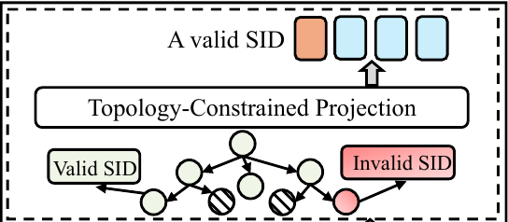
3.7
Topology-constrained token updates
Each root-to-leaf path is a catalog Semantic ID.
Motivation
Contributions
Suppress incompatible logits before beam expansion.
Method
Experiments
Fixed context | Compatible complete paths
(B, [MASK], 4, [MASK]) | (B, 6, 4, 9) or (B, 7, 4, 3)
Conclusions
Z̃ₜ⁽ˡ⁾[v] = −∞ for v ∉ Allowed(xₜ, l)
Illustrative catalog paths. Compatibility must preserve at least one valid complete path.
14 / 25
Notes:
Confidence tells us where another prediction may help. We also need to check whether the resulting ID can match a catalog item.
For that, we put the catalog IDs in a trie, or prefix tree. Every complete path is a valid ID. Before expanding a candidate, we suppress choices that cannot complete a path consistent with its fixed tokens.
For the context shown here, there are two valid completions. We must follow one complete path. Taking the second token from one path and the last token from the other could create an invalid combination. The constraint has to preserve that joint consistency.
Source: Camera-ready PDF, pp. 5–6, IV-D1, Eq. (11); Fig. 2 right; illustrative paths.

Slide 15
3.8
Beam search across refinement rounds
Candidate search
Motivation
1 Start with ([MASK], …, [MASK])
2 Predict, guide and constrain token expansions
3 Retain the top B candidate sequences
4 Refine uncertain positions for T rounds
B = 50
Contributions
Beam size
Method
Experiments
H = 100
Conclusions
Valid token expansions
Candidates use accumulated log-probabilities. T ≈ 4 is a practical operating point in the study.
15 / 25
Notes:
We keep several candidate sequences throughout this process. Starting from all masks, the decoder predicts token distributions, applies guidance, and expands candidates along compatible catalog paths.
It scores those candidates using accumulated token log-probabilities and keeps the best B for the next round. The confidence mask determines which positions to revisit.
Our default beam size is fifty, and we retain one hundred valid token expansions at a step. We repeat the process for T rounds. I'll show shortly why around four rounds is a practical choice in these experiments.
Source: Camera-ready PDF, p. 6, IV-D2; p. 7, V-B(c); p. 9, V-F.

Slide 16
3.9
From Semantic IDs to the final list
Map valid IDs to items, merge duplicates and remove items already in the history.
Motivation
Contributions
i* = arg maxᵢ [ ϕᵧ(i) + μ ΔCᵧ(i | Rᵤ) ]
Method
Cᵧ(Rᵤ) counts the categories represented in the selected list.
Experiments
Candidate | Utility ϕᵧ | New category? | Score with μ = 0.3
P | −0.50 | No | −0.50
Q | −0.65 | Yes | −0.35
R | −0.90 | Yes | −0.60
Conclusions
Illustrative next selection: Q. The existing list already contains P’s category.
16 / 25
Notes:
The decoder gives us candidate IDs. We map them to items, merge duplicates, and remove items the user has already interacted with. If several IDs map to the same item, we keep its highest controlled utility.
We build the list one item at a time. Each selection combines utility with a bonus for adding a new category.
In this example, Q starts at minus zero point six five. It adds a new category, so a bonus of zero point three brings its score to minus zero point three five. That puts it above P.
Mu controls this list selection bonus. Lambda controls the earlier guidance during generation.
Source: Camera-ready PDF, p. 3, Eqs. (1)–(2); p. 6, IV-D2, Eq. (12); illustrative selection.

Slide 17
3.10
One recommendation through ReGen
Stage | Illustrative state or operation
Initialize | User history Xᵤ and four masked target tokens
Guide | The coarse-token preference changes from A to B
Refine | Keep B and 4. Re-predict uncertain details
Constrain and search | Retain valid paths (B, 6, 4, 9) or (B, 7, 4, 3)
Construct the list | Map, deduplicate, remove history, select for coverage
Motivation
Contributions
Method
Experiments
Conclusions
The output is a ranked list of existing items
This walkthrough combines the toy examples. It is not a record from the evaluation data.
17 / 25
Notes:
Following one candidate through the process, we start with the user's history and four masked positions. Guidance changes the preferred coarse token from A to B.
We keep reliable context and revisit uncertain details. The trie restricts each expansion to compatible catalog paths, while the beam keeps several alternatives available.
Finally, we map the surviving IDs to items and choose the list using utility and category coverage. This example connects the token updates to the recommendations the user actually receives.
Source: Camera-ready PDF, Sections IV-A–D; illustrative walkthrough.

Slide 18
4.1
Evaluation setting and baseline utility
Amazon 2023 reviews, ordered chronologically
Leave one out: last interaction for test, second-last for validation
Motivation
Contributions
Dataset | Users | Items | ReGen R@10 | Best R@10
Instruments | 57,439 | 24,587 | 0.0646 | 0.0861 (Paragon)
Scientific | 50,985 | 25,848 | 0.0491 | 0.0715 (Paragon)
Video Games | 94,762 | 25,612 | 0.0726 | 0.0916 (SASRec)
Method
Experiments
Conclusions
Recall and NDCG measure utility. Diversity uses category coverage.
ReGen provides a useful utility basis, with lower pure accuracy than the best baselines.
Table II uses accuracy-oriented configurations. Trade-off and ablation settings differ.
18 / 25
Notes:
We evaluate on three Amazon review domains. Interactions are ordered by time, with the last interaction used for testing and the previous one for validation.
Recall and NDCG measure recommendation quality. Category coverage is our measure of diversity.
This table uses an accuracy-oriented configuration. ReGen trails Paragon on Instruments and Scientific, and SASRec on Video Games.
For control, we need to examine what happens as we ask for more diversity. The next plots use a separate sweep of operating settings.
Source: Camera-ready PDF, p. 6, V-A and Table I; p. 7, Table II and V-C.

Slide 19
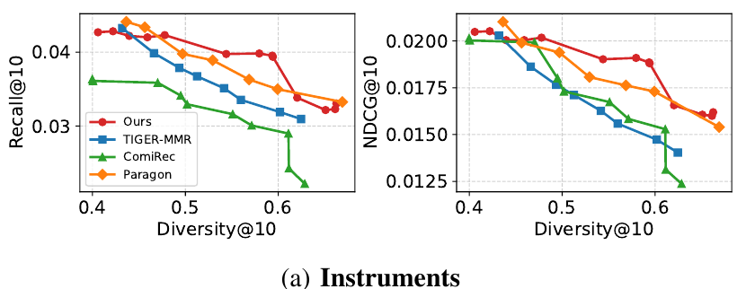
4.2
Accuracy and diversity on Instruments
Motivation
Contributions
Method
Experiments
Conclusions
At Diversity@10 ≈ 0.54
ReGen R@10 / NDCG@10: 0.0398 / 0.0190
TIGER-MMR: 0.0351 / 0.0163
19 / 25
Notes:
On Instruments, the horizontal axis is diversity. The vertical axes show recall and NDCG. To compare control, we look at how much accuracy each method retains at a similar diversity level.
At around zero point five four diversity, ReGen's recall is about four percent, compared with about three point five percent for TIGER with MMR re-ranking. The exact values are shown below the plots. NDCG follows the same pattern.
Over the measured range, ReGen can increase diversity with a relatively gradual loss in utility.
Source: Camera-ready PDF, p. 7, Fig. 3(a); p. 8, V-D1.

Slide 20
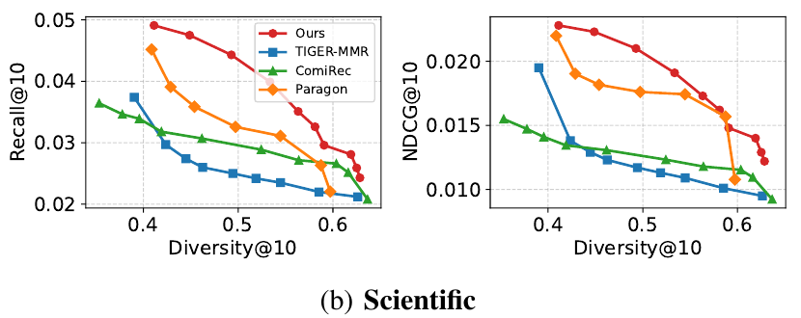
4.3
Accuracy and diversity on Scientific
Motivation
Contributions
Method
Experiments
Conclusions
At Diversity@10 ≈ 0.56
Recall@10: ReGen 0.0351, TIGER-MMR 0.0235, ComiRec 0.0272
NDCG@10: ReGen 0.0173, TIGER-MMR 0.0109, ComiRec 0.0118
20 / 25
Notes:
Scientific is more sensitive to the diversity requirement, and recall falls for all methods as diversity increases.
Around zero point five six diversity, ReGen's recall is about three point five percent. TIGER with MMR reaches about two point four percent, and ComiRec about two point seven percent. ReGen also has higher NDCG at that operating point.
The comparison supports guiding the candidate generation process itself. There's still a cost to increasing diversity, but ReGen retains more utility than these baselines at comparable diversity.
Source: Camera-ready PDF, p. 7, Fig. 3(b); p. 8, V-D2.

Slide 21
4.4
What each component contributes
Instruments, fixed controllability-oriented configuration
Motivation
Variant | Recall@10 | Diversity@10 | Valid IDs
ReGen (full) | 0.0339 | 0.5606 | 99.97%
Without guidance | 0.0355 | 0.4851 | 99.97%
Without refinement | 0.0130 | 0.7321 | 99.97%
Without topology | 0.0136 | 0.0001 | 27.63%
Contributions
Method
Experiments
Conclusions
Guidance increases diversity. Refinement preserves utility under control.
The topology constraint prevents most invalid code combinations.
Scientific shows the same pattern. Without topology, validity falls to 29.76%.
21 / 25
Notes:
The ablations help separate the roles of the components. All rows here use the same control-oriented decoding and ranking configuration, with only the indicated component changed.
Removing guidance lowers diversity. Removing refinement gives much higher diversity, but recall drops from about three point four percent to one point three percent. The items are more varied, but much less relevant.
Removing the catalog constraint causes validity to fall from ninety-nine point nine seven percent to about twenty-eight percent on Instruments. Scientific shows a similar drop. Refinement helps preserve recommendation quality, while the trie keeps generation within valid catalog paths.
Source: Camera-ready PDF, p. 8, Table III and V-E.

Slide 22
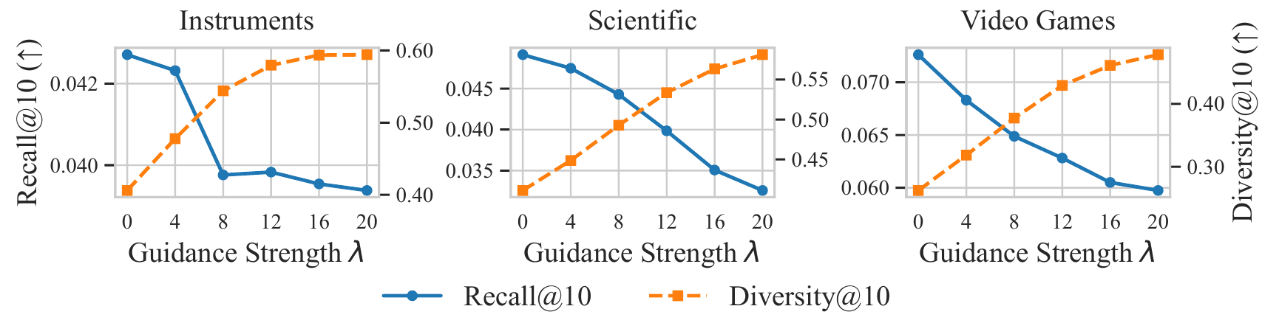
4.5
Guidance strength and refinement cost
Motivation
Contributions
Method
Experiments
Increasing λ raises category diversity. Stronger guidance also reduces recall.
Conclusions
Refinement rounds | Instruments | Scientific | Video Games
T = 4 | 72 min | 65 min | 128 min
T = 8 | 114 min | 102 min | 189 min
T ≈ 4 is a practical operating point. Times are total evaluation runs, not per-request latency.
22 / 25
Notes:
Lambda makes the accuracy and diversity trade-off visible. As it increases, diversity rises, while stronger guidance reduces recall. We therefore use moderate guidance when we want to preserve useful accuracy.
The refinement results settle down at roughly four rounds. More rounds add computation, with limited improvement in the reported settings.
The times in this table are for complete evaluation runs. For example, Instruments takes seventy-two minutes with four rounds and one hundred and fourteen with eight. They aren't response times for an individual user request.
Source: Camera-ready PDF, p. 9, Fig. 4 and V-F.

Slide 23
5.1
Scope and limitations
The evaluated control is category diversity
Motivation
Fairness, freshness and richer diversity objectives need their own control functions and evaluation.
Contributions
Method
Control relies on the learned semantic hierarchy
Noisy or poorly aligned codebooks can weaken coarse-level guidance.
Experiments
Conclusions
A finite candidate pool and repeated inference limit deployment
List construction can choose only generated candidates. More refinement rounds add cost.
23 / 25
Notes:
We tested category diversity. Other goals, such as fairness or freshness, would need their own control scores and experiments.
The method also depends on the tokenizer. If coarse codes don't capture useful semantic structure, coarse-level guidance becomes less effective.
And the final list can only use items that reached the generated candidate pool. A larger search or more refinement adds computation. These limits matter when using the method in a recommendation service.
Source: Camera-ready PDF, p. 9, Section VI; Sections IV-D2 and V-F.

Slide 24
5.2
Conclusions
Parallel refinement makes semantic choices revisable
Motivation
The masked predictor reconstructs details under guided coarse context.
Contributions
Method
Guidance, repair and topology have distinct roles
They steer diversity, recover relevance and constrain catalog-compatible generation.
Experiments
Conclusions
The evidence supports a favorable controlled trade-off
Moderate guidance preserves useful accuracy with high reported ID validity.
24 / 25
Notes:
The main idea is to let the generator revise its semantic choices. We guide the coarse tokens, then repair uncertain details under the new context, with the catalog tree constraining the search.
In our experiments, that combination gives a favorable accuracy and category-diversity trade-off under moderate guidance. It lets us adjust recommendation behavior at inference time while keeping the trained backbone fixed.
Source: Camera-ready PDF, p. 9, Section VII; pp. 8–9, Sections V-D–F.

Slide 25

THANK YOU
5.3 Thank you
Motivation
Contributions
Method
Experiments
Conclusions
Haichao Zhang
github.com/zhang-haichao/ReGen
haichao.zhang22@student.xjtlu.edu.cn
25 / 25
Notes:
Thank you for listening. The code is available in the ReGen repository shown here.
Source: Camera-ready PDF, p. 1, author information and source-code link.

