Slide 1
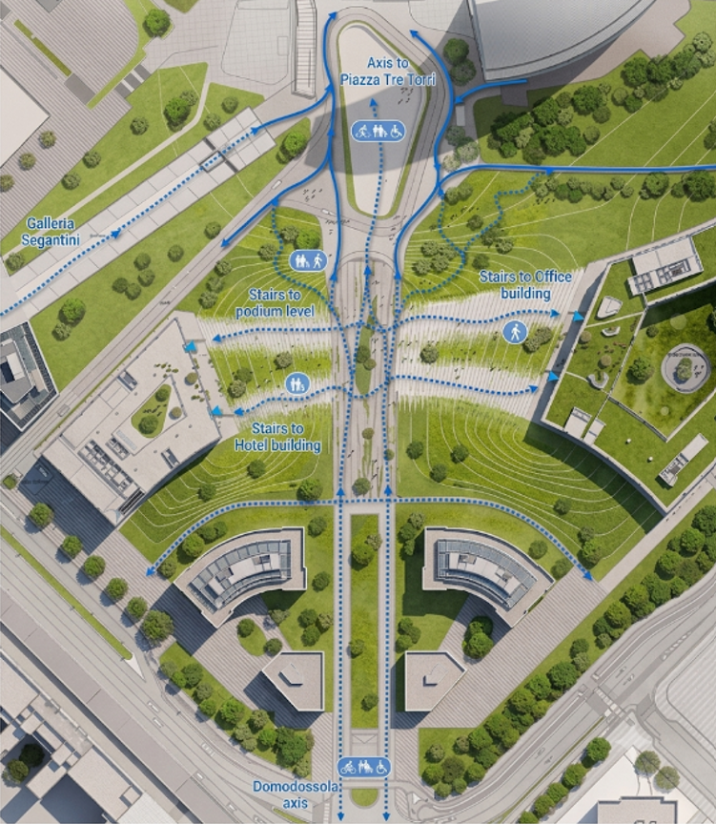

AccessMap
Can data predict which sidewalks
are accessible?
Group 13A · AI4ALL Ignite Summer 2026
· Zheng Zhang · Zaina Nadeem
· Laxmi Pesara · Gavino Vargas
· Ashton Moraes · Amen Bush
Live demo: accessmap-13a.streamlit.app
Notes:
Intro: 30 seconds. Names, one-line pitch: we tested whether data can predict sidewalk accessibility, and we deployed a live app.

Slide 2


The Problem
Wheelchair users can't tell if a sidewalk is passable before they get there.
Too narrow, curb too high — they find out on the spot. A wrong route isn't an inconvenience; it can end a trip.
Maps show that a road exists. They don't show whether a wheelchair can use it.
Why it matters
Wheelchair users, caregivers, seniors plan routes with confidence
Cities collect sidewalk data but rarely turn it into anything usable
A working model plugs into any routing app as a scoring layer
Research question: Can data predict which sidewalks are accessible for wheelchair users?
Notes:
1 minute. The pain point, then the research question. Keep it human: a wrong route can end someone's trip.

Slide 3


Two Datasets, One Question
PMR — Amsterdam sidewalks
Housing — US addresses
72,274
Physical measurements: width, curb height, crossings. Measures the physical world.
10,104
Crowd-sourced “sidewalk ok?” labels judged from Google Maps street images.
measured segments
crowd-labeled rows
No geographic overlap. One is meters in Amsterdam, the other spans a continent in degrees. Same pipeline runs on each; results are compared at the model level. Rows are never merged.
Notes:
45 seconds. Two angles on the same question: physical measurements vs what people see in photos. Emphasize: pipelines stay separate.

Slide 4
The Algorithms
Random Forest (main model)
Supporting tools
Type: Supervised classification — many decision trees vote Inputs: PMR: width, curb height, crossing, length. Housing: house type + crowd-confidence scores Output: accessible / not accessible, with a probability
ModernBERT
Embeds each address into a 768-dim vector (6,425 addresses)
FAISS
Similarity search over those vectors: “find addresses like this one,” ranked by distance
Why we chose it (pros)
Trade-offs (cons)
Handles mixed features well
Feature importance is readable — that's how we caught the bias
Strong baseline without heavy tuning
Can't invent signal that isn't in the features
Happily rides a biased shortcut feature
Less interpretable than a single tree
Notes:
1 minute. Hit rubric items exactly: name, type (supervised), inputs, outputs, pros AND cons. Mention feature importance is what exposed the bias later.

Slide 5
How the Project Evolved
V1
V2
V3
V4
Baselines
Bias fix
Precision fix
Deployment
Both models trained. Two problems surface: Housing below baseline, PMR over-flags.
Drop state from Housing, retrain. Result: a null finding — and an honest one.
PMR threshold tuning fails. Root cause found in features; curb height added.
Streamlit app built, tested locally + on the cloud, live for anyone to use.
We didn't get it right the first time — and that's the story worth telling.
Notes:
30 seconds. Set up the arc: four versions, each driven by a problem the previous one exposed.

Slide 6
Challenge 1 — The Housing Model Learned Geography
67.4% accuracy vs. an 85.3% baseline — worse than guessing. One feature, state, drove 89% of every decision. The model wasn't judging house condition. It was memorizing which states have more “bad sidewalk” labels. This is a bias problem, not a tuning problem.
Notes:
1 minute. Data viz #1. The chart makes the imbalance obvious: one feature is doing all the work, and it's a geographic proxy.

Slide 7
The Fix Revealed the Real Finding
Housing: 85.0% ties the 85.3% baseline. Recall on bad sidewalks: 0.01. Without state, no signal is left — and the raw data has no other features to add.
A null result is a result. “This dataset can't predict sidewalk condition, and here's why” is our headline bias finding — not a failure to hide.
Notes:
1.5 minutes. Data viz #2. Walk the four bars: Housing looks 'fixed' (67 to 85) but it's just the majority rate. State wasn't only bias - it was the only signal.

Slide 8


Challenge 2 — Confidently Wrong, Not Unsure
Attempt 1: move the threshold — failed
Attempt 2: fix the features — worked
PMR over-flagged “not accessible” (precision 0.55). We raised the cutoff from 0.5 to 0.65. Nothing changed.
Our label rule = width + curb height. But the model only ever saw width — it was guessing the curb half blind.
14 / 14,455
We added curb_height_max and a missing-value flag (74% of rows have no curb measurement — the missingness itself is information).
test predictions sat anywhere near the cutoff. Probabilities were pinned at 0 or 1 — the model wasn't hesitating, it was confidently wrong. A threshold can't fix confident mistakes.
Lesson: check the probability distribution before reaching for a threshold.
Notes:
1.5 minutes. The failed attempt IS the content: we diagnosed before re-fixing. 14 of 14,455 is the key stat.

Slide 9
Evaluation — Read the Numbers Honestly
PMR: 100% accuracy. Expected, not impressive. The two label inputs (width + curb height) now top the chart — the model recovers the rule we wrote. It proves the pipeline is consistent, nothing more. Housing: 85.0%. That's the majority-class rate, not skill. The honest conclusion stands: house-level features alone can't predict sidewalk condition.
Notes:
1 minute. Data viz #3. Perfect accuracy should raise questions: the top two bars are the label's own inputs. We say 'the model recovers our rule,' never 'we achieved 100%.'

Slide 10
Results, In Plain Language
What were the results?
What do the results mean?
PMR (Amsterdam): 100% accuracy after adding curb height. Housing (US): 85.0% vs. an 85.3% majority baseline once state was removed — recall on bad sidewalks just 0.01. Address search: FAISS retrieval works and ships in the live app.
The PMR score means the model consistently recovers the width + curb rule we wrote — proof the pipeline works, not superhuman skill. The Housing tie with the baseline is an honest null result: house-level features alone can’t predict sidewalk condition.
How did we get them?
How accurate are they?
The same recipe on both datasets: clean, encode, train a Random Forest, score on a held-out 20% test set, then audit feature importance. That audit — not the accuracy score — is what exposed the state bias and the missing curb feature.
PMR: 100% on 14,455 held-out segments — but scored against our own rule-based label; only 50 verified labels exist, too few to test on. Housing: no better than always guessing “ok.” We trust the audited pipeline more than any single number.

Slide 11


Live Demo
accessmap-13a.streamlit.app
Sidewalk Checker
Address Search
About & Limits
Enter width, curb height, crossing, length → accessible / not accessible + confidence
Pick an address → FAISS returns similar addresses with sidewalk labels + distances
What the app does, what it refuses to do, and why — honesty as a feature
One deployment decision we're proud of: the app does NOT predict sidewalk condition for US addresses. We tested that model — it has no signal — so the app reports the real crowd label instead of pretending to predict.
Notes:
1.5 minutes. Switch to the live app here. Test case to run live: width 0.5 -> not accessible. Then one address search. Backup: screenshots if wifi fails.

Slide 12
Deployment
Why is the app so simple — and how reliable is it?
Why we keep the app simple…
How reliable is it…
Every feature maps to a result we validated. We ship the two things that work — the PMR checker and the address search — and we refuse to ship US sidewalk prediction, because we tested that model and it has no signal. Fewer moving parts also means fewer failure points for the people who rely on the answer.
Confidence now comes with an explanation: it’s the share of the forest’s trees voting for that label, shown with the factors that drove the call. Inputs are range-checked, missing curb heights use the same fill value as training, and every known limit is stated inside the app itself.

Slide 13

Impact — Both Sides
Positive
Negative / risks
Wheelchair users and caregivers plan routes before leaving home
Cities can find clusters of bad segments and prioritize repairs
Accessibility becomes a data layer any routing app can adopt
A biased model could systematically mislabel whole regions — exactly what our Housing model did before the fix
False “accessible” labels are worse than no label: someone plans a trip they can't finish
Rule-based labels (ours) can encode wrong assumptions if never validated against real users
Notes:
45 seconds. Rubric wants BOTH sides. The negative side is concrete because we lived it: our own model was the cautionary tale.

Slide 14
Essential Question
How can the process of creating AI/ML solutions amplify or mitigate bias in our case?
It amplified bias when…
It mitigated bias when…
we let a geographic proxy (state) dominate training. The model looked like it was scoring house condition; it was really scoring ZIP codes. High feature importance made an unfair shortcut look like intelligence.
we audited feature importance, removed the proxy, retested, and reported the honest null result instead of a prettier number. The same ML process that created the bias also gave us the tools to catch it — if we chose to look.
Notes:
1 minute. This is the rubric's highest-weight answer. Key line: the same process that created the bias gave us the tools to catch it - if we chose to look.

Slide 15




Next Steps
Rule-free PMR experiment
Week 13
Retrain on only features outside the label rule (crossing, length, width_fill): can accessibility be guessed without measuring? The one test where the model can show real skill.
Validate the label
Week 13
Compare our width/curb rule against the 50 verified accessibility labels; report agreement.
Location-aware retrieval
Week 14
Add coordinates to the PMR index so retrieval ranks within tied groups instead of returning exact ties.
Individual roadmaps
Ongoing
Each member continues per their My AI Roadmap; repo stays public as a portfolio piece.
Notes:
30 seconds. Measurable, dated next steps (rubric 5/5). The rule-free experiment is the headline: it's the one place the model could show genuine skill.

Slide 16
Citations & Sources
Data sources
City of Amsterdam Open Data — PMR sidewalk accessibility dataset (72,274 segments)
CrowdFlower / Figure Eight “Data for Everyone” — Housing: Wheelchairs dataset (10,104 crowd-labeled US addresses)
Related work & methods
Breiman, L. (2001). Random Forests. Machine Learning, 45(1).
Johnson, J., Douze, M., & Jégou, H. (2019). Billion-scale similarity search with GPUs. IEEE Transactions on Big Data. (FAISS)
Warner, B., et al. (2024). Smarter, Better, Faster, Longer: A Modern Bidirectional Encoder. (ModernBERT)
Mehrabi, N., et al. (2021). A Survey on Bias and Fairness in Machine Learning. ACM Computing Surveys.
Saha, M., et al. (2019). Project Sidewalk: A Web-based Crowdsourcing Tool for Collecting Sidewalk Accessibility Data at Scale. ACM CHI.
Live app: accessmap-13a.streamlit.app Code + docs: github.com/zhang-systems/ai4all-accessmap
Notes:
Close: 15 seconds. Thank the audience, point at the QR/live link, invite them to try the app during Q&A.

Slide 17
Thank You!
Questions? Try the app yourself while we talk.
accessmap-13a.streamlit.app
Group 13A — AI4ALL Ignite Summer 2026
Notes:
Thank the audience. Invite them to open the live app on their own device during Q&A.

