Slide 1

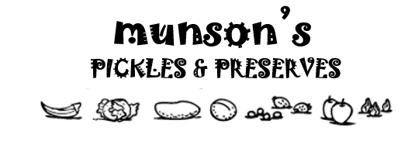
aka.ms/MIPC/AskCxeTeam
aka.ms/MIPC/uservoice
Know your retention labels and govern your data.
Never Delete
5 Year
1 Year
1 Month
1 Week
Learn how to secure your data at Link

