Slide 1


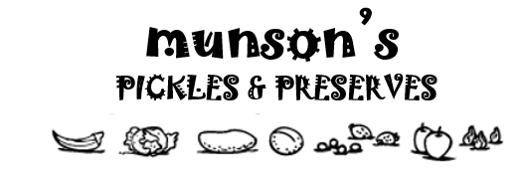

aka.ms/MIPC/askcxeteam
aka.ms/MIPC/uservoice
INFORMATION GOVERNANCE You govern the data.
Creation
Storage
5 Year
1 Week
Retention
1 Month
Never Delete
1 Year
Learn how to govern your items at LINK

