Slide 1




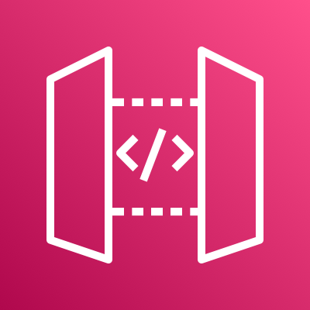






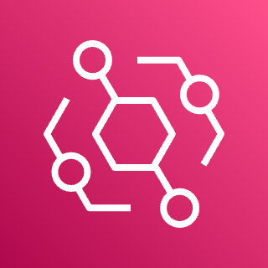





AWS Cloud
AWS Support
Feishu Endpoint
Feishu App ID
Larkbot
Amazon API Gateway
SDK
Polling Event
Amazon DynamoDB
Feishu App
Feishu Mobile App
S3 Standard
Amazon EventBridge
case table
bot_config table
Users
Version 2.0
AWS CloudFormation (SAM)
Administrator

Slide 2



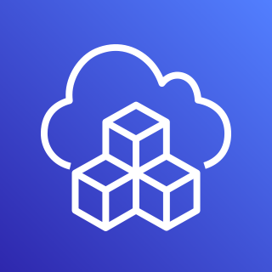
AWS Cloud
7
9
AWS Support API (By Account)
6
Feishu Endpoint
Feishu AppID & AppSecret
Assume Role
2
3
Larkbot
Amazon API Gateway
1
5
/messages (POST)
Polling Event
8
4
Feishu App
Feishu Mobile App
S3 Standard
Amazon EventBridge
Feishu AppID & AppSecret
Amazon DynamoDB
AWS Secrets Manager
case table
bot_config table
Users
0
Version 3.0
Administrator
AWS CDK

Slide 3
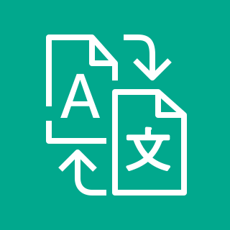

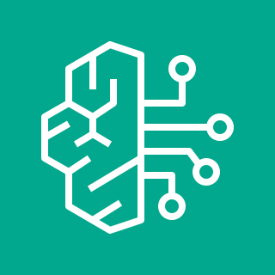

AWS Cloud
Amazon DynamoDB
AWS Secrets Manager
IM Endpoint
IM AppID & AppSecret
case table
bot_config table
IM AppID & AppSecret
Amazon API Gateway
IM bot
Amazon Translate
/messages (POST)
Polling Event
IM App
IM Mobile App
Amazon SQS
Q bot
Amazon Bedrock
S3 Standard
Amazon EventBridge
Amazon Q
Data Lake
Assume Role
Users
AWS CDK
AWS Support API (By Account)
Administrator
Notes:
Customer Obsession: Address customer pain points
Scalability: Any customer can use this: Dev to C-level
Readiness: Ready
How it works:
The diagram shows the architecture for our solution.
The user will talk to Amazon Q via an IM platform (Feishu in this case) which sends the request to our API GW. The lambda behind will first translate the language of the prompt to English before triggering Amazon Q. The translation is done via Bedrock (Claude 3) with AWS Translate as a failsafe. After Amazon Q responds, the system will translate it back to its original language and sends the response back to the user.

