Slide 1




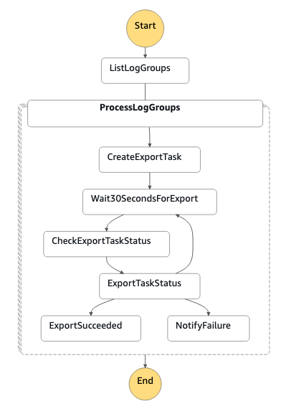




Region
1
CloudWatch Log Exporter workflow
Target bucket/prefix/export day(s)
Scheduler
2
3
4
List Log Groups / Create Export Task / Check Export Task Status
Amazon CloudWatch
Lambda function
Format Prefix
5
Send notice to SNS If export task failed

