Slide 1
Emerging Techniques for
Space-Air-Ground Integrated Networks
Polarforming · Atomic Quantum Receivers · MADRL and Rate-Splitting Multiple Access
Miao Zhang
Department / Laboratory, University
Seminar Series · Month DD, 2026
Notes:
Title slide. Replace the affiliation and date (they are placeholders). One-sentence hook: SAGIN promises global 6G coverage, but each layer brings its own bottleneck; this talk presents three emerging techniques that address them, and how to optimize each one.

Slide 2




Outline
ROADMAP
Background first, then three optimization case studies that share one structure: system model, proposed design, results.
PART I
PART II
PART III
PART IV
Introduction
Polarforming Design in SAGIN
Atomic-to-Space: Quantum Receiver for SAGINs
MADRL and Rate-Splitting Multiple Access for SAGIN
SAGIN
Polarforming
Atomic receivers
RSMA
MADRL
System model
Proposed design
Simulation results
System model
Proposed design
Simulation results
System model
Proposed design
Simulation results
Which tools fit which layer?
Can antennas follow the channel's polarization?
Can atoms hear weak satellite signals?
Can UAVs learn to share spectrum with RSMA?
Then: conclusion & future directions, references, and Q&A
Notes:
Walk through the four parts. Parts II–IV follow the same three-slide pattern (system model, proposed design, simulation results), so the audience knows what to expect.

Slide 3
Introduction
SAGIN · Polarforming · Atomic receivers · RSMA · MADRL
Notes:
Part I gives the background needed for the three technical parts: the SAGIN architecture and the four enabling techniques.

Slide 4

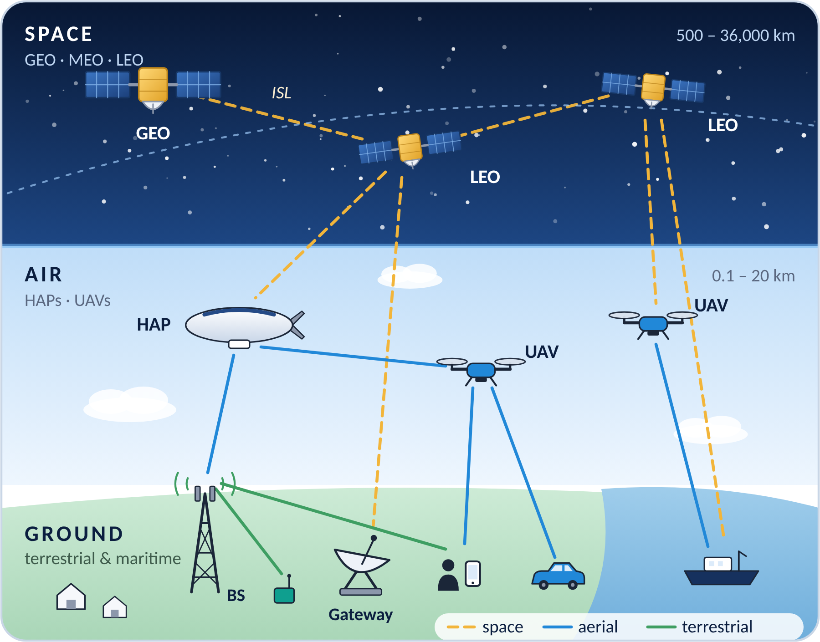



Space-Air-Ground Integrated Network (SAGIN)
Satellites, aerial platforms and terrestrial networks merged into one system for seamless, global 6G coverage [1].
Space layer
GEO/MEO/LEO satellites and mega-constellations: global coverage, backhaul and broadcasting.
Air layer
HAPs, airships and UAVs: flexible on-demand coverage, relaying and edge computing.
Ground layer
Cellular BSs, gateways, IoT devices, vehicles and ships: high capacity and low latency.
Key challenges
Heterogeneity
High mobility
Long delay & Doppler
Limited on-board power
Severe path loss
Cross-layer optimization: beamforming, access, trajectory and resource allocation must be designed jointly.
Notes:
Introduce the three layers and their roles. Stress that the layers differ in altitude, mobility, delay and on-board resources, which is exactly why cross-layer optimization is needed. Figure: own illustration; replace freely.

Slide 5
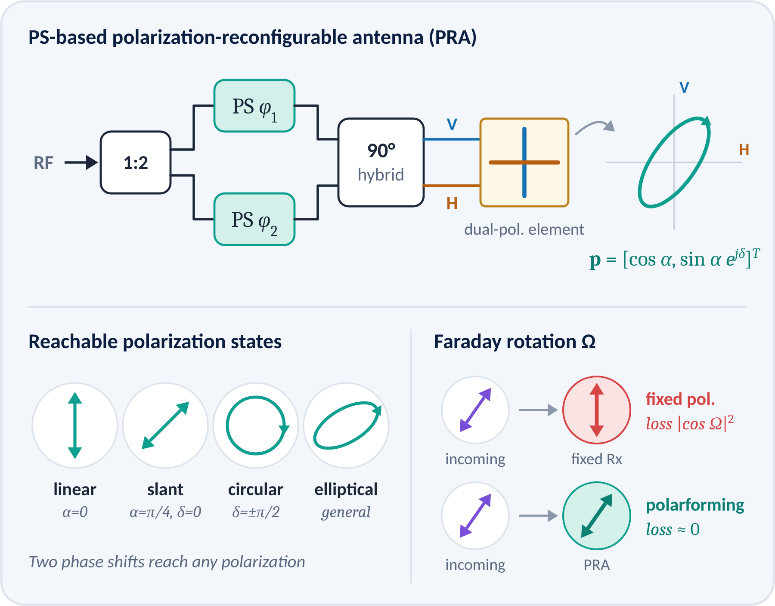



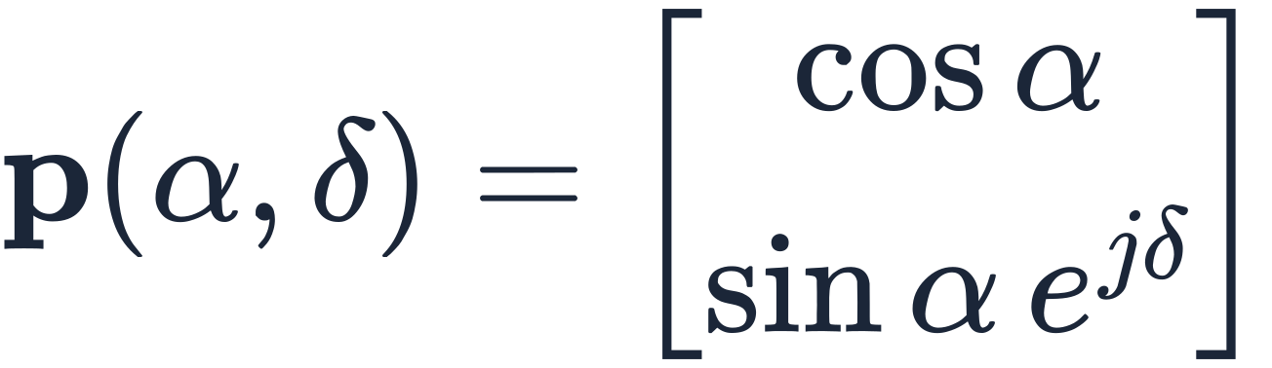
Polarforming: Reconfigurable Antenna Polarization
Adapt each antenna's polarization to the channel, just as beamforming adapts its phase and amplitude [2].
How it works
A dual-polarized element fed through phase shifters synthesizes linear, circular or elliptical polarization.
Why it matters
Faraday rotation, platform attitude and scattering cause polarization mismatch; at 90° a fixed antenna loses the link.
What it buys
Full polarization diversity (order 2 per dual-polarized antenna) and robustness to depolarization [2].
Polarforming (Jones) vector of one antenna
In SAGIN: track ionospheric rotation on satellite links and attitude changes of UAV and handheld terminals.
Notes:
Polarforming (Zhou et al. [2]) uses polarization-reconfigurable antennas. With two phase shifters and a hybrid, one element can synthesize any polarization state. Key message: polarization becomes an optimization variable, which matters in satellite links because of Faraday rotation.

Slide 6
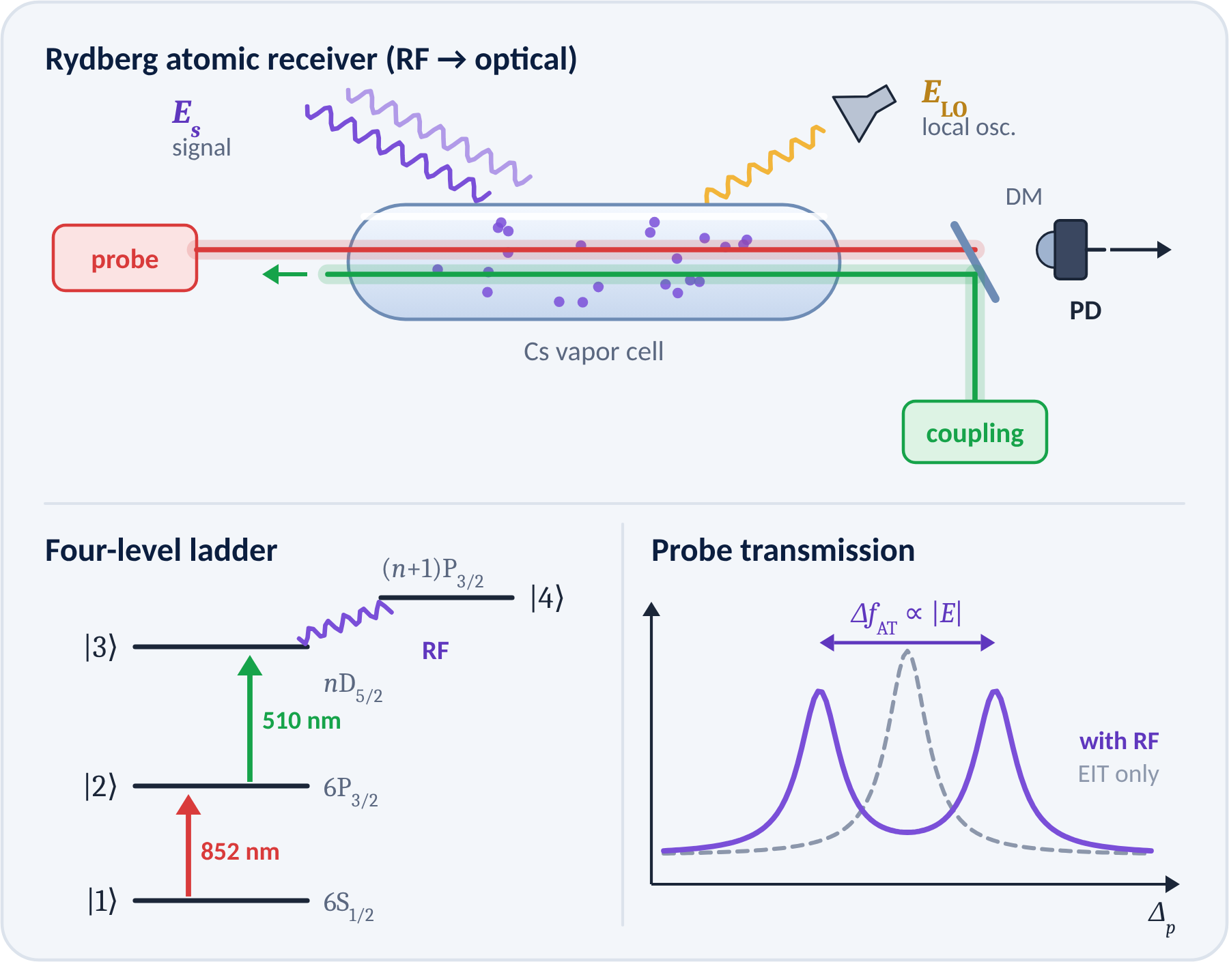


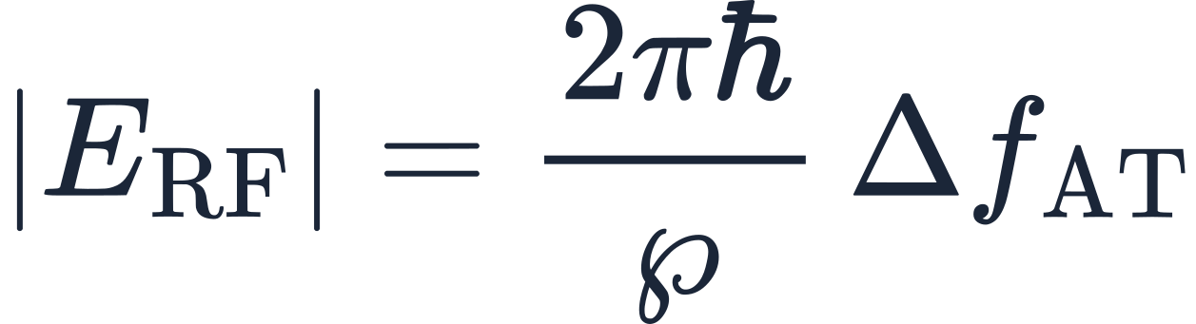
Atomic (Rydberg) Quantum Receivers
Highly excited atoms in a vapor cell act as the antenna: an RF field changes how the atoms absorb laser light [3].
Principle
Probe and coupling lasers create EIT; a resonant RF field splits the line (Autler–Townes) in proportion to |E|.
Superheterodyne
A local-oscillator field adds phase readout; measured sensitivity 55 nV cm⁻¹ Hz^{-1/2} [4].
Advantages
SI-traceable, tunable from MHz to THz, and the sensor size is not tied to the wavelength.
Field from the measured splitting (SI-traceable)
In SAGIN: detect very weak signals on long space–ground links; one vapor cell can serve several bands.
Notes:
Explain EIT and Autler–Townes splitting with the ladder diagram. The superheterodyne version (Jing et al. [4]) adds a local oscillator so amplitude and phase can be read out. Be careful with sensitivity claims; quote the measured number and its reference.

Slide 7
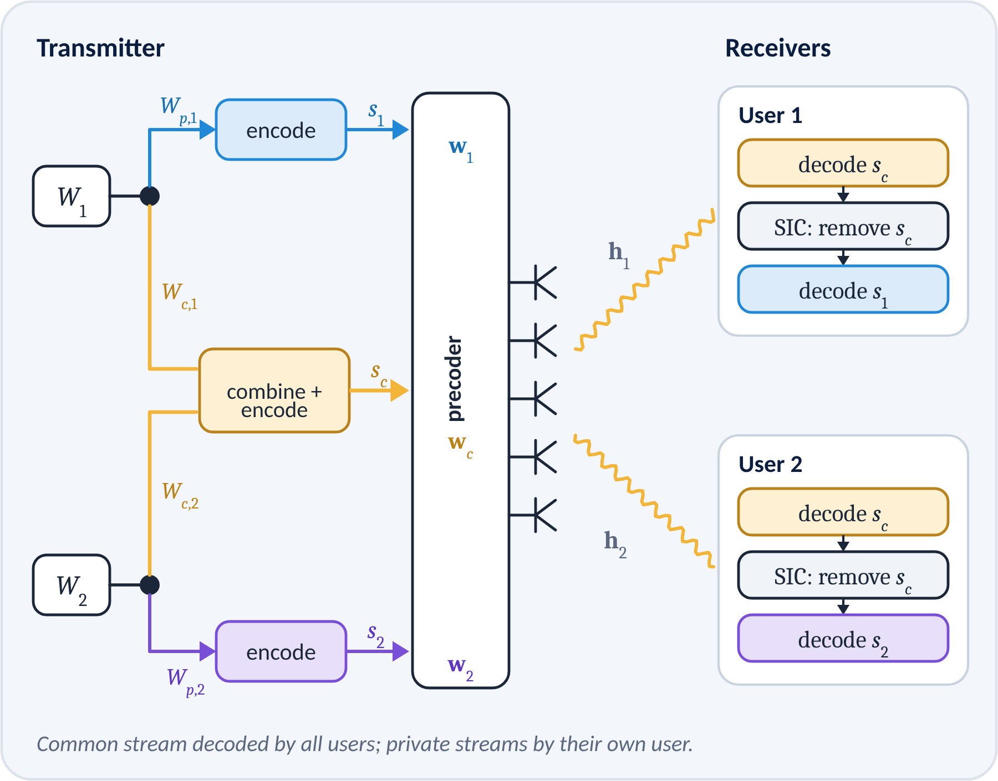



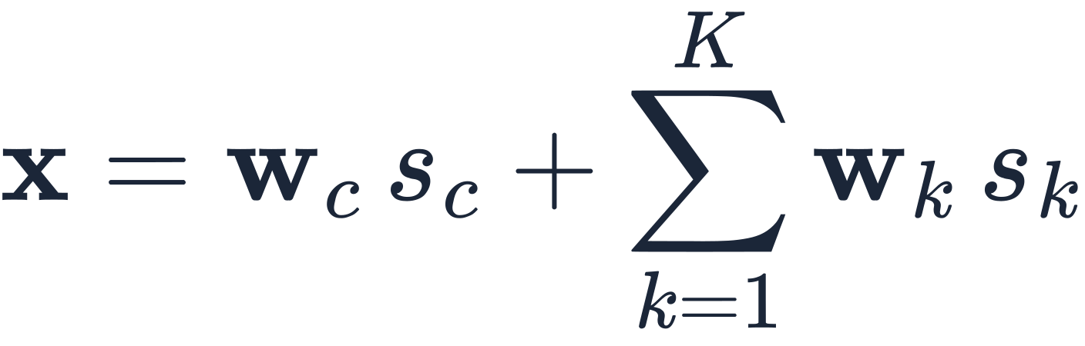
Rate-Splitting Multiple Access (RSMA)
Split messages into common and private parts, so interference is partly decoded and partly treated as noise [5], [6].
Rate splitting
Message W_{k} is split into a common part W_{c,k} and a private part W_{p,k}.
Superposition + SIC
Users decode the common stream s_{c}, remove it by SIC, then decode their own s_{k}.
Generality
SDMA, NOMA, OMA and multicasting are all special cases of RSMA [6].
Transmit signal
In SAGIN: robust to imperfect CSIT from long delays and Doppler, and to overloaded satellite beams.
Notes:
RSMA (Mao, Clerckx et al. [5], [6]) bridges SDMA (no common stream) and NOMA (full SIC). In SAGIN it is attractive because satellite CSIT is outdated and beams are often overloaded. It is the multiple-access scheme used in Parts II and IV.

Slide 8

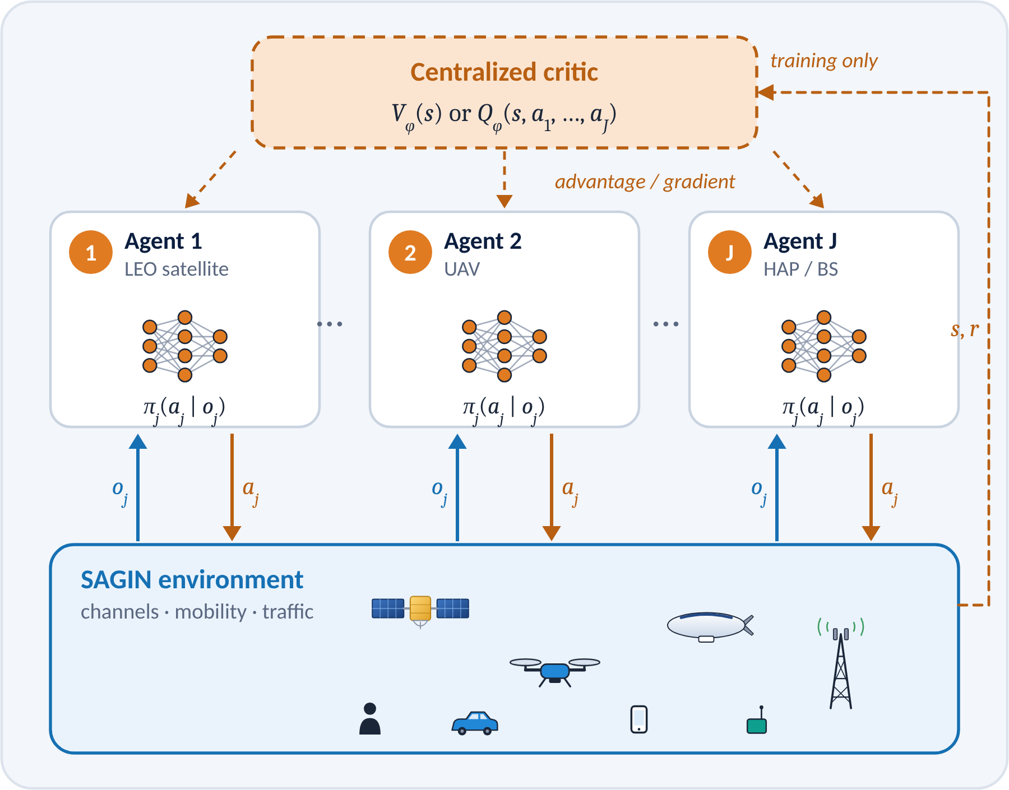

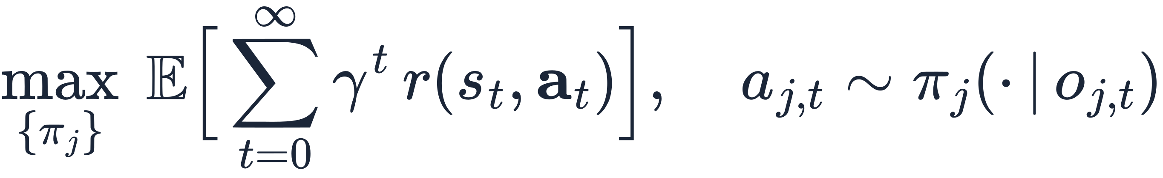
Multi-Agent Deep Reinforcement Learning (MADRL)
Satellites, UAVs and base stations learn cooperative policies from interaction instead of re-solving a hard problem every slot.
Model
Markov game / Dec-POMDP: agent j sees observation o_{j}, takes action a_{j}; agents share reward r.
CTDE
Centralized training with a critic that sees the global state; decentralized execution with local actors.
Algorithms
MADDPG [7], MAPPO [8], QMIX and other value-decomposition methods.
Cooperative objective
In SAGIN: real-time, distributed control of trajectory, power, beamforming and access.
Notes:
Introduce the Markov game / Dec-POMDP view and the CTDE paradigm (MADDPG [7], MAPPO [8]). Emphasize: training can use global information, execution only needs local observations — a natural fit for SAGIN where global CSI is unavailable in real time.

Slide 9
Polarforming Design in SAGIN
System model · Proposed design · Simulation results
Notes:
Part II: polarforming-aided RSMA for a LEO downlink. Replace the content with your own model and results; the three-slide structure stays.

Slide 10
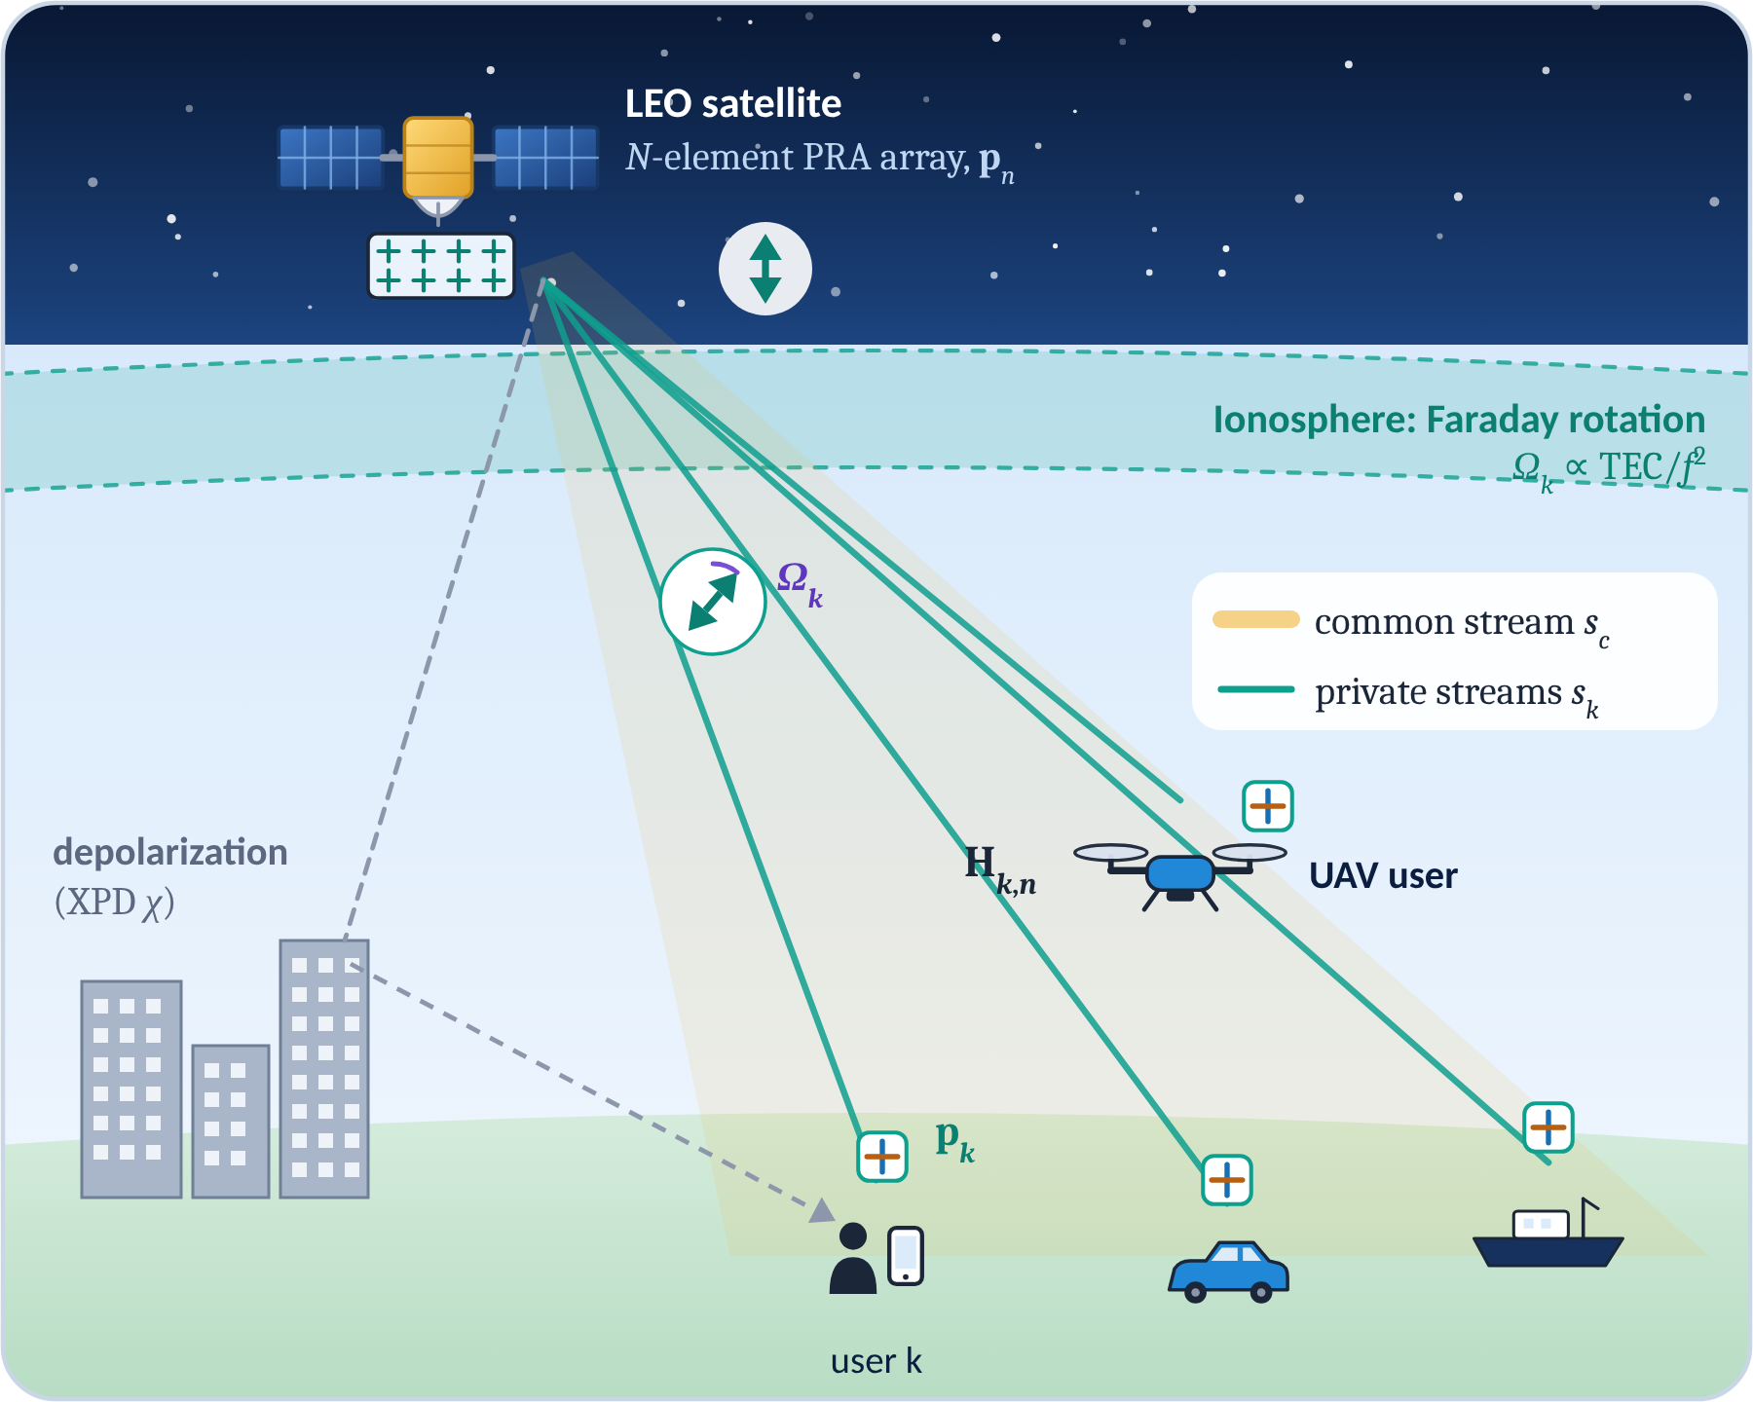
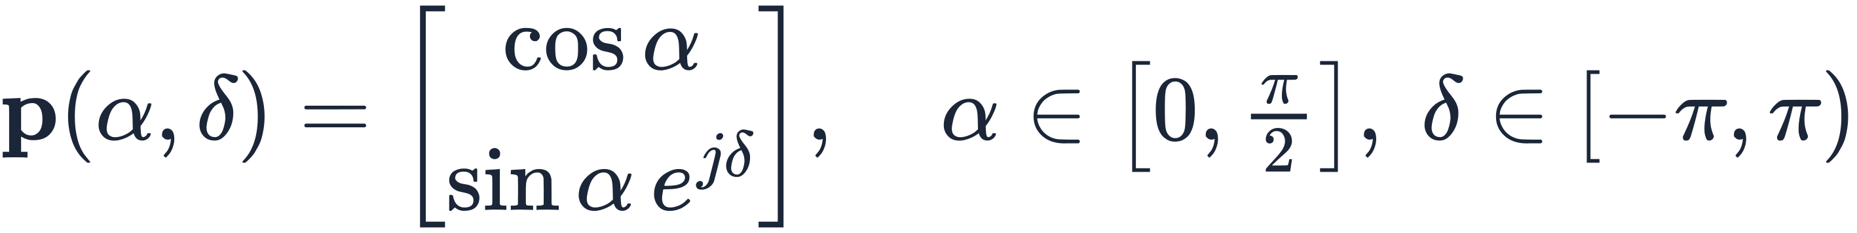
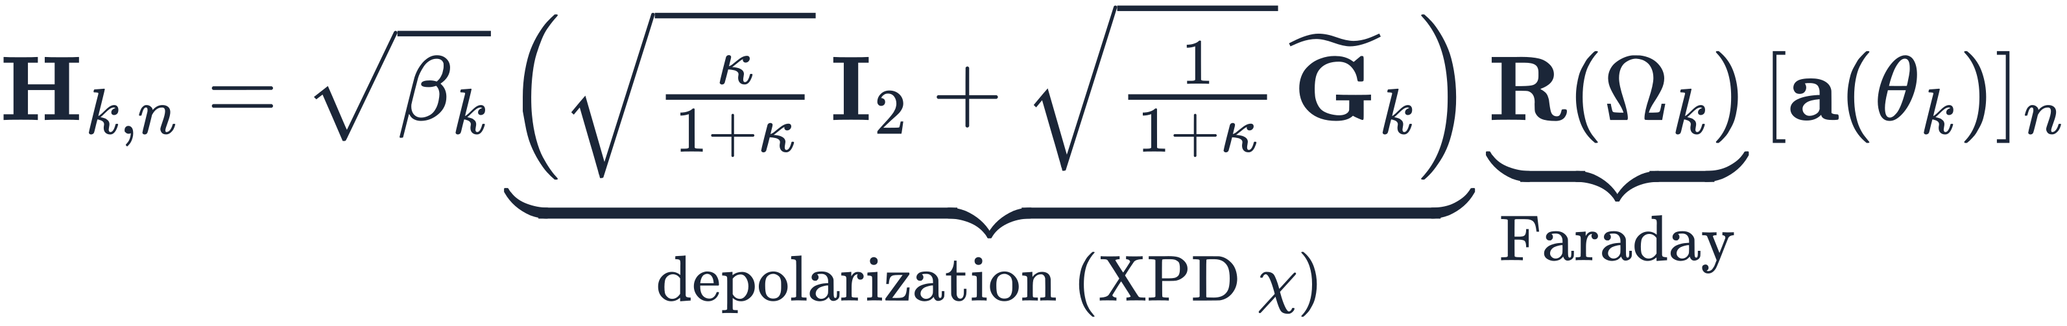
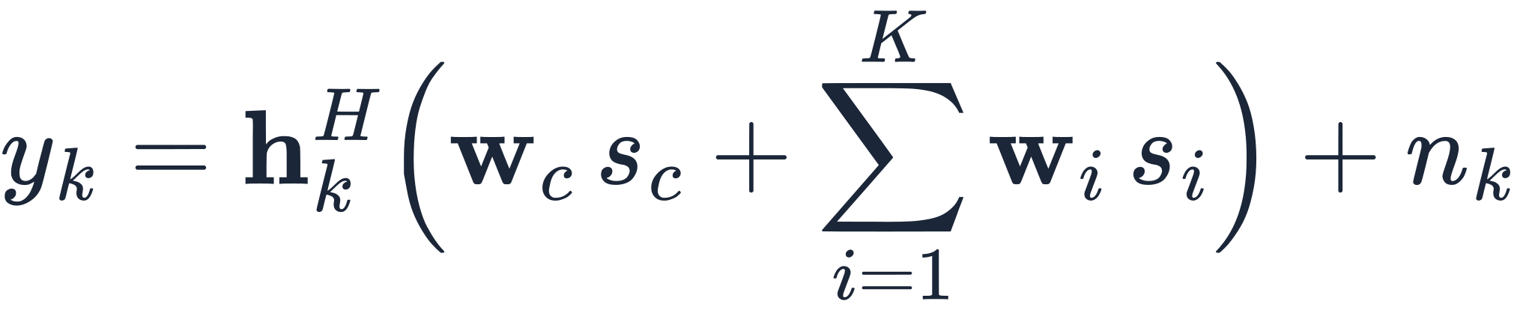
System Model
A LEO satellite with an N-element PRA array serves K PRA-equipped ground and aerial users with RSMA.
Polarforming vector of each PRA (transmit p_{n}, receive p_{k})
Polarized channel from antenna n to user k
Effective channel and received RSMA signal
Fig. Polarforming-aided RSMA downlink through a rotating, depolarizing channel.
Notes:
Walk through the figure from top to bottom: PRA array on the satellite, ionospheric Faraday rotation, depolarization near the ground, PRA at each user. Then the three equations: Jones vector, polarized channel, effective channel and received signal. Template note: equations are images; their LaTeX source is in each picture's alt text.

Slide 11
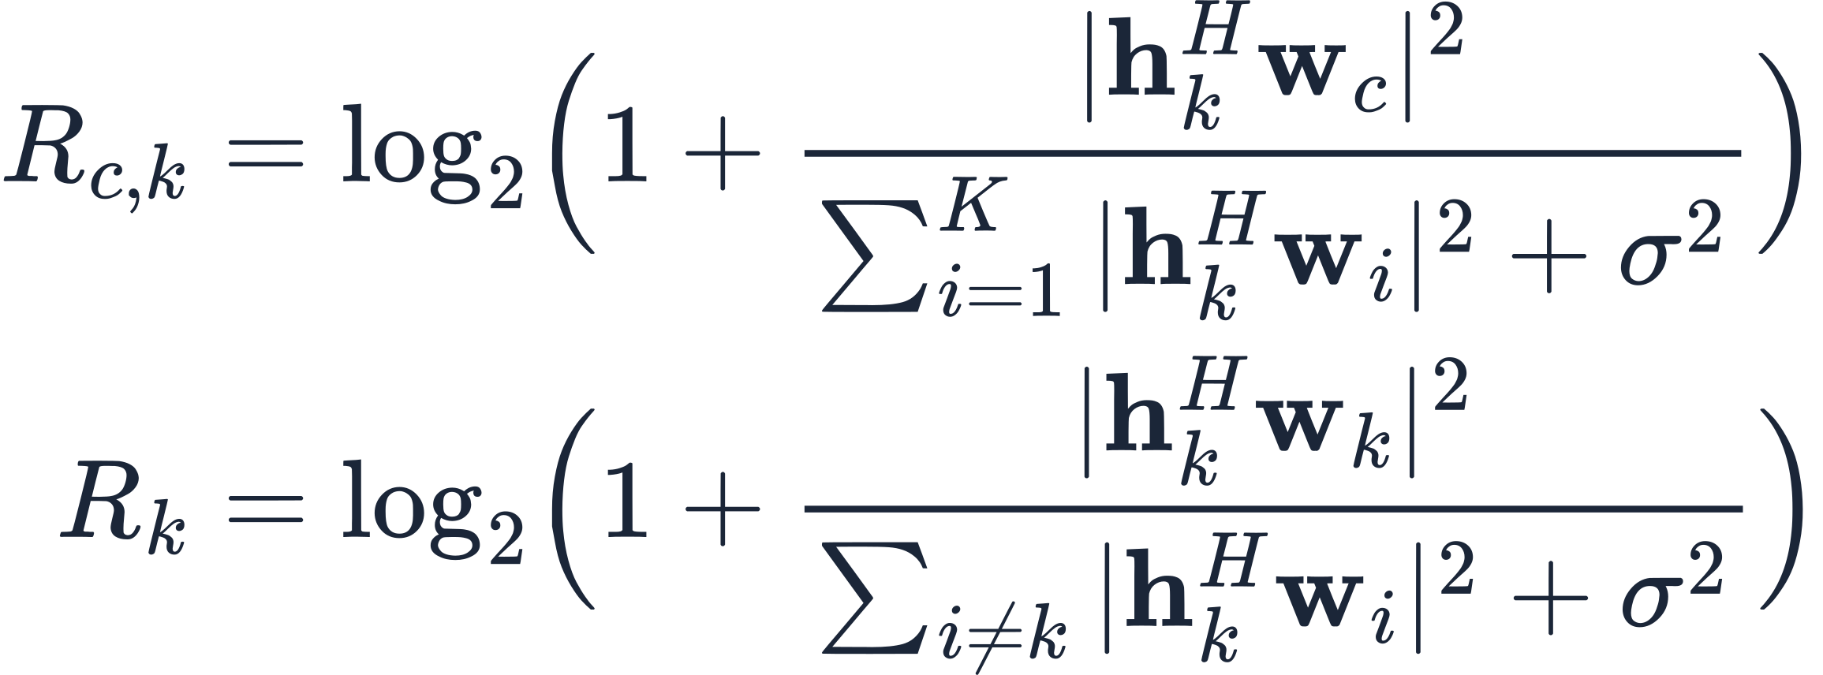
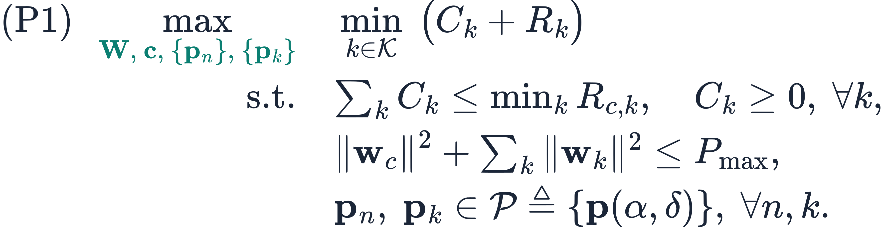
Proposed Design: Polarforming-Aided RSMA
Maximize the minimum user rate by jointly optimizing RSMA precoders, the common-rate split and every polarforming vector.
Common and private rates of user k
Alternating optimization (AO)
Initialize fixed polarization p_{n}, p_{k} and a feasible W
① Precoders + common rate
given p: convex SCA / WMMSE step for W, c
② Receive polarforming
p_{k} ← dominant eigenvector (closed form)
Max-min fairness problem
③ Transmit polarforming
p_{n} ← SCA / manifold step over (α_{n}, δ_{n})
Converged? objective gain < ε
no
Challenges:
non-convex rates
coupled variables
Jones constraints
Each block never decreases the objective, so AO converges monotonically.
Notes:
State the max-min problem (P1). Explain why it is hard: non-convex rates, coupled precoders and polarization vectors, and Jones-vector constraints. Then the AO algorithm: each block is solved optimally or by a convex surrogate, so the objective never decreases. Replace with your actual algorithm and complexity.

Slide 12
Simulation Results
Polarforming lifts every curve, RSMA keeps scaling at high power, and fixed linear polarization collapses under Faraday rotation.
Max-min rate vs. transmit power
Robustness to Faraday rotation (20 dBW)
Setup: N = 16, K = 4 clustered users, Rician κ = 10 dB, XPD 12 dB, 3% CSIT error. PF/FP: polarforming / fixed polarization.
ILLUSTRATIVE DATA · replace with your results
+60%
vs. fixed polarization at 20 dBW
+57%
RSMA vs. SDMA, both with polarforming
8×
vs. fixed linear at Ω = 90°
Notes:
Left: max-min rate versus transmit power. Right: robustness to Faraday rotation at 20 dBW. THE DATA ARE ILLUSTRATIVE (toy model in src/sim_data.py) — right-click each chart → Edit Data to paste your own results; the callout numbers below must be updated by hand.

Slide 13
Atomic-to-Space: Quantum Receiver for SAGINs
System model · Proposed design · Simulation results
Notes:
Part III: Rydberg atomic quantum receivers for satellite-to-ground links. The structure mirrors Part II.

Slide 14
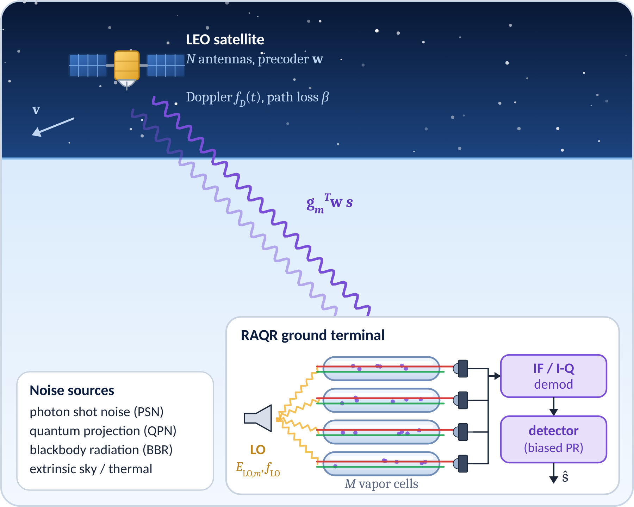
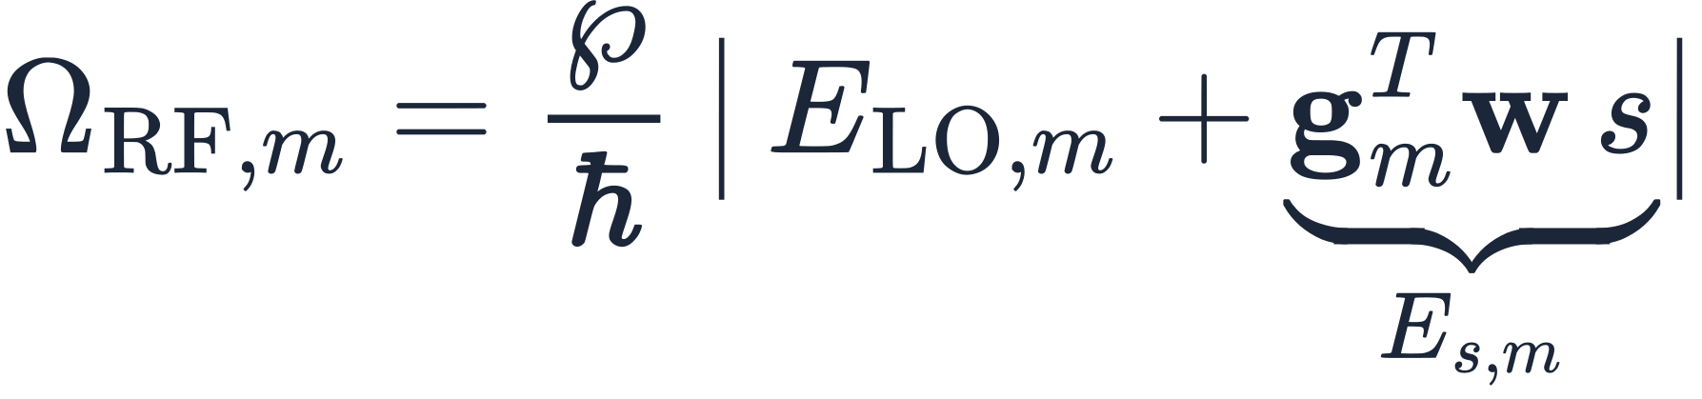
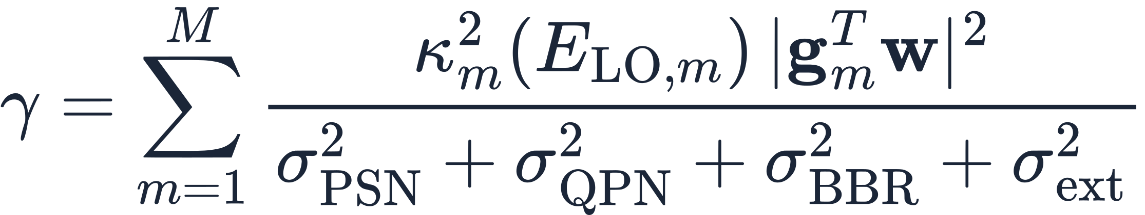
System Model
A LEO satellite precodes its downlink to a ground terminal whose antenna is an array of M Rydberg vapor cells with a local oscillator.
Atomic response: Rabi frequency of the RF transition in cell m
General output model: biased phase retrieval [9]
Strong-LO (superheterodyne) linearization
Output SNR with combining over M cells
Fig. Satellite-to-RAQR link with superheterodyne (LO-assisted) detection.
Notes:
Physical chain: satellite precoder → long, Doppler-shifted link → vapor cells illuminated by an LO → photodetectors → IF demodulation → detector. The general model is a biased phase-retrieval problem (Cui, Zeng, Huang [9]); with a strong LO it becomes linear (superheterodyne). Noise terms: photon shot, quantum projection, blackbody, extrinsic.

Slide 15
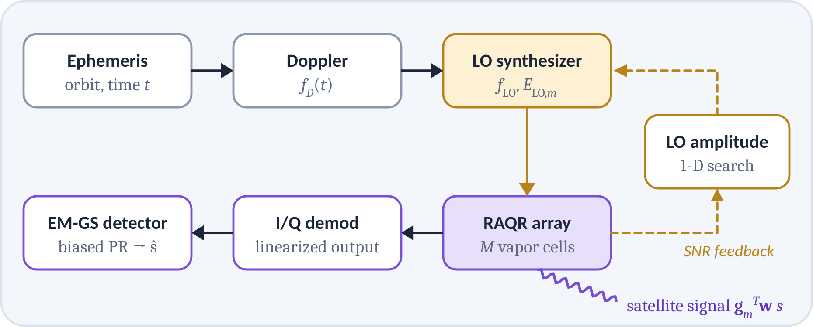
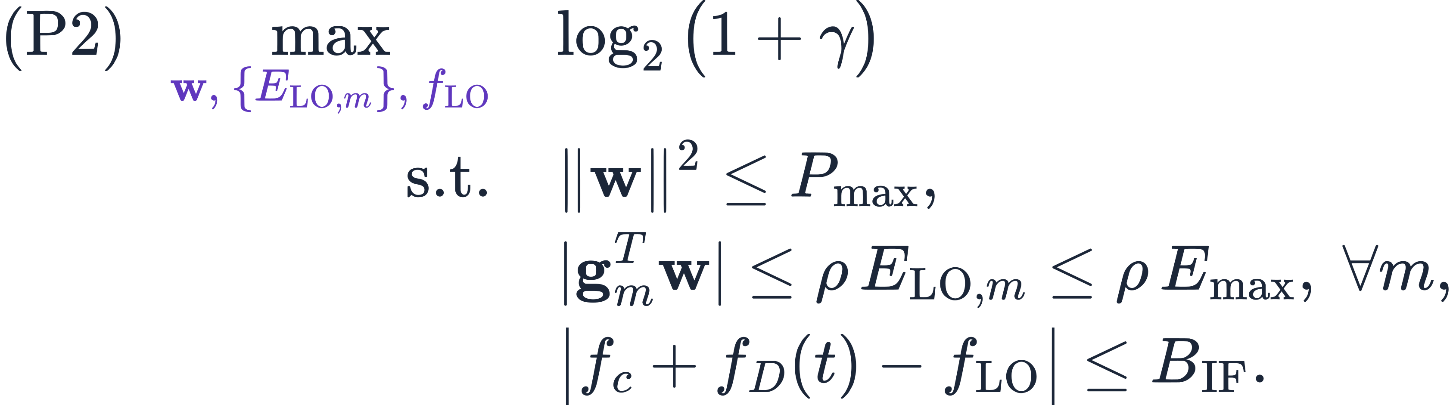


Proposed Design: LO- and Doppler-Aware Reception
Choose the satellite precoder and every cell's LO jointly: maximize SNR while each vapor cell stays in its linear regime.
SNR maximization with linear-regime and bandwidth constraints
1 Doppler-aware LO tracking
2 LO amplitude + precoder (AO)
3 Biased phase-retrieval detection
Predict f_{D}(t) from the ephemeris and set f_{LO} = f_{c} + f_{D}(t) − f_{IF}, so the beat note stays inside B_{IF}.
1-D search of E_{LO,m} maximizes κ_{m}²/σ_{m}²; for fixed LOs the precoder w is a convex SOCP. Alternate.
EM-based Gerchberg–Saxton (EM-GS) handles the residual nonlinearity to recover ŝ [9].
Notes:
Problem (P2): the LO amplitude sets the conversion gain κ and the noise; the linear-regime constraint keeps the signal small relative to the LO; the frequency constraint keeps the Doppler-shifted beat note inside the atomic bandwidth. The three-step solution is shown below the pipeline. Replace with your algorithm.

Slide 16
Simulation Results
Atomic reception stretches the usable slant range, but only if the LO amplitude is chosen well.
Achievable rate vs. slant range
Output SNR vs. LO amplitude
Setup: LEO downlink, free-space loss, conventional front-end SNR 8 dB at 500 km; LO amplitude normalized to its optimum.
ILLUSTRATIVE DATA · replace with your results
+10 dB
SNR over a conventional RF front end
4.8×
rate at 2,000 km slant range
−10 dB
if the LO is 5× too strong
Notes:
Left: achievable rate versus slant range for the proposed LO/precoder design, a fixed LO, and a conventional RF front end. Right: output SNR versus normalized LO amplitude — there is an optimum, which motivates step 2. THE DATA ARE ILLUSTRATIVE (toy link budget in src/sim_data.py); replace them and the callouts.

Slide 17
MADRL and Rate-Splitting Multiple Access for SAGIN
System model · Proposed design · Simulation results
Notes:
Part IV: multi-agent deep reinforcement learning combined with rate-splitting multiple access, for a multi-UAV network with LEO backhaul.

Slide 18
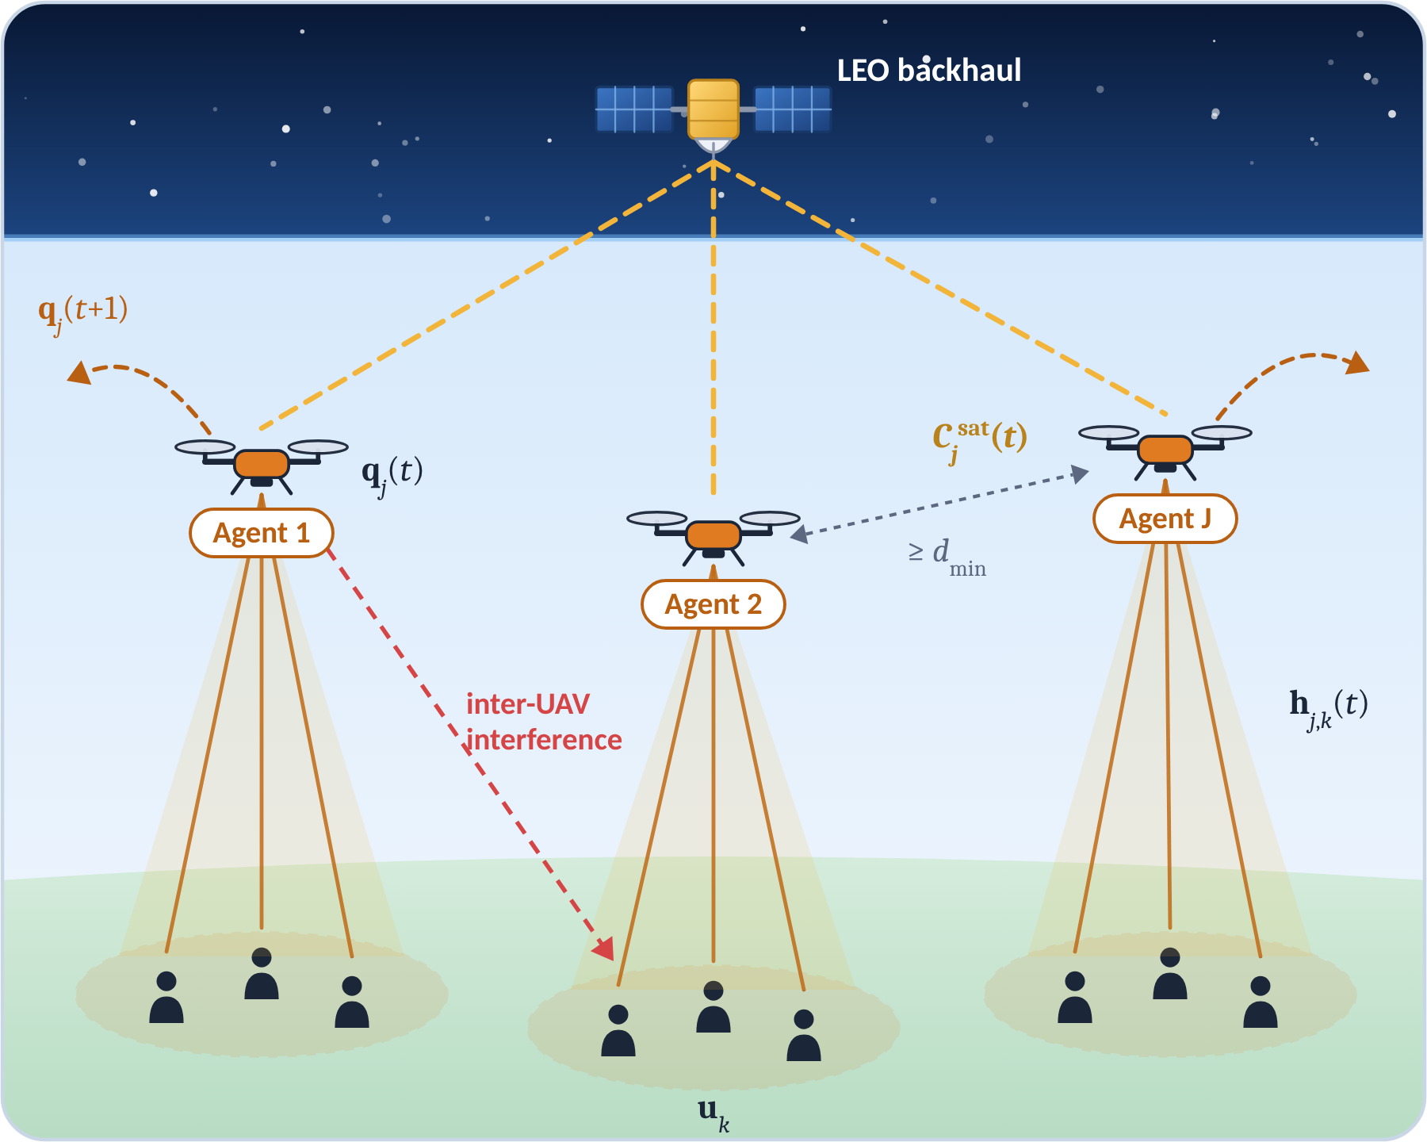
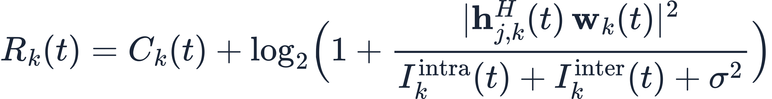
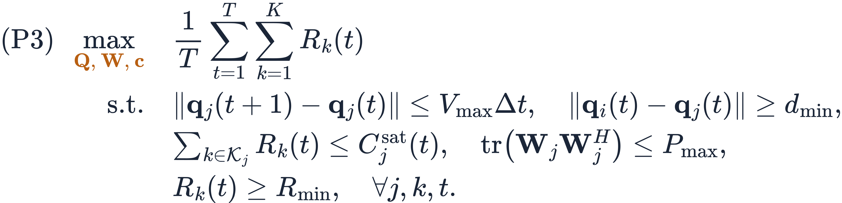
System Model
J UAVs with LEO backhaul serve K ground users with RSMA; each UAV is an agent that moves and allocates power on its own.
Air-to-ground Rician channel (d_{j,k}: UAV–user distance)
Achievable rate of user k served by UAV j
Long-term sum-rate maximization
Fig. Multi-UAV RSMA network with LEO backhaul; one agent per UAV.
Notes:
Scenario: LEO satellite provides backhaul C_j^sat(t); each UAV serves its cluster with RSMA; inter-UAV interference couples the agents. Problem (P3) is a long-term, coupled, partially observable control problem — hard for one-shot optimization, natural for MADRL.

Slide 19
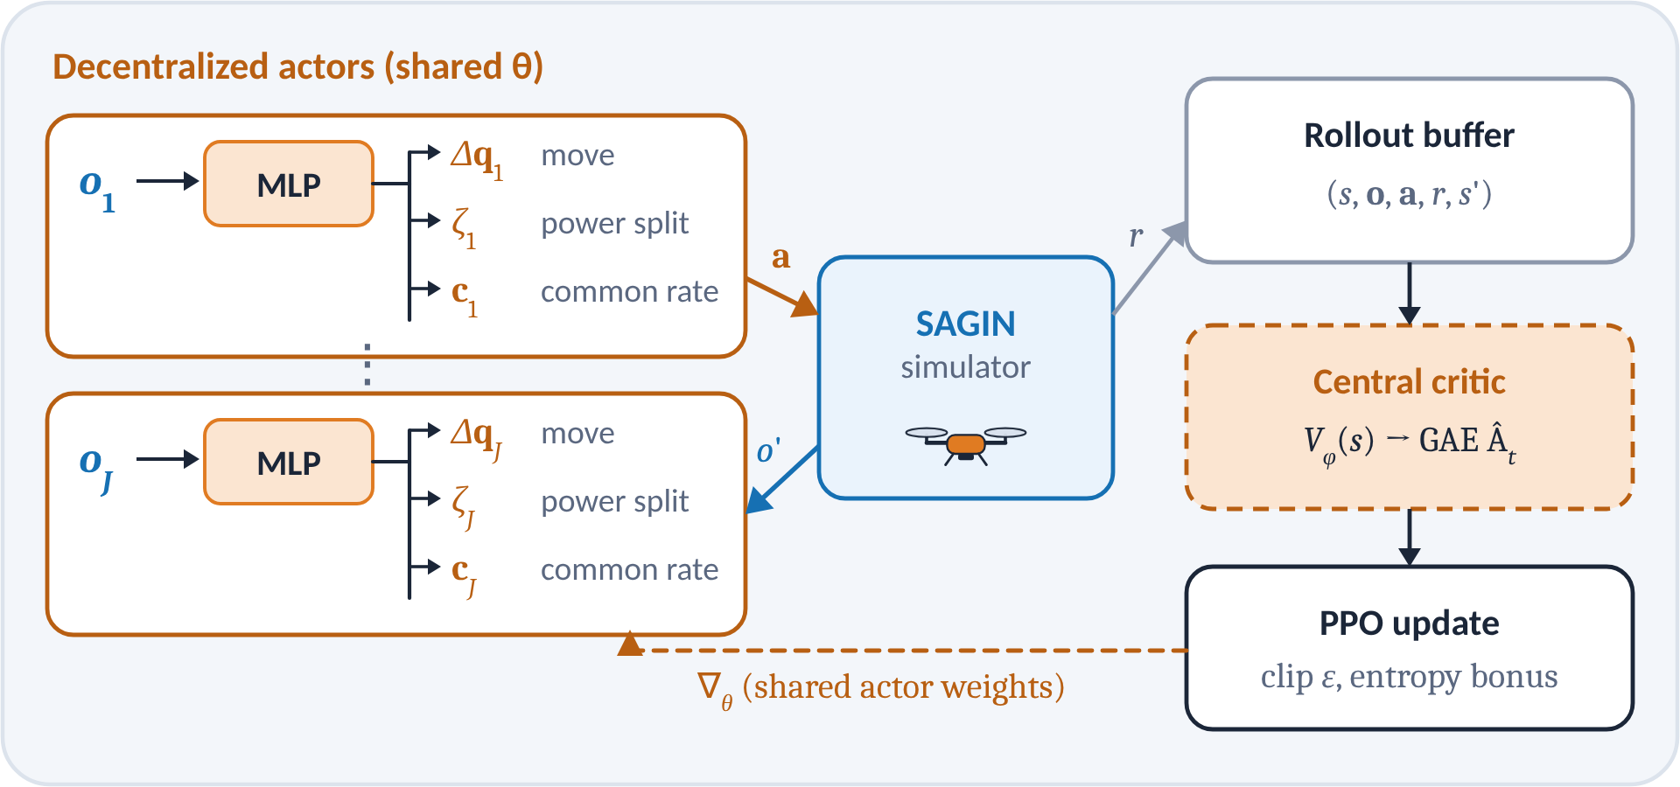
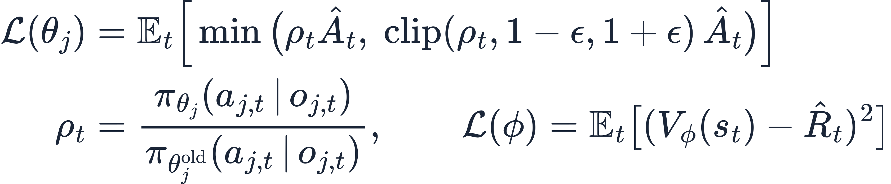
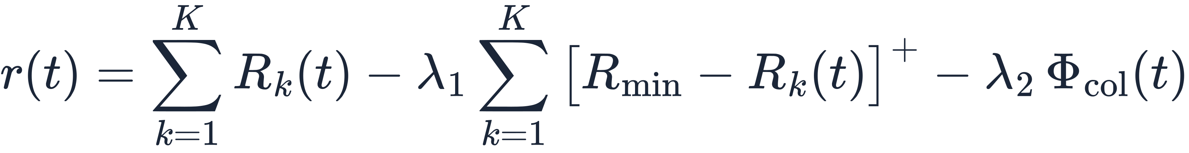
Proposed Design: MAPPO with a Centralized Critic
Recast (P3) as a Dec-POMDP and train shared actors with a centralized critic; execution needs only local observations.
Element | Design
Observation o_{j}(t) | own position q_{j}, neighbors' positions, local channel gains, backhaul C_{j}^{sat}, users' QoS backlog
Action a_{j}(t) | move Δq_{j}, common/private power split ζ_{j}, common-rate shares c_{j}
Reward r(t) | shared: sum rate minus QoS-violation and collision penalties
Training | CTDE, parameter sharing, GAE, PPO clip ε = 0.2
MAPPO actor (clipped surrogate) and critic losses
Shared reward
Execution: each UAV runs its own actor on board from local o_{j} only; the critic is dropped after training.
Notes:
Map P3 to a Dec-POMDP (table). Actors output movement, power split and common-rate shares; the critic sees the global state during training only. Mention reward shaping (QoS and collision penalties) and training tricks (parameter sharing, GAE, PPO clipping). Replace with your network sizes and hyperparameters.

Slide 20
Simulation Results
MAPPO with a centralized critic learns faster and better, and RSMA keeps adding rate when the network is overloaded.
Training convergence
Sum rate vs. number of users
Setup: J = 3 UAVs with 4 antennas, altitude 100 m, LEO backhaul, 3,000 training episodes.
ILLUSTRATIVE DATA · replace with your results
+21%
final reward vs. MADDPG
2.0×
faster to MADDPG's 90% reward level
+34%
sum rate vs. SDMA at K = 36
Notes:
Left: learning curves (average episode reward). Right: sum rate versus number of users for different multiple-access schemes. THE DATA ARE ILLUSTRATIVE (synthetic curves in src/sim_data.py); replace them and the callouts.

Slide 21



Conclusion & Future Directions
WRAP-UP
Each layer of the SAGIN has its own bottleneck, and each called for a different optimization tool.
Polarforming
Atomic receivers
MADRL + RSMA
Polarization is a new degree of freedom: joint polarforming + RSMA design removes mismatch loss and adds diversity.
Quantum front ends extend space–ground links; LO and Doppler awareness decide how much of the gain is realized.
CTDE learning steers UAV trajectories and RSMA power and rate splitting in real time, from local observations only.
Future directions
Polarization-resolved atomic receivers: polarforming meets Rydberg sensing
Integrated sensing and communication across SAGIN layers
LLM-assisted and foundation-model MADRL for network control
Hardware prototypes and over-the-air validation
Take-home: match the optimization tool to each layer's bottleneck: polarization, receiver sensitivity, or coordination.
Notes:
One takeaway per technical part, then open problems. Adapt the future directions to your own research agenda.

Slide 22
References
KEY LITERATURE
[1] J. Liu, Y. Shi, Z. M. Fadlullah, and N. Kato, “Space-air-ground integrated network: A survey,” IEEE Commun. Surveys Tuts., vol. 20, no. 4, pp. 2714–2741, 2018.
[2] Z. Zhou, J. Ding, C. Wang, B. Jiao, and R. Zhang, “Polarforming for wireless communications: Modeling and performance analysis,” arXiv:2409.07771, 2024.
[3] T. Gong et al., “Rydberg atomic quantum receivers for classical wireless communication and sensing,” IEEE Wireless Commun., 2025 (arXiv:2409.14501).
[4] M. Jing et al., “Atomic superheterodyne receiver based on microwave-dressed Rydberg spectroscopy,” Nature Physics, vol. 16, pp. 911–915, 2020.
[5] Y. Mao, B. Clerckx, and V. O. K. Li, “Rate-splitting multiple access for downlink communication systems: Bridging, generalizing, and outperforming SDMA and NOMA,” EURASIP J. Wireless Commun. Netw., art. 133, 2018.
[6] Y. Mao, O. Dizdar, B. Clerckx, R. Schober, P. Popovski, and H. V. Poor, “Rate-splitting multiple access: Fundamentals, survey, and future research trends,” IEEE Commun. Surveys Tuts., vol. 24, no. 4, pp. 2073–2126, 2022.
[7] R. Lowe et al., “Multi-agent actor-critic for mixed cooperative-competitive environments,” in Proc. NeurIPS, 2017.
[8] C. Yu et al., “The surprising effectiveness of PPO in cooperative multi-agent games,” in Proc. NeurIPS Datasets and Benchmarks Track, 2022.
[9] M. Cui, Q. Zeng, and K. Huang, “Towards atomic MIMO receivers,” arXiv:2404.04864, 2024.
Notes:
Key references cited on the slides. Add your own papers here (and cite them on the Part II–IV slides).

Slide 23
Thank You
Questions & discussion
Miao Zhang · your.email@university.edu
Department / Laboratory, University
Notes:
Closing slide. Replace the contact details.

