Slide 1
Bond Price Study
Jiahao Zhang
Presenting to
Wells Fargo

Slide 2

Bond Characteristics
Corporation and government issue bonds to raise money from society.
Fix income instrument.
It has a mature date when principal part (face value) will be paid back.
Bond prices are sensitive to interest rates.

Slide 3
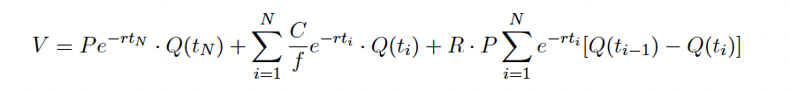




Bond Pricing Model
expectation value of buying price when bond matures.
all the future bond coupon rewards discounting to the presenting time.
Bond got default between Q(t_{i-1}) and Q(t_{i})
Bond Default?
Pay Recycling.
Pay Principle
$$t_{0}$$
$$t_{i}$$
Bonds Mature
Discount all the future paid money into present is the price of the bond
Pay Coupon

Slide 4
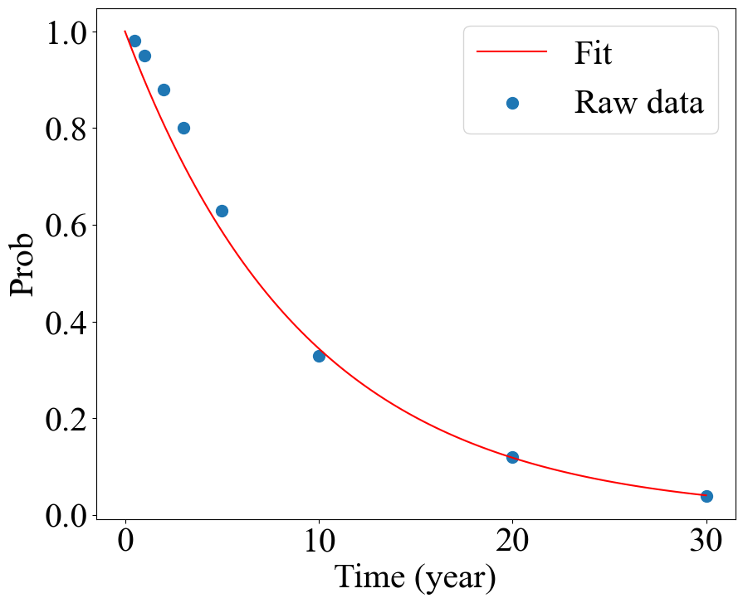
Survival Rate fitting
The function is an exponential distribution.
Fitting P = Exp(-a t), R²=0.997

Slide 5
Bond Price as Coupon rate and Mature years
Bond price increase as function of coupon rate.
Bond price increase insignificantly with paying frequency.
Low coupon rate, bond price decrease as year increase. Because the default risk term dictates.
High coupon rate, bond price increase as year increase. Because coupon payment term dictates.

Slide 6
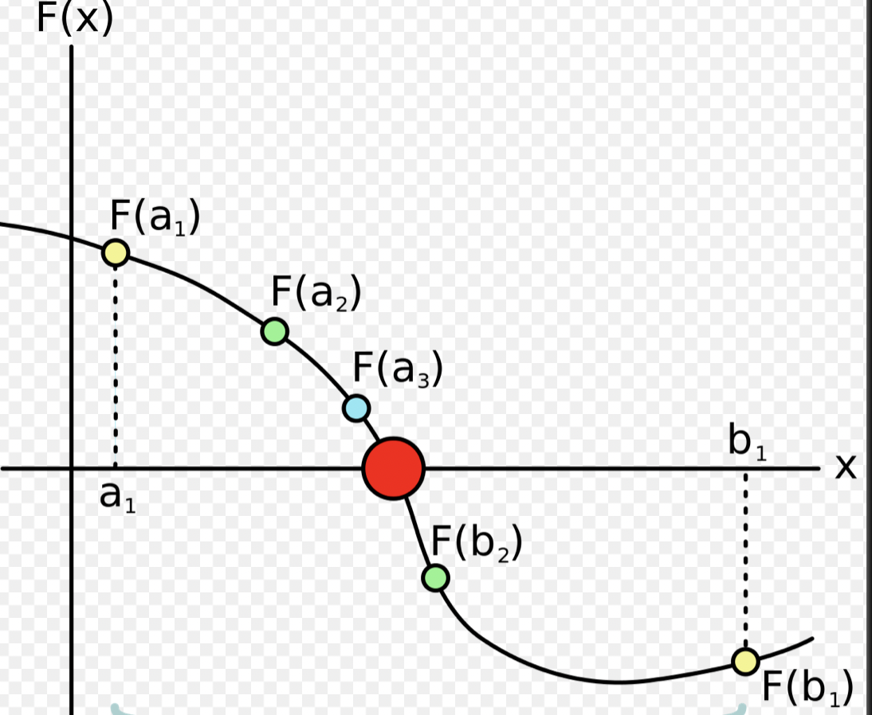
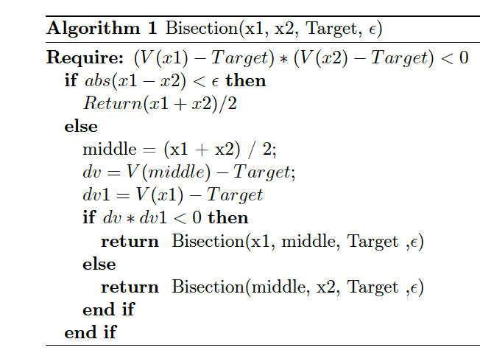
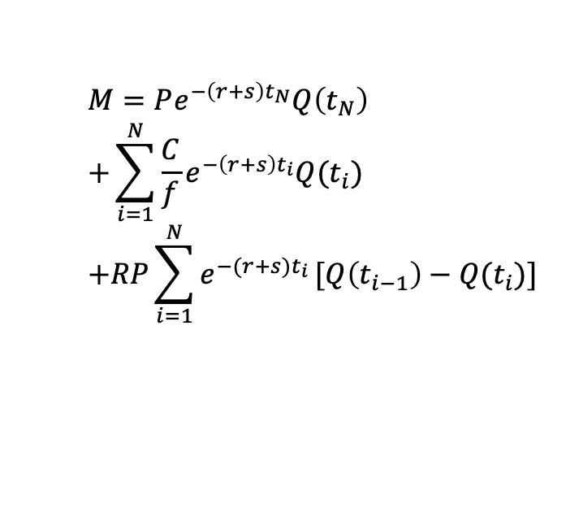
Calibration
$$M=Pe^{−\left(r+s\right)t_{N}}Q\left(t_{N}\right) \\ +\sum_{i=1}^{N}{\frac{C}{f}e^{−\left(r+s\right)t_{i}}Q(t_{i})} \\ +RP\sum_{i=1}^{N}{e^{−(r+s)t_{i}}}[Q\left(t_{i−1}\right)−Q(t_{i})]$$
One year bond with 3% paid semi-annually with market quota = 102
The price quoted in the market may not be the same as the model predicted, we need to calibrate the rate r according to the market price.
Binary search finding the root
The Market think the interest rate is not 3%, instead it’s -5.4% (s = -8.4%)

Slide 7
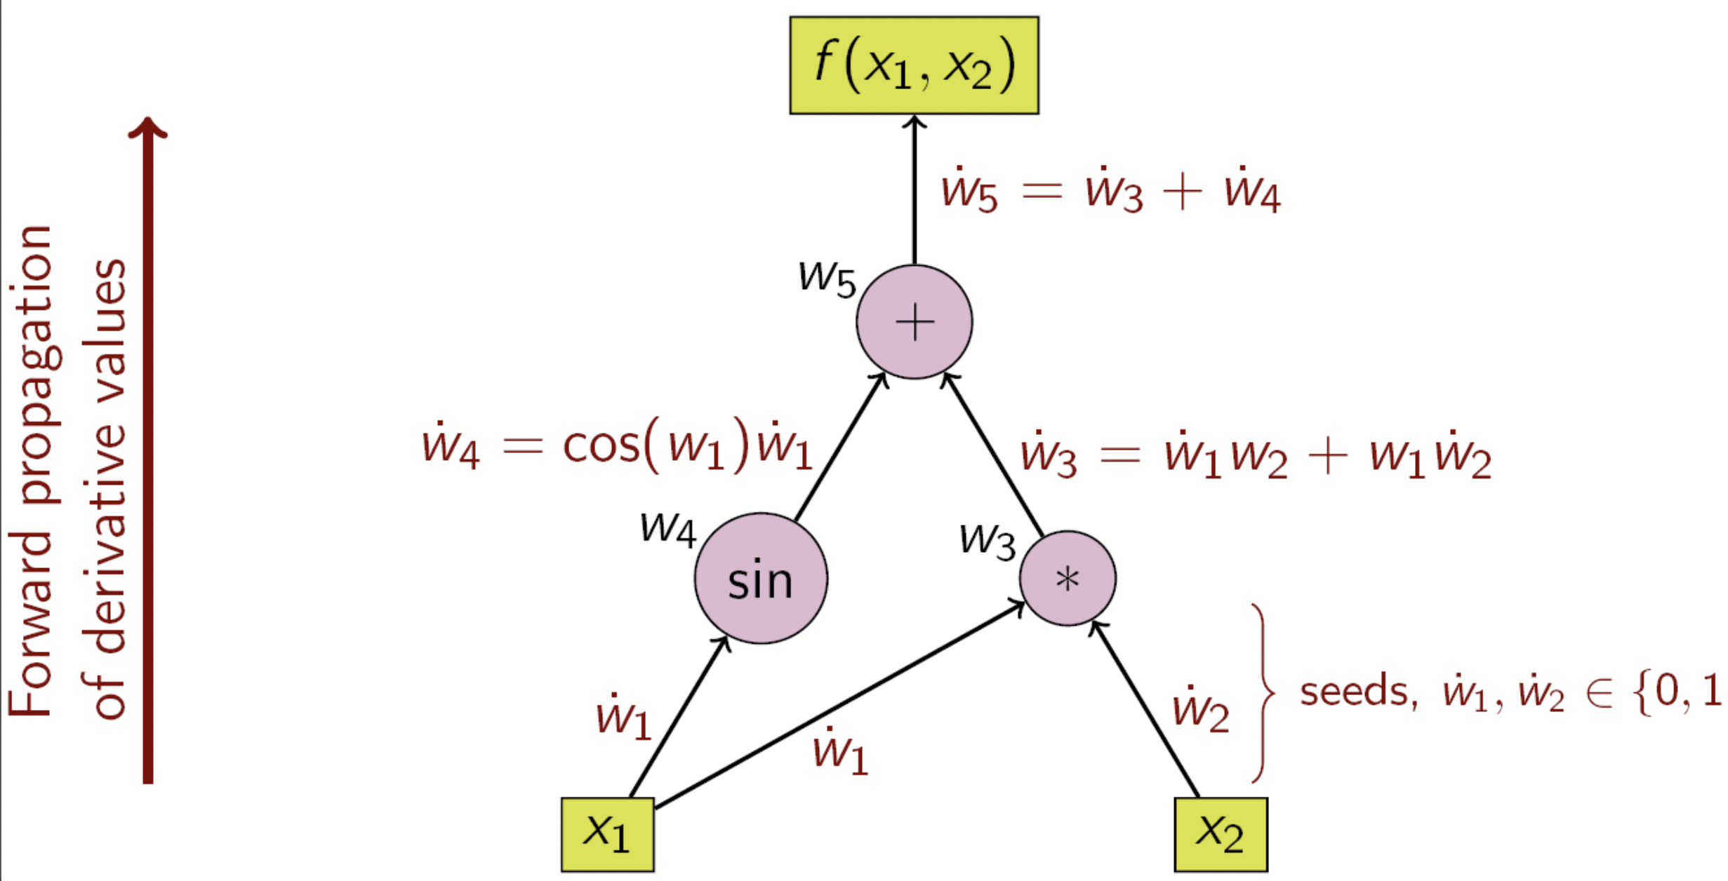
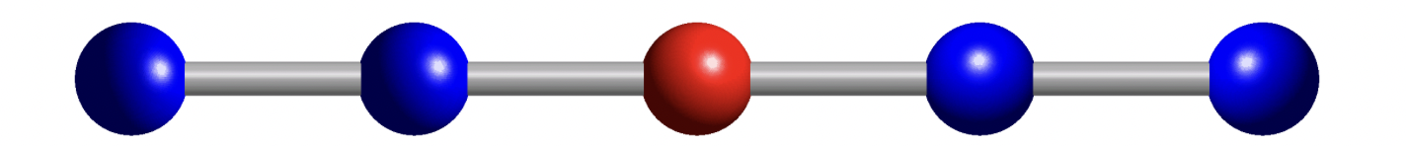
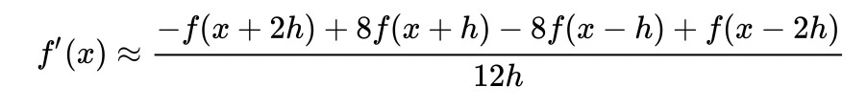


Numerical Differentiation
Five stencil
Automatic differentiation
Automatic differentiation doesn’t have numerical instability.
Differentiation over mathematical operator through computer graphics.
1- year bond with 3% coupon paid semi-annually( f = 2 ).

Slide 8
Bond Sensitivity as Coupon rate and Mature years
Maxima doesn’t exist
Depending on the coupon rate, you can see a maxima or not.
Maxima exists

Slide 9
Conclusion
We have implemented the bond price analysis model to predict the bond price.
We have found bond survival rate is a exponential distribution function of time.
We have found the bond price sensitivity has a maximum with respect to mature time. When coupon rate is small. This is contrast conventional understanding that long term bond is more sensitive to interest rate.

