Slide 1




Eamonn Keogh
Taposh Dutta Roy
The HexagonML/UCR Time Series Anomaly Detection Contest at SIGKDD 2021

Slide 2
Outline
The need for the contest
The rationale for the contest design
Creating the datasets
Brief overview of the results, what techniques did people use?
Flaws in the contest
The winners!
Fifth Place, Honorable Mention
Tied Third Place, $500 USD
Tied Third Place, $500 USD
Second Place, $1,000 USD
First Place, $2,000 USD
Concluding remarks

Slide 3
The Rationale for the Contest I
In the past 4 or 5 years, there has been an explosion of papers on time series anomaly detection.
The vast majority of these papers use one or more of datasets created by Yahoo, Numenta, SMAP (NASA), MSL (NASA), SDM (“OMNI” Pei’s Lab ), MBA-ECG (Boniol) or SWAT.
However, all these datasets suffer from at least one of the following flaws¹.
Triviality: Can be solved with decade old ideas, using as little as a single line of code.
Mislabeling: Both false negative and false positives in the claimed ground truth.
Run-to-failure bias: Just guessing the last datapoint is an anomaly works very well.
Unrealistic anomaly density: Up to 50% of the data are anomalous.
In addition, many papers are using inappropriate scoring methods
Spurious precision that gives the illusion of significance. You got found 2 out of 3 anomalies, great. But should you really report 0.66667?
Overcounting successes. If Xmas day is the only anomaly in your hourly recorded dataset, and you do find it, is that a single success, or 24 successes? Surely that should only be counted as a single success.
¹Wu and Keogh: Current Time Series Anomaly Detection Benchmarks are Flawed and are Creating the Illusion of Progress.

Slide 4
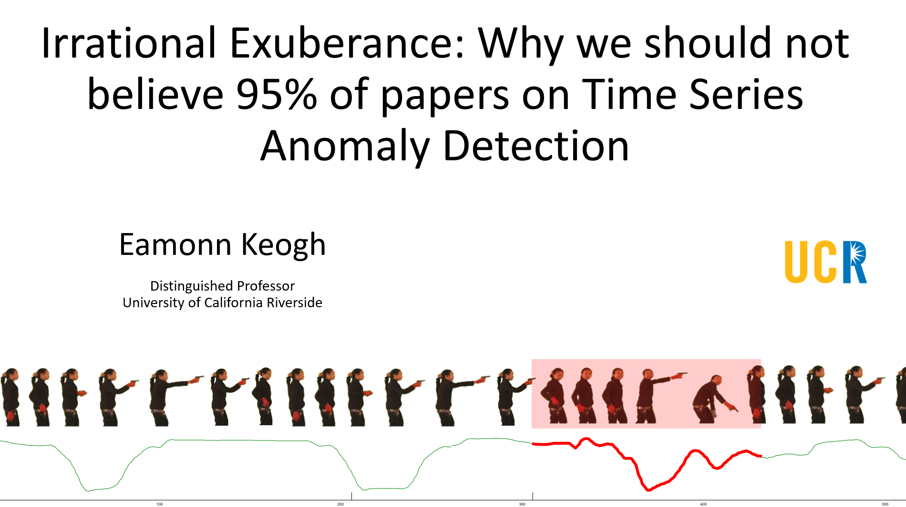
If you want to learn more about the problems with the existing datasets, please see my talk later this week
W26A: 7th SIGKDD Workshop on Mining and Learning from Time Series (full day - A)

Slide 5
The Rationale for the Contest II
Given the previously noted issues, we ask if we could we create a better data collection?
Avoiding Triviality, Mislabeling, Run-to-failure bias and Unrealistic anomaly density (some “trivial” datasets are OK to have a spectrum of difficulty).
Avoid issues in scoring by making the discovery of an anomaly be a binary event.
Have lots of datasets, so the sum of many binary events is a real number (the percentage correct) that discriminates among competing ideas.
Some algorithms may be biased to predict the beginning or the end of an anomaly. In any case, the exact beginning or end might not be well defined. Let's bypass the issue, by adding some “slop” before and after the anomaly. This barely effect the default rate and avoids penalizing otherwise very accurate algorithms.
True anomaly is in yellow region, but prediction in any part of the highlighted region is marked as correct.

Slide 6
The Rationale for the Contest Design
Anomaly discovery methods typically have two parts
(a) finding the region(s) most likely to be an anomaly
(b) using some “threshold” to predict if it really is an anomaly.
We may be wrong, but we see ‘a’ as being the hardest part of the challenge. In any case, ‘b’ can sometimes depend on some out-of-band information.
We can completely remove the ‘b’ question by having exactly one anomaly per dataset, and telling people there is exactly one anomaly per dataset.
If we do have binary scores per dataset, we are going to need to have lots of datasets, in order to have discrimination among teams.
How do we get lots of datasets?? (next slide)

Slide 7
Getting Datasets
We posted a call for datasets in Reddit/ML and in Dbworld
We wrote to essentially everyone that published a paper in SIGKDD, ICDM, ICDE, SDM, VLDB, SIGMOD, NeurIPS in the last five years, on the topic of time series anomaly detection¹.
We wrote to essentially everyone that cited Yahoo, Numenta, SMAP, MSL, SDM, MBA-ECG SWAT (using Google scholar).
These efforts yielded zero datasets.
Thus, Dr. Keogh created the datasets himself (with some help from his students)
¹To be fair, we might have missed a paper or two, and we did not aggressively pursue bounce emails etc.

Slide 8
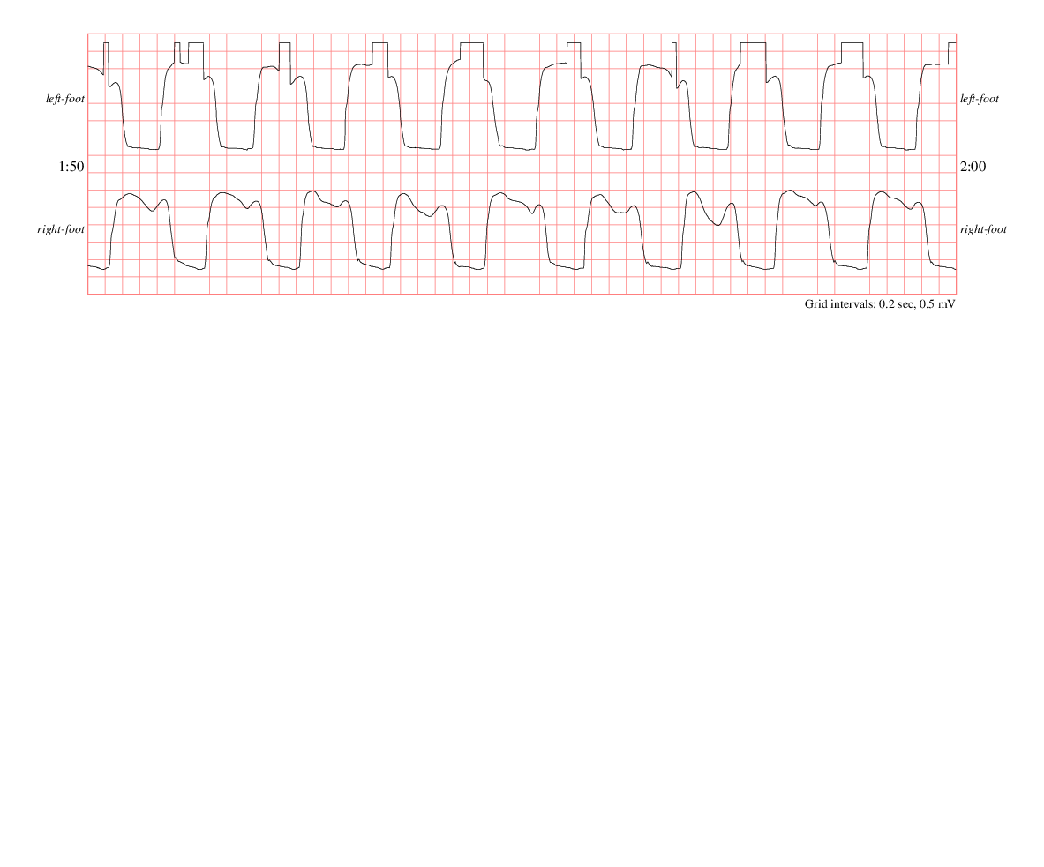
How do we know that there is only one anomaly per dataset?
Let us show you one example
This original dataset comes from someone walking on a force plate in a biomechanics lab. The individual had a mostly symmetric gait, however, after some time, the left foot sensor developed a fault.
This allows us to create an almost 100% natural dataset. We simply took faulty data from the left foot, and used it to replace two cycles of right foot data. We shifted it by a half cycle, slightly smoothing it to remove cut and paste artifacts.
Thus, this dataset is almost completely natural, and we can state with high confidence, that there is just one anomaly.
Fault in left sensor
500
0
-500
-1000
-1500
-2000
500
0
500
1000
1500
0
-500
UCR_Anomaly_gaitHunt2_18500_31200_31850.txt
-1000
-1500
-2000
0
1
2
3
4
5
6
7
4
10

Slide 9
The Contest
There were 193 teams, but a handful were placeholders or test submissions of some kind.
176 teams are real, they made at least one submission that was statistically significantly better than default rate.
Of the top ten entries, seven came from Chinese or Japanese companies, only three came from universities.
There have been a few dozen top-tier (SIGKDD,ICDM,ICDE,VLDB,SIGMOD etc.) papers on deep learning anomaly detection in time series in the last three years. But almost none of these groups competed¹, and the few that did, did not place well.
It does not appear that any of the USA big tech (Google, Facebook, Amazon, IBM, Microsoft, Apple, Oracle) took part, at least not officially. This is surprising, as some have products in this space, and they surely all have at least internal tools for this.
Dr Keogh strongly discouraged his extensive co-authorship network from participating.
¹We tried to email as many such teams as possible, to invite them to compete. They may have competed under other names, as they changed jobs or graduated etc.

Slide 10
The Results
If we plot the accuracy of the top 100 performers sorted by rank, and fit a line to it, there is some visual evidence of the top-ten doing “better than expected”.
90
80
70
60
Accuracy (%)
50
40
30
20
10
0
10
20
30
40
Rank
50
60
70
80
90
100

Slide 11
What Approaches did the Teams Try?
We will only give terse, high-level debriefing of what worked well, based on a voluntary debrief paragraph we asked teams to write.
We hope the high placing teams themselves write papers/blogs/patents, release code etc. They are in the best position to tell their story.
(it would be great for a low performing team to write a sort of “Five things we tried, but did not work” paper)

Slide 12
High Level Summary of what the Teams used
In the brief (user supplied) description of the top five approaches, we had: (mentions are not necessarily exclusive)
Four mention time series discords (in the broadest sense)
One mention deep learning (in the broadest sense)
Four mention ensembling multiple methods (in the broadest sense)
One mention Outlier Factor
One mention data augmentation
In the brief description of sixth to tenth approaches, we had:
Three mention time series discords
Two mention deep learning
Four mention ensembling multiple methods
In the brief description of fourteen approaches ranked from 11 to 95:
Nine mention time series discords
Three mention deep learning
Four mention ensembling multiple methods
Two mention Outlier Factor

Slide 13
Debrief Notes
The most commonly listed pain points for the top performers
How to set some parameters, especially subsequence length (more than half the teams mentioned this)
How to ensemble (weight/rank) multiple algorithms (again, the majority of teams mentioned this)
Only three of the top ten performers explicitly mention a change of representation
One use derivatives of the data (along with the original data)
One used the ROCKET transform
One used FFT (along with the original data)
Informally, it seems that most teams used…
Some preprocessing of the data (smoothing, change of representation etc.)
Used multiple algorithms, then…
Some post-processing of the results (“ensembling” in its most general sense)
…and it seems that that these pre/post processing steps are very important in boosting accuracy.

Slide 14
Flaws in the Contest
One file (out of 250) was mislabeled. Fixed for future reference
It would be better to have many people create/donate datasets, to prevent bias towards one person’s interests/access to data etc.
For about 90% of the datasets, visual inspection allowed users to find the true anomalies. Moreover, it seems that almost teams did this, and used that information in tuning their models. Thus, the results may be a little optimistic.
It would have been better to hide the test data, making people submit code that we ran on the test data. We did not do this because it is logistically tricky to do.
We did batch anomaly detection, which is sometimes useful. But clearly online anomaly detection is much more useful.
(We welcome other corrections and suggestions offline)

Slide 15
Now the winners!
Fifth Place, Honorable Mention
Tied Third Place, with two teams, $500 USD
Second Place, $1,000 USD
First Place, $2,000 USD

Slide 16


In 5th Place: AIST AI Research Center (AIRC)
Approach:
He calculated multiple non-negative anomaly scores using a sliding window
to deal with various lengths and types of anomalies.
Based on the precondition that every time series has exactly one anomaly,
he selected the anomaly score with the most prominent peak in the test data
from among the multiple scores.
Noteworthy is the anomaly scores calculated using the Matrix Profile (MP),
which are normalized based on the Local Outlier Factor (LOF) concept.
Genta Yoshimura
This work is based on results obtained from a project, JPNP20006, commissioned by the New Energy and Industrial Technology Development Organization (NEDO).
Contact: yoshimura.genta@aist.go.jp

Slide 17




In tied 3rd Place: Hikvision Research Institute
Approach: They combined the Deep One-Class Classification approach and the Outlier Exposure approach together by
applying data augmentations to create synthetic outliers and
exposing the anomaly detector to these outliers to teach the network better representations for anomaly detection.
They designed more than 10 kinds of data augmentations for time series data and used 1d convolutional neural network (CNN) to extract features from time series.
Kebing Xue
Jia Tan
Haiming Sun
Contact xuekebing@hikvision.com

Slide 18





In tied 3rd Place: Hitachi America. R&D
Approach: They created a compound model consisting of two submodules respectively for 1) anomalous cycles with uncommonly nosier data and 2) anomalous cycles whose shape is different compared with the normal cycles. They used a smoothness score to mark nosier cycles. When detecting cycles with anomalous shapes, they proposed an ensemble strategy to handle the hyperparameters in Dynamic Time Warping distance-based anomaly detection methods. They also designed an automated function that examines the time series and maps each time series to a submodule to detect the anomaly.
Qiyao Wang
Wei Huang
Ahmed Farahat
Haiyan Wang
Contact qiyao.wang@hitachi.hal.com

Slide 19




In 2nd Place: Huawei Noah’s Ark Lab
Approach: They applied a set of algorithms, each specialized on a specific type of anomaly (discrete, spike, discord, variance, etc.), in a fixed order until a confident prediction was made. Those algorithms that focused on easier anomaly types and those that were more conservative were used first. The key components were period inference (individual algorithm parameters were mostly based on the period), confidence level computation and thresholding, and ensemble learning.
Marcus Kalander
Sixiao Yang
Contact marcus.kalander@huawei.com

Slide 20




In 1st Place: DeepBlueAI
Approach: They used an ensemble of Fourier Transformation based methods, Matrix Profile and prediction-based models (LightGBM, Dilated CNN). The period of each time series signal is automatically detected based on the peaks and troughs. Ensemble weights of models are determined by the degree of confidence (the ratio of the first and second highest peaks of the residual calculated from each model).
Zhixing He
Xu Zhang
Jin Wang
Contact hezhx@deepblueai.com

Slide 21
Congratulations to all Participants!
We expect to see several interesting papers come out of this contest
We will make the datasets publicly available in perpetuity for the community.
Thanks to folks at hexagon-ml for administrative work, and to Keogh’s students for help with the data, and the dozens of independent researchers (going back decades) that created the original datasets.
The datasets will be archived at subpage of www.cs.ucr.edu/~eamonn/time_series_data_2018/

Slide 22
Thanks for your Attention!
The datasets will be archived at subpage of www.cs.ucr.edu/~eamonn/time_series_data_2018/

