Slide 1




A
B
Existing Paradigm
ISR(Ours)
Generate code
LLM Self-Assessment
Self-correct
External Safety Classifier
LLM
Iterative Repair

Slide 2
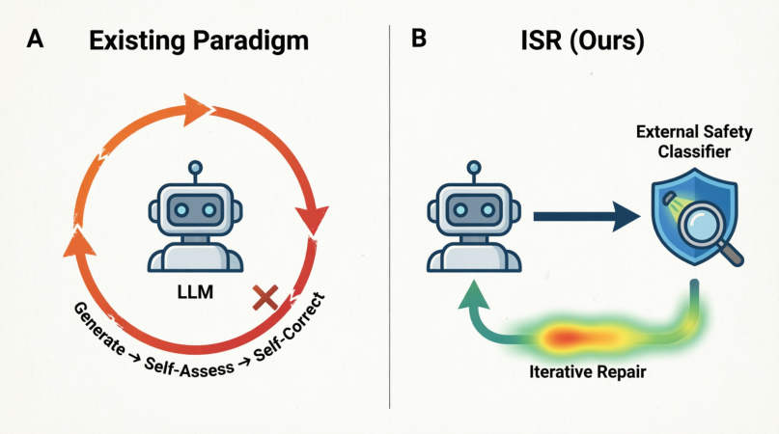

Slide 3
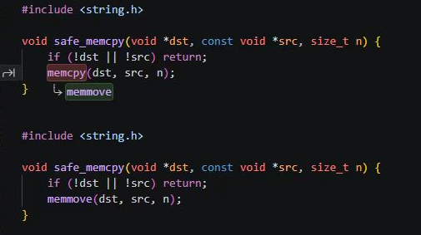
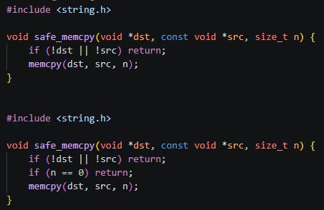
ISR-2 Real Attention
ISR-random Random Attention
Attn=0.92
Random Attention
√
×

