Slide 1
Indexing (B+ Trees)
based on lecture notes by Hector Garcia-Molina

Slide 2
Indexing & Hashing
value
record
?
value

Slide 3
Topics
B-trees
Hashing schemes

Slide 4
Outline:
B-Trees ⇒ NEXT
Hashing schemes

Slide 5
B+Tree Example n=3
Root
100
30
120
150
180
3
5
11
30
35
100
101
110
120
130
150
156
179
180
200

Slide 6
Sample non-leaf
57
81
95
to keys to keys to keys to keys
< 57 57≤ k<81 81≤k<95 ≥95

Slide 7
Sample leaf node:
From non-leaf node
to next leaf
in sequence
57
81
95
To record
with key 57
To record
with key 81
To record
with key 85

Slide 8
In textbook’s notation n=3
Leaf:
Non-leaf:
30
35
30
35
30
30

Slide 9
Size of nodes: n+1 pointers
n keys
(fixed)

Slide 10
Don’t want nodes to be too empty
Use at least
  Non-leaf: ⎡(n+1)/2⎤ pointers
  Leaf: ⎣(n+1)/2⎦ pointers to data

Slide 11
n=3
Full node min. node
Non-leaf
Leaf
120
150
180
30
3
5
11
30
35
counts even if null

Slide 12
B+tree rules tree of order n
(1) All leaves at same lowest level (balanced tree)
(2) Pointers in leaves point to records except for “sequence pointer”

Slide 13
(3) Number of pointers/keys for B+tree
Max Max Min Min
ptrs keys ptrs→data keys
Non-leaf
(non-root)
n+1
n
⎡(n+1)/2⎤
⎡(n+1)/2⎤- 1
Leaf
(non-root)
n+1
n
⎣(n+1)/2⎦
⎣(n+1)/2⎦
Root
n+1
n
1
1

Slide 14
Insert into B+tree
(a) simple case
  space available in leaf
(b) leaf overflow
(c) non-leaf overflow
(d) new root

Slide 15
(a) Insert key = 32
n=3
100
30
3
5
11
30
31

Slide 16
(a) Insert key = 32
n=3
100
30
3
5
11
30
31
32

Slide 17
(a) Insert key = 7
n=3
100
30
3
5
11
30
31

Slide 18
(a) Insert key = 7
n=3
100
30
3
5
3
5
11
30
31
7

Slide 19
(a) Insert key = 7
n=3
100
30
7
3
5
3
5
11
30
31
7

Slide 20
(c) Insert key = 160
n=3
100
120
150
180
150
156
179
180
200

Slide 21
(c) Insert key = 160
n=3
100
120
150
180
150
156
179
160
179
180
200

Slide 22
(c) Insert key = 160
n=3
100
120
150
180
180
150
156
179
160
179
180
200

Slide 23
(c) Insert key = 160
n=3
100
160
120
150
180
180
150
156
179
160
179
180
200

Slide 24
(d) New root, insert 45
n=3
10
20
30
1
2
3
10
12
20
25
30
32
40

Slide 25
(d) New root, insert 45
n=3
10
20
30
1
2
3
10
12
20
25
30
32
40
40
45

Slide 26
(d) New root, insert 45
n=3
10
20
30
40
1
2
3
10
12
20
25
30
32
40
40
45

Slide 27
(d) New root, insert 45
n=3
30
new root
10
20
30
40
1
2
3
10
12
20
25
30
32
40
40
45

Slide 28
Deletion from B+tree
(a) Simple case - no example
(b) Coalesce with neighbor (sibling)
(c) Re-distribute keys
(d) Cases (b) or (c) at non-leaf

Slide 29
(b) Coalesce with sibling
  Delete 50
n=4
10
40
100
10
20
30
40
50

Slide 30
(b) Coalesce with sibling
  Delete 50
n=4
10
40
100
10
20
30
40
50
40

Slide 31
(c) Redistribute keys
  Delete 50
n=4
10
40
100
10
20
30
35
40
50

Slide 32
(c) Redistribute keys
  Delete 50
n=4
10
40
100
35
10
20
30
35
40
50
35

Slide 33
(d) Non-leaf coalese
  Delete 37
n=4
25
10
20
30
40
25
26
1
3
10
14
20
22
30
37
40
45

Slide 34
(d) Non-leaf coalese
  Delete 37
n=4
25
10
20
30
40
25
26
1
3
10
14
20
22
30
37
40
45
30

Slide 35
(d) Non-leaf coalese
  Delete 37
n=4
25
10
20
30
40
40
25
26
1
3
10
14
20
22
30
37
40
45
30

Slide 36
(d) Non-leaf coalese
  Delete 37
n=4
25
new root
10
20
30
40
25
40
25
26
1
3
10
14
20
22
30
37
40
45
30

Slide 37
Complexity analysis of search
Assumption: N keys
n order or the tree
Each search requires navigating along a path
from the root to a leaf
Thus the complexity corresponds to the
height h of the tree

Slide 38
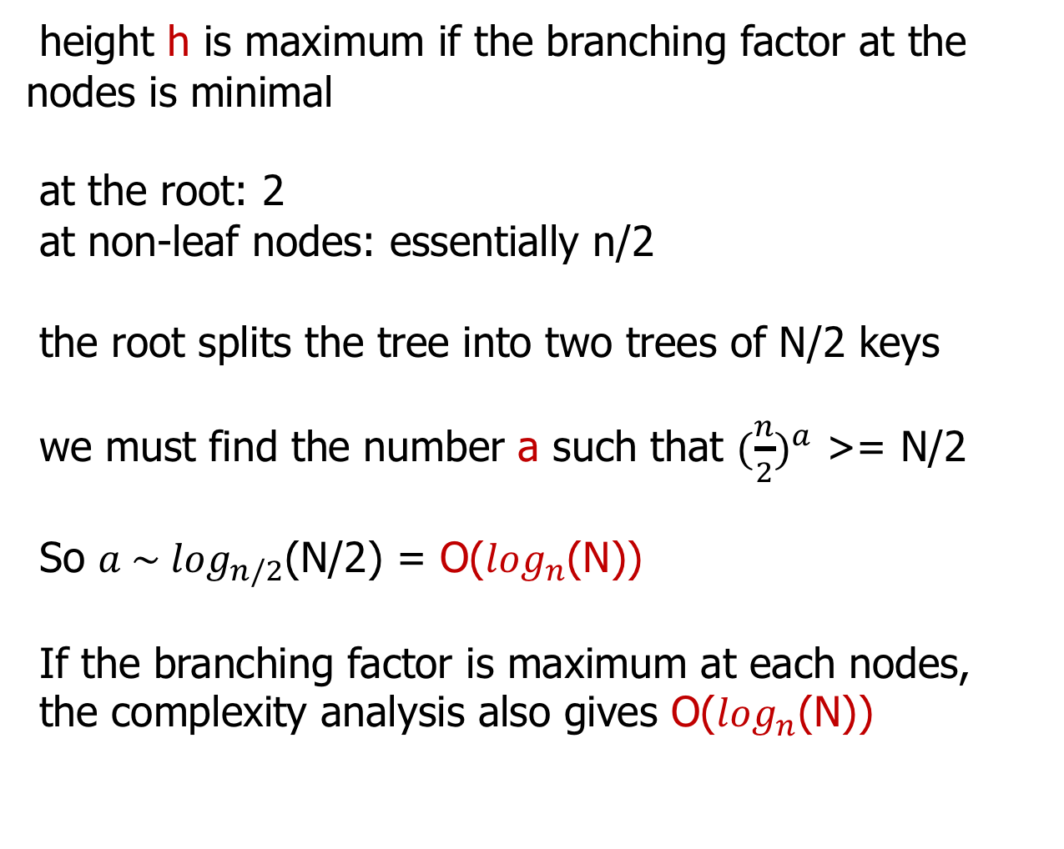

Slide 39
