Slide 1


Let's Make a Deal
deepai
Abner Zhang
https://github.com/zhangabner

Slide 2

Simulation - Monte Carlo Methods - Monte Carlo for the Monty Hall Problem
Let us assume it is A. The participant’s initial choice is either A, B or C with equal probabilities. The cumulative probabilities are shown in the table and these can be coupled with a random number to indicate the participant’s first choice.
11.<number>

Slide 3
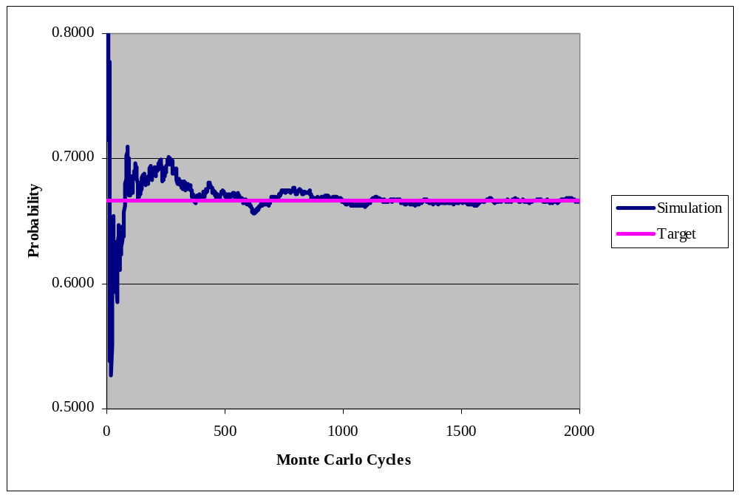
Simulation - Monte Carlo Methods - The Simulation of 2000 Cycles of the Switching Probability
11.<number>

Slide 4
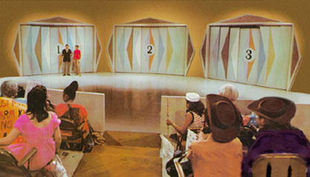
The Monty Hall Show
87% of people stay with their original selection
13% of people switch

Slide 5
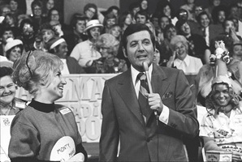
The interview with Monty Hall
non-switching strategy: 4 cars and 6 goats
switching doors: 8 cars and 2 goats
Source:http://www.nytimes.com/1991/07/21/us/behind-monty-hall-s-doors-puzzle-debate-and-answer.html?pagewanted=2

Slide 6
Change the focus on Mr. Monty
Choice and result | count | Monty
Guest is right and refuse the fool | 4 | fool
Guest is wrong and refuse the help | 6 | help
Guest is wrong but accept the help | 8 | help
Guest is right but be fooled | 2 | fool
The right chance of first guess is 1/3
The probability of help is 2/3, so take the help

Slide 7
Assumption :always offering switch choice
Based the rule, Mr. Monty can offer the switch or not , and usually not offer：
  Whenever the contestant began with the wrong door, Mr. Hall promptly opened it and awarded the goat;
  whenever the contestant started out with the right door, Mr. Hall allowed him to switch doors and get another goat.

Slide 8
The real Show:1/2 chance to offer switch
Choice and result | count | Monty
Guest is right and refuse the fool | 4 | fool
Guest is wrong and refuse the help | 3 | help
Guest is wrong but accept the help | 4 | help
Guest is right but be fooled | 2 | fool
Then the probability of help is 7/13
It all depends on his mood

Slide 9
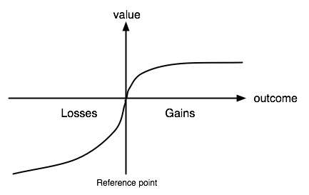
Prospect theory
Win $20000
Lose $20000

Slide 10
Mental accounting
lose and win
win and win
lose and lose
win and lose

Slide 11
What will happen to guest’s mood
win and win and defeat fool
lose and win and accept help
lose and lose and reject help
win and lose and be fooled

Slide 12
A rational Bayesian
100 times of Simulations of 30 guess
  The guess based on past result: 15.3
  The random guess: 14.9
  Based on assumption: Mr. Monty has his own mental accounting and try to keep 50% chance of “help” each month
Win $20000
Lose $20000

Slide 13
A rational Bayesian
100 Simulations of 30 guess
But suppose you are the 18 guest
  ‘Help’ * 5 + ‘Fool’ * 12, the next is help ?
  ‘Help’ * 12 + ‘Fool’ * 5, the next is help ?

Slide 14
A rational Bayesian
100 Simulations of 30 guess
But suppose you are the 18 guest
If you are offered $5,000 not to open the door?

Slide 15
A rational Bayesian
100 Simulations of 30 guess
But suppose you are the 18 guest
If you are offered $5,000 not to open the door?
How good are you at reading Monty’s mood
  write an AI to read Monty’s mood?

