Slide 1
Kentico CMS

Slide 2
1. 判断媒体类型
2. Foundation Flex Grid
3. Css stylesheet
4. Public area
5. widgets

Slide 3
1. 判断媒体类型
@media screen and (max/min-width:XXpx){}
Eg.
1. @media screen and (max-width:240px){
.box{width:500px;}
.title{color:red;}
}
2. @media screen and (min-width:240px){
.box{width:200px;}
.title{color:red;}
}
3. @media screen and (max-width: 0em), screen and (min-width: 40em) ){
.box{width:200px;}
.title{color:red;}
}
Tips: 主要分辨率 768、992、1200

Slide 4
2. Foundation Flex Grid
<div class="row">
<div class=“small-12 medium-6 large-8 column">8 columns</div>
<div class=“small-12 medium-6 large-4 column">4 columns</div>
</div>
<div class="row">
<div class=“small-12 medium-6 large-8 column">
<div class=“row”>
<div class=“small-12 medium-6 large-8 column">8 columns</div>
<div class=“small-12 medium-6 large-4 column">4 columns</div>
</div>
</div>
<div class=“small-12 medium-6 large-4 column">2 columns</div>
</div>
tips:

Slide 5
3. Prime Css stylesheet
Foundation – response
Hamburgers – medium NAV
Mmenu – medium NAV
Phishing-quiz, SW_SM – Phishing-quiz
Sonicwall_prime – Prime css after foundatio

Slide 6
4. Public area
Foundation (flex grid) – header, body, footer
Top navigation – foundation sticky effect
Medium nav – hamburgers + mmenu

Slide 7
Foundation sticky
<div data-sticky-container="" class="sticky-container" style="height: 92px;"> <div class="title-bar sticky is-at-top" data-sticky data-options="marginTop:0;" data-events="resize" id="main-menu"> <div class="title-bar-left"> <span class="title-bar-title">Sticky Navigation</span> </div> <div class="title-bar-right"> <ul class="dropdown menu align-right" data-dropdown-menu="ucwxka-dropdown-menu" role="menubar"> <li role="menuitem"><a>Item 1</a></li> <li role="menuitem"><a href="#">Item 2</a></li> </ul> </div> </div>
</div>
<div class="column row" id="root"> <h3 class="text-center">Creating a sticky Nav Menu with Title Bar, DropdownMenu, and Sticky!</h3> <div class="callout primary"> <p class="lead">It's important to note that sticky requires a bit of developer input to work properly. To create a sticky nav bar like this one, set the nav container width to 100%. It's also important to set the minimum top-anchor point to 1px, otherwise it'll never stick!</p> <p>Here we're also having a bit of fun with transitions using event triggers from the sticky plugin. When the nav bar becomes sticky, it emits <code>sticky.zf.stuckto:top</code>, which we're listening to. Then we're adding a class to reduce the height and top padding of our nav bar.</p> </div>
</div>

Slide 8
5. widgets

Slide 9
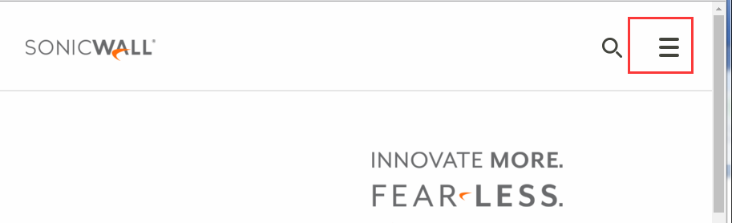
hamburgers
https://jonsuh.com/hamburgers/

Slide 10
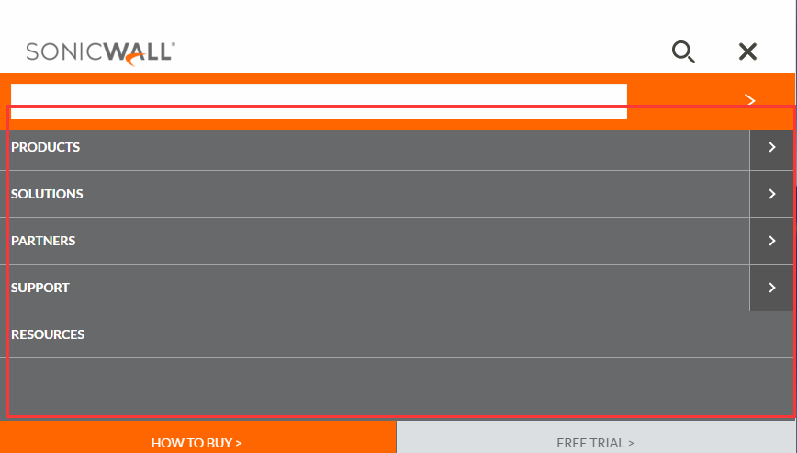
Mm-menu
http://mmenu.frebsite.nl/examples.html

