Slide 1
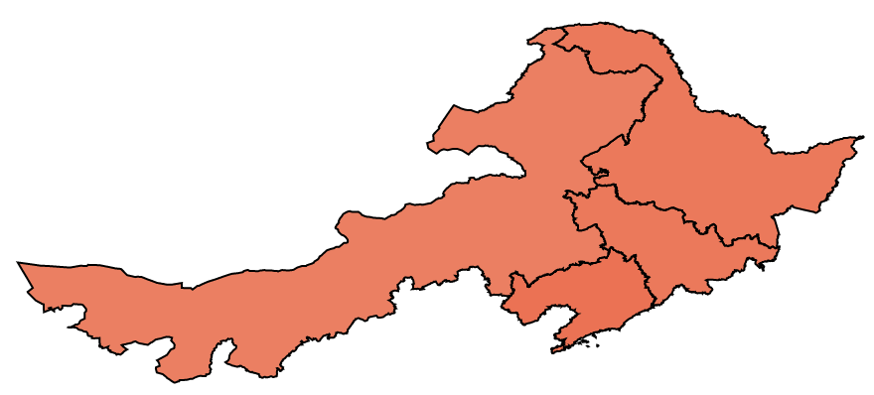


Narrow Range
Full Range

Slide 2
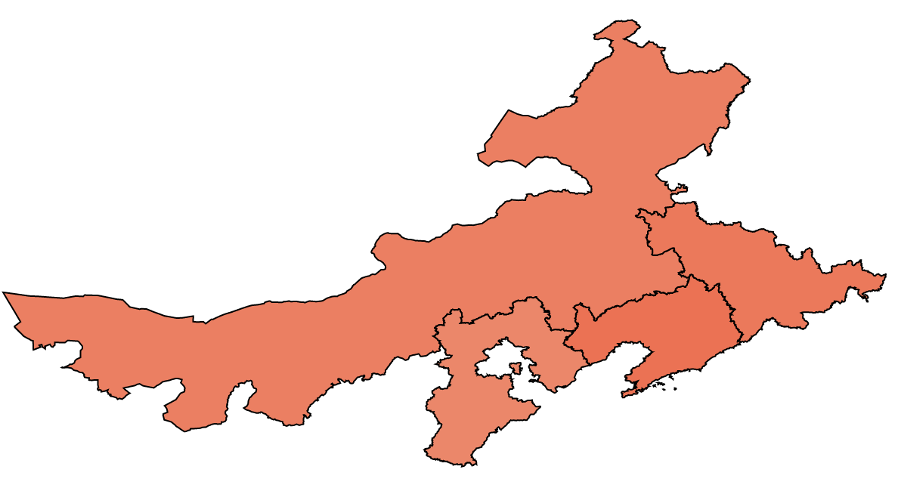

Narrow Range
Full Range

Slide 3
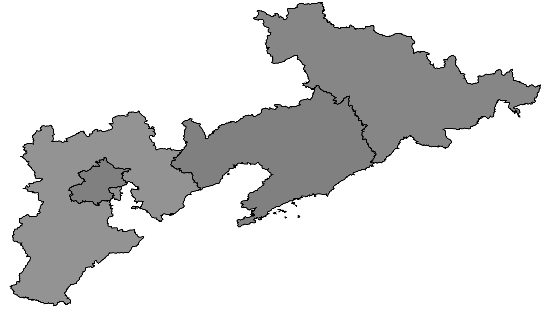


Narrow Range
Full Range

Slide 4
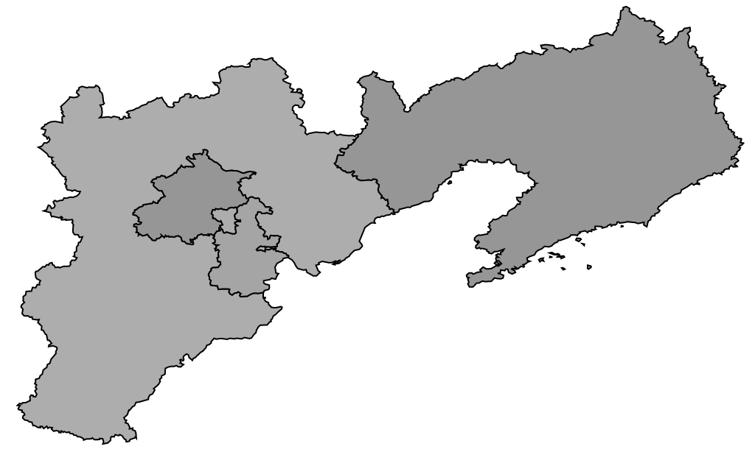


Narrow Range
Full Range

Slide 5
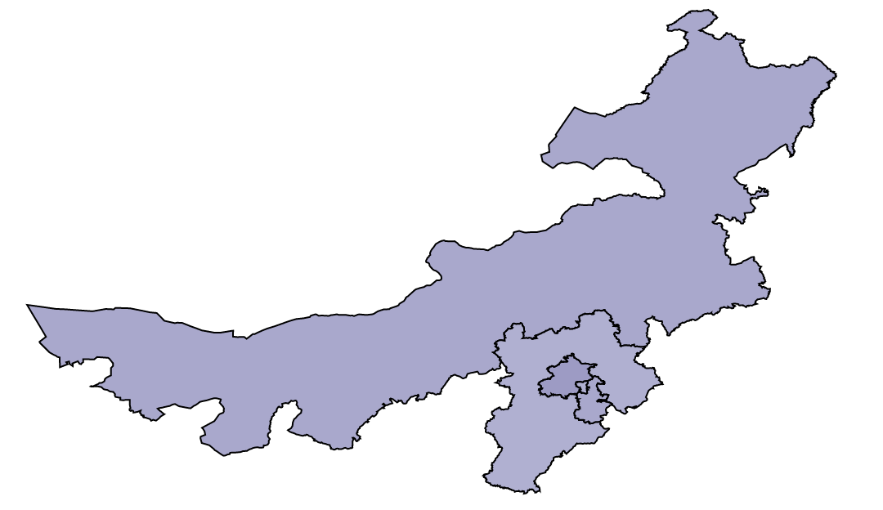


Narrow Range
Full Range

Slide 6
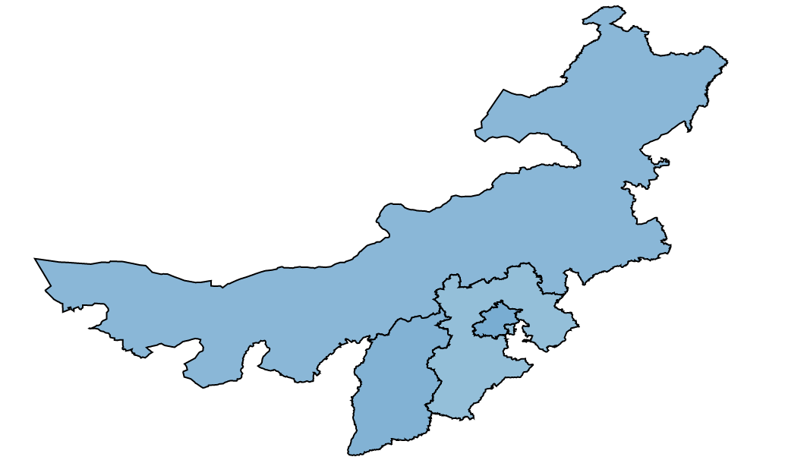


Narrow Range
Full Range

Slide 7
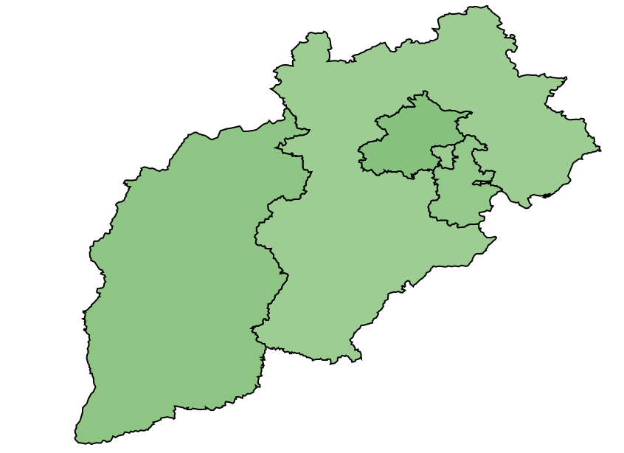


Narrow Range
Full Range

Slide 8
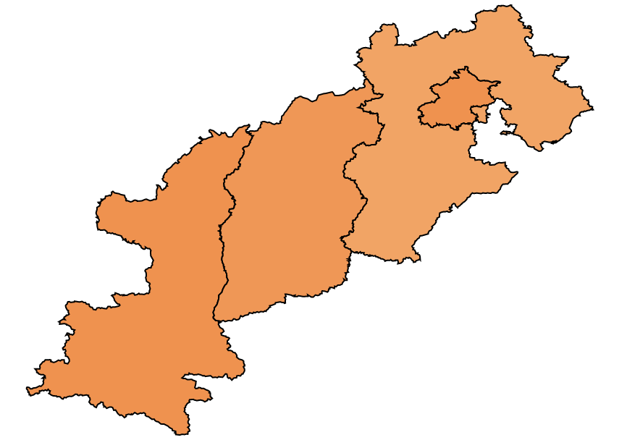


Narrow Range
Full Range

Slide 9
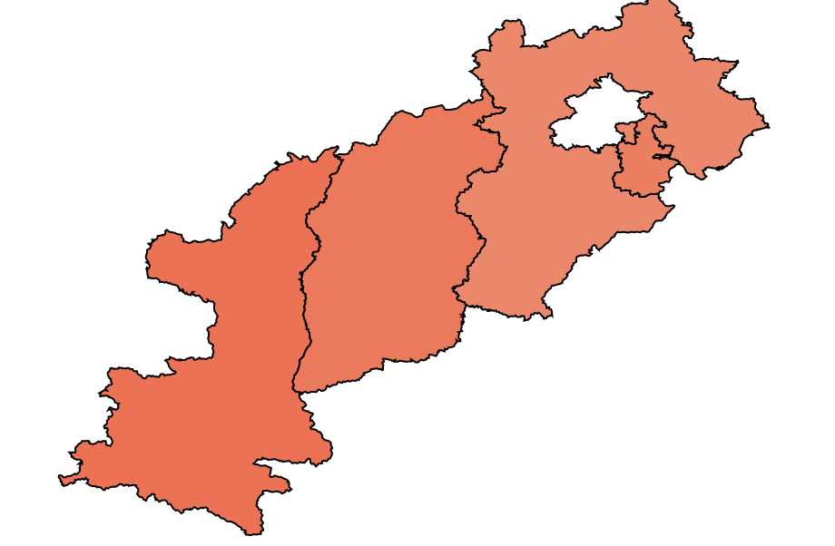


Narrow Range
Full Range

Slide 10
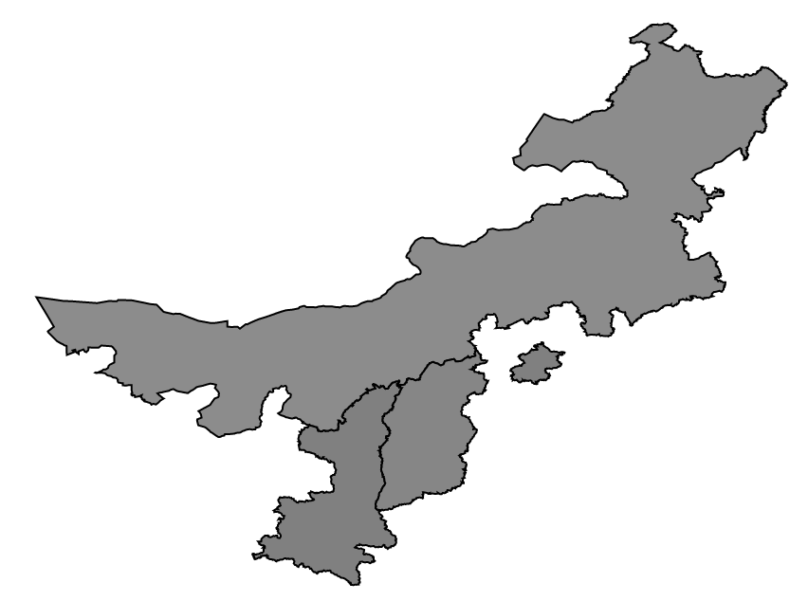


Narrow Range
Full Range

Slide 11
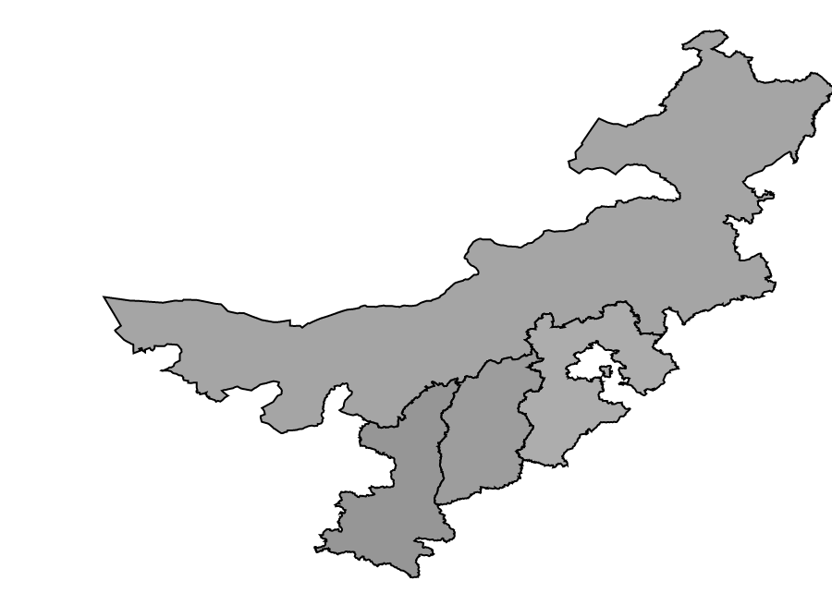


Narrow Range
Full Range

Slide 12
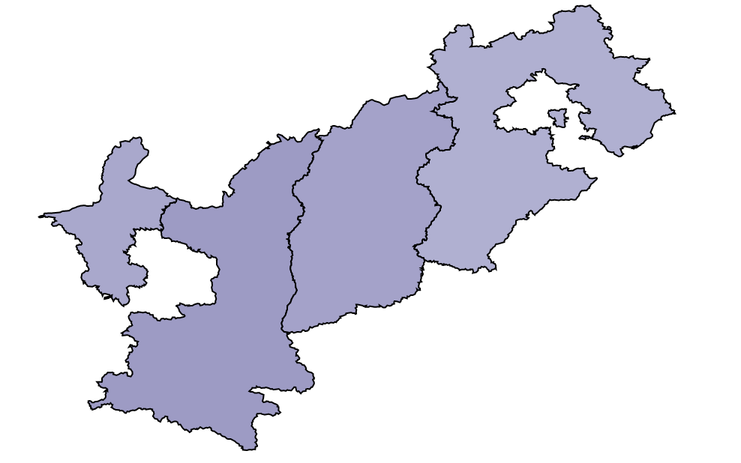


Narrow Range
Full Range

Slide 13
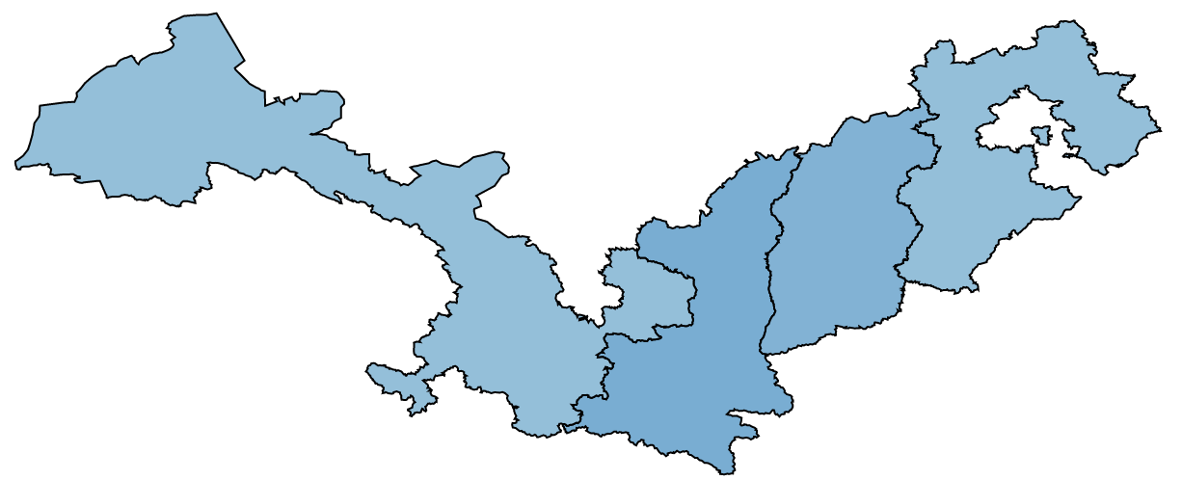


Narrow Range
Full Range

Slide 14
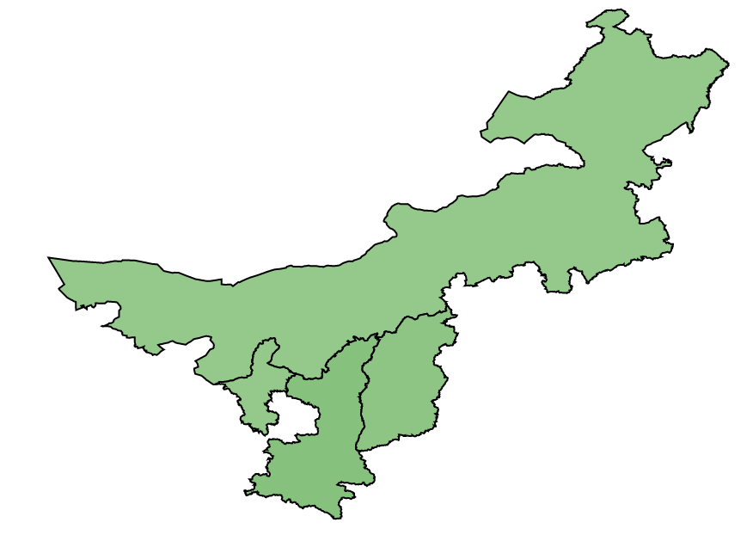


Narrow Range
Full Range

Slide 15
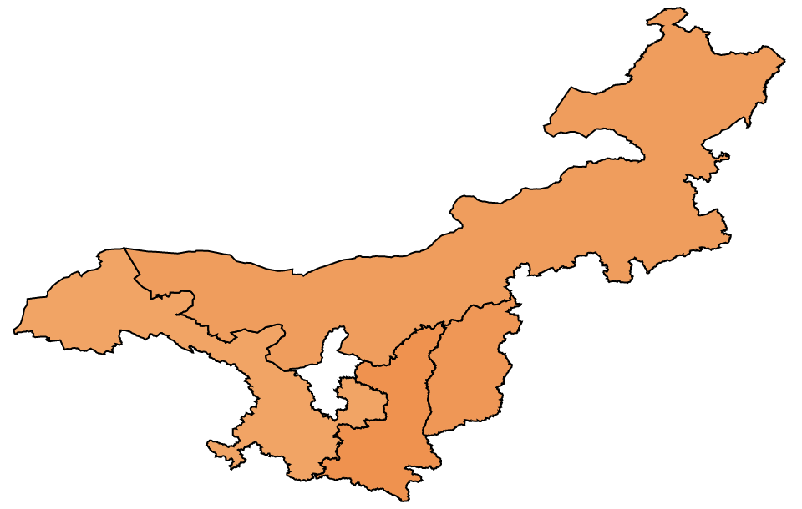


Narrow Range
Full Range

Slide 16
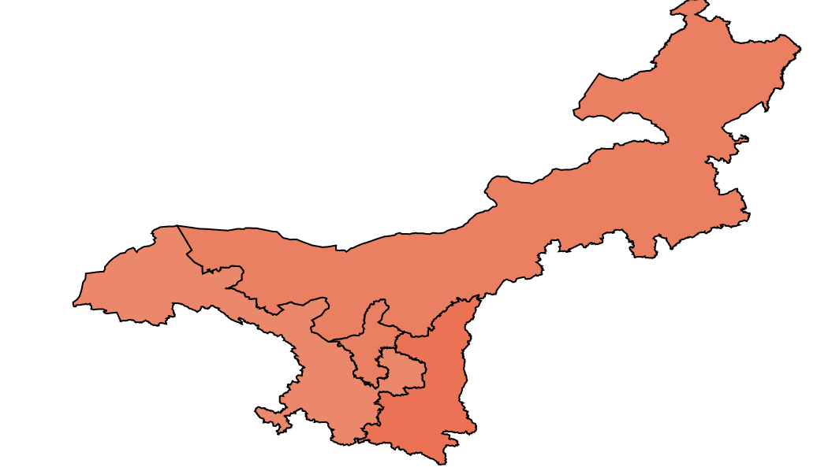
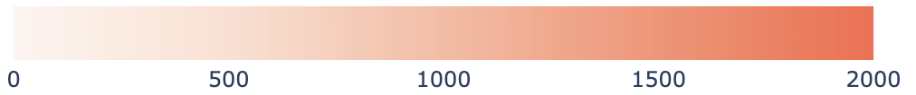

Narrow Range
Full Range

Slide 17
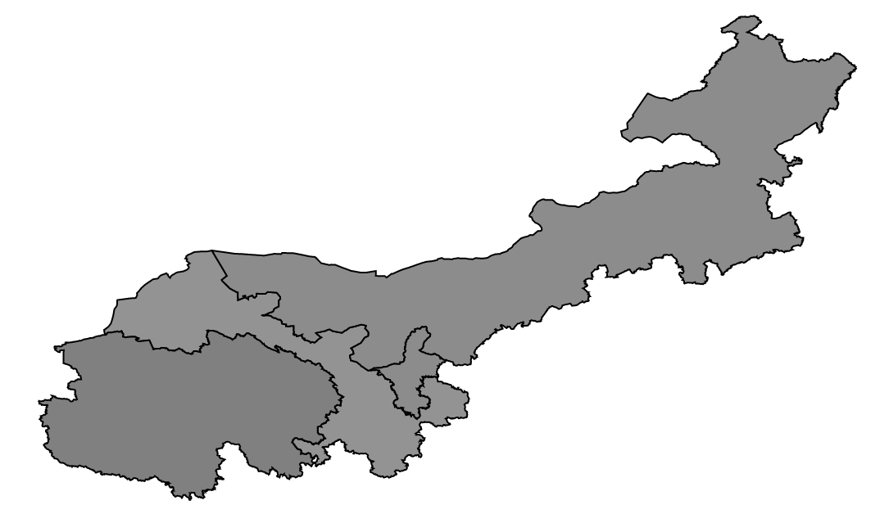
Narrow Range
Full Range

Slide 18
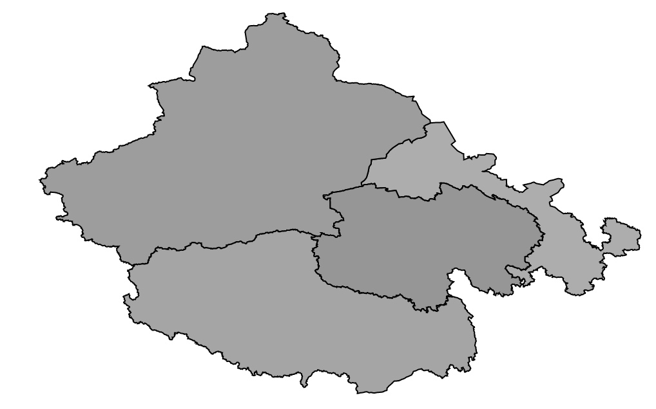
Narrow Range
Full Range

Slide 19
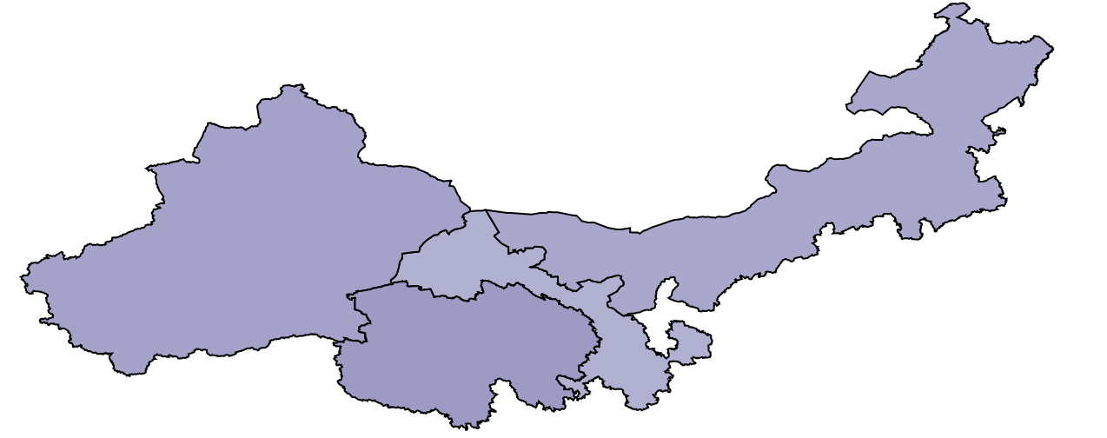
Narrow Range
Full Range

Slide 20
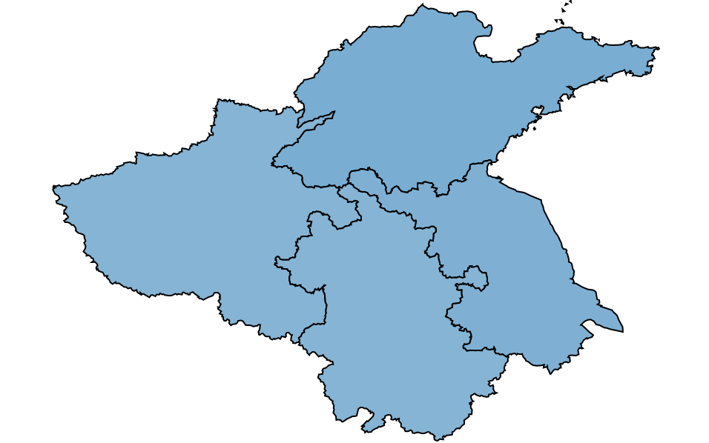


Narrow Range
Full Range

Slide 21
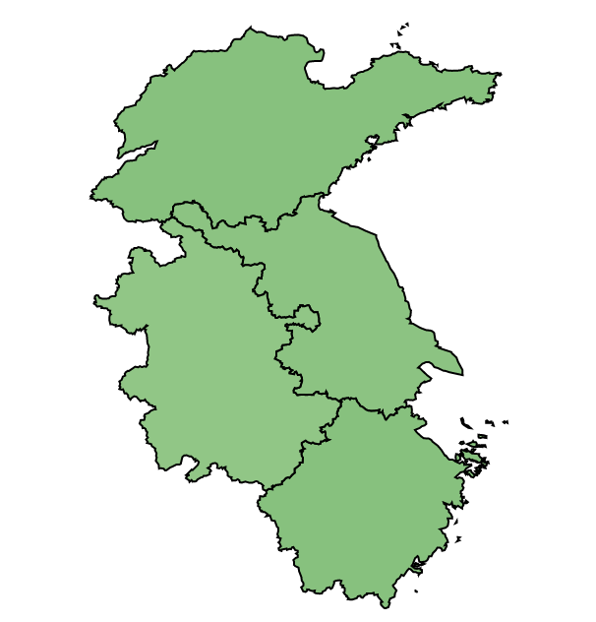


Narrow Range
Full Range

Slide 22
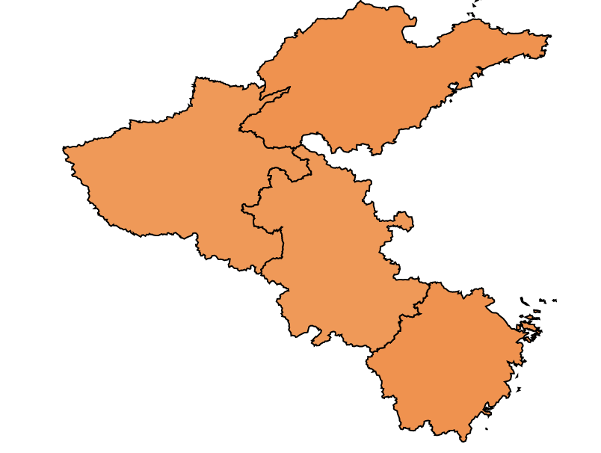


Narrow Range
Full Range

Slide 23
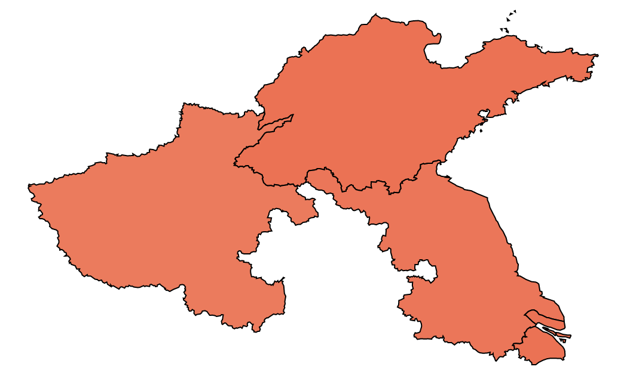


Narrow Range
Full Range

Slide 24
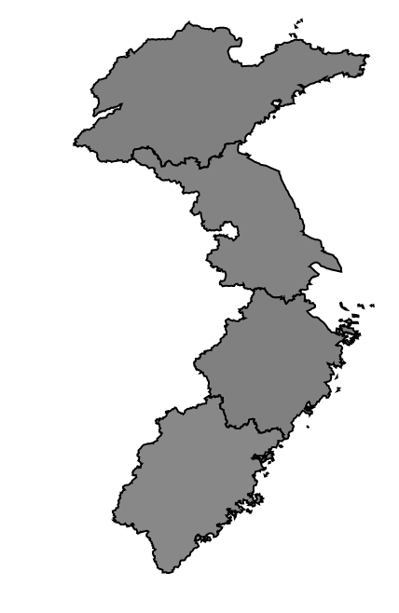


Narrow Range
Full Range

Slide 25
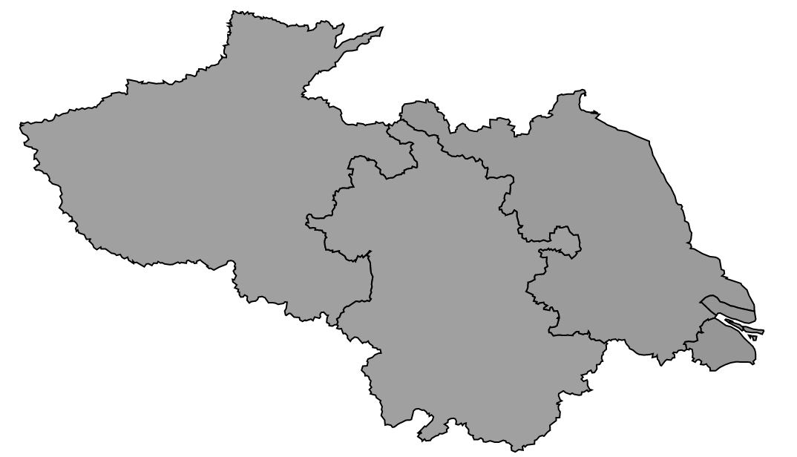

Narrow Range
Full Range

Slide 26
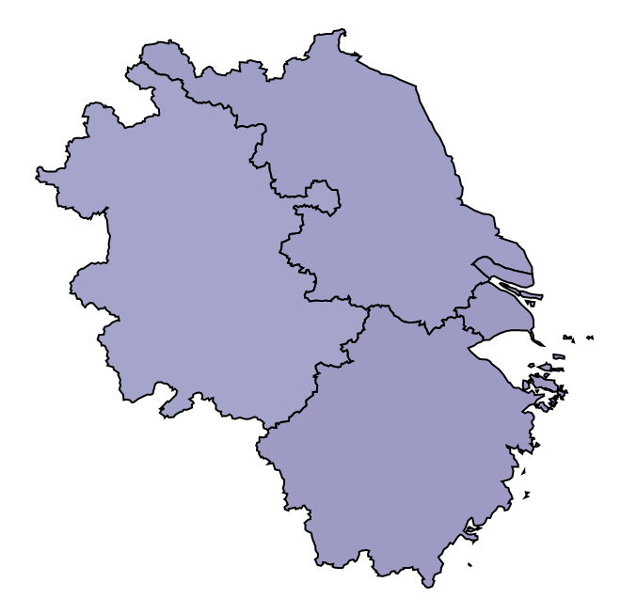


Narrow Range
Full Range

Slide 27
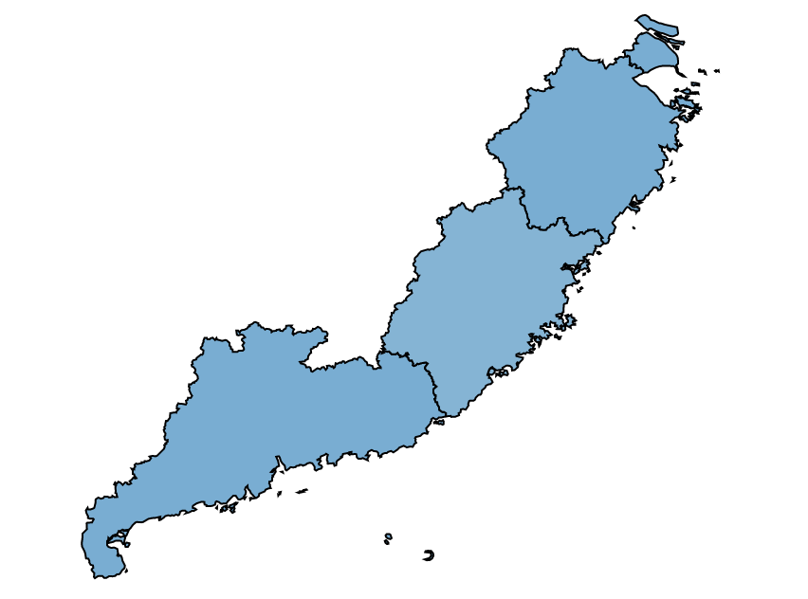
Narrow Range
Full Range

Slide 28
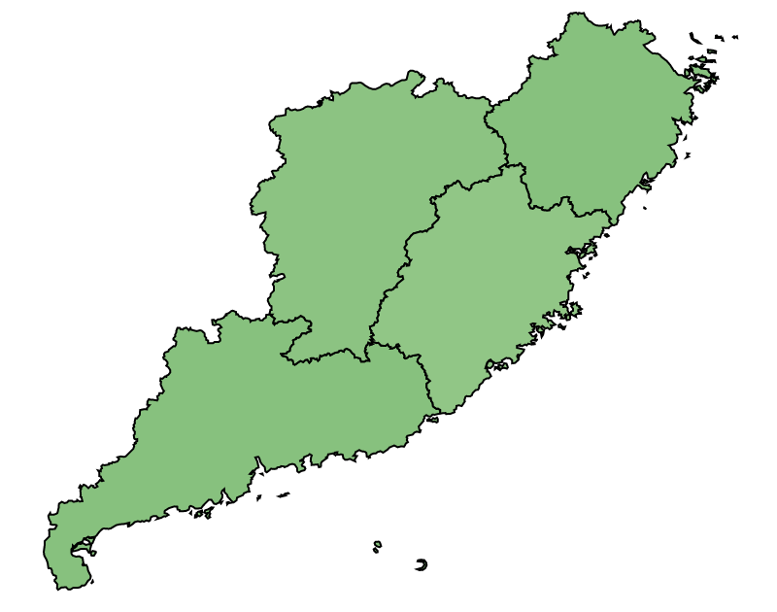
Narrow Range
Full Range

Slide 29
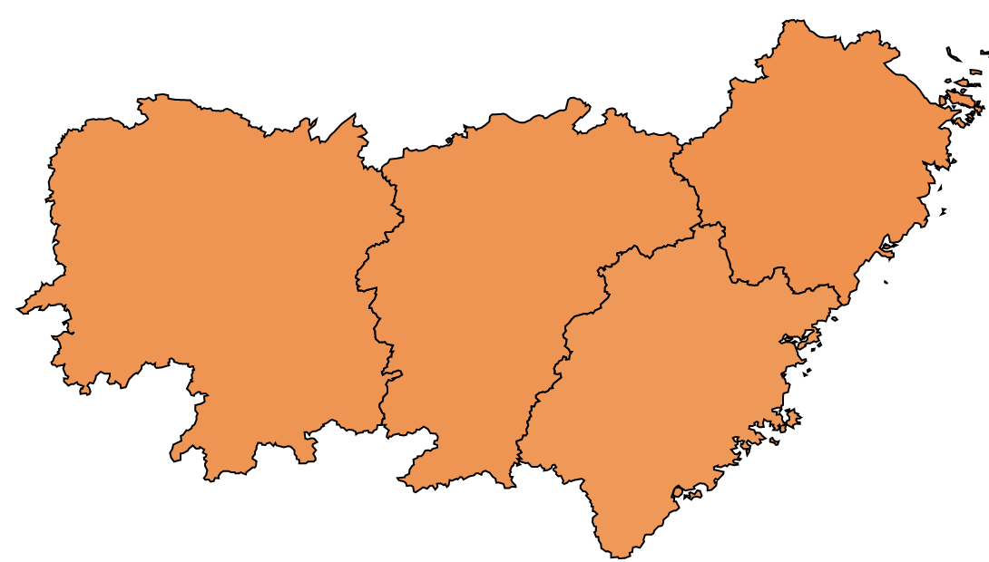
Narrow Range
Full Range

Slide 30
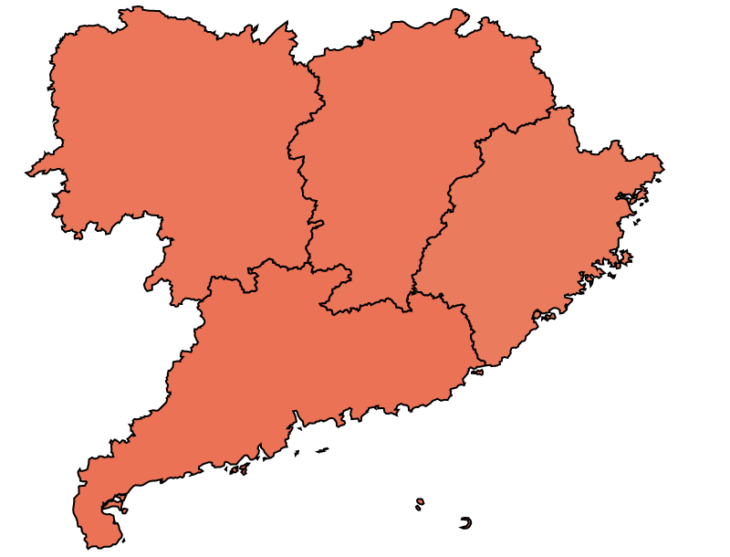
Narrow Range
Full Range

Slide 31
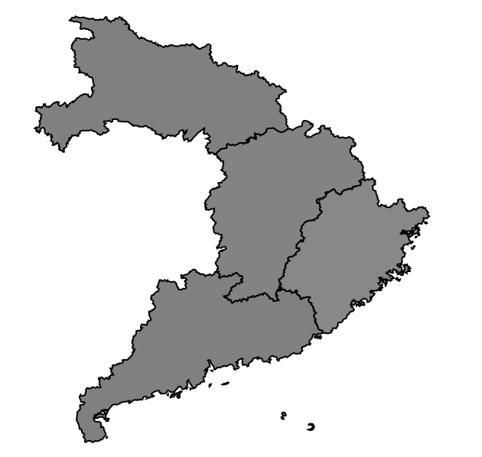
Narrow Range
Full Range

Slide 32
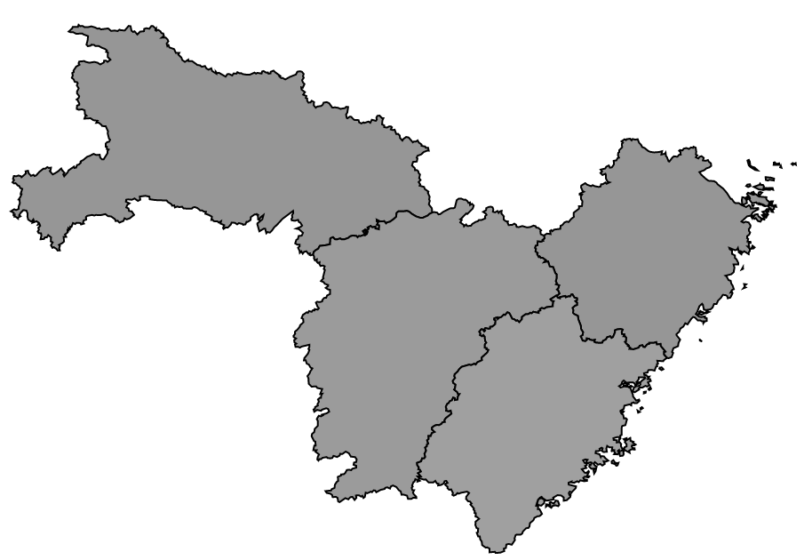
Narrow Range
Full Range

Slide 33
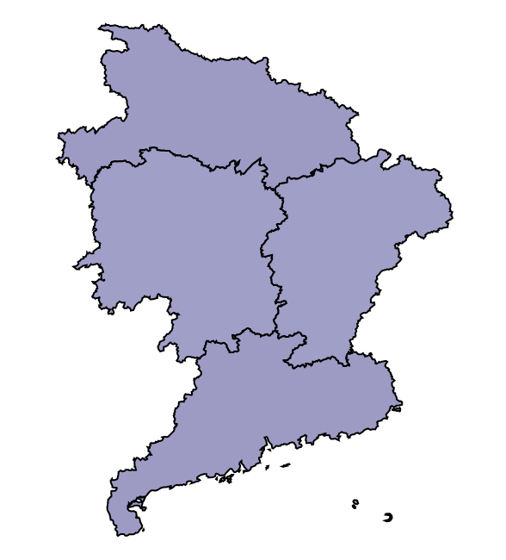
Narrow Range
Full Range

Slide 34
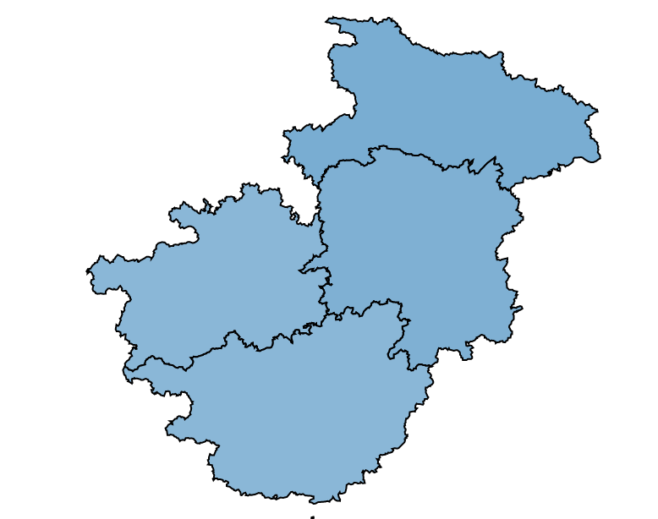
Narrow Range
Full Range

Slide 35
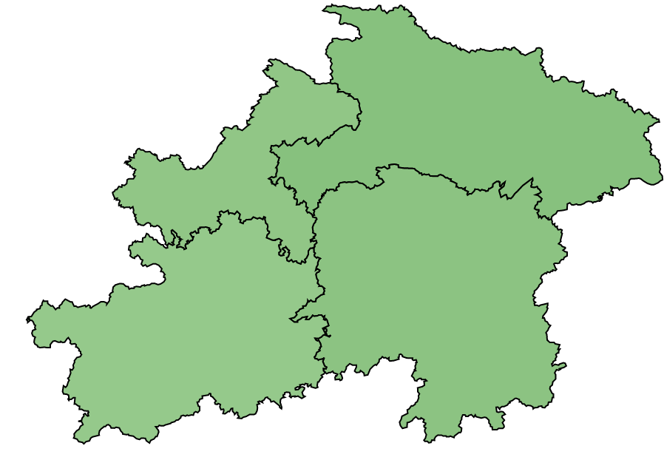
Narrow Range
Full Range

Slide 36
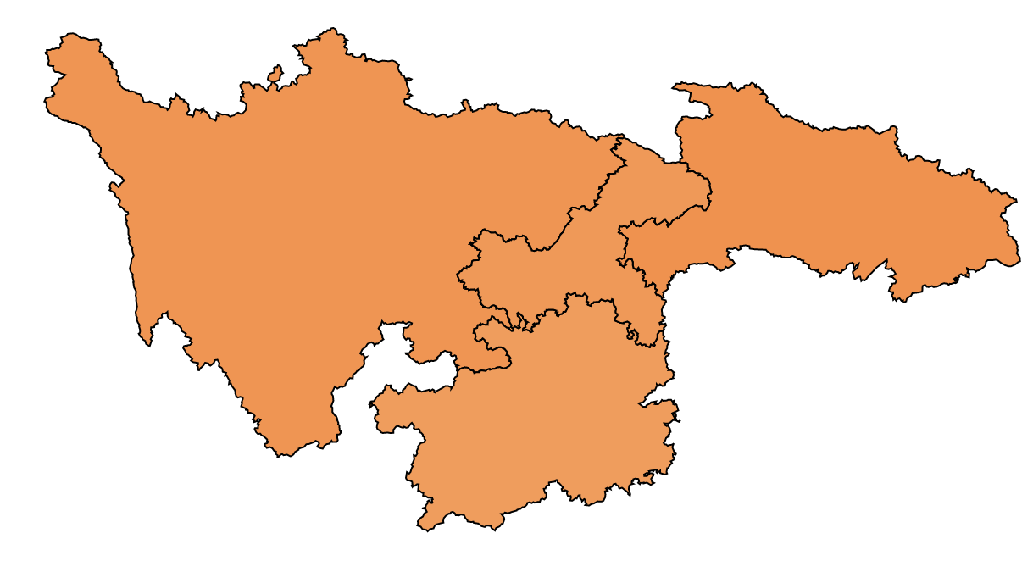
Narrow Range
Full Range

Slide 37
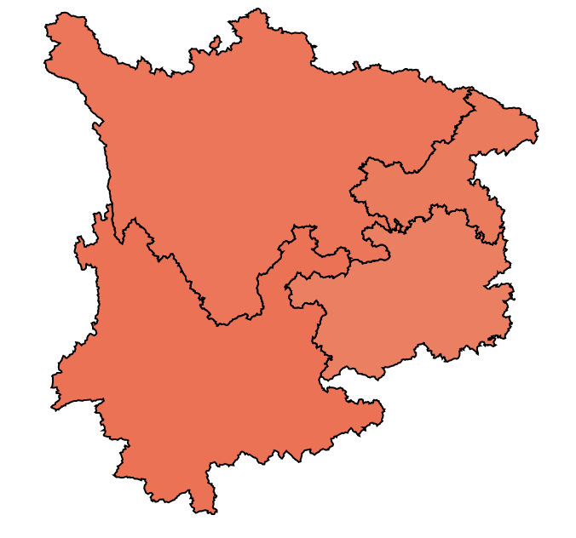
Narrow Range
Full Range

Slide 38
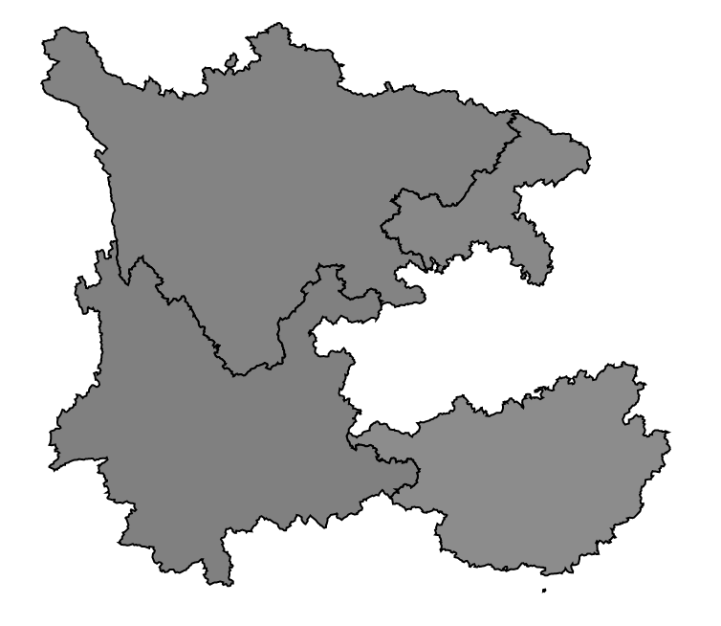
Narrow Range
Full Range

Slide 39
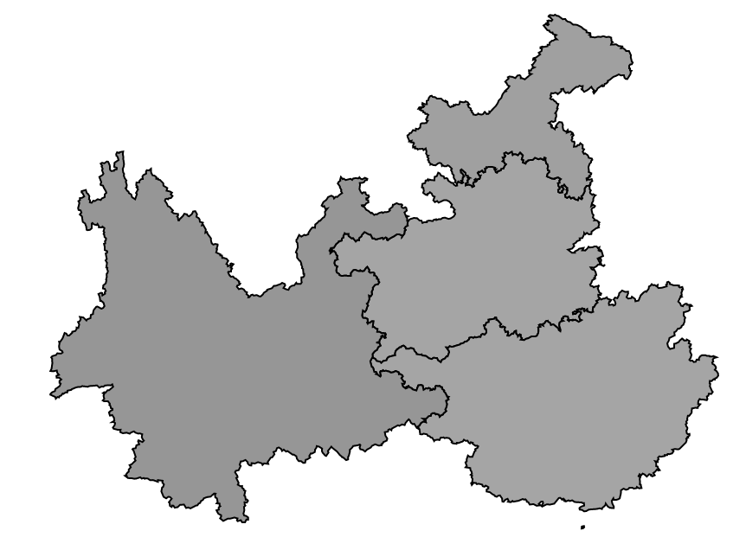
Narrow Range
Full Range

Slide 40
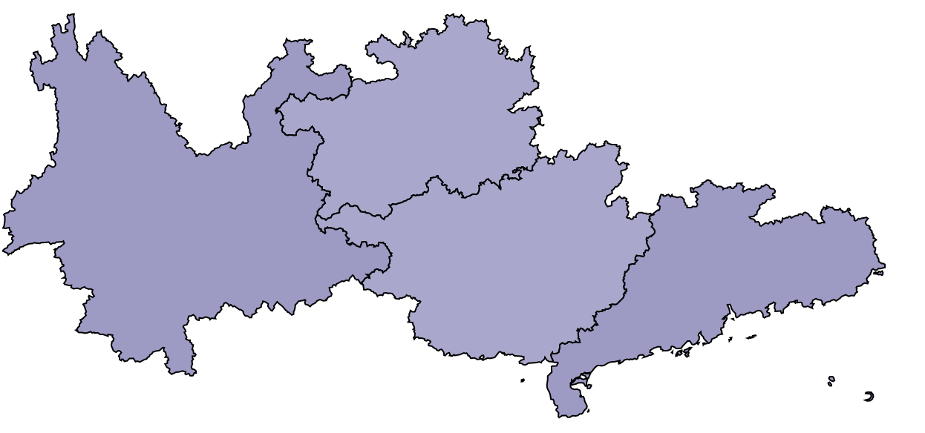
Narrow Range
Full Range

