Slide 1
print()
上课老师：张老师

Slide 2
print("ni hao") print('ni hao') print(ni hao)
print("123") print('123') print(123)

Slide 3
aaa = "ni hao“
print(aaa) print("aaa") print('aaa')
aaa = 123
print(aaa) print("aaa") print('aaa')

Slide 4
a = "ni" b = "hao“
print(a + b) print("a + b")
a = 10 b = 20
print(a + b) print("a + b")

Slide 5
a = "nihao " b = 3 print(a + b)
print(a * b) print(a + str(b))

Slide 6
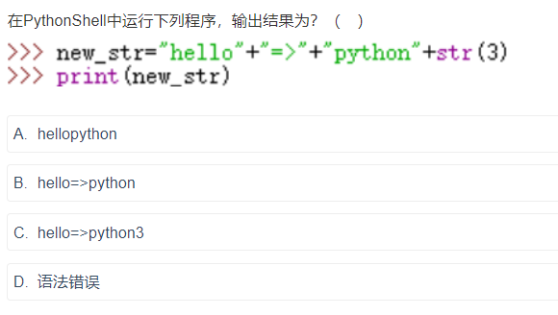

Slide 7
